Slide 1
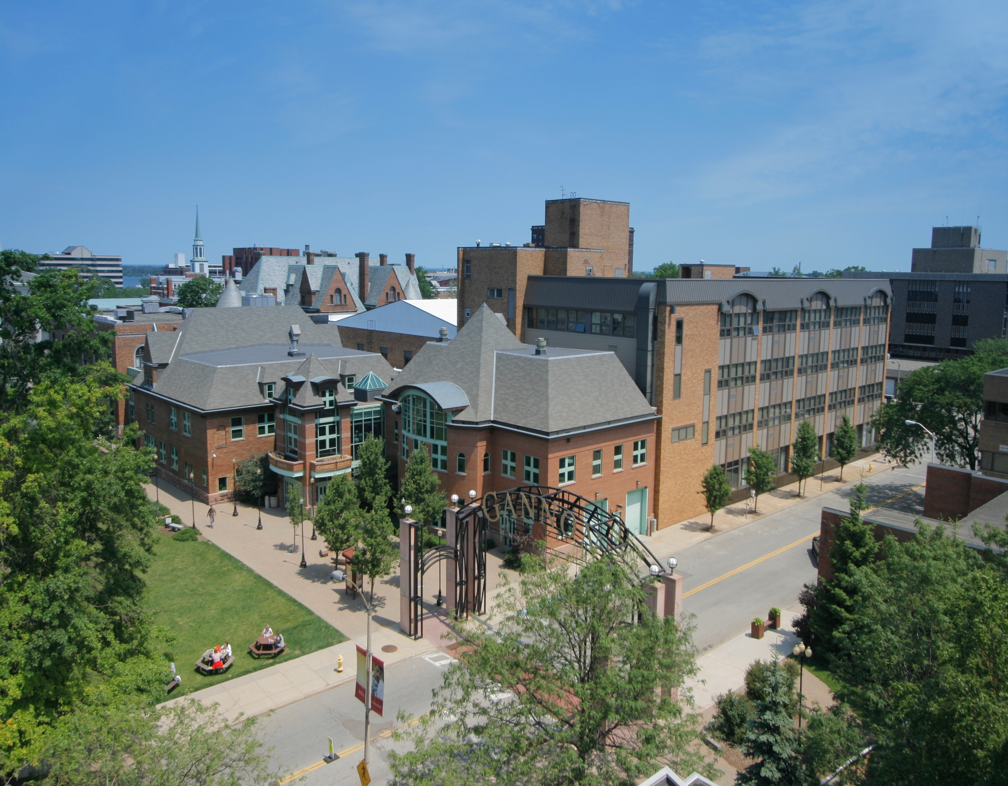
Gannon University
Believe in the Possibilities

Slide 2
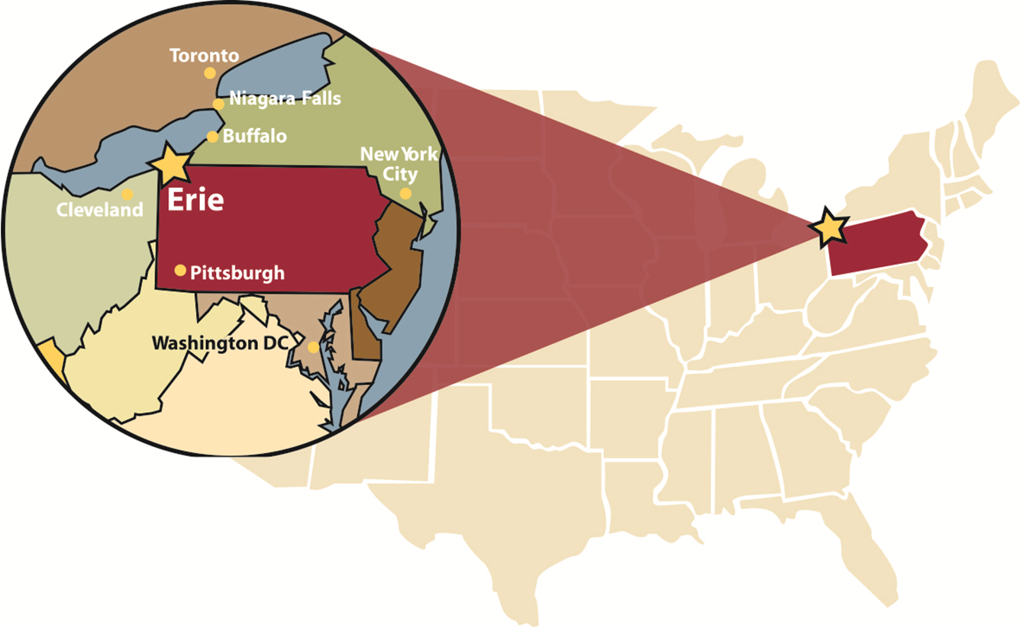
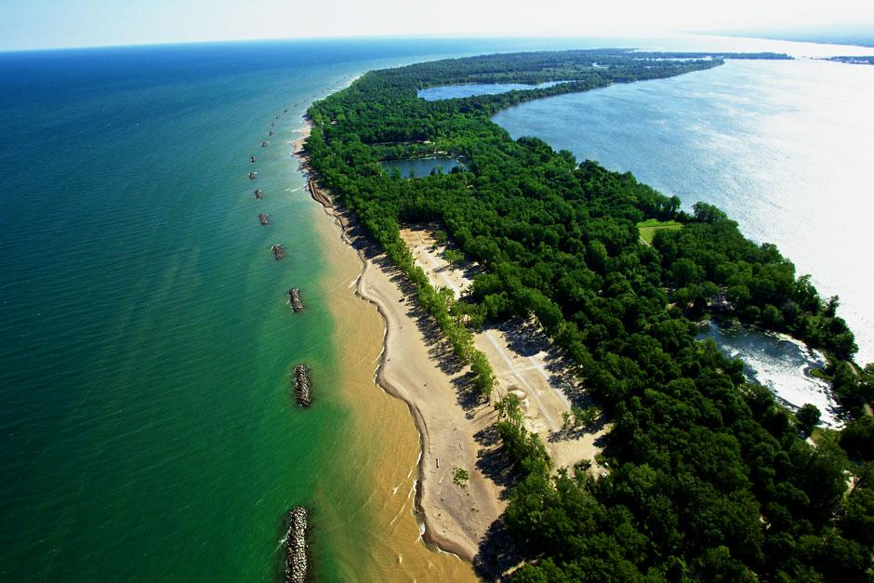
Highlights of the City of Erie
4th largest city in Pennsylvania
Population of 99,475
Gem City - the sparkling lake
4 Seasons!
Recreational Opportunities
Theaters, Sports Stadiums, Bayfront
Presque Isle: 9 beaches, 13-mile bike trail
Peach Street Shopping Area
Where WE Are
Our Location

Slide 3
Know GU More
Founded in 1925
Student-to-faculty ratio of 13:1
Class size: Under 20
Location: Erie, PA
4,400+ Students 400+ Global Students
Where WE Stand
#218 in National Universities
Ranked in the Top 25% in Engagement of Undergraduate Students in the Academic Experience –
2020 Wall Street Journal College Ranking
Top 10 “Best Value” University and Top Tier University in North Region –
U.S. News & World Report’s Best College, 2019 Edition
Top 100 Master’s Universities –
Washington Monthly’s 2017 College Guide
1 of 74 in the USA –
Catholic College of Distinction:
Top 8% Contribution To Student Success –
Brookings Institution:
12th Consecutive Year Top Tier University in North Region –
Top Tier University in North Region:
HIGHLY
RANKED

Slide 4
STEM MBA
STEM Approved
Qualifies for up to
3 years OPT
No GMAT required
(unless GPA is under 3.0)
3-year Bachelor Degrees Accepted
3-YEAR BACHELOR DEGREES
Admitted Directly To Masters
Acceptance letter and
I-20 will indicate a Masters Degree
Masters Program duration will be 2-2.5 years in duration for students entering with 3-year Bachelor Degrees

Slide 5
Gannon Popular Programs
What WE Offer - Academics
4 Doctoral Degrees / 26 Master Degrees / 64 Bachelor Degrees
7 Associate Degrees / 11 Pre-Professional Programs
Master’s Level:
Bachelor’s Level:
O Criminal Justice
O Journalism Communication
O Digital Media Communication
O Political Science
O Public Service and Global Affairs
O Public Health
O Psychology
O Biology
O Chemistry
O Biochemistry
O Medical Laboratory Science
O Business Administration
O Public Administration
O Health Communication
O Mechanical Engineering
O Engineering Management
O Computer and Information Science
Data Science
Information Technology
Software Engineering
O Electrical Engineering
O Embedded Software Engineering
O Mechanical Engineering
O Electrical Engineering
O Biomedical Engineering
O Industrial and Robotics Engineering
O Software Engineering
O Cyber Engineering
O Cybersecurity
O Management
O Finance
O Marketing

Slide 6
English language proficiency requirements
Qualifying English Tests Accepted by Gannon | Score
TOEFL Internet-based | 79
IELTS | Overall band of 6.0 for Computer and Information Science, Mechanical Engineering, Embedded Software Engineering, Electrical Engineering, Engineering Management, Masters of Business Administration and Masters of Public Administration All other majors require an overall band of 6.5
PTE | 53
ENGLISH 3 | 66
ELS Language Centers | Completion of Level 112
ESL placement test is administered to all students without a qualifying English scores to exempt them from English language training.
*This is not an exhaustive list. There are some programmatic exceptions, see document library at the end of this presentation for more details.
IELTS
TOEFL
PTE
English3

Slide 7
UNDERGRADUATE DEGREES 2020 – 2021 ANNUAL EXPENSES
 | Amounts
Undergraduate Tuition per academic year | $12400 (discounted from $32,000-$35,000)
Housing (doesn’t include summer) | $3000
Food (doesn’t include summer) | $3893
University Fee | $956
Total cost of attendance with max awards | $19,493
 | Health Insurance add $880 (University Plan) Textbooks and Supplies $400-$1,000 (estimated)
UNDERGRADUATE COSTS

Slide 8
GRADUATE DEGREES 2020 – 2021 ANNUAL EXPENSES
 | Amounts
Graduate Tuition per year (2 semesters) Costs may differ based on the program | $19,980 (1110 USD / Credit)
Award per year | $5000
Tuition with awards | $14,980
Living Expenses (estimated) | $6000
Health Insurance | $880
Textbooks and Supplies (estimated) | $400-$1000
Total cost of attendance with awards | $22,260
 | Health Insurance add $880 (University Plan)
GRADUATE COSTS

Slide 9
Complete applications (South Asia)
GRADUATE (MASTER):
UNDERGRADUATE (BACHELOR):
Copy of your passport
Diploma Completion Certificate
Diploma Transcript (All Semester mark sheet)
Diploma Consolidated Marks Sheets
Bachelor Completion Certificate
Bachelor Transcript (All Semester)
Bachelor Consolidated Marks Sheets
English Proficiency Scores (optional)
Resume/ Curriculum Vitae
3 Letters of Recommendation
Statement of Purpose/ Essay
with student details and focused on the program applying in GU
Bank Statement showing a balance of $29,000 USD
Affidavit of Support form
Copy of Passport
High school transcripts (10th, 11th and 12th)
CV (If the gap is more than 2 years)
English Proficiency Scores (optional)
One letter of recommendation
Personal Essay
with student details and focused on the program applying in GU
Bank Statement showing a balance of $23,000 USD
Recent Affidavit of Support from your sponsor
GPA 75% or 3/4
GPA 60% or 2.5/4 or 3/5
Backlogs: 5 to 8
Bank Statement must be Color copy

Slide 10
Extra Points
Job Oppurtunities–
While studying
Academic Related
Clerical
Normal
After studying
Accommodation
Off Campus
On Campus
Escort Service
Incubator System
Transportation
Open Door Policy
No Application fee
No application Deadline
Admission Decision within 3-5 business working days
Intake: Spring / Summer / Fall
GRE / GMAT
Mock Visa Interview
5000 USD Non-Refundable Deposit

Slide 11
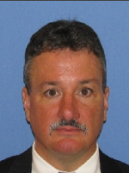
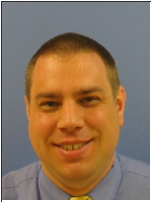
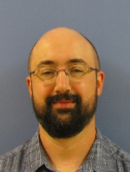
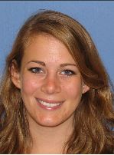
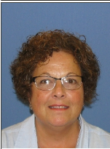
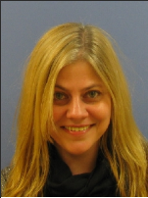
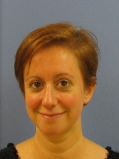
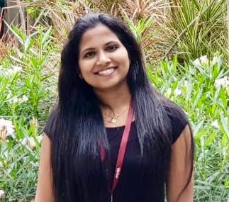
GLOBAL ADMISSION AND OUTREACH STAFF
TOM HASSETT
Associate Vice President
hassett001@gannon.edu
DUSTIN CASSELL
Director
cassell005@gannon.edu
RATHEESH RAVI
Regional Director
ravi002@gannon.edu
DAVID STEWART
Assistant Director
stewart052@gannon.edu
EMILY ERNES
Associate Director
ernes001@gannon.edu
KIRAN DEVINENI
Regional Application Manager
devineni001@gannon.edu
LYNNE
Admin Secretary & PDSO
wright033@gannon.edu
KELLY SCHULTZ
Secretary
schultz030@gannon.edu
ADELE GROSS
Applications Processor
gross013@gannon.edu
SOUMYA S
Student Advisor
+91-96 1123 8899

Slide 12
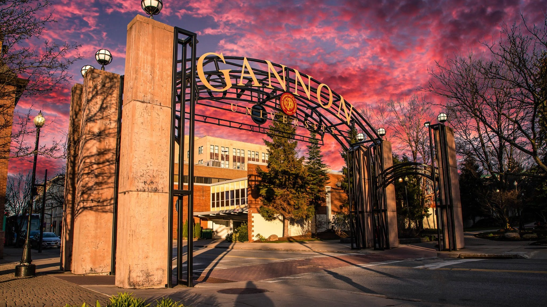
cassell005@gannon.edu
cassell005@gannon.edu
THANK YOU
Questions?
EMILY ERNES
ASSOCIATE DIRECTOR
GLOBAL ADMISSIONS
+1-440-812-8862
WWW.GANNON.EDU
ERNES001@GANNON.EDU
+91-89 7175 7788
+91-96 1123 8899
WWW.GANNON.EDU
RAVI002@GANNON.EDU

Slide 13
cassell005@gannon.edu
cassell005@gannon.edu
THANK YOU
THANK YOU
EMILY ERNES
ASSOCIATE DIRECTOR
GLOBAL ADMISSIONS
RATHEESH RAVI
Regional Director
ravi002@gannon.edu
ratheeshkply - Skype
+1-440-812-8862
WWW.GANNON.EDU
ERNES001@GANNON.EDU
+91-89 7175 7788
+91-96 1123 8899
WWW.GANNON.EDU
RAVI002@GANNON.EDU

