Slide 1
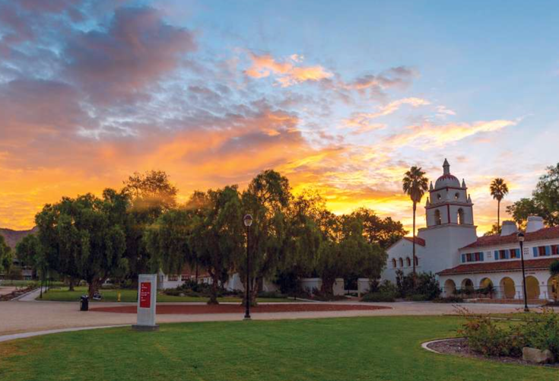
Study Metro Online International Education Fair
April 17, 2020 9:45pm IST
Estimated Costs

Slide 2
Aerial View of Campus

Slide 6
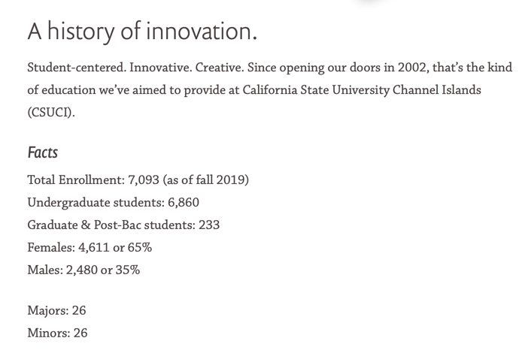

Slide 7
Graduate Programs (Please note that we do not charge out of state tuition and fees for our graduate programs)
Programs | Length | Fees
MS Biotechnology & Bioinformatics | 33-35 Semester Units 2 years | $825 per unit $28,875 ($14,437 per year)
Dual MS Biotechnology & Bioinformatics and MBA Program | 72-80 Semester Units 2.5-3 years | $825 per unit – Bio $600 per unit - MBA
MS Mathematics | 32 Semester Units 2 years | $525 per unit $16,800 ($8,400 per year)
MS Computer Science | 32 Semester Units 2 years | $525 per unit $16,800 ($8,400 per year)

Slide 8
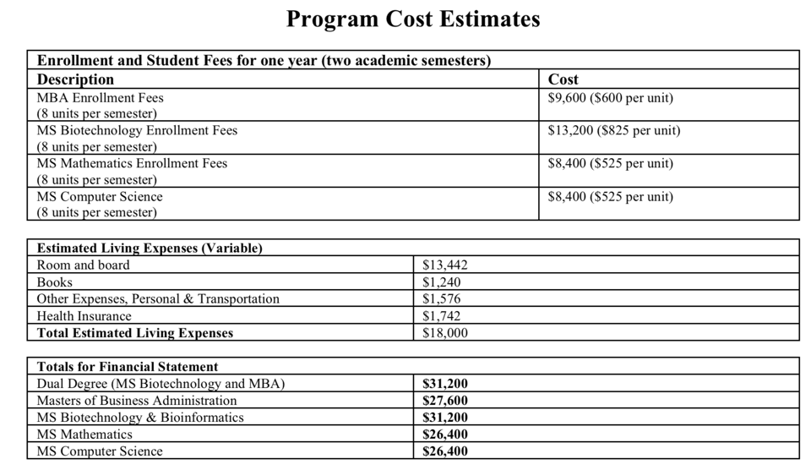
Estimated Costs

Slide 9
Documents to submit for graduate applicants:
Mark Sheets with Provisional Certificate or Degree
TOEFL score of 80 or IELTS score of 6.5
Statement of Purpose
Resume (C/V)
2 Letters of Recommendation
$70 Application fee or a fee waiver coupon obtained from Study Metro
Program Specific Requirements
MS in Mathematics – No GRE required, applicants need to have completed math classes during bachelor’s degree
MS in Biotechnology – No GRE required, applicants need to have complete biology classes during their bachelor’s degree.
Dual MBA (Master’s in Business Administration & MS in Biotechnology – No GRE required, applicants need to have complete biology classes during their bachelor’s degree. Students can complete business foundation classes before starting MBA classes.
MS in Computer Science – Applicants should have knowledge of computer science by either work experience or in their bachelor’s degree. GRE is strongly recommended and applicants are tpyicall expected to score in the range of V-25%, Q-50%, AWA-25%

Slide 10
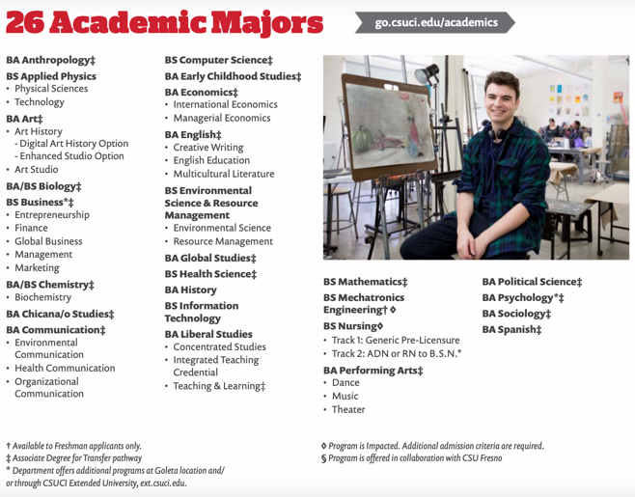
Bachelor’s Programs
Please note that Nursing and Mechatronics are not open to international applicants

Slide 11
Bachelor’s Programs
Estimated Expenses for Bachelor’s Programs (based on 2 semesters, 24 units per year
Tuition and Fees | $16,310
Health Insurance (12 months) | $1,742
Room and Food (variable) | $13,442
Books and Supplies (variable) | $2,002
Other Expenses, personal & Transportation (variable) | $1,504
Total Estimated Cost | $35,000

Slide 12
Freshmen Admission Requirements
Secondary School Mark Sheets with 3.0 Average (Above 50% Marks in India)
TOEFL score of 61 or IELTS score of 6.0
$70 Application fee or fee waiver code from Study Metro

Slide 15
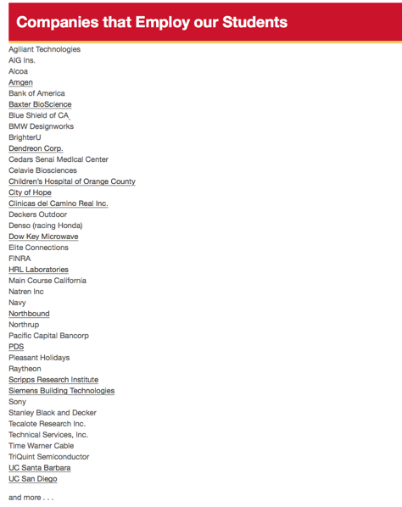

Slide 17
Housing is optional, we offer guaranteed housing for applicants who apply on time. The costs depends on the village and floor plan you choose. Average cost is $6,000 per semester with a meal plan.

Slide 23
Contact Study Metro for an application fee waiver. We will provide a coupon code to waive the $70 Application fee.

