Slide 1
EduCo Ireland Training – Sept 2020 intake
(Popular PG programs still open for September 2020 Intake)

Slide 2
Ireland’s Technology Landscape

Slide 8
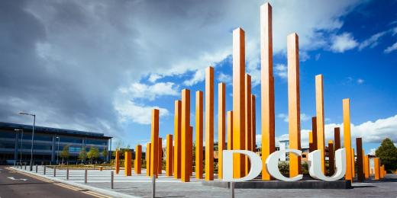

Slide 9
Requirements: 4 years UG degree with overall 60% or higher in Electronic, Electrical, Computer Engineering. (Not more than 5 backlogs). IELTS: 6.5 with no band less than 6. TOEFL/PTE also acceptable.
Application Fee: 50 Euros
Tuition Fees: 17,000 Euros
Duration: 1 year
Upcoming Intake: September 2020
1 year of education + 2 years of post study work visa
Graduates have been employed by companies including Google, Intel, Oracle, IBM and Boston Scientific.

Slide 10
Dublin City University is ranked 19th in the world and 1st in Ireland for its graduate employment rate, according to the 2020 QS Graduate Employability Rankings.
Requirements: A business-disciplined UG degree with overall 60% from tier-1 universities (65% from tier-2 universities). Not more than 5 backlogs.
Application Fees: €50
Tuition Fees: €16,000
Duration: 1 year
Intake: September 2020
1 year degree + 2 years of post study work visa
Graduates have been employed by companies including including Facebook, Google, Microsoft, Yahoo!, Edelman, Accenture, Dell, An Bord Bia, Core Media, Starcom, Oracle, Trivago, Adroll and many more.

Slide 11
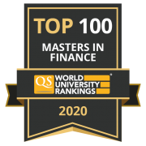
Dublin City University is ranked 19th in the world and 1st in Ireland for its graduate employment rate, according to the 2020 QS Graduate Employability Rankings.
Requirements: Minimum 60% in a Business-related or Engineering, Physics, Maths and Computer Science discipline. Not more than 5 backlogs.
Application Fees: €50
Tuition Fees: €16,000
Duration: 1 year
Intake: September 2020
1 year degree + 2 years of post study work visa
Graduates are employed by major financial institutions including UBS, Standard & Poor's, Royal Bank of Scotland, KPMG, PwC, Boston Scientific, Commerzbank, AIB, Bank of Ireland, Goodbody Stockbrokers, Davy, Geneva Trading, Mercer, Nestle, Citco Fund Services, Standard Life and BNY Mellon.

Slide 12
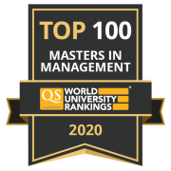
Dublin City University is ranked 19th in the world and 1st in Ireland for its graduate employment rate, according to the 2020 QS Graduate Employability Rankings.
Requirements: UG degree with overall 60% from tier-1 universities (65% from tier-2 universities) in a discipline other than Business and not more than 5 backlogs.
Application Fees: €50
Tuition Fees: €16,000
Duration: 1 year
Intake: September 2020
1 year degree + 2 years of post study work visa
97% are currently in employment in a wide variety of industries and functions by leading indigenous and international organizations including eBay, IBM, Goldman Sachs, Google, Kerry Foods, UniCredit and GAM Fund Management.

Slide 13
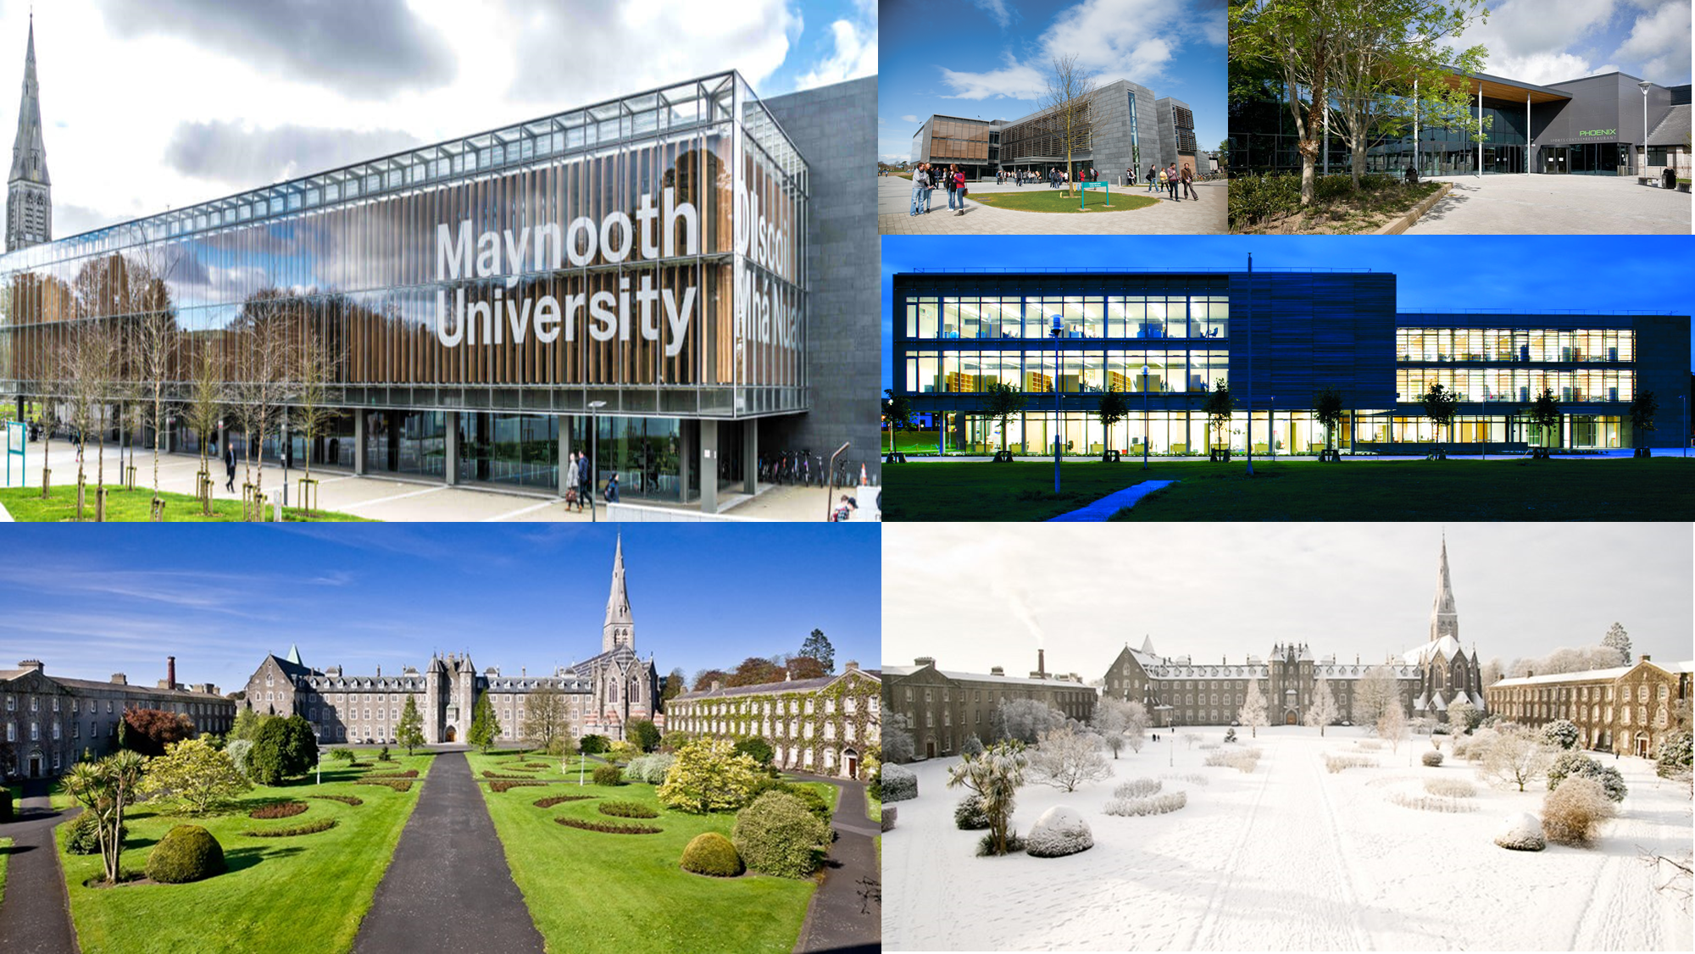

Slide 14
Requirements: Candidates should have a minimum 55% in UG degree which includes quantitative techniques including business studies, management science, economics, finance, accounting, engineering, mathematics, physics, computer science and other sciences. IELTS: 6.5 with no band less than 6. TOEFL and PTE are also acceptable.
Application Fees
€50
Tuition Fees
€15,000

Slide 15
Requirements: Candidates should have a minimum 55% in a business, management or marketing related UG degree. Alternatively, you may hold a non-Business degree (minimum 2.2 overall) with at least five years’ relevant work experience
IELTS: 6.5 with no section less than 6.0. TOEFL and PTE are also acceptable.
Application Fees
€50
Tuition Fees
€15,000

Slide 17
TECHNOLOGICAL UNIVERSITY DUBLIN, IRELAND
MSc Applied Cyber Security
Post Study Work Visa of 2 Years
Requirements: B.E. or B.Tech. in Computer Science or IT with overall 60%.
IELTS: 6.5 overall (or equivalent) with nothing less than 6 in each component. TOEFL/PTE also acceptable.
Tuition Fees: 14,500 Euros
Duration: 1 year
Intake: September 2020
CYBER SECURITY ECOSYSTEM IN IRELAND
ACTIVITIES UNDERTAKEN IN IRELAND

Slide 18
TECHNOLOGICAL UNIVERSITY DUBLIN, IRELAND
MSc Electronic and Communication Engineering
Post Study Work Visa of 2 Years
Requirements: Overall 55 to 60% in Electronic, Computer or Communications Engineering or a related discipline.
IELTS: 6.0 overall (or equivalent) with nothing less than 6 in each component. TOEFL/PTE also acceptable.
Tuition Fees: 14,500 Euros
Duration: 1 year
Intake: September 2020
This course will provide graduates with the knowledge and skills set required to work at a high level within the research, design and development divisions of the telecommunications sector and related areas in the electronics industry.

Slide 19
TECHNOLOGICAL UNIVERSITY DUBLIN, IRELAND
MSc Technology and Innovation Management
Post Study Work Visa of 2 Years
Requirements: Overall 55 to 60% in any engineering degree.
IELTS: 6.0 overall (or equivalent) with nothing less than 6 in each component. TOEFL/PTE also acceptable.
Tuition Fees: 14,500 Euros
Duration: 1 year
Intake: September 2020
Modules
This conversion programme is targeted at science, engineering and technology graduates who have an interest in developing an innovation, management and commercial perspective on technology, and/or who wish to pursue management careers in a technology focused industry.

