Slide 2
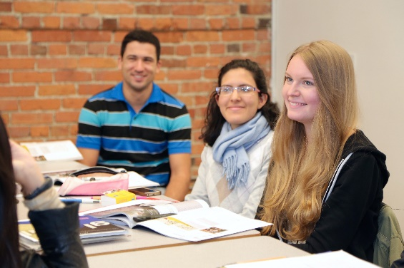
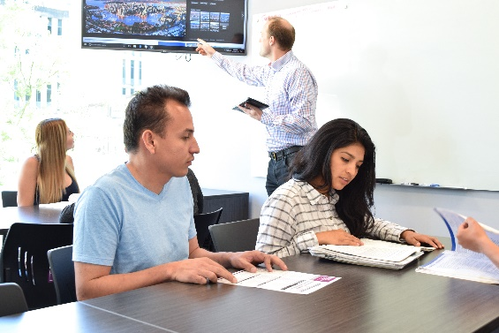
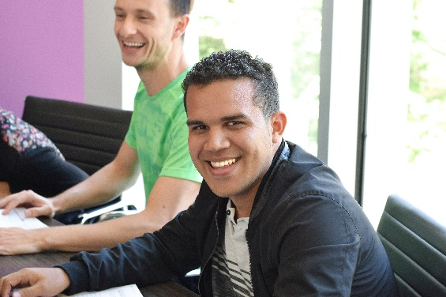
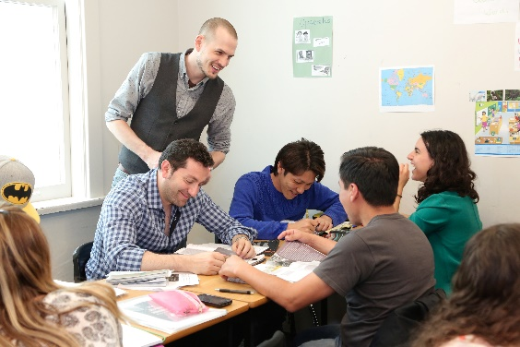
Where The World Comes to Study
SCHOOL OF ENGLISH LANGUAGE

Slide 3
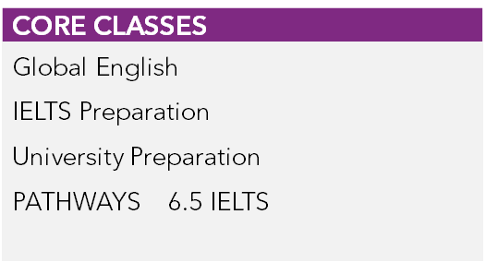
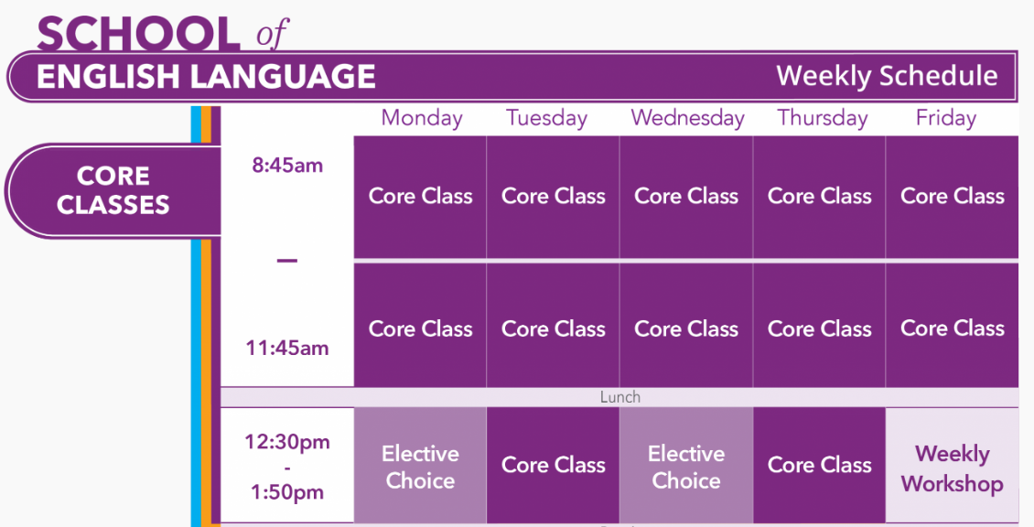
VGC VIRTUAL Time Table
18 Hrs /week

Slide 4
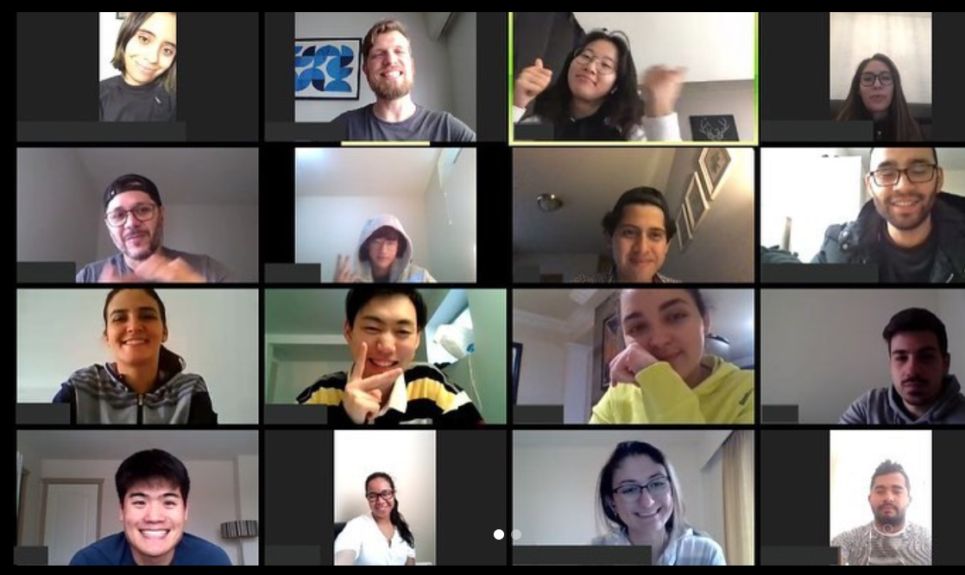
VGC VIRTUAL

Slide 5
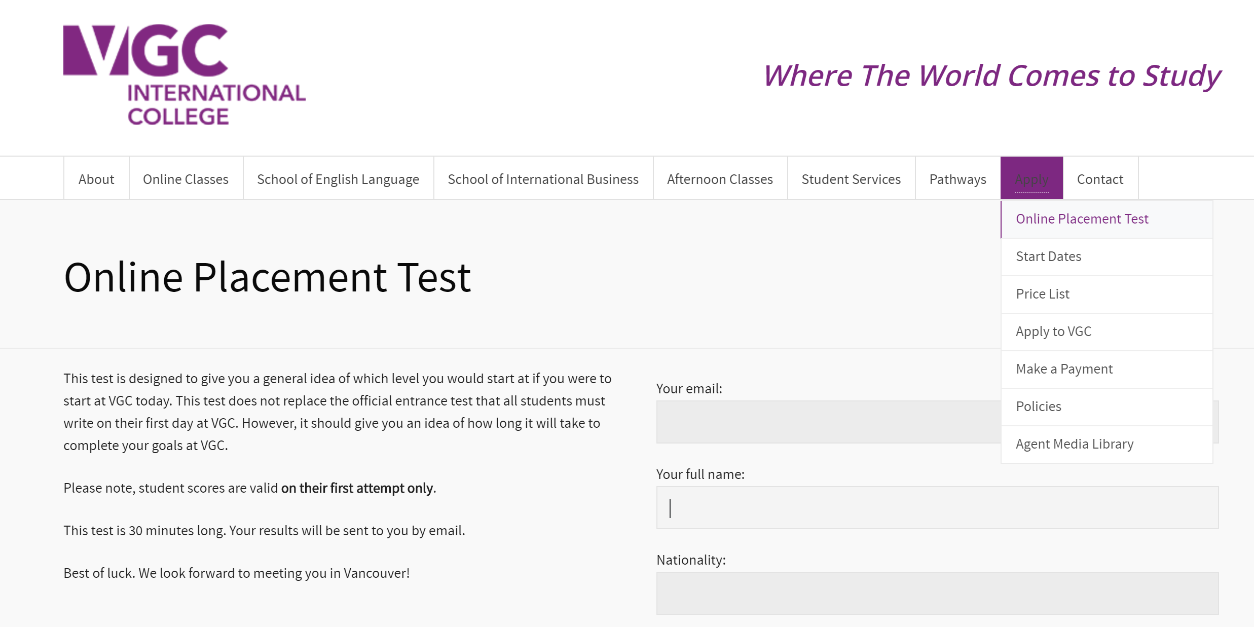
WHAT’S NEW

Slide 6
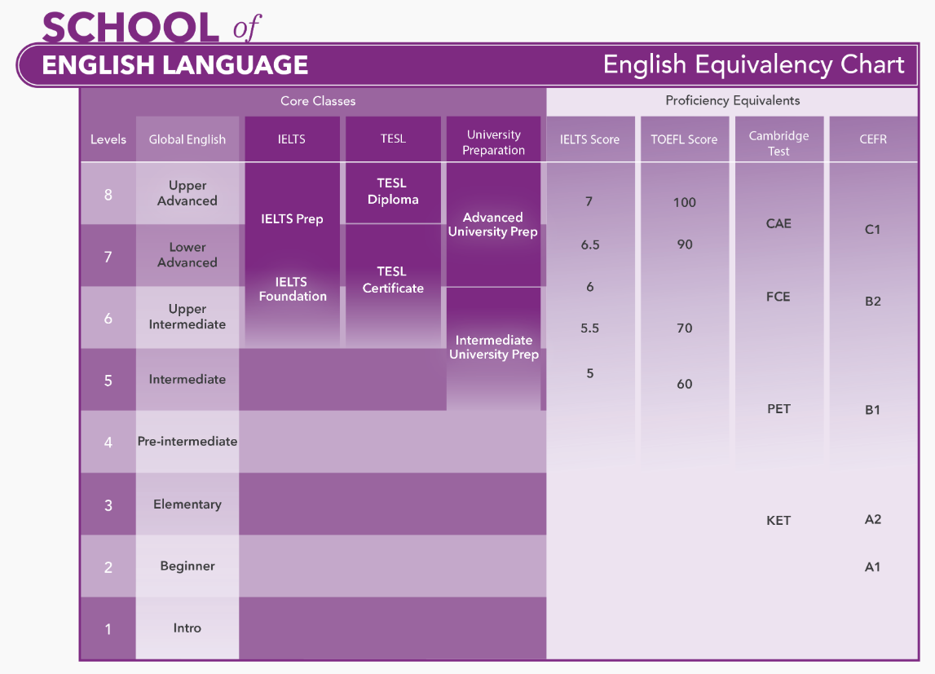
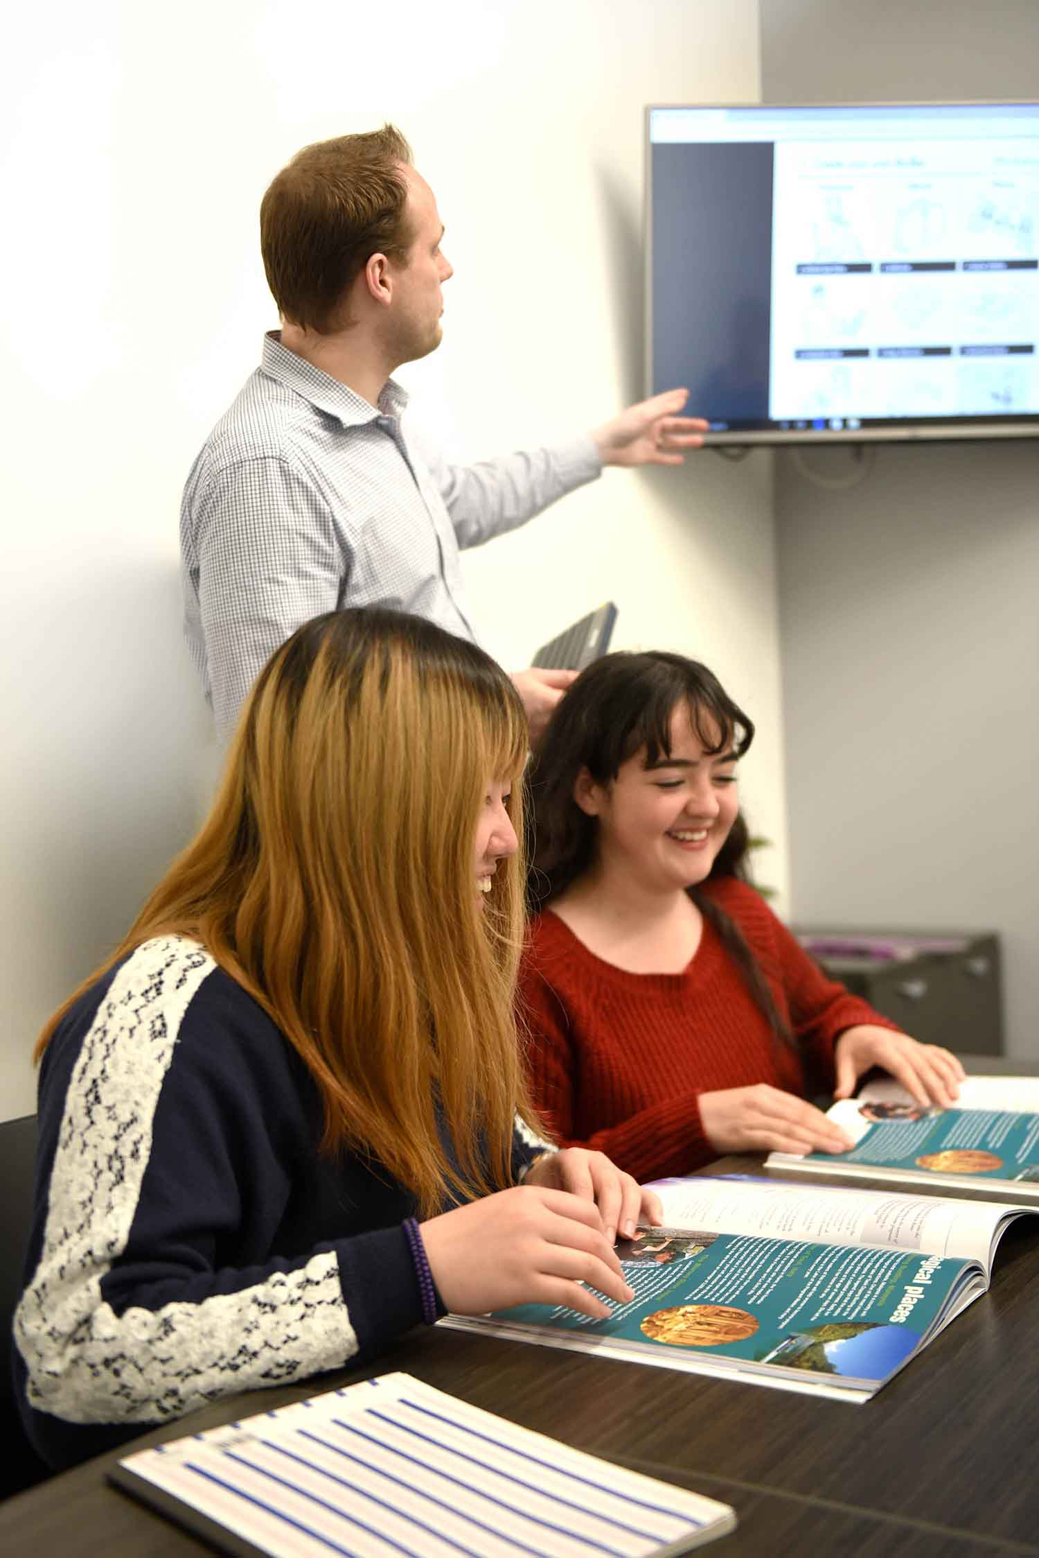
Level Chart

Slide 7
VGC VIRTUAL PATHWAYS

Slide 8
VGC International College
VGC SCHOOL OF INTERNATIONAL BUSINESS
FOUR WEEK BUSINESS CERTIFICATE PROGRAMS Practical Business Calculations Business Presentations and Practices Business Communication Essentials Applied Leadership in the Workplace Communication for Customer Satisfaction and Excellence Practical Sales Techniques Principles of Managing Customer Relationships Marketing Essentials Introduction to Canadian Business Management DIPLOMA BUSINESS PROGRAMS: Diploma in Business Communications – Diploma in Business Communications Diploma in Managing Customer Relationships Diploma in Managing Customer Relationships
Accredited English Language School and Career College
School of English Language and School of International Business
One of the fastest growing schools in Canada
Students from over 70 countries
Two campuses in Downtown Vancouver, BC, Canada

Slide 9
PROMO

Slide 10
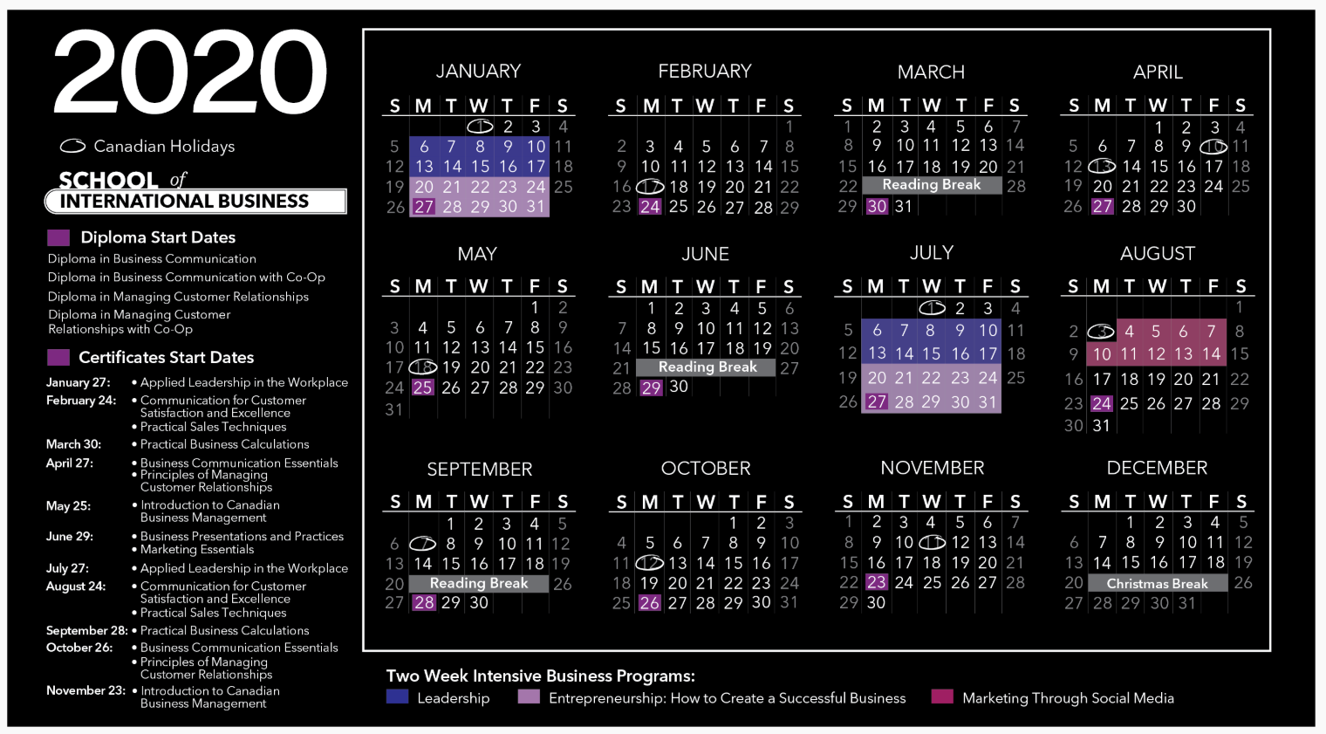
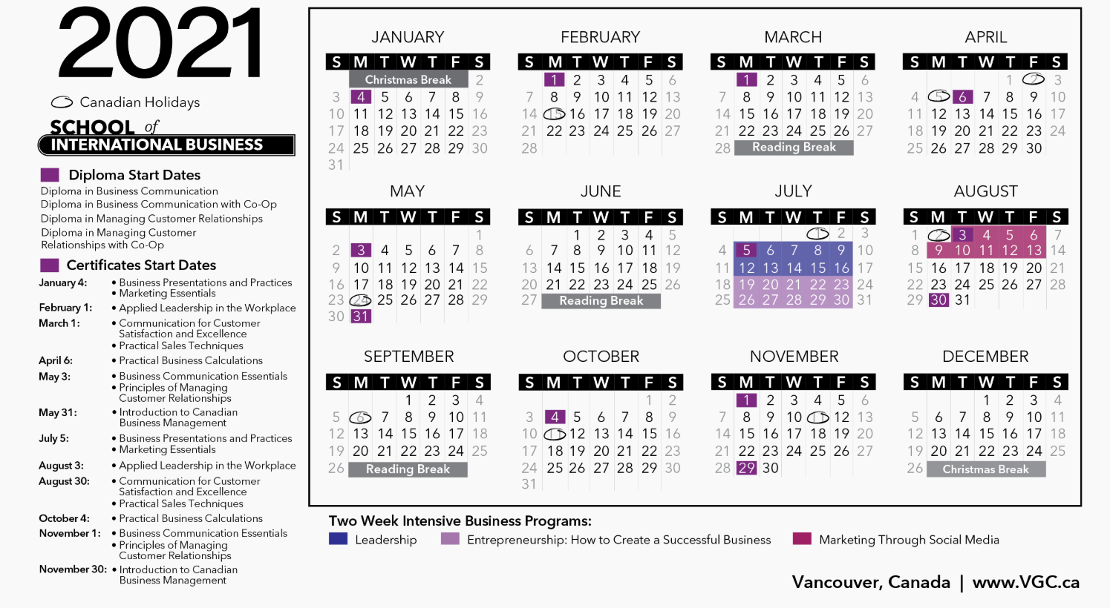
Business Start Dates
OVERVIEW OF 2020/21 START DATES
DIPLOMA PROGRAMS: Monthly intakes throughout the year
FOUR WEEK BUSINESS CERTIFICATE COURSES: Selected Start Dates with various options each month
TWO WEEK INTENSIVE BUSINESS COURSES: New winter intakes in addition to the summer seminars. Programs are available throughout the year for special group requests.

Slide 11
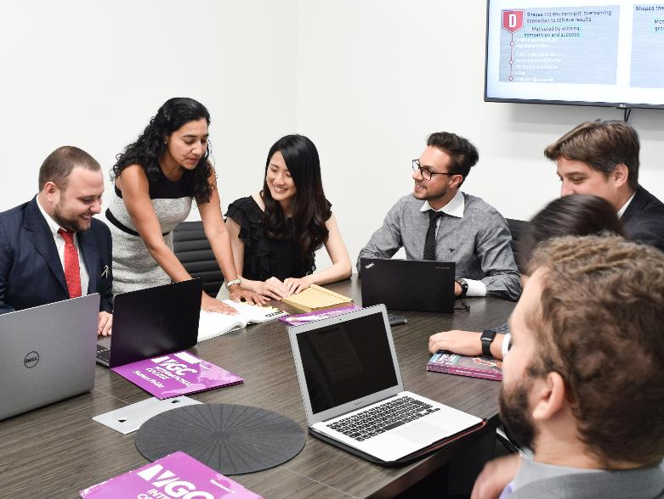
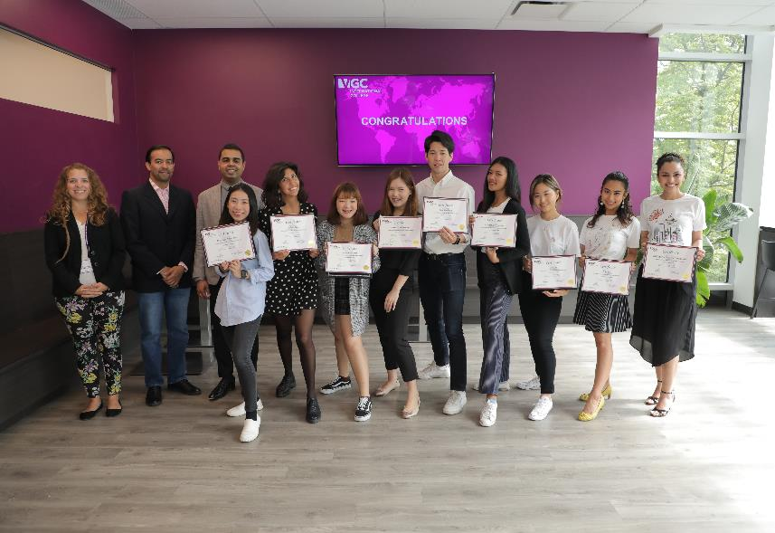
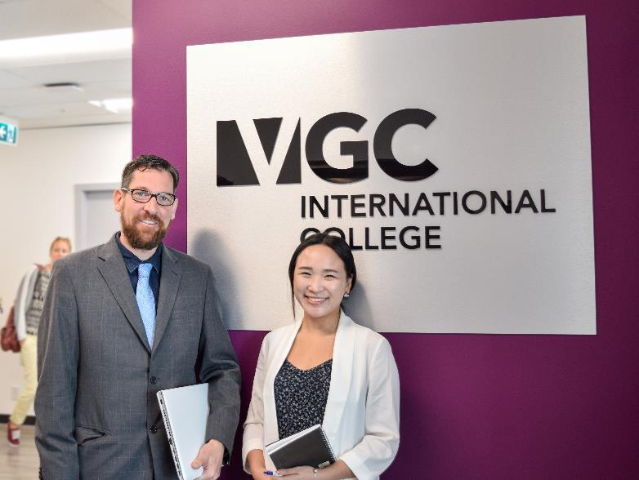
Thank You
Pablo Contreras
www.VGC.ca
marketing@vgc.ca
+1-778-231-9916

