Slide 1
RoboProof
Commodity
Verified Robot Policy Reliability Audits
Decentralized robot policy reliability audit and red-teaming subnet
Bittensor Subnet Proposal
Replayable failure evidence
Feasible simulation stress tests
Actionable retraining recommendations
Jieyu Lian · jieyulian3@gmail.com

Slide 2
PROBLEM
Robot policies pass demos, then fail in edge cases.
Internal validation usually tests familiar conditions. Hardware trials expose the expensive surprises.
Clean demo
Open-set failure
Hardware cost
The policy succeeds in standard simulator setups and curated task definitions.
Small shifts in pose, friction, lighting, recovery state, or contact dynamics trigger brittle behavior.
The team discovers the issue late, after paying for robot time, engineer time, and integration cycles.
The pre-hardware question:
Where will this policy break, and can that failure be reproduced?
RoboProof
02

Slide 3
WHY BITTENSOR
Robot failure modes are an open set, not a closed benchmark.
A single centralized team cannot continuously discover every grasp failure, recovery loop, contact instability, perception brittle case, or sim-to-real edge case.
Centralized red-team tool
RoboProof subnet market
Fixed test suite improves slowly
Many miners search different failure families
Coverage limited by one team
Validators enforce reproducibility
Reports are hard to reuse
Emissions flow to useful failure discovery
Bittensor turns open-ended failure search into a standing market.
RoboProof
03

Slide 4
COMMODITY
RoboProof does not produce robot policies. It produces verified reliability audits.
The miner artifact is executable and comparable: scenario configs, failure hypotheses, rollout evidence, and recommendations.
Failure predicate
Feasibility proof
task failure, collision, action loop, recovery failure
within simulator bounds and physically possible
Replay evidence
Reference outcome
seeds, configs, trajectories, outcome summaries
weak, medium, and strong policy behavior
Minimal trigger
Next action
smallest perturbation that still causes failure
retraining, recovery logic, or hardware validation
RoboProof
04

Slide 5
PROTOCOL LOOP
Miners generate tests. Validators test the tests. Yuma routes rewards.
The subnet rewards audit intelligence, not raw simulation volume.
Miners
Validators
Bittensor
Submit stress-test suites, adversarial scenarios, failure hypotheses, and audit reports.
Run static checks, feasibility checks, policy-bank rollouts, and reproducibility retests.
Converts AuditScore into miner weights and distributes emissions through Yuma Consensus.
Scenario suite
AuditScore
set_weights()
Miner rewards
RoboProof
05

Slide 6
MINER ARTIFACT
A good miner submits a causal test, not a random perturbation dump.
The strongest submissions explain the failure mechanism and minimize the trigger.
What validators reward
{
"task": "pick_and_place",
"object_pose_shift_cm": 12,
"friction": 0.18,
"sensor_noise": 0.06,
"failure_hypothesis":
"missed grasp followed by recovery loop",
"safety_predicates":
["unstable_recovery", "action_loop"]
}
Feasible scenario within validator bounds
Confirmed failure predicate in rollout logs
Reproducible under retests and seeds
Minimal trigger with a testable hypothesis
RoboProof
06

Slide 7
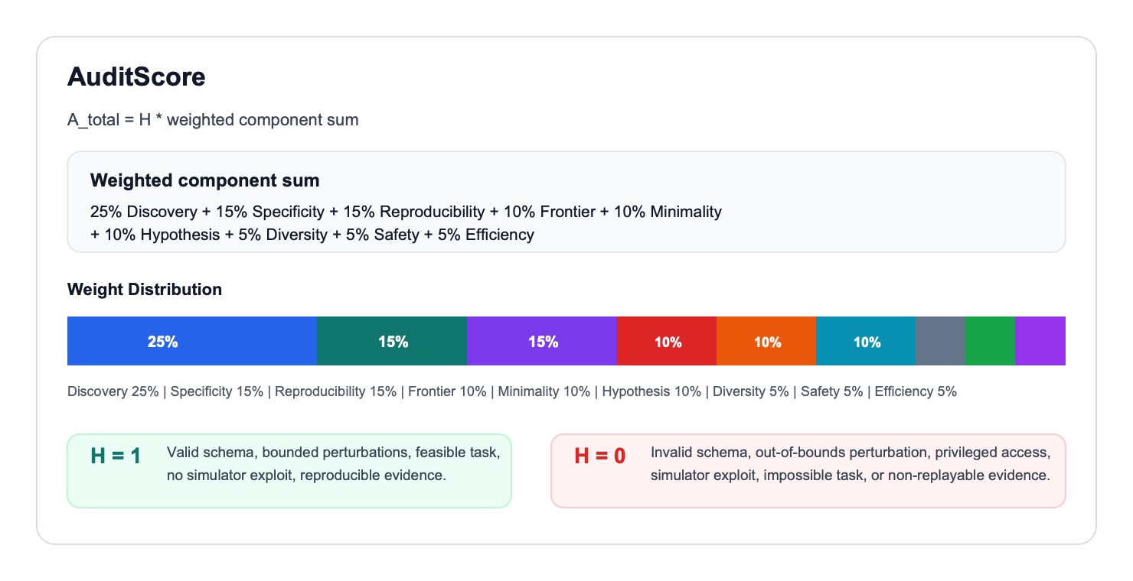
AUDITSCORE
The score rewards useful failure discovery while rejecting invalid scenarios.
Hard gates remove impossible tasks and simulator exploits before component scoring.
Objective predicates
Task failure
Collision or force violation
Action loop
Recovery failure
RoboProof
07

Slide 8
ANTI-GAMING
The invalid case is not 'strong policy failed.' The invalid case is 'the task was impossible.'
RoboProof separates hard edge cases from meaningless failure farming.
Impossible task
Feasibility check + hard gate
Random parameter spam
Minimality + hypothesis quality
Simulator exploit
Sanity checks + allowed API boundary
One-off failure
Seeded reproducibility retests
Policy overfitting
Hidden references + epoch rotation
Specificity = 1 - impossible_failure_rate
RoboProof
08

Slide 9
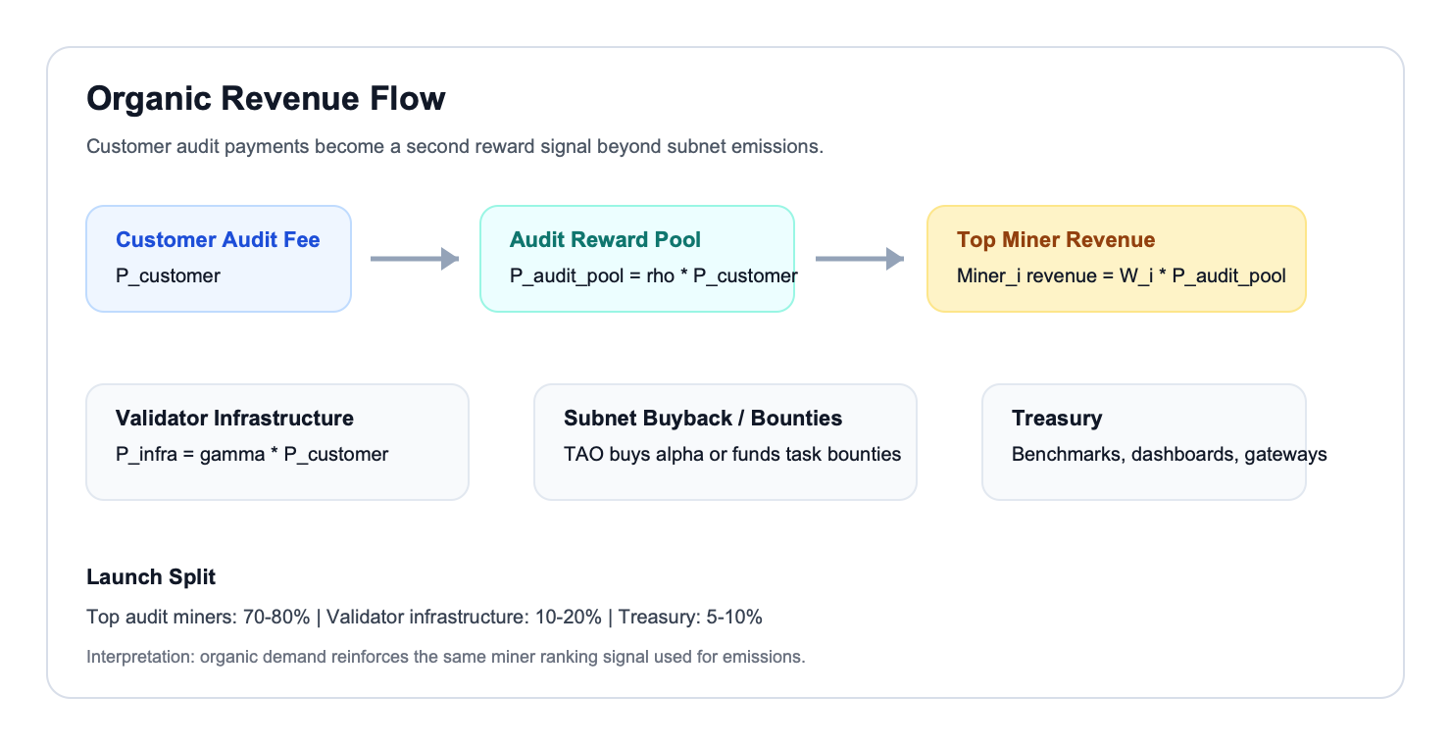
BUSINESS MODEL
Customers pay for audits; top miners earn from both emissions and demand.
Organic revenue creates a second market signal for useful failure discovery.
Why not a centralized audit vendor?
Open scoring rules instead of closed methodology
Multi-miner coverage instead of one consultant team
Reusable scenario library instead of one-off reports
Pay-per-policy audits: $100-$1,000 launch range
RoboProof
09

Slide 10
MVP
Start narrow: tabletop manipulation audits with public policies.
Phase 1 proves scoring without asking customers to expose proprietary robot policy weights.
1
2
3
4
Public-policy audits
Private endpoint pilot
Navigation audits
Long-horizon audits
Isaac Lab / MuJoCo manipulation tasks
Customer keeps weights private
Obstacle and localization failure modes
Recovery and compounding errors
Demo already shows: miner scenario suites, validator replay, AuditScore leaderboard, and JSON audit export.
RoboProof
10

Slide 11
RoboProof
The reliability audit layer for robot policies before hardware deployment.
Build testnet
Public manipulation task suite + reference policy bank
Recruit miners
Computer vision, robotics, fuzzing, and RL specialists
Run pilots
Robotics teams auditing policies before hardware trials
Question RoboProof answers:
Where will this robot policy break?

