Slide 1
Applying to DigiPen
What to Expect, Timeline, and Requirements

Slide 2
Programs Overview
Areas of Expertise
Computer Science
Computer Engineering
Digital Art and Animation
Game Design and Development
Music and Sound Design
Academic Approach
Academic Fundamentals
Project Learning

Slide 3
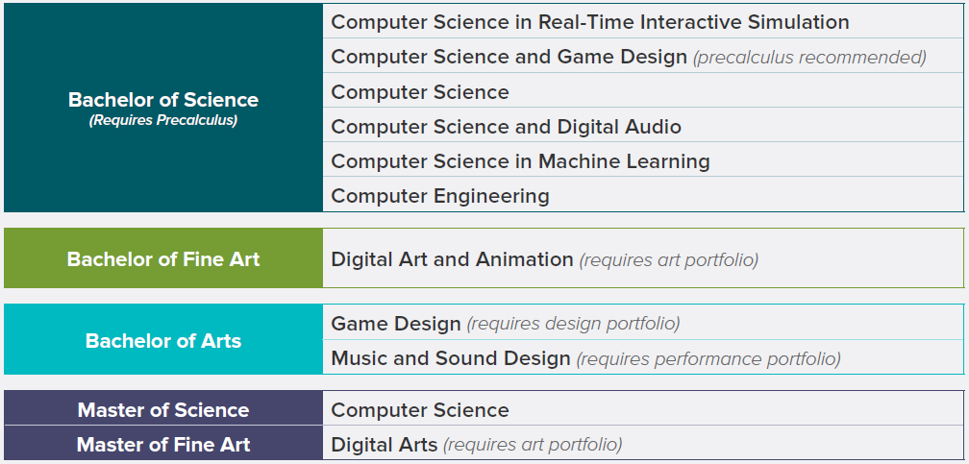
Undergraduate and Graduate Degree Programs

Slide 4
What to Expect When You Apply
Application
Evaluation
Decision and Beyond
Regular check-ins from Admissions staff
Materials submitted within 4 weeks
Begins once all materials are received
Notification via email
2-4 weeks for decision
Notification via email
Printed materials within 2 weeks
Email communication re: open house, enrollment, registration, Facebook group, summer assignments, orientation

Slide 5
Admissions Timeline
September 3 Application for Fall 2020 opens
Rolling admissions from now until July 1
February 1 Priority Application Deadline
Apply by this date for greater access to scholarships and housing
April 1 General Application Deadline
Apply by this date to guarantee your spot in the Fall 2020 class
July 1 Final Application Deadline
Apply by this date to be considered for the Fall 2020 class

Slide 6
Admissions Requirements
All Undergraduates
All BS except BS in Computer Science and Game Design
BFA in Digital Art and Animation
BA in Music and Sound Design
BA in Game Design
Online application
Application fee
Official transcripts
SAT/ACT scores
Essay
Optional essay
Optional letters of recommendation
Precalculus
Separate essay
Art portfolio
Performance portfolio
Design portfolio

Slide 7
Outreach Events
Campus Tours
Online Undergraduate Programs Preview Days
May 2nd
June 6th
July 18th
Online Graduate Programs Preview Day
May 15th

Slide 8
Contact Information
Office of Admissions
Office of Financial Aid
Phone: (425) 629-5001
Toll-Free: (866) 478-5236 (Opt. 1)
Email: admissions@digipen.edu
Phone: (425) 629-5002
Toll-Free: (866) 478-5236 (Opt. 2)
Email: faid@digipen.edu
Address and Office Hours
9931 Willows Rd. NE, Redmond, WA 98052
Monday-Friday, 9:00-5:00

