Slide 1

Ciao!
Hello!
もしもし！
你好！
Xin chào!
Сәлеметсіз бе!
Cześć!
Salut!
Hola!
Merhaba!
नमस्कार!
Привет!
Привіт!

Slide 2

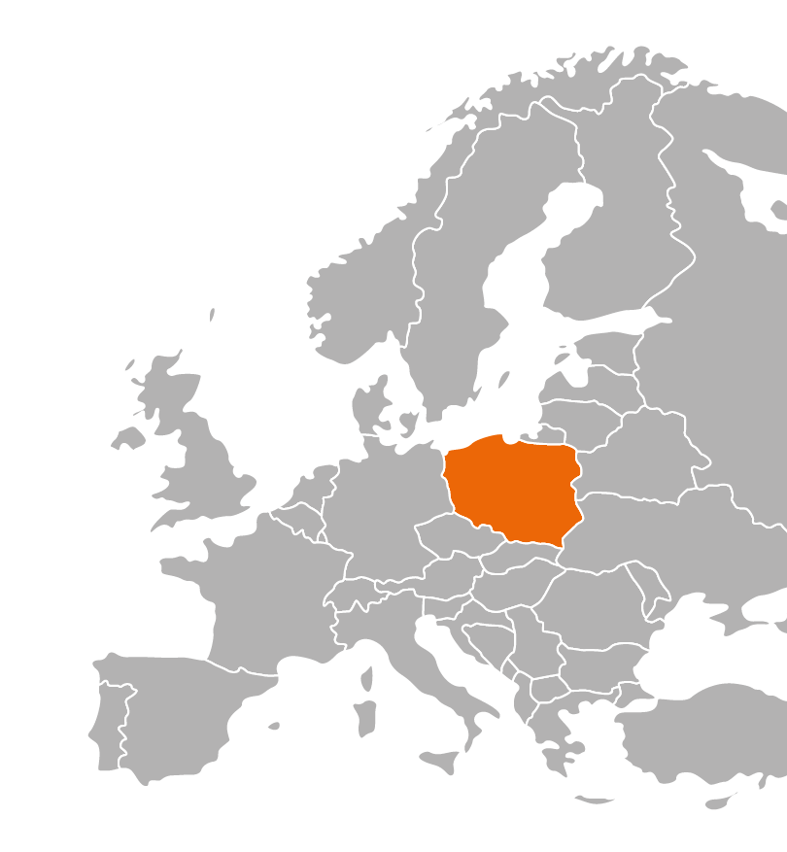
ŁAZARSKI UNIVERSITY
THE ANSWERS YOU ARE LOOKING FOR
STUDY in POLAND
AT A WORLD-CLASS UNIVERSITY

Slide 3





POLAND IS A GREAT PLACE
TO STUDY AND TO LIVE
SAFETY
WORK
OPPORTUNITIES
AMAZING
FOOD
GOOD STANDARD
OF LIVING

Slide 4








Best Location - Warsaw, Poland
Warsaw – Polish business city
Dynamic country, located in the heart of Europe
Culturally and ethnically diverse city
Member of the European Union
Relatively low costs of living
Foreigners-friendly country

Slide 5



Why Lazarski University?
No 1
around
5000
faculty of economics and management
in Poland for cooperation with business
According to magazine
students
Located in
Ranked the best university in Poland by
U-Multirank, a global ranking funded
by the European Commission
WARSAW
POLAND’S ECONOMIC
AND POLITICAL CAPITAL

Slide 6



Why Lazarski University?
No 3
British Degrees
through our double-degree programs
with Coventry University
in Great Britain
among non-public universities
in Poland according to
No 1
faculty of Law and Administration among
non-public universities in Poland according
to newspaper

Slide 7



Educational offer and tuition fees
(single degree programs)
BA in Economics 1 620 EUR/sem
MSc in Economics 1620 EUR/sem
BA in International Relations 1 620 EUR/sem
MA in International Relations 1 620 EUR/sem
BA in Law in International Relations 1 620 EUR/sem MA in Law in International Relations
BA in Law In Business Management 1 620 EUR/sem BA in Finance and Accounting
BA/MA in Management 1 740 EUR/sem
All Single Degree Programs have a Registration Fee of 200 EUR

Slide 8


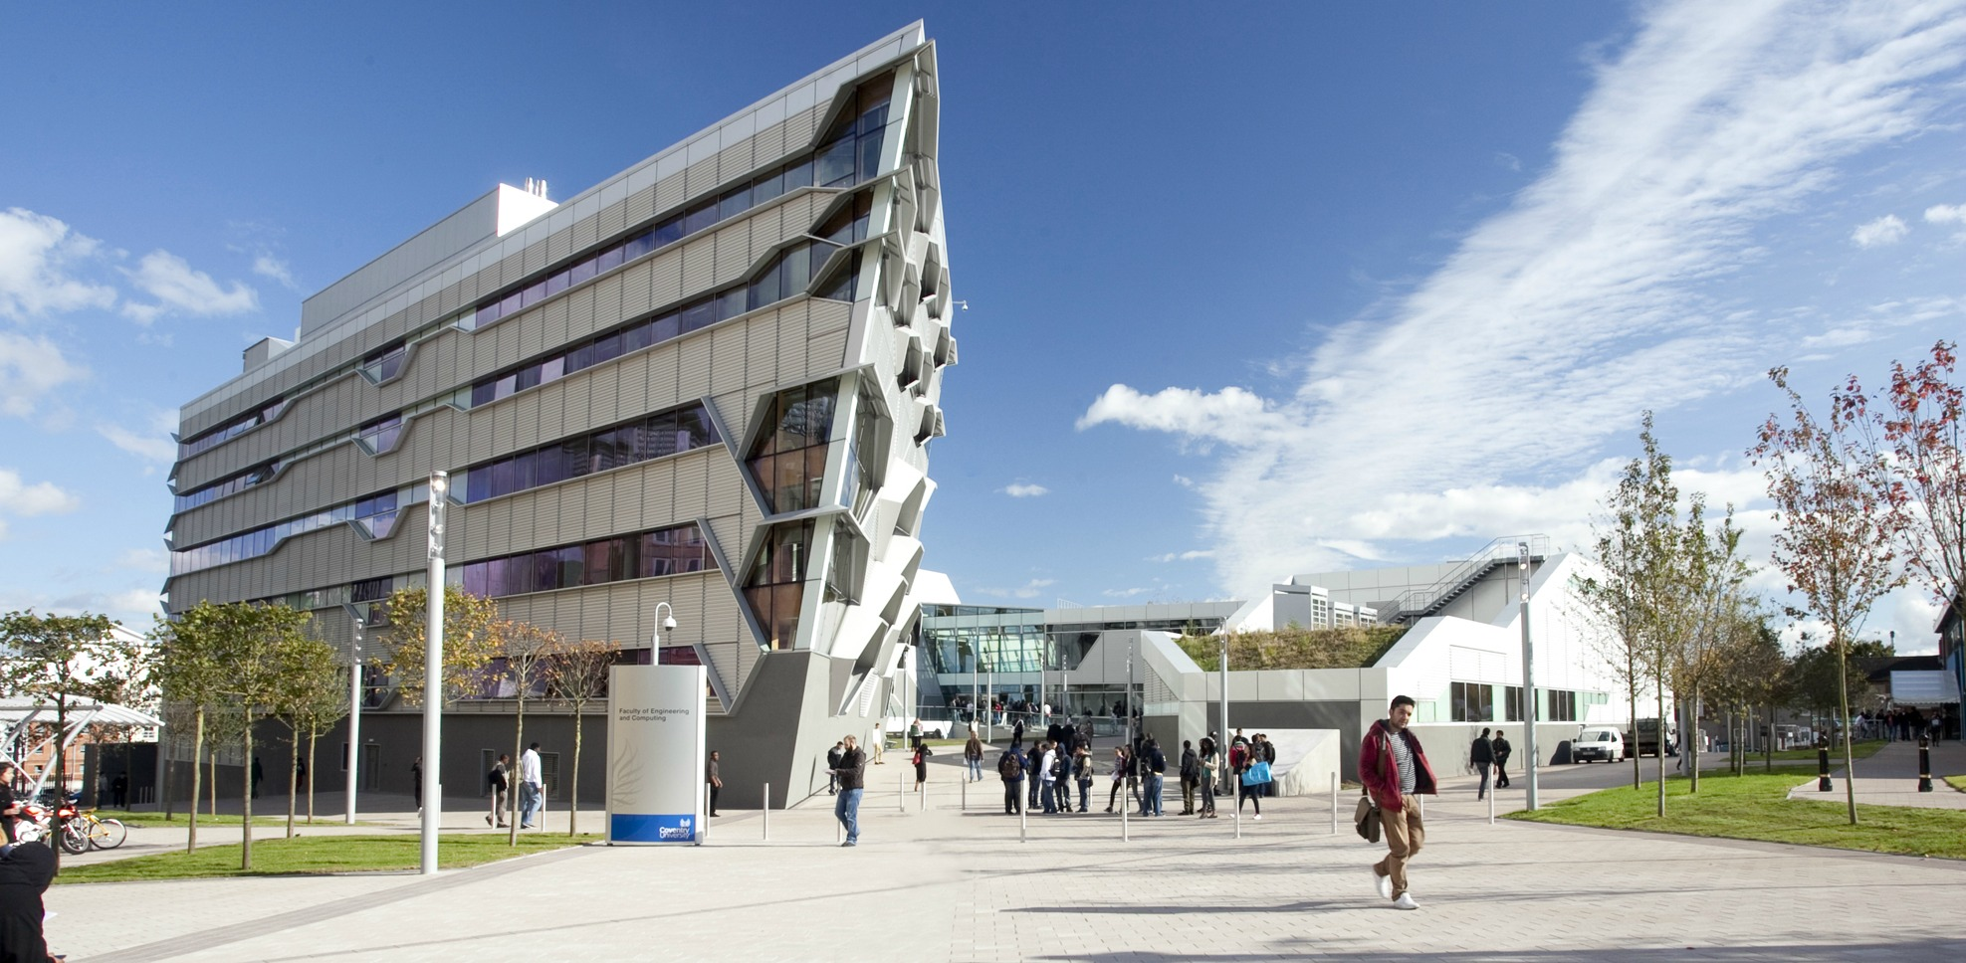


Educational offer and tuition fees (dual award programs)
+
Located in Coventry, England - 32 000 students
BA/ MSc in Business Economics 2040 EUR/sem
BA/ MA in International Realtions 2040 EUR/sem
13th University in the United Kingdom according to The Guardian University Guide

Slide 9





Lazarski Flying Academy
BA in Aviation Law and Professional Pilot Licence
12 000 EUR/sem
LAZARSKI UNIVERSITY

Slide 10







SUCCESS
WELL- PAID JOB
BENEFICIAL INTERNSHIP
INTERESTING UNIVETSITY PROGRAM
BACKGROUND KNOWLEDGE FROM
LAZARSKI LANGUAGE COURSE

Slide 11




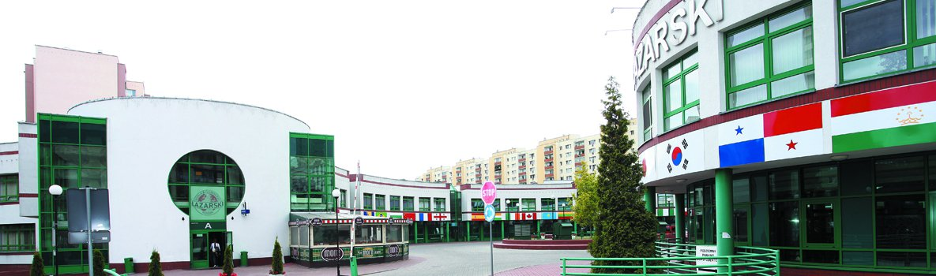
University Facilities
Library
Over 180 000 books
Virtual Library of Science
Online journals and magazines
Rest Zones
Comfy sofas all around the camp
Mini-park
Sport Facilities
2 gyms
Swimming pool
Food Courts
One restaurant with home-made food
2 coffee shops

Slide 12

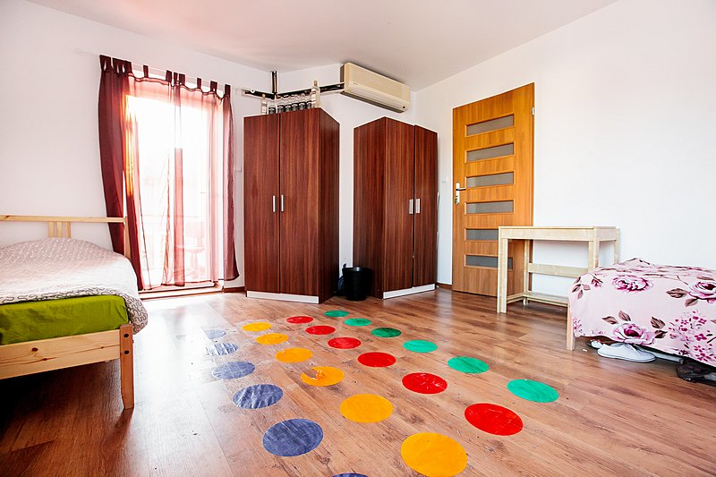
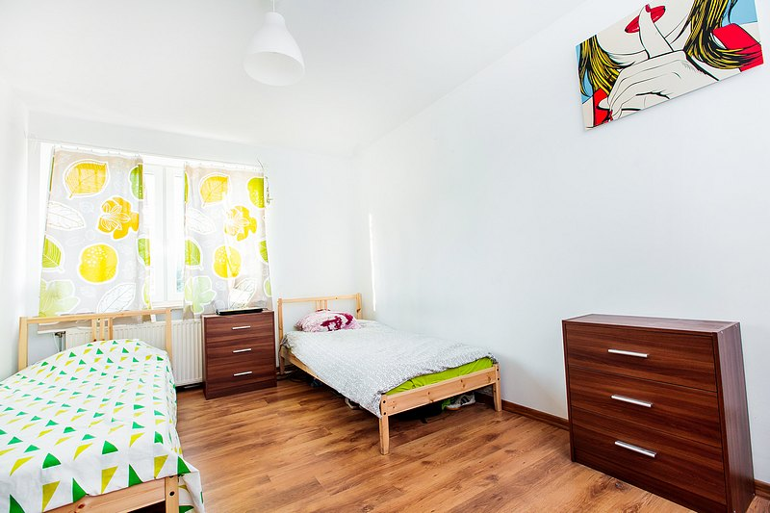
Accommodation
Accommodation Department
provides different housing solutions
Lazarski houses
Student dorms
Flats
Prices:
Lazarski houses – 600 EUR/semester
Students dorms - 400 EUR/semester

Slide 13














Internships and Jobs Placement
Career and Internship Department assists students in finding jobs and internships
Regular job fairs are organized at Lazarski where
students can meet their potential employers
Internship Abroad is real! Erasmus + Internship program sponsored by the European Union
Students receive professional assistance in creating their CVs and getting ready for job interviews

Slide 14







Out-of-Class Activities
Sport Activities
Aerobics, football, fitness,
kung fu, basketball, swimming, yoga
Student Union
Integration events, parties, conferences, workshops
Debate Club
Cheerleading Team
Music Band

Slide 15




Exchange Programs
ERASMUS +
One year or one semester in a partnership universuty
All over Europe: Germany, France, Italy, Spain, etc.
Grant 300-500 EUR/month
Coventry University
One semester in Coventry
University
For bright students
Grant 500 EUR/month

Slide 16

How to apply?
STEP 2
STEP 1
CHOOSE YOUR PROGRAM
CHECK IF YOU ARE ELIGIBLE TO APPLY
STEP 3
STEP 4
REGISTER ONLINE
SUBMIT YOUR DOCUMENTS
STEP 5
PAY YOUR TUITION FEE
STEP 6
APPLY FOR YOUR
VISA
STEP 7
:)
WELCOME TO
ŁAZARSKI!

Slide 17


Slide 18



MAKE THE RIGHT CHOICE

