Slide 2
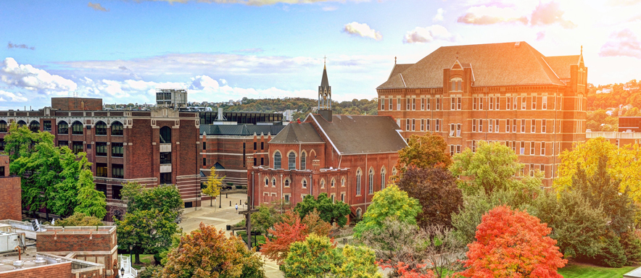
The Duquesne Difference
What are the most important things to know?
#132 by U.S. News and World Report Overall National Ranking
50 STEM eligible Undergraduate & Graduate programs
Located within a dynamic and affordable U.S. city
Undergraduate annual merit scholarship between $5,000-$18,000
24 Graduate programs offering 25% tuition scholarship

