Slide 1
Study Metro Online College Fair
April 20, 2020
www.uncg.edu

Slide 2
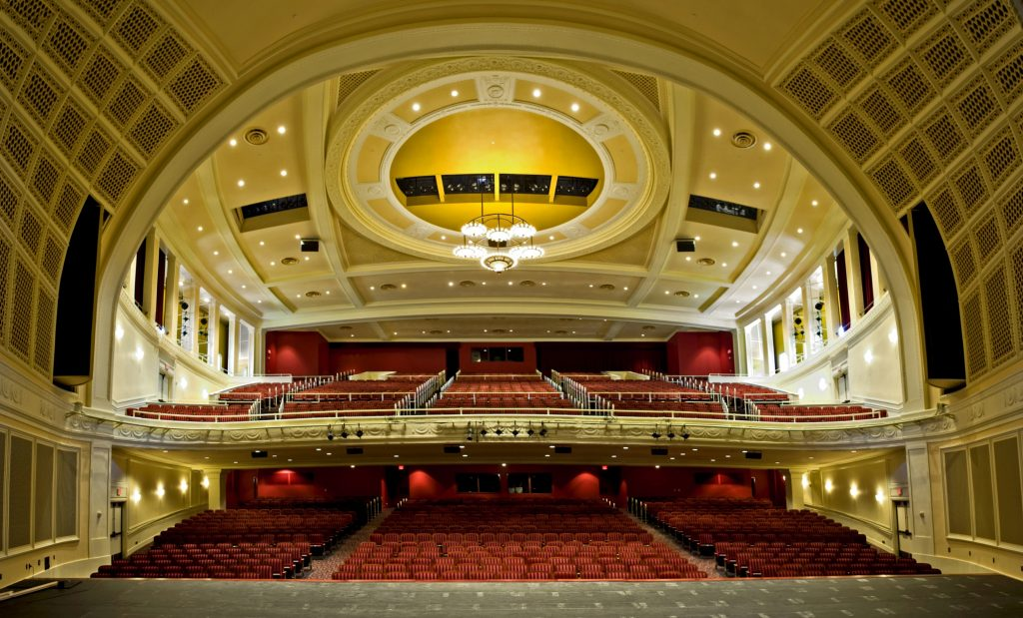
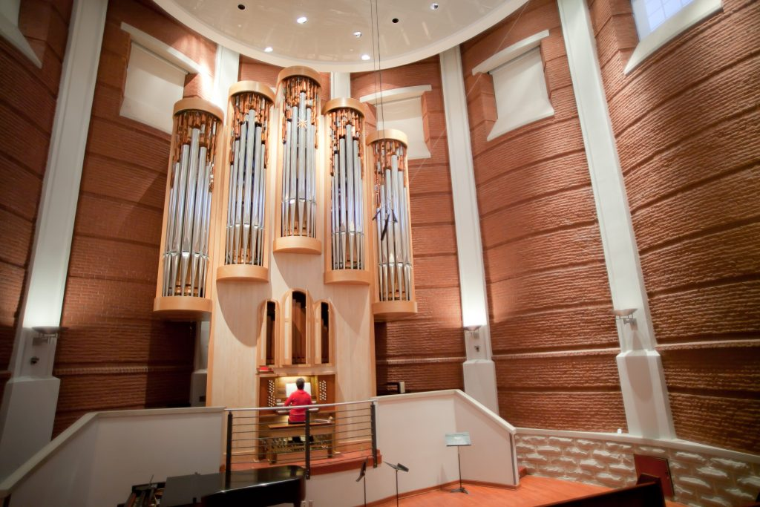
www.uncg.edu
The Bryan School of Business
Bachelor’s, Master’s, PhD
Accounting
Business Administration
Economics
Consumer Apparel & Retail Studies (Fashion)
International Business
IT & Supply Chain Management
Marketing
Sustainable Tourism & Hospitality
MBA
MS in IT & Management
Concentrations in Cybersecurity, Data Analytics, Supply Chain Management
The College of Visual and Performing Arts
School of Music
#1 in North Carolina; nationally, globally recognized
Bachelor’s, Master’s, Doctoral
School of Art
School of Dance
School of Theatre

Slide 3
About The Uncg www.uncg.edu
Founded in 1891
20,000 proud, brave Spartans studying full time
125 Degree Programs – Bachelor’s, Master’s, PhD
700+ International Students
93 Countries Represented
230 acres, beautiful campus
250 clubs & organizations
Annual International Festival (I-Fest), attracting thousands
Part of the UNC System; third largest university in UNC
Ranked #201 among public universities - US News & World Report
Faculty student ratio: 25:1

Slide 4
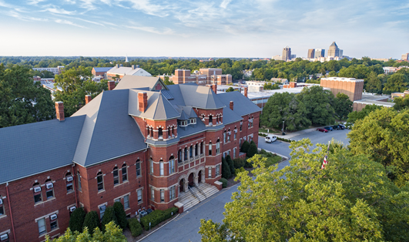
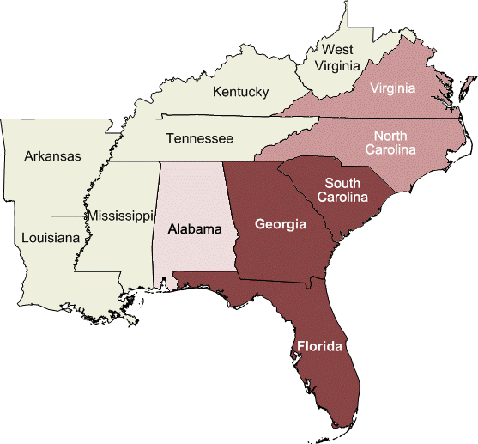
Beautiful Campus, Friendly Students, Excellent Programs, World Class Faculty, Premier Facilities in a Great State Located in the central part of North Carolina, a four-season state – mild summers, moderate winters, beautiful spring, fall Two international airports: Raleigh-Durham (RDU) 1 hr away; Greensboro (GSO) 15 minutes away Low cost of living in NC compared to other states NC experiencing significant job growth, particularly in STEM fields, healthcare
Greensboro, NC

Slide 5
Undergraduate Admission Criteria & How to Apply
IBT 79 TOEFL or
IELTS 6.5 Band Score or ELS 112 Report or PTE Academic 57, etc.
SAT / ACT - optional
Strong Essay/Personal Statement – optional but recommended
GPA 2.5 minimum; Preferred 3.0
Some programs require higher GPA and/or English language scores
Recommendations – not required
Undergraduate Freshmen: Blue & Gold Academic Merit Based Scholarships
$3,000 USD to $6,000 USD per Year
GPA 3.5 (A-) minimum
When admitted to uncg, your name automatically put into scholarship committee for review
Other scholarships available on campus (department)
F1 visa holders are eligible for on-campus employment
Academic Year Costs 2020-2021
Fall (Sept) & Spring (Jan) Combined:
Tuition & Fees $22,890
Room (Double) $5,381
Meal Plan $3,657
Annual Cost $31,928
Costs of health insurance, books, supplies, travel, and personal expenses extra. Certain programs may have cost structure.

Slide 6
Applying to UNCG: Undergraduate Degrees
Apply through SpartanLink:
https://spartanlink.uncg.edu/
Or, The Common Application
UNCG Application Deadlines
Fall (August): March 1 Recommended
July 1 Deadline
Spring (January): October 1 Deadline

Slide 7
Intensive English Programs
UNCG Global Pathways - https://soeglobalpathway.uncg.edu/ - for Graduate Only:
3 Levels of Intensive English
Conditional admission offered for UNCG Grad Programs
TOEFL/IELTS waived by completing Level 3
Or,
If you need a little or a lot of English help
Interlink’s Intensive English Program
Level 5, the highest, allows you to waive the TOEFL or IELTS
Conditional undergraduate admission offered for UNCG

Slide 8
Graduate students: 79 Master’s Degrees
MS in Computer Science (GMAT 150 Quantitative minimum)
MS in Informatics & Data Analytics (no GRE or GMAT)
MS in IT & Management (GRE, GMAT flexible with relevant work experience, grades at bachelor’s degree) – (w/Cybersecurity)
MBA (GRE, GMAT required but waiver possible with relevant work experience – must request waiver) – (w/Global Supply Chain Management)
MS in Nanoscience & NanoEngineering (GRE, GMAT required)
MS in Biology, Biochemistry (GRE required but recommendations more important)
MS in Accounting GRE, GMAT required but waiver possible with relevant work experience – must request waiver)
MA in Mathematics & Statistics
So much more!!
Complete list of Grad/PhD programs at: https://grs.uncg.edu/programs/

Slide 9
Graduate Application Requirements
Completed Graduate School Application and graduate application fee
Official transcripts in English (to be evaluated by UNCG’s Graduate School)
Statement of Purpose/Essay
Three letters of recommendation, at least two from professors
Resume
Minimum TOEFL (iBT 79), IELTS (6.5 band score), iTEP, IELTS 112, taken within the last 2 years from date of application to UNCG
Deadlines vary – apply early and check graduate degree list
How to Apply: https://gradapply.uncg.edu/apply/

Slide 10
Graduate Tuition, Fees, Housing Options
Residential Life – Graduate Housing
Example: 2BR/2BA for Fall/Spring: $8,539.00
Optional Unlimited meal plan extra – Example: $1,874.19 per semester
Numerous 1B/1BA apartments in the community to rent
$650 - $900 per month
Cost of Attendance at UNCG
Credit Hours | Semester | Cost USD $
9 | Fall | $ 10,598.67
12 | Spring | $ 10,923.00
9 | Summer | $ 8,632.32
30
UNCG Academic Year (Fall/Spring): |  | $ 21,521.67
UNCG Total Tuition & Fees: |  | $ 30,153.99

Slide 11
Graduate Assistantships (GA)
when applying, check on your application that you want to be considered for a ga position
example:
tuition waiver for full-time enrollment
$20,000 usd stipend for 20 hours work per week minimum
note: ga funding varies and can be substantially more
graduate expo – showcasing graduate research projects
ga jobs also posted at: www.uncg.edu – human resources / jobs search

Slide 12
Student Support Services
Internships for course credit (3-6 credit hours) with major industries in North Carolina & Greensboro area (ex: Volvo, Honda, VF International, Fedex, Amazon, GE, UNC & Cone Health Systems, Etc.)
Multi-cultural center
Multi-faith quiet rooms for meditation
Career Services Center
Comprehensive tutoring and writing center
Division I Sports and intramural sports
Office of disability services
Writing & Math Centers
Each department has its own advising & career services center
Lloyd International Honors College
Study abroad services (International Programs Center)
Dormitories / Residential Halls (18) including an International Hall

Slide 13
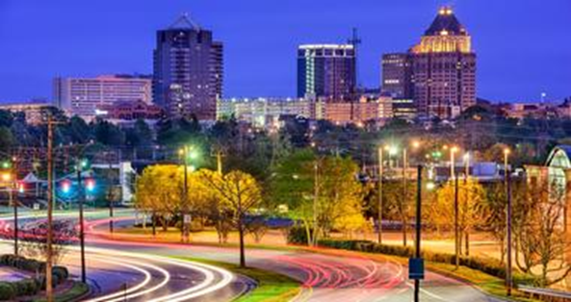
About Greensboro
A metro city of about 300,000 population
Greensboro Coliseum – attracting major talent around the globe
Greensboro symphony orchestra
TANGER AUDITORIUM
Multicultural grocery stores
Arts, culture, diverse food, music, entertainment, festivals
Foodie culture – Multi-ethnic foods
Progressive bus line/transportation system
Excellent, Large Shopping Centers
Friendly Shopping Center
Four Seasons Mall
International Markets
TANGER OUTLETS
SO MUCH MORE!
Multi-faith houses of worship
Science Center/Aquarium Downtown, historic Greensboro
WEATHERSPOON ART MUSEUM
Civil Rights Museum
FARMER’S MARKETS
Foodie culture, great nightlife
Greensboro International Airport (GSO) – 15 minutes from uncg

Slide 14
WELCOME TO UNCG!
Carol L. Mandzik, MBA Director of International Recruitment Carol.Mandzik@uncg.edu

