Slide 1
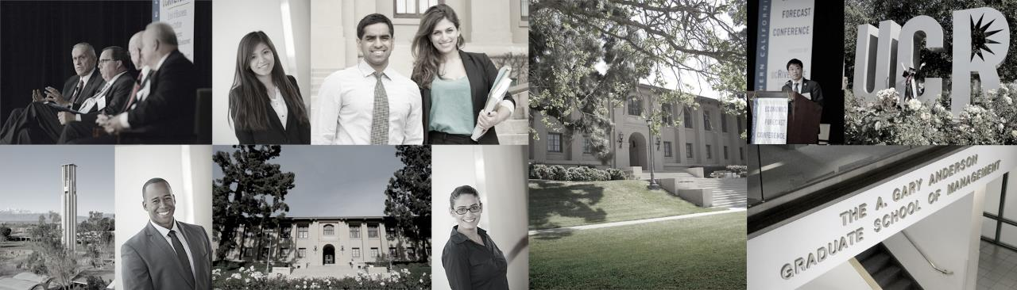

Slide 2

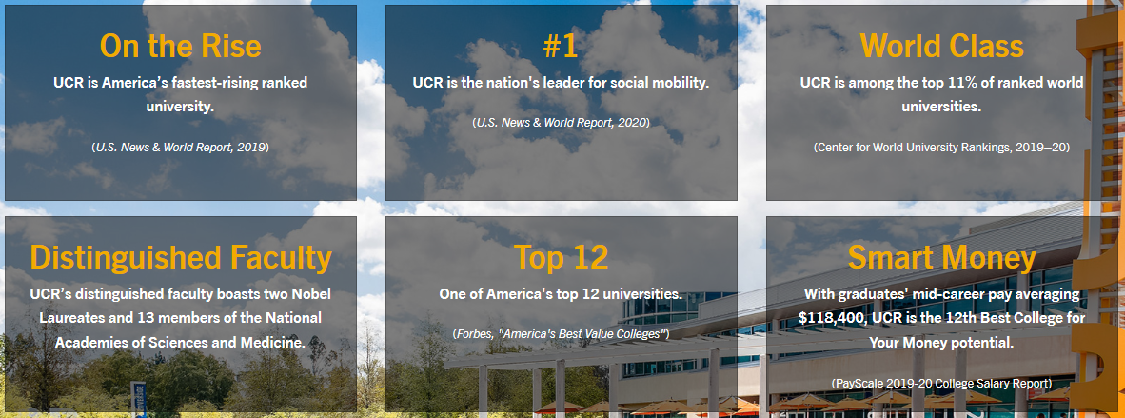

Slide 3
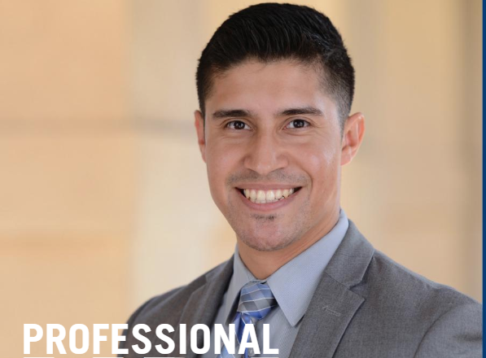
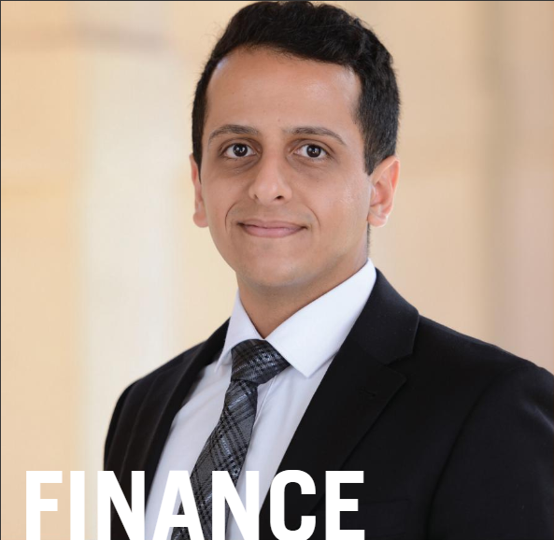
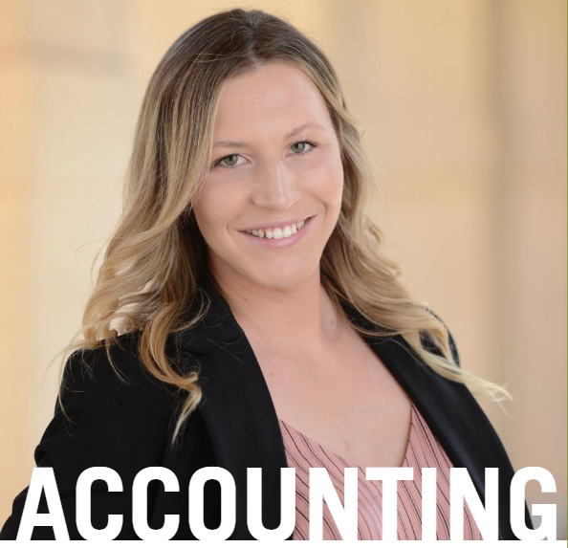
Choose your graduate major
MBA
MFIN
MPAC
Master of Business Administration
Top 100 Business Program
Completed in two years
Master of Finance
STEM Designated
Completed in one year
Master of Prof. Accountancy
STEM Designated
Completed in one year

Slide 4
MBA
MASTER OF BUSINESS ADMINISTRATION

Slide 5
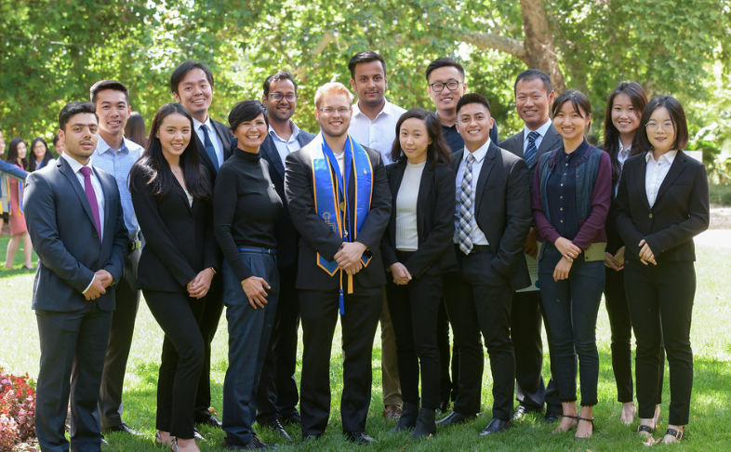
MBA PROGRAM
Admission in Fall only
Open to students from
all undergraduate majors
Typically 21 months to complete
Prepares you for a career
in a variety of functions and industries
No work experience required (but beneficial)
Notes:
Full time MBA = Fall admission only.
Done in less than two years.
Internship is required.

Slide 6
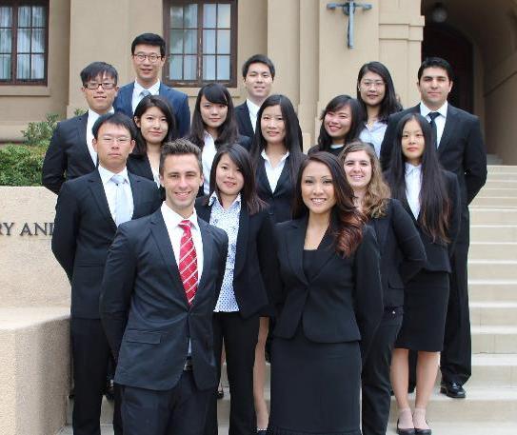
MBA CLASS PROFILE
Average GPA: 3.29
Average GMAT: 611
Average GRE: 306
42% Women, 58% Men
43% International, 57% Domestic
21 countries represented:
  Mexico, China, Indonesia, Nigeria, Japan, Saudi Arabia, USA, Taiwan, India, Cambodia, France, Germany, Canada, Vietnam, Thailand, Australia
Notes:
These are all averages, we do not have any minimum requirements as we look at each candidate utilizing a holistic approach.
We look at everything – not just GPA or GMAT. However, the higher score you have on your GMAT – the more competitive of an applicant you become.
However, if you have a high GPA and lower GMAT, we also look at that - everything balances out.

Slide 7
MFIN
MASTER OF FINANCE

Slide 8
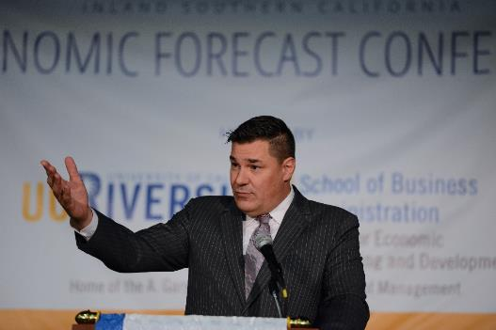
MASTER OF FINANCE
Addresses the substantial unmet demand
for trained finance professionals
Appropriate undergrad majors:
  Business, engineering, math, statistics, physics, etc.
  Requires strong quantitative background
48 units
9 month program (3 quarters)
No work experience required
STEM Designated Degree Program
Notes:
MFin –there are no pre-req; however, we highly encourage a background with a strong quantitative background as this is a competitive program. It is 9 month program and will certify you for the CFA program. We highly recommend that you are scoring above a 600 and in the 80% percentile of the quantitative methods on the GMAT.

Slide 9
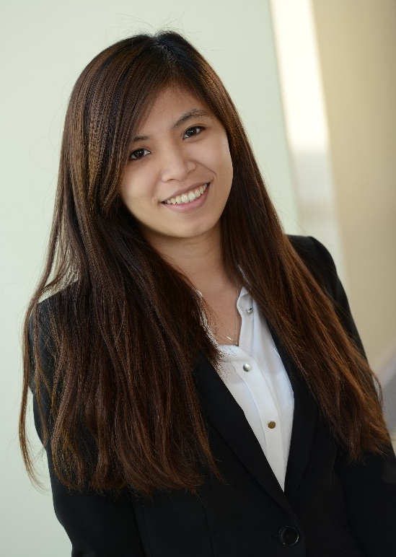
MASTER OF FINANCE
You can build a career as a:
  Chartered Financial Analyst (CFA)
  Certified Financial Planner (CFP)
Possible Career Paths for MFIN students:
  Equities Trading
  Corporate finance
  Risk management
  Asset Management
  Investment Banking
  Quantitative Research
  Investment Management
  Private Wealth Management
Highly Accomplished Faculty:
  Richard Smith, PhD (4,900 Google scholar citations)
  Jean Helwege, PhD (4,000 Google scholar citations)
Notes:
Some of the career paths an Mfin students may pursue are:

Slide 10
MPAc
MASTER OF PROFESSIONAL ACCOUNTANCY

Slide 11





MASTER OF PROFESSIONAL ACCOUNTANCY
Growing demand for qualified Certified Public Accountants (CPAs)
  California requirement of 225 quarter hours of applicable credit
A variety of possible certifications
  CPA (Certified Public Accountant)
  CMA (Certified Management Accountant)
  CIA (Certified Internal Auditor)
48 units
9 month program (3 quarters)
100% CPA Pass Rate historically for MPAc Graduates
STEM Designated
Notes:
MPAc – this program is designed to get you in and out quickly so you can jump right into your desired industry.
The MPAc is a master’s degree that will help you study for and pass the CPA exam. This program qualifies you to take the CPA exam.
The MPAc program has five pre-requisites courses that are required in order to gain admission to the program. These courses are listed on our AGSM website.

Slide 12
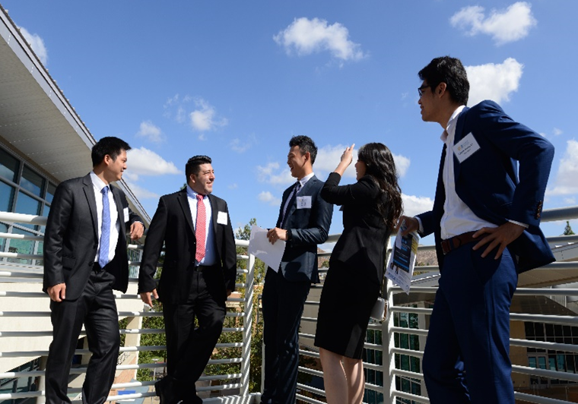
MASTER OF PROFESSIONAL ACCOUNTANCY
MPAc Track 1
For undergraduates with backgrounds in
business, accounting, economics, etc.
MPAc Track 2
All other Academic backgrounds
No pre-requisite courses required for admission
Pre-requisite courses can be taken with us, while here at AGSM (15 months)
Provides ease and convenience for students looking to transition into an Accounting career

Slide 13
Career Development Center
Individual Coaching
Career assessment
Workshops and Webinars
Resumes
Company & Industry Info
Job Leads
Resume assistance
Mock interviews
Networking
Social media
Information Sessions
Company site visits
Full-time positions
Job search resources
Internships
Campus career fairs
LinkedIn coaching
Interviewing
Negotiations
Job-search strategies
CareerTalk series
Industry Exposure

Slide 14
APPLICATION REQUIREMENTS
ALL APPLICANTS:
  Online Application
  Application Fee ($150)
  Resumé
  Combined Essay:
    Statement of Purpose
    Statement of Personal History
  Official Transcripts**
  1 Letters of Recommendation**
  Official GMAT or GRE score**
**These Items can be submitted after applying!
INTERNATIONAL APPLICANTS:
  Official TOEFL (min score 80 ibt) or IELTS (min score 7)
  Transcripts and Degree Certificate
  in the original language of instruction
  Contact your local Study Metro agent for application fee waiver!
Notes:
Start your application within the next 24 hours – you don’t need to complete, just start your application and save.
A few things you will need during the application process:
Statement of purpose and personal history is one essay with two questions:
Answer the question! By answering the question, you are showing you follow instructions.
Spelling – Have multiple people proof read it.
Grammar – proof read! Your grammar shouldn’t be compound or fragmented sentences. It should flow and be easily understood.
Brag about yourself – The whole point of this essay is for us to get to know you. And for you to show off!
The differentiator – How do you add value? How are you different? What makes you unique?
The flow – Remember I read hundreds of essays. Make it stand out!

Slide 15
ADMISSION CHANGES FALL 2020
The GMAT/GRE will not be required for all applicants, but strongly recommended. A GMAT/GRE score can help maximize scholarship potential.
For international applicants, the TOEFL/IELTS exam can be waived, based upon an admissions interview.
Should you want your application to be considered without the submission of a GMAT/GRE score, simply include the phrase “Consider without exam” at the top of your statement of purpose essay.
Notes:
Start your application within the next 24 hours – you don’t need to complete, just start your application and save.
A few things you will need during the application process:
Statement of purpose and personal history is one essay with two questions:
Answer the question! By answering the question, you are showing you follow instructions.
Spelling – Have multiple people proof read it.
Grammar – proof read! Your grammar shouldn’t be compound or fragmented sentences. It should flow and be easily understood.
Brag about yourself – The whole point of this essay is for us to get to know you. And for you to show off!
The differentiator – How do you add value? How are you different? What makes you unique?
The flow – Remember I read hundreds of essays. Make it stand out!

Slide 16
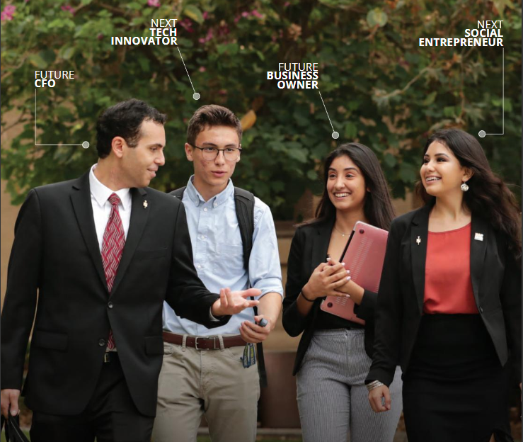
APPLICATION DEADLINES
Fall 2020
Final Round: June 1, 2020 (Int’l)
August 1, 2020 (Domestic)
Notes:
We are currently in our third round; however, we know good students come at all times during the application process. Don’t feel you’ve missed your opportunity. At the end of the day you are only competing with yourself.

Slide 17
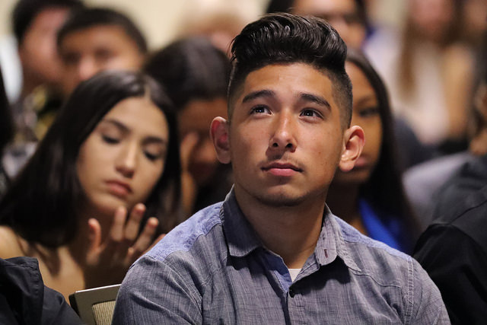
Financial Awards and Scholarships
Fellowships
  All incoming students are considered upon admission
Teacher Assistants
  Available to 2nd year MBA students
Campus Jobs
  Reader Position
  Graduate student workers
Notes:
UCR is one of the most generous programs in terms of fellowship availability.
Dean Wang feels that all schools should be affordable, so we do everything we can to make this the most affordable and best education possible.
Students enrolled full time in the flex or full time MBA, carrying a minimum of 12 units and above a 3.0 GPA are allowed a TA appointmentship. TA appointment will give you $2,200 salary each quarter you are a TA. $6,600 additional dollars in your pocket if you maximize the TA appointments. Along with that we pay your Gship, which is health insurance - $1,137 and all international students are required to carry this insurance. We pay a partial fee remission at $4,098 per quarter as long as you are a TA. So this is almost $7,500 per quarter additional or $22,500 additional per year. If you are a competitive student you can be guaranteed a TAship is part of your scholarship package.
Your first year you can do readerships during your third quarter. These are about $11.00 per hour assisting professors. We try our best to make sure you have every opportunity to have financial assistance while in our program.

Slide 18
Contact:
Connect with your Study Metro counselor for application fee waiver
The A. Gary Anderson Graduate School of Management
Notes:
A few of the things we are offering for you….admission counseling, expedited admissions consideration, scholarships up to 50% and an application fee waiver. We want coming to our school to be easy and affordable for you.
I want to finish with two things….I have the best job at the School of Business. In my position I get to work directly with our international students on the fun stuff. If you have academic problems or questions, you are going to go to an academic advisor or your professor. If you have life questions….come to me. Last year I got to help students learn to bake a turkey, told them the best rides to go on at Disneyland, helped plan a trip to Seattle. So consider me your personal assistant. Come see me and let’s be friend.
The second thing is we have a wonderful Taiwanese Graduate Student Association. This association holds events all through the year, helps students with housing and they come to Taipei the end of July each year to hold an orientation session for students heading to the U.S. They give you information like how to open a bank account, how to get a drivers license, the best places to buy books and more information. We also have a wonderful international affairs office on campus that provides mentors and events throughout the year. We are here for you in every aspect of your education and life in the U.S.

Slide 19

Thank you!
School of Business
University of California Riverside
Riverside, California 92521
BUSINESS.UCR.EDU

