Slide 2
Wright State University
Birth place of the Wright brothers – pioneers of the first successful airplane.

Slide 3
Why Dayton?
Wright State University is located in a safe area just 11 miles from downtown Dayton - a city that combines an affordable cost of living while bustling with activities. Dayton has convenient public transportation that connects directly to Wright State so that you can experience all that Dayton has to offer, no matter where you live. You’ll also be close to major cities like Columbus, Indianapolis, Cincinnati and Chicago.

Slide 4
About Wright State University
State-of-the-art research facilities, outstanding faculty members, and extensive library resources along with personal attention and support from a diverse and welcoming campus community
Located in Fairborn, 11.6 miles east of downtown Dayton
18,000 students – 1,800 international students
8 colleges and 3 schools offer more than 100 undergraduate degrees and 76 Doctoral/Masters/Professional degrees
The university is accredited by the Higher Learning Commission at the doctoral degree-granting level

Slide 5
About Dayton Campus
Multiple options for finding food and clothing close to the campus. Two major supermarkets Kroger and Meijer are close to Wright State’s campus
The Mall at Fairfield Commons, only a short drive from campus
Home to the National Museum of the U.S. Air Force, the world’s largest and oldest military aviation museum
The famous ‘Five Rivers MetroParks’ provides outdoor recreation and education experiences
The Midwest’s largest amusement and waterpark, Kings Island, is just 35 miles south of Dayton

Slide 6
Colleges and Schools
College of Engineering and Computer Science
Raj Soin College of Business
College of Science and Mathematics
College of Liberal Arts
Boonshoft school of Medicine
College of Education and Human Services
College of Nursing and Health
School of Professional Psychology

Slide 7
College of Engineering and Computer Science
Computer Engineering
Computer Science
Electrical and Computer Engineering Technology
Electrical Engineering
Aerospace Systems Engineering
Industrial and Systems Engineering
Materials Science and Engineering
Mechanical Engineering
Biomedical Engineering
Cyber Security
Renewable and Clean Energy Engineering

Slide 8
Raj Soin School of Business
Master of Accountancy
Master of Business Administration (MBA)
Business economics
Finance
Health care management
Interdisciplinary business
International business
Investments
Management, innovation, and change
Marketing
New venture creation
Project management
Masters in Marketing Analytics and Business Insights
Master of Science in Social and Applied Economics

Slide 9
College of Science and Mathematics
Anatomy
Applied Mathematics
Applied Statistics
Biochemistry and Molecular Biology
Biological Sciences
Chemistry
Clinical Laboratory Science
Earth and Environmental Sciences
Earth Science
Environmental Science
Human Factors/Industrial Psychology
Interdisciplinary Applied Science and Mathematics
Mathematics
Medical Laboratory Science
Microbiology and Immunology
Neurosciences
Pharmacology and Toxicology
Physics
Physics and Mathematics
Physiology and Neuroscience
Public Health
Statistics

Slide 10
College of Liberal Arts
Acting
Anthropology
Applied Behavioral Sciences
Art
Art History
Classical Languages and Cultures
Communication Studies
Crime and Justice Studies
Dance
Design/Technology
English
French
History
International and Comparative Studies
International Studies
Liberal Studies
Media Studies
Motion Pictures
Music
Performance
Philosophy
Political Science
Psychology
Religion
Social Work
Sociology
Theatre Studies
Urban Affairs
Women, Gender and Sexuality Studies

Slide 11
College of Education and Human Services
Athletic Training
Early Childhood Education
Health and Physical Education
Leadership Development
Middle Childhood Education
Organizational Studies
Public Health Education
Rehabilitation Services
Sign Language Interpreting
Sports Management
Sports Science
Student Affairs in Higher Education Administration
Wellness Studies

Slide 12
College of Nursing and Health
Nursing
School of Professional Psychology
Clinical Psychology

Slide 13
Admission Requirements
Graduate
Undergraduate
GPA: 2.75-3.0
Proof of English proficiency
TOEFL: 79 or higher
IELTS: 6.0 or higher
GMAT: 400 or more
GRE: 300
Statement of Purpose (not required for all programs)
Letters of reference (not required for all programs)
GPA: 2.0
Proof of English proficiency
TOEFL: 61 or higher
IELTS: 5.5 or higher
PTE: 51 or higher

Slide 14
Cost of Academic Year 2019-2020
Graduate
Undergraduate
Tuition fees: $13,800
Living expenses: $9,000
Insurance and Books: $3252
Tuition fees: $19346
Living expenses: $9,000
Insurance and Books: $3252
Scholarships*: We offer limited scholarships up to $5000 per year depending on student’s profile.
Fall Semester: May 30
Spring Semester: October 15
Summer Semester: February 15
Deadlines are rolling
but recommended to
apply by this time:

Slide 15
Admission process UG/PG/Doctoral
Decision
Made
Create
Account
Application complete/ under review
Complete profile and sections of applications
Admission process
Document verification/missing documents
requested
(if any)
Pay application fee ($40 – Grad/ $30 UG)
Submit
application
Upload required documents (online)
Send official GRE/GMAT and TOEFL/IELTS score

Slide 16
Life on Campus
At Wright State, we’re surrounded by affordable on-campus and off-campus housing options, from dorms to apartments
Live with in walking distance to your classes, campus events, and student resources
Join one of our 190+ student organizations or come to one of our many campus events like April Craze, the International Festival, or the Multicultural Fall Festival
UCIE also organizes field trips to help you explore the Dayton area, spring break trips, and camping trips
Visit local sites and parks, go see a show at one of our many theatres, or explore downtown Dayton

Slide 17
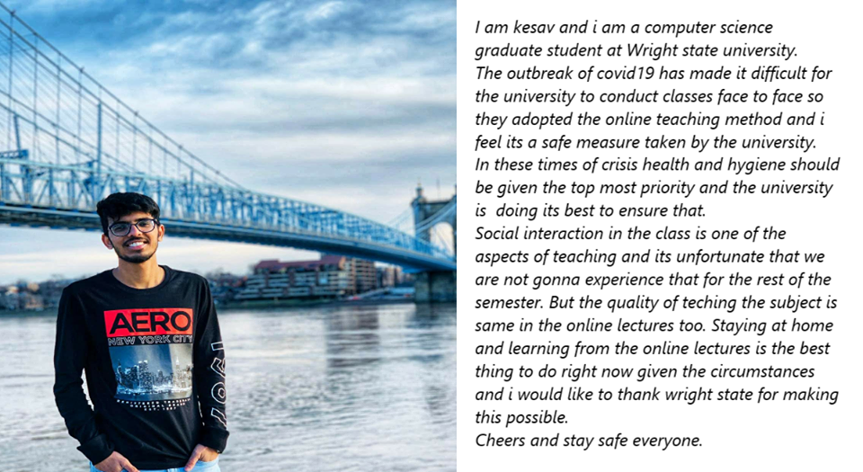
Student Testimonials

