Slide 1
Study MBBS in Armenia

Slide 2
About Armenia
Armenia was the first country to have adopted Christianity as its state religion
The capital of Armenia is Yerevan which has population of 1.7 Million
Indian embassy is present in the capital city of Yerevan
Armenia is Ranked among Top 10 safest countries in world
Armenia has very easy immigration procedure for Indians
The 1st language of Armenia is Armenian and Russian and English is also known to many Armenians

Slide 3
Why study MBBS in Armenia
Armenia offers english medium programmes for studying MBBS
Tution fees and cost of living in Armenia is very low as compared to other countries
The exchange rate for 1INR is 6.50 AMD
Students studying Medicine in Armenia are given corpses to practice from the second year itself
Indian food is easily available with different veg/Nonveg options
The cost of living for 1 individual is approximately 250$per month
The duration of programme is 6years

Slide 4
Options available for Indian students after completing MBBS in Armenia
Preparation for MCI exam in order to practice in india.
Preparation for USMLE to practice in USA
Post graduation in other european countries like Germany
Practice in Armenia

Slide 5
Annually welcoming 4000 students from different countries Yerevan “Haybusak” University is institutionally accredited by the Estonian Quality Agency for Higher and Vocational Education(Ekka)according to the guide for Institutional Accreditation.
We assimilate and adapt the best principles of European education, without forgetting the rich three thousand-year –old traditions passed on from the great minds of Armenia. We have infinite stream of knowledge waiting to be explored, let’s delve in together
About Yerevan Hayabusak university

Slide 6
Fees structure and Courses offered by Yerevan Haybusak University
MBBS-6years
Dentistry-5years
Pharmacuticals-5years
1st year -5400$
2nd year -3800$
3rd year -3800$
4th year - 3800$
5th year - 3800$
6th year - 3800$

Slide 7
Hostel and Indian mess fees -250-300$/Month
Insurance – 100-150$/ per annum Approximately

Slide 8
WHY study Yerevan Haybusak University
The University is approved by WHO and MCI
Programme is offered in English medium
The university is present at the Heart of the city Yerevan
There are 14 specialised Hospitals in Haybusak
Best University in Armenia with highest passing percentage in FMGE exam which is 40%
We also have Indian teachers who also refer Indian books for MCI coaching
Yerevan Haybusak University is recently renovated with new equipment’s
Students in Haybusak are given advantage of practicing with corpses from 2nd year itself

Slide 9
Applicant requirements
The applicant must score atleast 50% in 12th pcb and 60% in English
The applicant must prepare SOP and Motivation letter
Neet exam is not manditory
No application fees for applicant
The fees shall be paid within 2 weeks as the applicant recieves letter of acceptance from university in order to confirm their seat
The applicant with less score in English will be given other chance of interview where their speaking skills will be tested

Slide 10
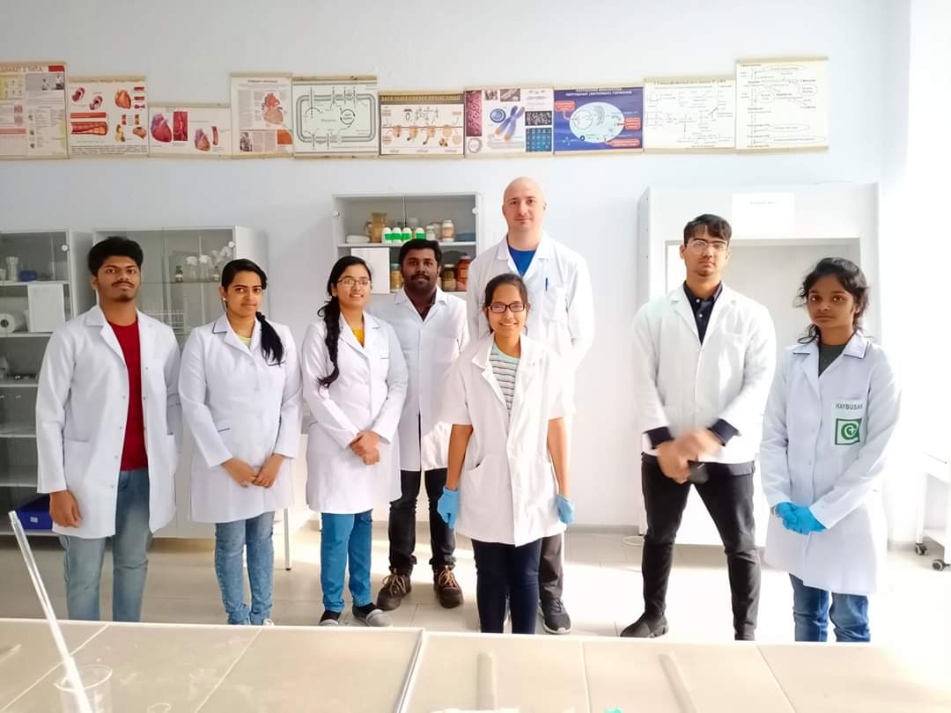

Slide 11
Thank you

