Slide 1
Cal State Monterey Bay

Slide 2
Presenter
Brian Childs
Director of International Student & Scholar Services

Slide 3
About Monterey, CA
Beautiful central coast of California

Slide 4
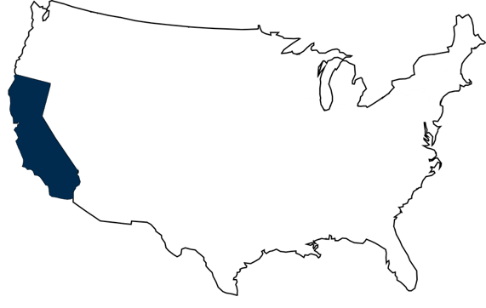
Location
Located on the Central Coast of California
Closest CSU to the ocean
Climate typically 16-22° C year-round
Minimal humidity, rain, and no snow
Natural Environmental Beauty
Surrounded by ocean, mountains, redwood forests, white sand beaches
Outdoor activities – hiking, whale watching, scuba diving, kayaking
Monterey

Slide 5
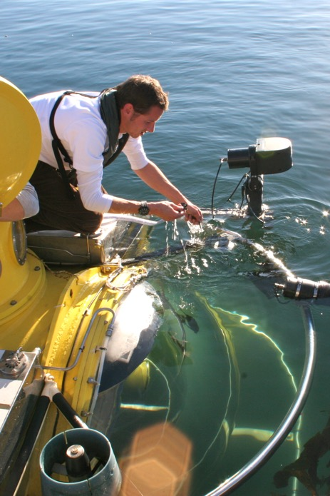
Location Influence on Academics
HANDS ON EXPERIENCE
Marine Science
Monterey Bay Aquarium
Diverse marine life – sea otters, sea lions, harbor seals, whales & dolphins
Sustainable Hospitality Management
Portal Hotel & Spa – LEED Certified
Internship Programs – Pebble Beach Golf & Resort; InterContinental Hotel
Agricultural Plant and Soil Science & Agribusiness
Salinas Valley – “Salad Bowl of the World”
Computer Science
Silicon Valley – 105km away

Slide 6
About Cal State Monterey Bay
Campus, Housing, Academic, Programs

Slide 7
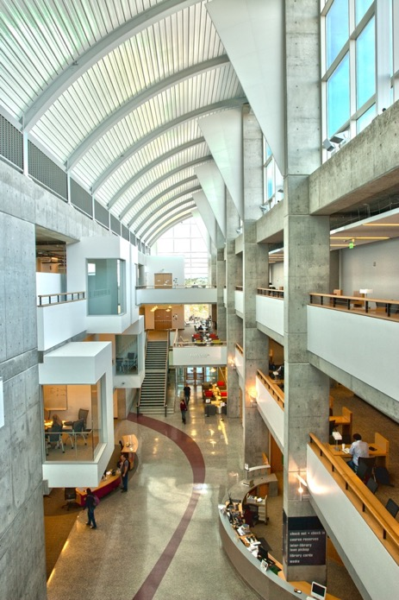
Campus
California State University (CSU) System – 23 campuses
Largest 4-year public university system in U.S.
Most diverse student body in U.S. ethnically, economically, academically
Closest CSU to the beach; 2.5 km away
“Walking campus”
On-campus dining and housing options, student center, sports center, swimming pool, recreation field, stadium, and theater
Student population: 7,500+
Avg class size: 20-30 students
International Students: ~450/semester

Slide 8
Service Learning Institute
Nationally recognized service learning and civic engagement program
Building authentic partnerships that demonstrate shared leadership, collaboration and reciprocity
Acting with compassion, demonstrating honesty and authenticity
Working towards social justice: continual movement toward an equitable society
Developing multicultural understanding and respect for differences
Cultivating awareness of self in relation to social inequities through reflection and active service with the community

Slide 9
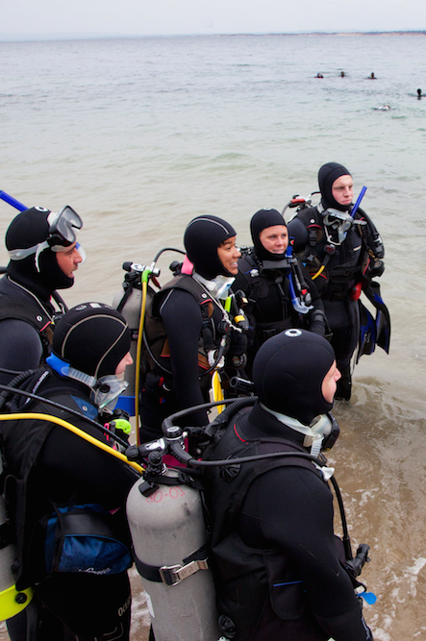
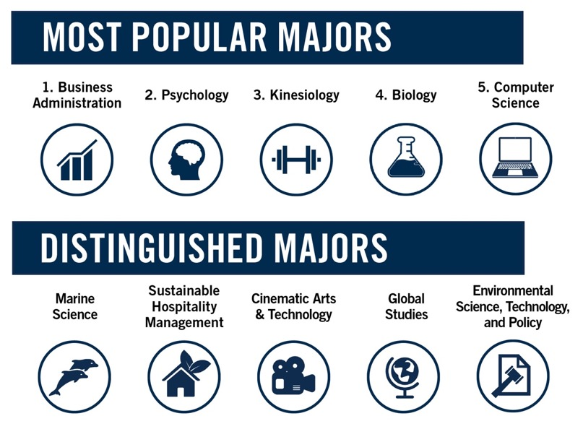
Academics
24 Undergraduate Degrees
38 Academic Minors
4 Graduate Programs
Teaching Credentials & Certificate Programs
csumb.edu/academics

Slide 10
Majors & Concentrations
Arts, Humanities &
Social Sciences
Cinematic Arts & Technology B.A.
Global Studies B.A.
Humanities & Communication B.A.
Communication Studies
Creative Writing & Social Action
Education (English)
English Studies
Ethnic & Gender Studies
Historical Studies
Journalism & Media Studies
Legal Studies
Philosophy & Applied Ethics
Japanese Language & Culture B.A.
Music B.A.
Psychology B.A.
Social & Behavioral Sciences B.A.
Anthropology
Archaeology
Geographic Information Systems
Native American Studies
Political Economy
Social History
Sociology
Spanish Language & Hispanic Cultures B.A.
Visual & Public Art B.A.

Slide 11
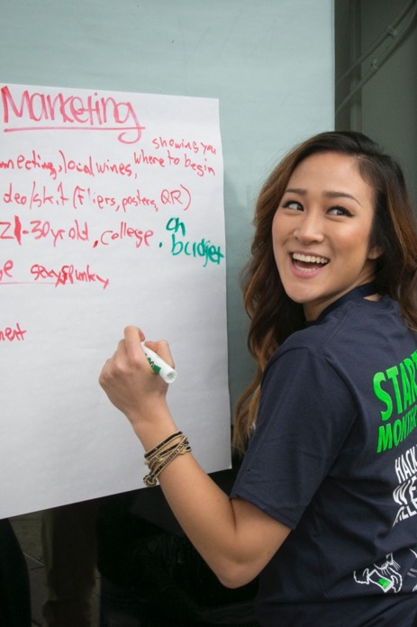
Majors & Concentrations
Business
Business Administration B.S.
Accounting
Agribusiness
Entrepreneurship
Hospitality Management
Hotel/Resort Management
Information Systems
Management & International Business
Marketing
Sustainable Hospitality Management B.S.
Sustainable Ecotourism Management
Sustainable Hotel, Resort & Event Management

Slide 12
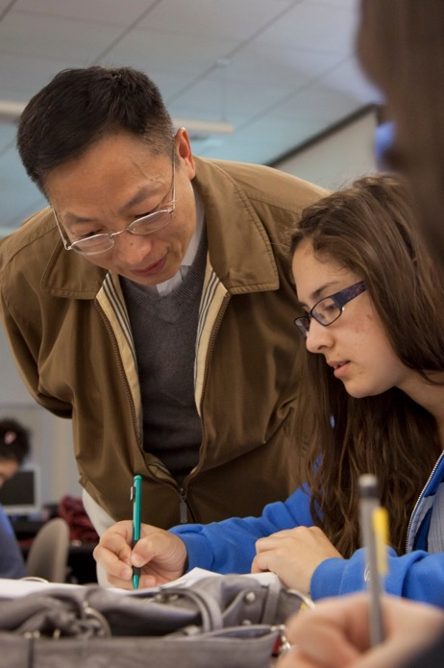
Majors & Concentrations
Education
Liberal Studies B.A.
Human Development & Family Science B.S.
Health Sciences & Human Services
Collaborative Health & Human Services B.A.
Community Health
Social Work
Public Administration & Nonprofit Management
Kinesiology B.S.
Exercise Science
Wellness
Nursing Degree Completion B.S.

Slide 13
Majors & Concentrations
Science
Agricultural Plant and Soil Sciences B.S.
Biology B.S.
Ecology, Evolution, & Organismal Biology
Education (Biology)
Molecular Biology
Communication Design B.S.
Game Design & Interactive Media
Visual Design
Web Design
Computer Science B.S.
Data Science
Game Development
Network & Security
Software Engineering
Environmental Science, Technology & Policy B.S.
Applied Ecology
Watershed Systems
Environmental Studies B.A.
Education (Environmental)
Science for Sustainable Communities
Marine Science B.S.
Mathematics B.S.
Education (Math)
Mathematics
Statistics B.S.

Slide 14
Housing

Slide 15
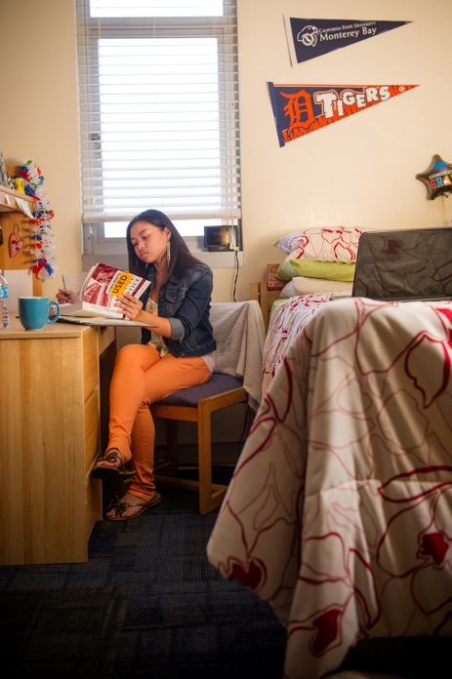
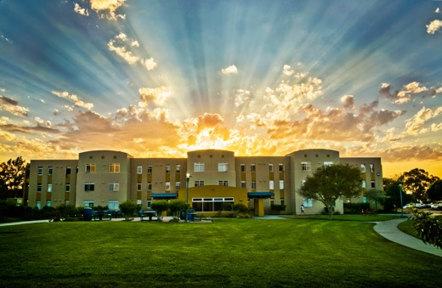
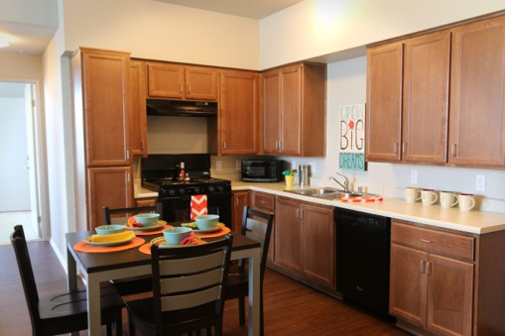
On-Campus Housing
On-campus housing is guaranteed for international students
Residential halls, suites, and apartment style housing
Homestays (ALCP program)
$3,105 - $6,686 per semester

Slide 16
Program Types

Slide 17
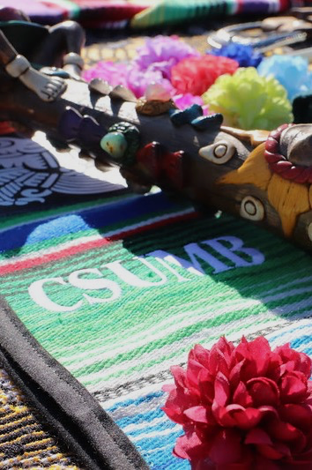
Program Overview
Degree-Seeking
Undergraduate Degree
Graduate Degree
Semester@CSUMB

Slide 18
Undergraduate Degree-Seeking
ADMISSION REQUIREMENTS
 | First Time Freshmen | Lower Division Transfer | Upper Division Transfer
College Units Completed | N/A | 0 – 59 Credits | 60+ Credits
High School GPA | 2.4+ | 2.4+ | N/A
College GPA | N/A | 2.0+ | 2.0+
Fall Application: April 1 – July 1
Spring Application: Oct 1 – Dec 1
csumb.edu/international/apply
Estimated cost per year
(Tuition, housing, meals, personal expenses)
$29,857 - $39,143*
*cost may vary

Slide 19
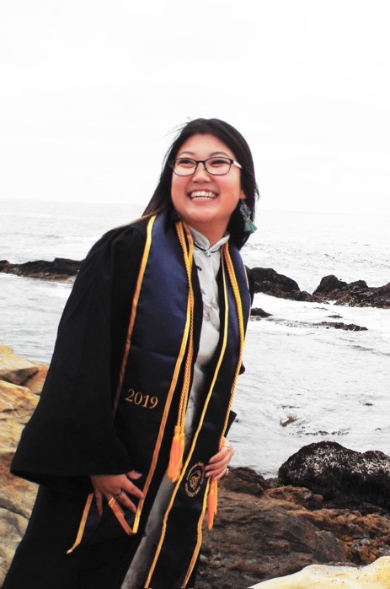
Language Requirement
UNDERGRADUATE
TOEFL: 61(iBT)
IELTS: 6.0
PTE: 45
Attending full-time where English was the primary language of instruction for at least 3 years immediately preceding admission to CSUMB
Completing highest level of CSUMB’s ALCP
Transferring with college credit that meets the CSUMB General Education Written Communication (Area A2) requirement

Slide 20
Graduate Degree-Seeking
Minimum: 2.5 GPA
Language Requirement
TOEFL: 80 (iBT)
IELTS: 6.5
PTE: 65
Attending a school full-time where English was the primary language of instruction for at least 3 years immediately preceding admission to CSUMB
Environmental Science, M.S.
Education, M.A.
Marine Science, M.S.
Master of Social Work, M.S.W.
Physician Assistant, M.S.
View each Graduate Program for specific admission requirement

Slide 21
Semester@
ADMISSION REQUIREMENTS
Good standing at current university
Copy of transcripts in English
No minimum GPA
No test scores required
Estimated cost per semester
(Tuition, housing, meals, personal expenses)
$14,850*
Optional Degree Pathway
Can apply to our Bachelor’s program and transfer 24 earn credit towards degree.
*cost may vary

Slide 22
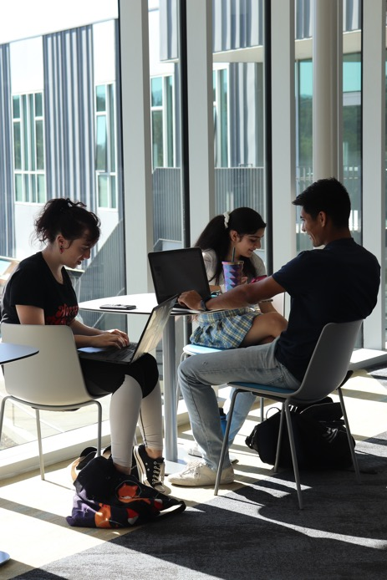
Language Requirement
SEMESTER@ & EXCHANGE
TOEFL: 61 (iBT)
IELTS: 6.0
PTE: 45
Attending a school taught in English for 3 years immediately preceding admission
Currently pursuing a degree at another U.S. college
There may be other ways to meet the requirement. Please consult your advisor/campus coordinator.

Slide 23
Questions?

