Slide 1
INDIANA INSTITUTE OF TECHNOLOGY (INDIANA TECH)

Slide 2
WHERE ARE WE LOCATED?
Second largest city in Indiana with a population near 300,000
Lowest cost of living in the region, Niche 2018
5th safest city to live in the U.S.

Slide 3
Overview of Indiana Tech
Founded in 1930
Small, private non-profit 4-year university in Fort Wayne Indiana. Over time, we have become one of strongest universities in the Midwest region
Five Colleges and Schools at Indiana Tech. More than 60 degree options at the associate, bachelor’s, master’s and Ph.D. level.
Ranked in top 100 colleges for highest Return on Investment (ROI) in the US by Payscale.com

Slide 4
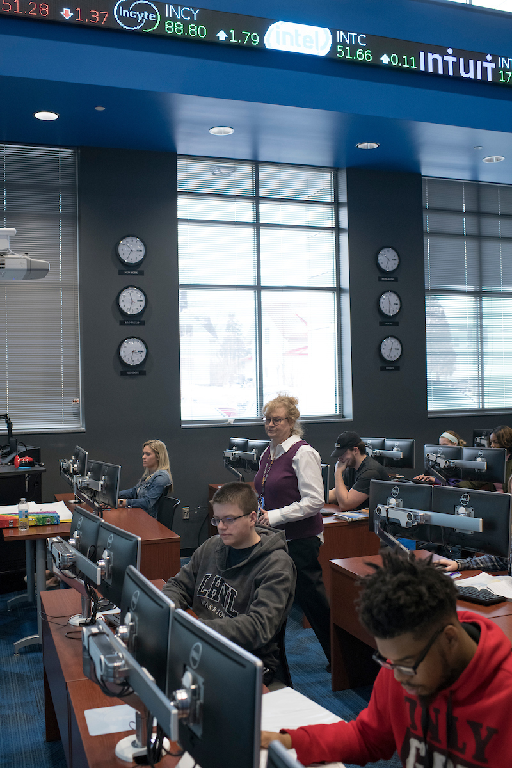
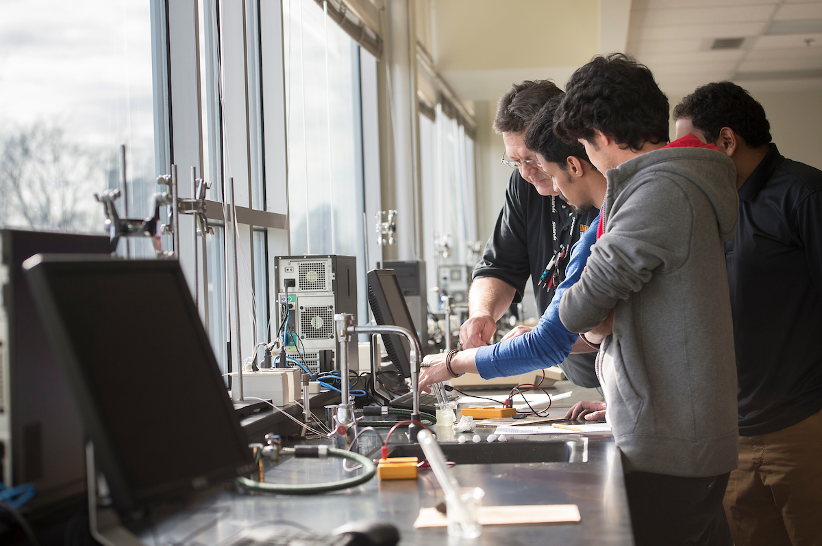
Colleges & Schools at Indiana Tech
College of Business
School of Computer Science
College of Engineering
College of Arts & Sciences
Center for Criminal Justice

Slide 5
Degree Offerings
View our degree offerings with the QR codes below!
Undergraduate Degrees:
Graduate Degrees:

Slide 6
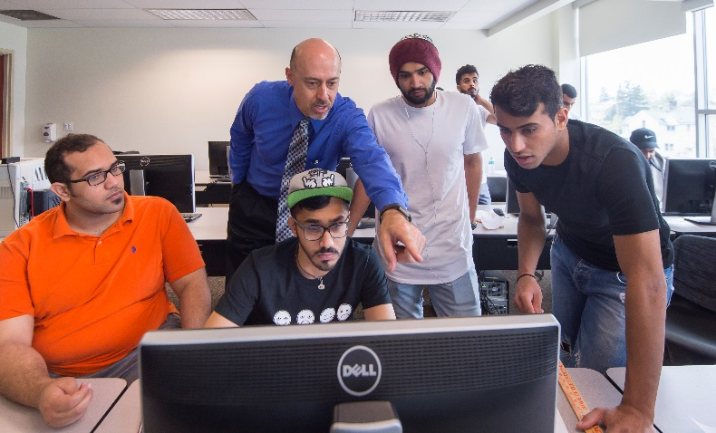
Why Indiana Tech?
Fully Accredited University
-Higher Learning Commission
-ABET
-IACBE
Small class size, relationship-based education, no TA’s or GA’s, and individual attention from professors, 18 hours office hours/week.
On-Campus career service
-Provides extensive career preparation: Mock interviews, resume competitions, professional dress day, etc.

Slide 7
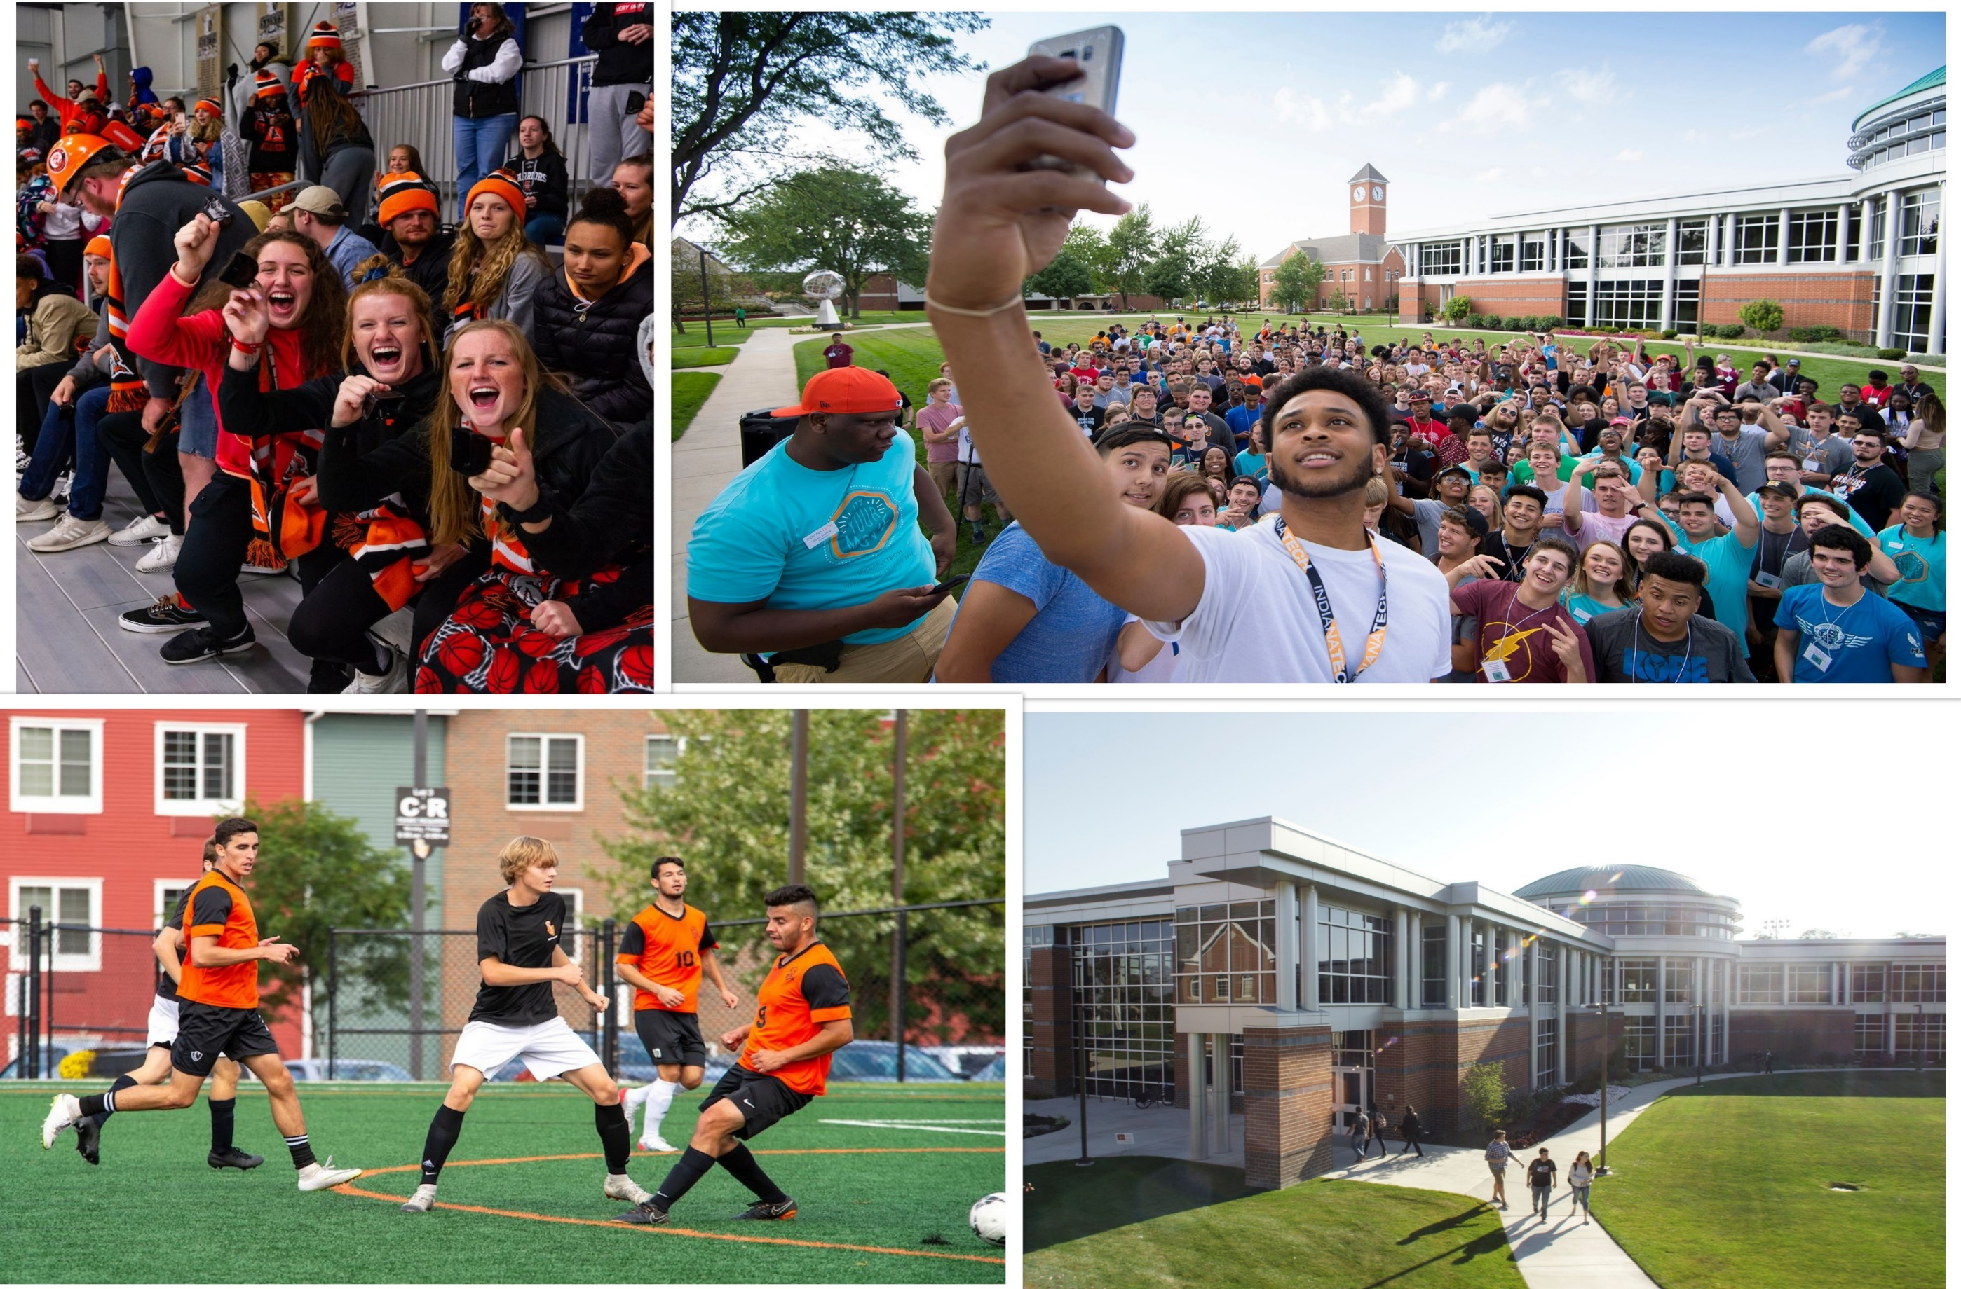
Title
Life at Indiana Tech

Slide 8
A Diverse and Supportive Campus
On-Campus population of 1,500+ students
International student population: 18%
Students from 30 countries
Average class size of 17 students

Slide 9
Title
The Application Process

Slide 10
The Steps:
Apply to Indiana Tech (Study Metro team can help you apply to Indiana Tech and will provide you the link for free online application).
Receive your Admissions Decision in as little as three days!*
Obtain your I-20
Email your counselor for the necessary documents
Obtain your F-1 visa*
Schedule an appointment at your nearest US embassy
Make your travel arrangements to Fort Wayne, Indiana
Move into your dorm/apartment!

Slide 11
Documents Required for International Students
Undergraduate Students
Application
Official High school transcripts in English
College transcript (for transfer students)
ACT/SAT scores (optional)
English Proficiency Scores; IELTS (6.0),
TOEFL (70), Duolingo English Test (95), PTE (48)

Slide 12
Documents Required for International Students
Graduate Students
Application
Official High school transcripts in English
Undergraduate Transcripts
Two Letters of Recommendation
English Proficiency Scores; IELTS (6.0),
TOEFL (70), Duolingo English Test (95), PTE (48)
*GRE or GMAT is not required!

Slide 13
Requirements for Immigration Documents
Proof of Financial Support
*Document showing proof of funds for one year (i.e. bank statement, savings account, proof of salary, etc.)
Indiana Tech Sponsor’s Affidavit
Copy of Passport

Slide 14
Title
Tuition and Fees

Slide 15
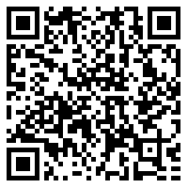
Undergraduate Tuition and Fees
View our Cost Sheet:
Tuition - $26,990
Student Services Fee: $450
International Student Processing Fee - $250
Program Fees - $640 - $1,730
*program specific
Housing $10,252
*Housing Deposit - $350

Slide 16
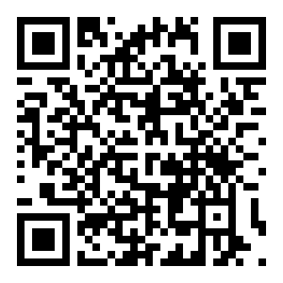
Graduate Tuition and Fees
View More Information:
Tuition and Fees
Business (MBA, MSM) - $10,815 per year
Engineering (MSE, MSEIS) - $11,697 per year
Cost of Living - $10,000

Slide 17
Title
Scholarships and Aid

Slide 18
95% of international undergraduate students receive scholarships!
Premier Scholarship: Up to $15,000/year based on GPA and test scores
Presidential Scholarship and Vietnamese Scholarship for Excellence: Full Tuition
Athletic & Esports Scholarships*
**Merit Scholarships don’t apply to government sponsored students
*Athletic scholarships determined by the coach

Slide 19
Title
Life in Fort Wayne

Slide 20
Big City Feel, Small Town Prices
In Fort Wayne, you can find all the opportunities of a large city, but with a much lower cost of living.
We have two major shopping centers, professional sports teams, an expanding downtown, and much more!
We are also driving distance from major cities like Chicago, Detroit, and Indianapolis.

Slide 21
Ready to Become a Warrior?
Reach out to our office through the Study Metro team to fill out an application for FREE on our website today!
Admissions decisions can be received in as little as 2-3 business days!*
*Admissions decisions will be processed upon receiving all necessary documents

Slide 22
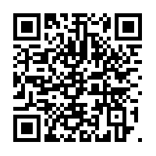
Join Us For A Visit!
Schedule a virtual visit to our Fort Wayne campus!
Set up a virtual appointment with your Admissions Counselor
Scan the QR code or search “Visit IT” on our website!

Slide 23
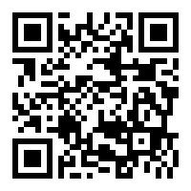
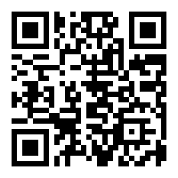
Follow Us on Social Media
Or Search:
Indiana Tech International Admissions
@international_intech

Slide 24
Testimonials
Check out some of our international students’ testimonial videos!
Adam: https://youtu.be/DR0wjhYLFjc
Ibrahim: https://youtu.be/9EerwUURkvQ
Vi: https://youtu.be/-IHOfkz_xNw
Barbara: https://youtu.be/3PvRmrg0QnU

