Slide 1
Notes:
Welcome to Vancouver Film School. We are creative arts school teaching all programs related to entertainment art industry.
Talk about Location, standard of living in BC, Climate. VFS was founded in 1987 offering only 1 program -Film Production. Today it offers 14 programs as the industries is growing up rapidly

Slide 2
Notes:
Talk about the 1 year model at VFS v/s the university model with practical learning.

Slide 3
Notes:
Talk About program

Slide 4
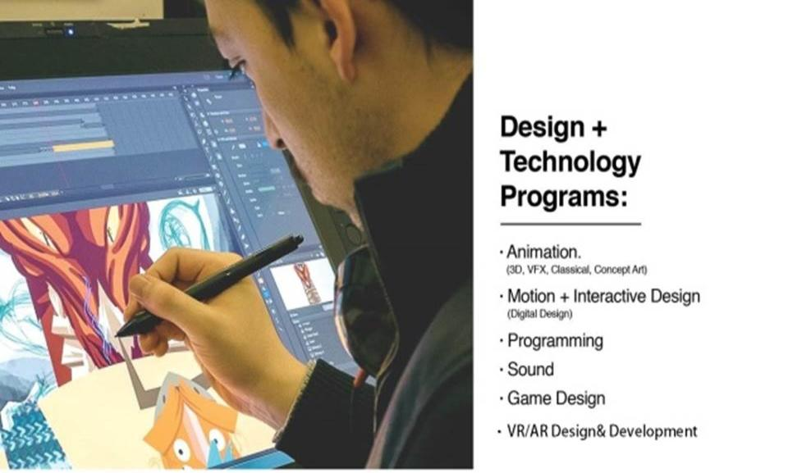
Notes:
Talk about the program in details

Slide 5
Notes:
Talk about the program in details

Slide 6
Notes:
There’s two pages of this. Please remove 1 of the pages.

Slide 7
Notes:
Here you can see the ranking. Because of our High quality education , VFS is one of the top rated institutes in the creative arts field in the world.

Slide 8
Notes:
Few of the blockbuster released last year in which VSF students worked.

Slide 9
Notes:
To get into VFS all you need is your portfolio, academic documents, IELTS

Slide 10
Notes:
Vancouver Film School - Facilities Tour
https://www.youtube.com/watch?v=S9CS2CBArDE&feature=youtu.be

