Slide 1
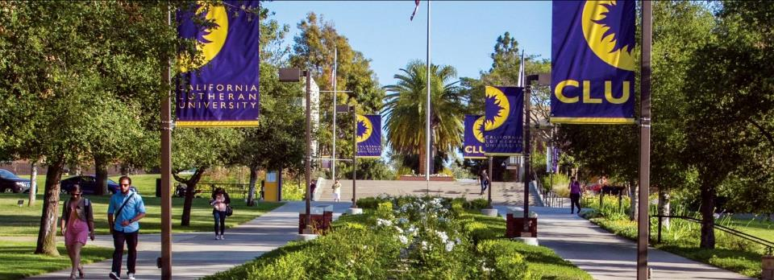
Welcome to
California Lutheran University
Southern California, USA

Slide 2
The Cal Lutheran Advantage Location

Slide 3
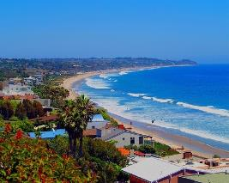
Living & Learning in Southern California Dynamic and Globalized
California: 5th largest economy in the world*
The Los Angeles and Ventura County region:
Internships (CPT) & Research
Career Opportunities (OPT)
Culture & Recreation
Diverse & Welcoming
Education, experiences, and connections made in California are key to global professional success
Ideal climate: never too hot, never too cold
Average high temperature is 23 C (74 F)
300 days of sunshine
*The Guardian 5/4/18

Slide 4
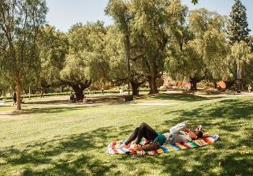
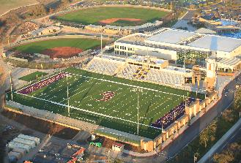
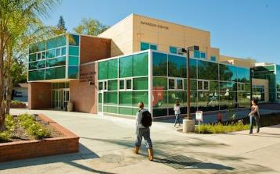
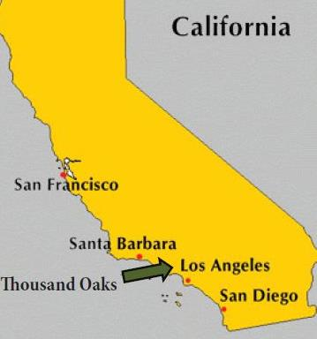
Southern California Thousand Oaks Is An Ideal Location
Thousand Oaks & Conejo Valley area (population 300,000+) is one of the safest in the U.S., according to the FBI
Easy access to:
Los Angeles – 60 minutes
Hollywood – 45 minutes
Malibu Beach – 30 minutes
Beautiful 90+ hectare (225 acre) campus
Notes:
*according to the U.S. Federal Bureau of Investigation

Slide 5
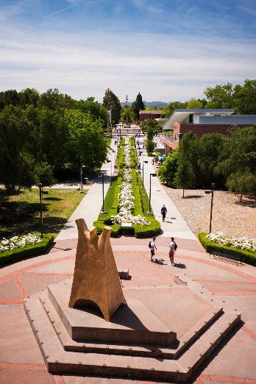
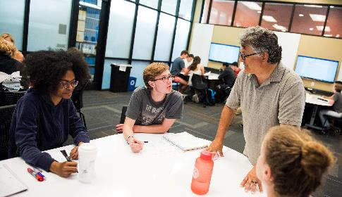
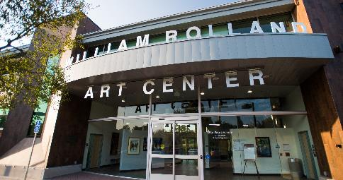
The Cal Lutheran Advantage Campus & Resources

Slide 6
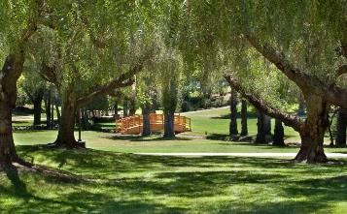
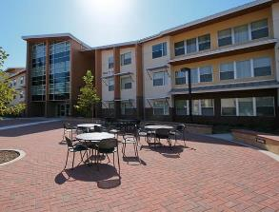
Exceptional Community Thriving Campus Life
Inclusive and diverse campus culture
HSI: Hispanic Serving Institution
International Student Services
Students from 55+ countries
90+ clubs and organizations
Opportunities for service and leadership
On and Off-campus housing
Vibrant art, music, and theatre
Athletics: Intramural, Club, and NCAA DIII

Slide 7
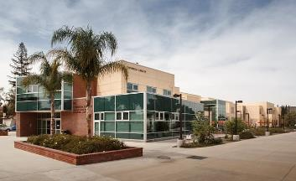
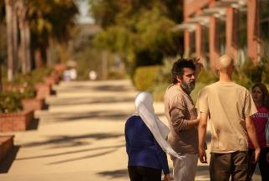
Exceptional Community Thriving Academic Life
A 15:1 student-faculty ratio - collaboration, discussion, and debate
Average class size of 17 – individualized student support and mentoring
Highly challenging yet strongly supportive
85% of full-time faculty have the highest possible degree in their field (e.g., Ph.D., etc.)
Academic resources available to all students (included in tuition):
Writing Center Academic Advising Career Center
Peer Mentors Faculty Advisors Tutoring

Slide 8
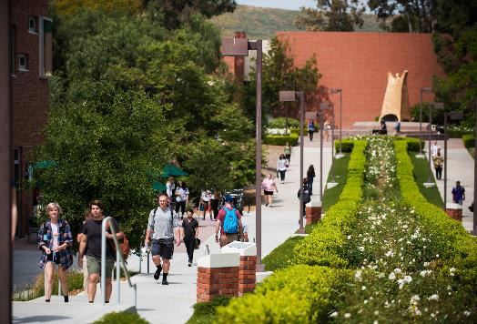
The Cal Lutheran Advantage Bachelor’s Degree Programs 3,000 Undergraduate Students Bachelor of Arts (BA) Bachelors of Science (BS)

Slide 9
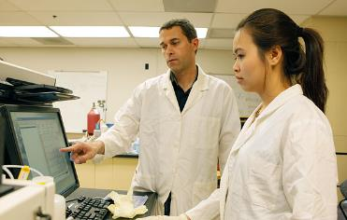
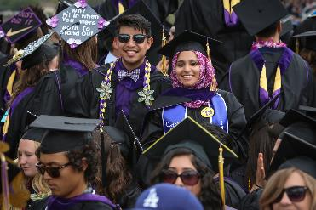
Undergraduate Programs Educating leaders for a global society
40 Majors / 41 Minors:
Business, Creative Arts, Education, Humanities, Science, Social Science, and Technology
New Majors in Hospitality & Tourism Management and Film
Largest Majors
Business Administration
Biochemistry and Molecular Biology
Communication
Exercise Science
Psychology
Focus on results through experiential learning
Internships - Research – Study Abroad

Slide 10
Undergraduate Programs Scholarships and Aid
Academic Scholarships: $8,000-$29,000 – Academic merit
Global Scholars Program: Students who embody the university’s mission to educate leaders for a global society
Freshmen – up to $35,000 each year (apply by Jan 1)
Transfers – up to $30,000 each year (apply by June 1)
Visual and Performing Arts Scholarships: $500-Full Tuition
Based on an audition or portfolio review (apply by Jan 1); major not required
International Grants : $1,000-$10,000 – Family demonstrated need
2019-2020 Costs:
Tuition & Fees: $46,183
Room & Board: $14,100 **97% of students receive aid/scholarships
Total : $60,283**

Slide 11
Undergraduate Programs Admission
Two entry points per year: August (fall) and January (spring)
Direct application through the Common Application
Application Essay
Official Transcripts
2 Letters of Recommendation
SAT or ACT – Optional for international students
Duolingo English Test (105), TOEFL (79), IELTS (6.5), PTE (58), or ELS 112
Conditional Admission through ELS

Slide 12
The Cal Lutheran Advantage Master’s Degree Programs 1,400 Graduate Students Masters & Doctoral Programs in Business, IT Economics, Education & Psychology

Slide 13
Master’s Degree Programs School of Management
Master of Business Administration (MBA)
Executive MBA (EMBA)
Master of Science in Management (MSM)
Master of Science in Information Technology (MSIT) – STEM
Master of Science in Quantitative Economics (MSQE) – STEM
Master of Public Policy and Administration (MPPA)
Advantage – Flexibility
A degree in 12, 15, 18 or 24 months by taking more or fewer courses per term
Four 11-week terms per year / Four start dates (August, November, February, May)
CPT and OPT available and encouraged
Work experience not required for international students
GMAT or GRE usually waived
Foundation courses for students with non-related degrees for MBA & MSIT

Slide 14
Graduate School of Psychology
Additional Degree Programs
Graduate School of Education
Master of Science in Counseling & College Student Personnel
Doctorate in Higher Education Leadership (Ed.D.)
Master of Science in Counseling Psychology (MFT)
Master of Science in Clinical Psychology
Doctorate in Clinical Psychology (Psy.D.)

Slide 15
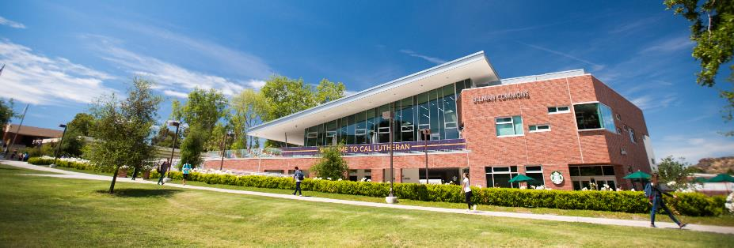
The Cal Lutheran Advantage Results

Slide 16
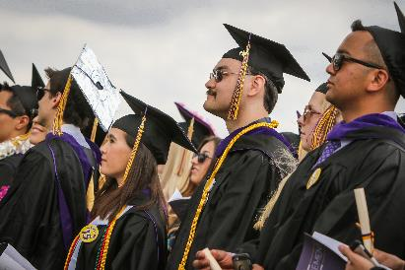
Cal Lutheran Reputation Results
Leaders who are confident
in their identity and vocation
Career Center Resources
Personal career counseling
Annual career and internship Expo with over 100 companies
Soft skill development through workshops (at no additional cost):
Resume Writing Proactive Job Search
Interviewing Salary Negotiation
The School of Management offers workshops & networking events with local and national business leaders, entrepreneurs, future employers
Alumni – graduates become a part of an increasingly connected and global network of 27,000+ alumni
97% of students are employed or in a graduate program within 6 months

Slide 17
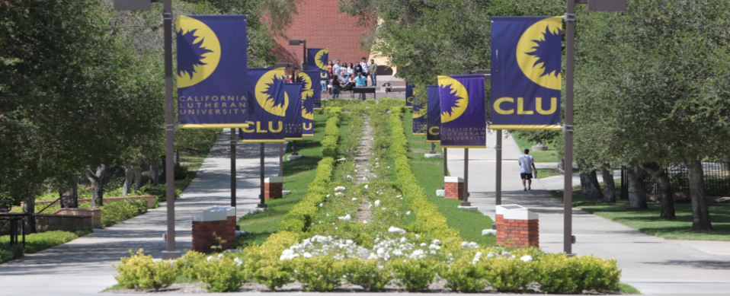
Bachelors & Masters Degree Programs
At a Highly-Ranked University in Southern California

