Slide 1
Study in California, USA: An Affordable Pathway to a quality U.S. Higher Education
Mr. Tim Honadel, Director
International services & Programs (ISP)
College of the Canyons (COC), California, U.S.A.

Slide 2
Presenters college of the Canyons (COC)
Mr. Tim Honadel, Director, International Services & Programs

Slide 3
Where Are We Located?
Santa Clarita, CA is located in beautiful Southern California. It is in a suburb in Los Angeles surrounded by beautiful hiking trails and nature. It is a close drive to iconic landmarks like Hollywood and Santa Monica and is a safe city in the USA.

Slide 4
#OpenDoorsReport

Slide 5
Why California: In California, we have
Terrific Weather
A Culture that embraces diversity
One of the States with the best higher education systems:
California Community College System (114)
California State University (23)
University Of California (10)
Private Schools (76)

Slide 6
Why Community Colleges?
It’s the Future of U.S. Higher Education
due to
low costs and low barriers to entry
1+1+2

Slide 7
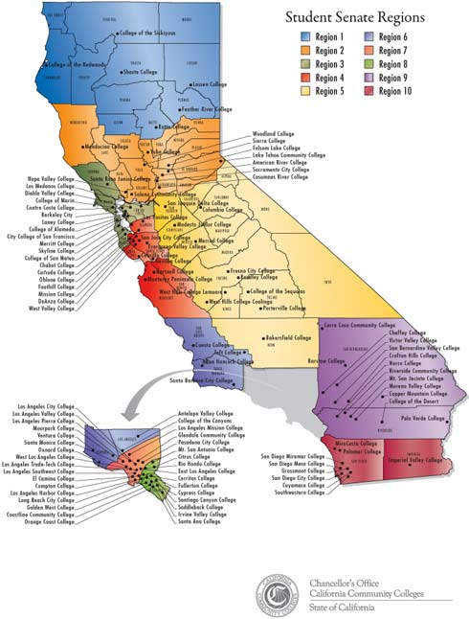
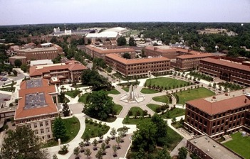
Community Colleges
Transfer Programs
Guaranteed to CSU’s with 2.0
Transfer: TAG or TAP
New MOU between CCC and UC’s with a strong transfer agreement, starting F19
Transfer
Private or Outside CA Universities

Slide 8
41 percent of all College graduates in the U.S. studied at a Community College National Student Clearinghouse Research Center

Slide 9
8 Reasons: U.S. Community Colleges Are The Best Kept Secret in U.S. Education!
Remove difficult university admission process & exams such as SAT and AP
Start at an IEP or ESL program to bypass English Proficiency TESTs such as TOEFL & IELTS
Save students/parents $10 to $90 thousand in tuition fees
Enhance student success and help maintain higher grades/marks
Smaller classes: focus on teaching & personal attention
Transfer to (top) U.S. universities
Excellent student advising & support services
Option to work after an associate degree to build up resume (Optional Practical Training - OPT)

Slide 10
Community colleges have Plenty of Room for International Students
More than 1 million international students in the U.S.
Only 9.5% are in community colleges
Long-term success plan for you
From CC to named brand universities: the same diploma
Ideal candidates to attend college of the canyons
Students with ability but not much money
Parents with money but students without demonstrated academic aptitude yet
Students with ability and parents with money, but with no acceptance from the dream school

Slide 11
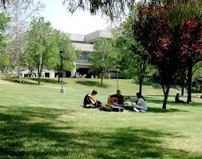
One Semester
@ college of the canyons (COC)
Tuition and Fees
$5,000
Living expenses
Housing, food, transportation, insurance:
$7,000

Slide 12
4 years at California state University (CSU)
Tuition
$72,000
€65,000
€20,000 SAVED
same degree
2+2 program CSU
Tuition:
$52,000
€47,000

Slide 14
Questions You May Have:
How to apply?
Student support?
Campus life?
Student Success?
Contact
StudyMetro!

