Slide 2
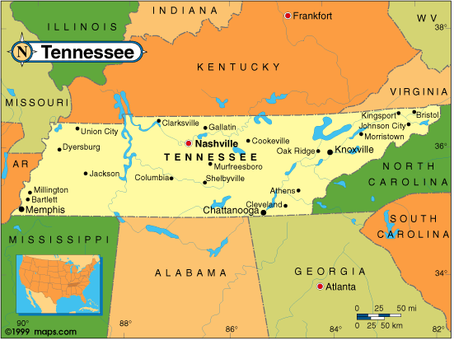
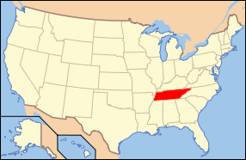
FACTS ABOUT TENNESSEE
17th largest State
8 interstate highways
Key Industries: automotive, logistics, chemicals and plastics, advanced manufacturing, energy technology and health care
Tennessee hosts the largest cherry blossom festival in the U.S. South
Japan is Tennessee’s #1 foreign investor, comprising 60% of the state’s foreign investment (about 15 billion dollars)
Tennessee exports $2.5 billion in goods and services to Japan
3 U.S. Ambassadors to Japan were born in Tennessee

Slide 3
ACCREDITATIONS
The Commission on Colleges of the Southern Association of Colleges and Schools
National Council for Accreditation of Teacher Education
National Association of Schools of Music
The American Chemical Society
The Association for Technology, Management and Applied Engineering
Accreditation Board for Engineering and Technology
American Association of Family and Consumer Sciences
AACSB-International - The Association to Advance Collegiate Schools of Business
Accreditation Council for Education in Nutrition and Dietetics (ACEND)
Commission on Collegiate Nursing Education
National League for Nursing Accreditation Commission
National Association of Schools of Art and Design, Associate Member
TTU STUDENT POPULATION
10,140 Students Total
8,957 Undergraduate
1,183 Graduate Students
300+ International Students
UNIVERSITY RETENTION
91% of students return for Spring semester
74% of students return for Second year (National average is 58.2%)
85% of Basic Engineering return for the Second year. Basic Engineering is the most popular major among international students

Slide 4
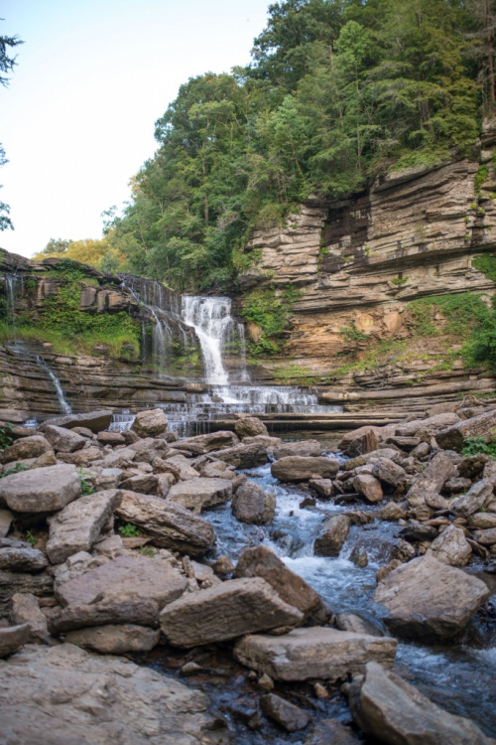
TOP NATIONALITIES
United Arab Emirates | 33
India | 27
China | 26
Saudi Arabia | 21
Nigeria & Bangladesh | 20
Japan | 17
Brazil & South Korea | 9
Egypt, Ghana, | 8
Kenya, Germany, Nepal & Spain | 7
COOKEVILLE AND THE COMMUNITY
31,000 Residents
An hour an 20 minutes from Japanese Consulate
Winters (-2°C) – Summer (31°C)
Neighbors
Nashville (110 km)
Knoxville (137 km)
Chattanooga (145 km)
Atlanta, GA (212 km)
Asheville, NC (217 km)
Kazakhstan | 5

Slide 5
ACCELERATED PROGRAMS
Chemical Engineering
Chemistry
Civil Engineering
Computer Science
Counseling and Psychology
Curriculum and Instruction
Electrical and Computer Engineering
English
Mathematics
Business/MBA
Mechanical Engineering
Popular Majors for International Students: Mechanical Engineering, Electrical Engineering, Business, Chemical Engineering, Chemistry, Biology, Exercise Science, Computer Engineering, Computer Science, and Engineering Technology

Slide 6
SCHOLARSHIPS FOR DEGREE SEEKING STUDENTS ONLY
International Undergraduate Scholarships are available:
Merit scholarship covers 55% of out-of-state tuition, which is approximately $4,300 per semester
The Multinational scholarship is $1,000 per semester to promote diversity
Legacy scholarship is $500 per semester for students who have had family members attend TTU.
Honors College’s Academic Scholarship:
Merit scholarship offering $8,000 per semester. Requires 3.5 GPA and minimum 1200 on SAT Reading and Math composite.
*All scholarships are renewable for up to 4 years.
Tuition per semester at TTU is: $13,101 for Fall 2020-Spring 2021

Slide 7
CO-OPS AND CAREERS
Nissan
Bridgestone: the largest manufacturer of tires in the world
Bloom Energy Corp
Flowserve: a world leader in supplying pumps, valves, seals, automation, and services to the power, oil, gas, chemical, and other industries
Pelican Co
Alcoa: the world’s largest producer of aluminum
Guang'anmen Hospital of Traditional Chinese Med
IBM
Cummins: designer, manufacturer, and distributor of power generation equipment, power systems, gasoline engines, custom power supplies and filtration
Castle Medical
ITG Schneider: building automation, security, access control, digital video, and IT networks
Roper
Imerys: the world leader in mineral-based specialty solutions for industry, headquartered in France

