Slide 1
_{Iliminku Jarinku}

Slide 2
Hausa is one of Africa's most widely spoken language
72M Speakers
wikipedia

Slide 3
Do you know ?
Disconnected
Digital World
Language Barrier
NEW PATH

Slide 4
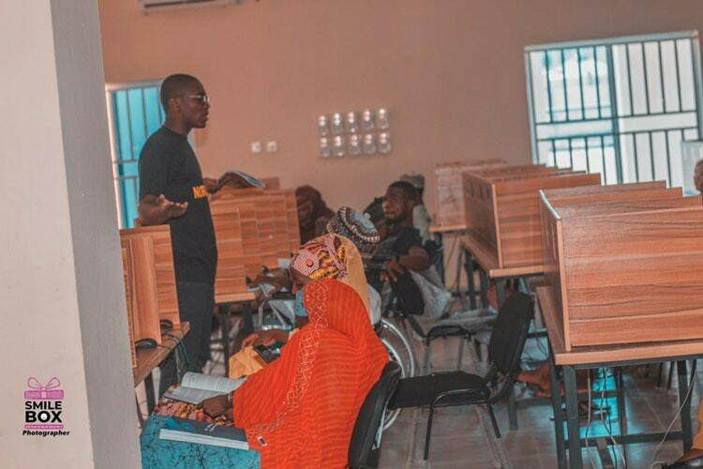
INTRODUCING NORTHINO

Slide 5
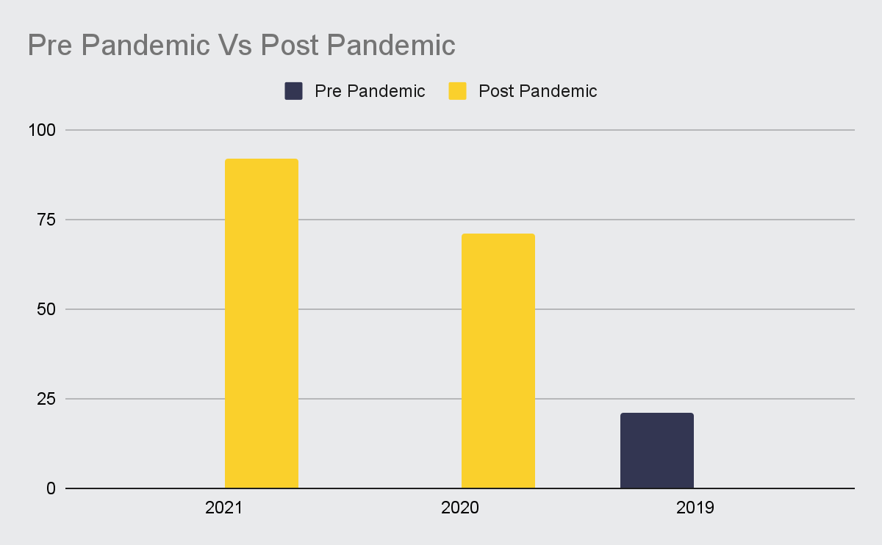
HOW ONLINE LEARNING EXPLODED IN THE PAST FEW YEARS
2016 - 2019
21M students Registered for coursera
35%
2020 - 2021
92M Registered Students

Slide 6
Case Scenario: Learner
Hurray!
How do i get Started ?
VISIT OUR PLATFORM
Get certified to become employable
ENROLL FOR A COURSE

Slide 7
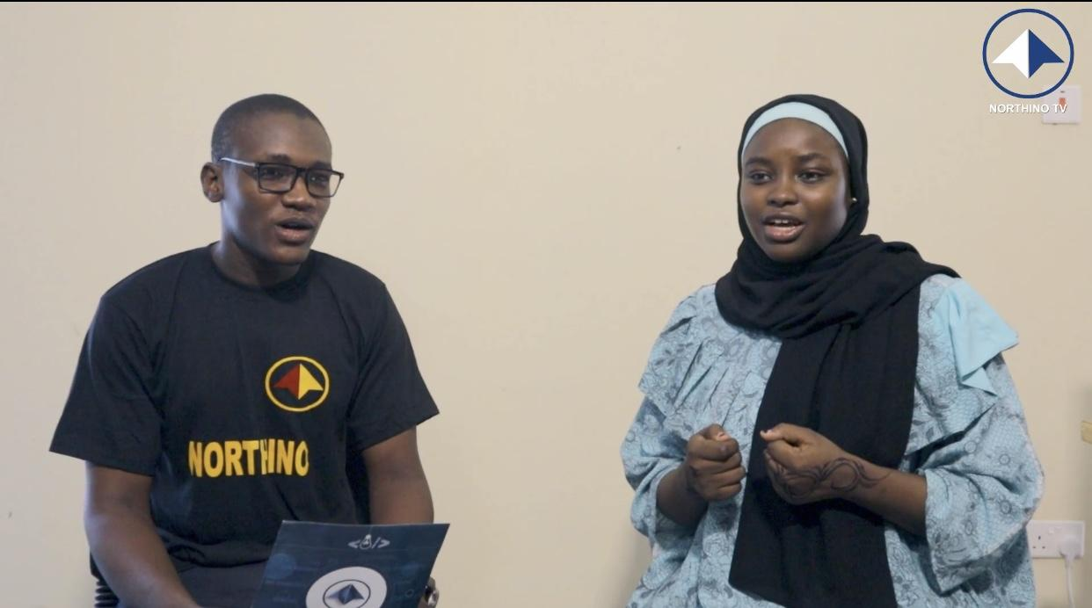
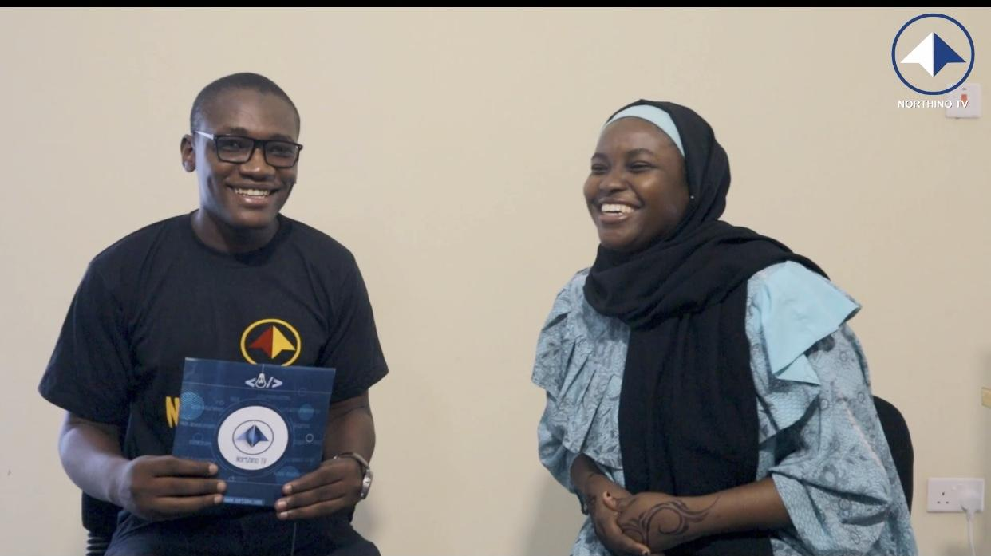
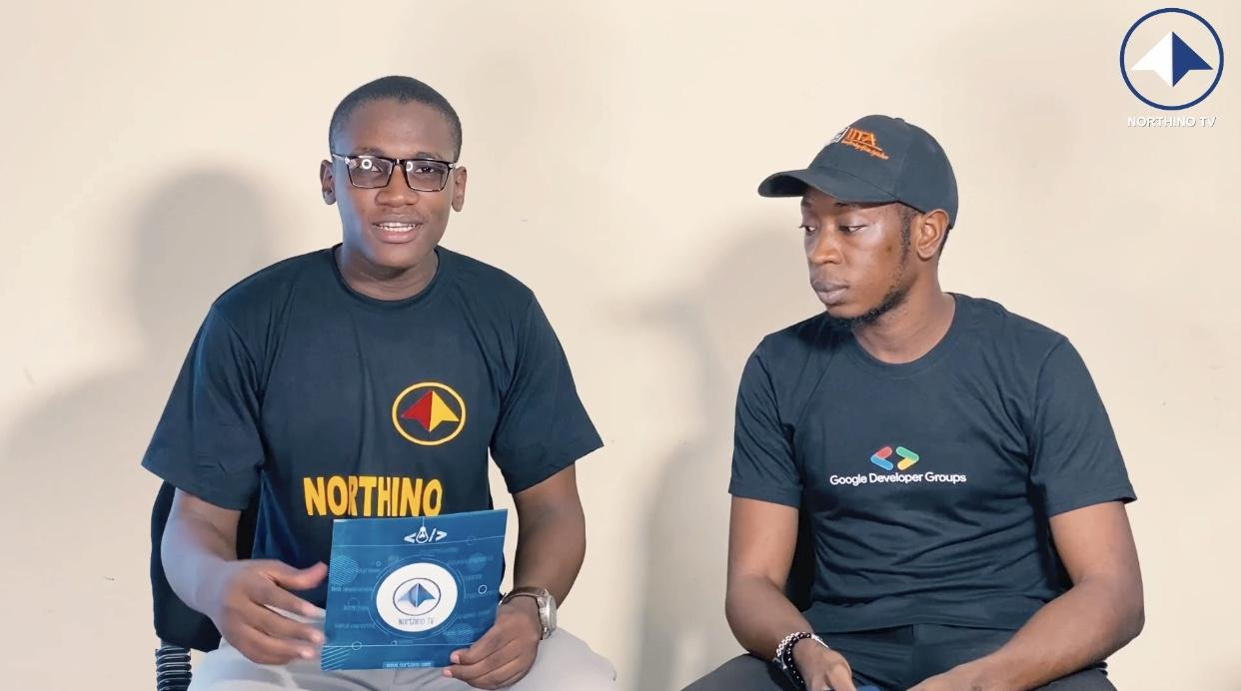
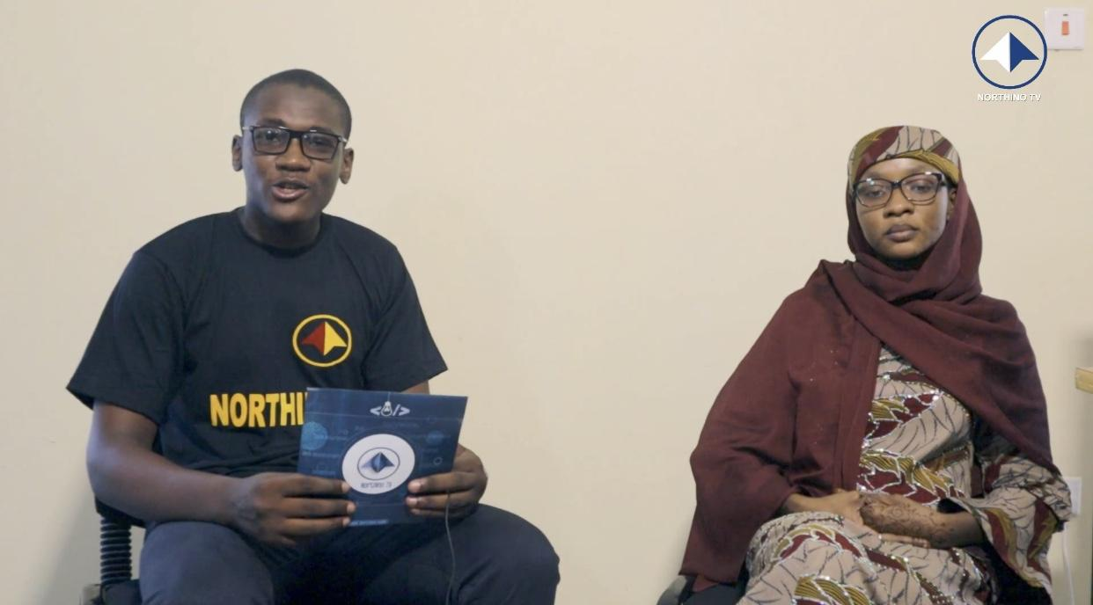
PILOT TESTING
1.3K VIEWS
17+ watch hours
400+ SUBSCRIBERS
30+ COMMENTS + REVIEWS

Slide 8
Business Model
3,000 Course Enrollments
N15m Revenue
N5m
Online Courses
Recording Course
Online Courses
Uploading of Course on our platform
Recording Course
Uploading of Course on Youtube Channel

Slide 9
ESTABLISHED
SELLING ONLINE COURSE
CO-WORKING SPACE
NATIVE LANGUAGE

Slide 10
Market Size
TAM : $2.7Bn
Price * Hausa youths In Africa
SAM : $2.25Bn
Price * Hausa youths in Nigeria
SOM : $340M
Price * Illiterates and unemployed youths
Northern Nigeria

Slide 11
Team Northino
MUHAMMAD SANI IBRAHIM
CTIO/CO-FOUNDER
ABUBAKAR ALMUHANDIS
CEO/FOUNDER
IBRAHIM KHALIL BALA
COO/CO-FOUNDER
Maryam Abdulhafiz
Chief Business Officer
A Team of like-minded Individuals sharing a vision for success

Slide 12
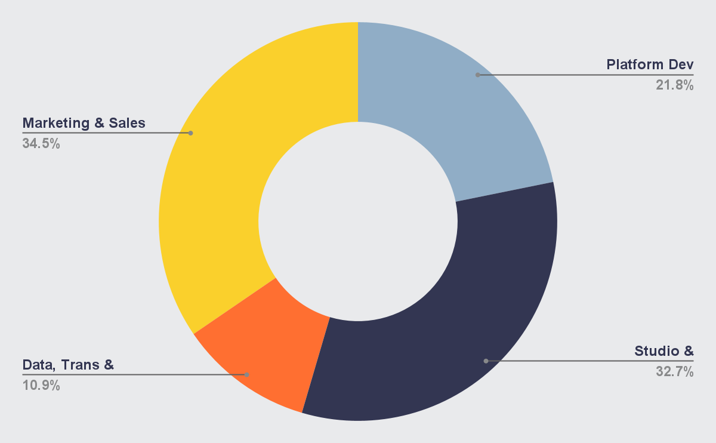
The Ask
We are raising seed round of N10m for 5%
PLATFORM DEVELOPMENT
STUDIO SETUP
MARKETING & SALES
OPEX

Slide 13
GET IN TOUCH
THANKS FOR LISTENING!
EMAIL ADDRESS
northino.info@gmail.com
Phone Number
08063122206
Location
Sheka Babban Layi, Along Zoo Road.
Kano State, Nigeria

Slide 14
APPENDIX

Slide 15
REFERENCES
https://en.m.wikipedia.org/wiki/Hausa_language
https://www.weforum.org/agenda/2022/01/online-learning-courses-reskill-skills-gap/
https://www.macrotrends.net/countries/NGA/nigeria/literacy-rate
https://en.m.wikipedia.org/wiki/Youth_in_Africa
https://www.google.com/amp/s/businessday.ng/amp/news/article/nigerias-young-population-offers-boundless-opportunities-experts/
https://www.statista.com/statistics/382366/unemployment-rate-in-nigeria/
https://en.m.wikipedia.org/wiki/Hausa_language

Slide 16
Case Scenario: TUTOR
How do i Start earning?
Hurray!
Create a Course
Promote your course
Upload Course on Northino platform
Start Earning

