Slide 1



Vatel Institute of Hospitality Management at Alliant International University
San Diego

Slide 2
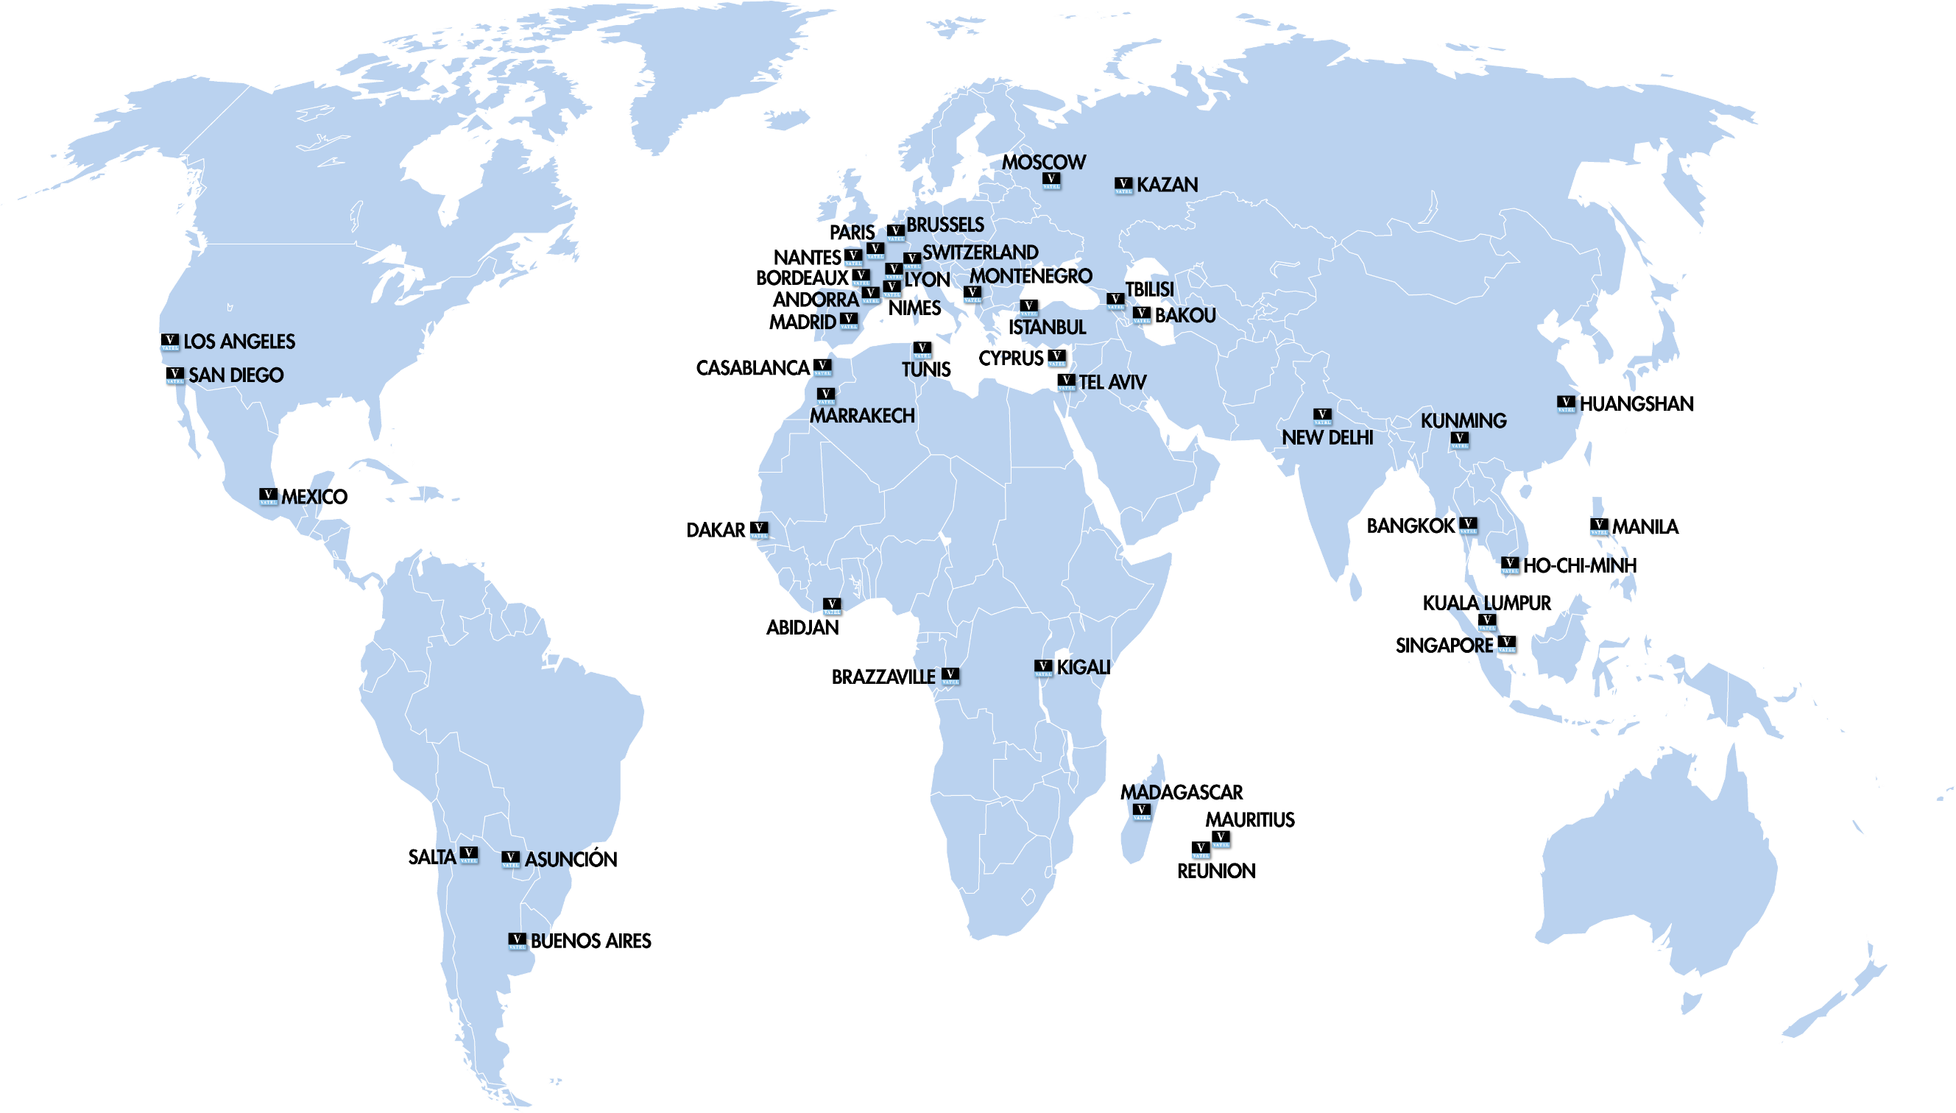

Vatel Around the World
Founded in 1981
50 Schools over 5 continents – 9,000 Students – over 35,000 Alumni

Slide 3

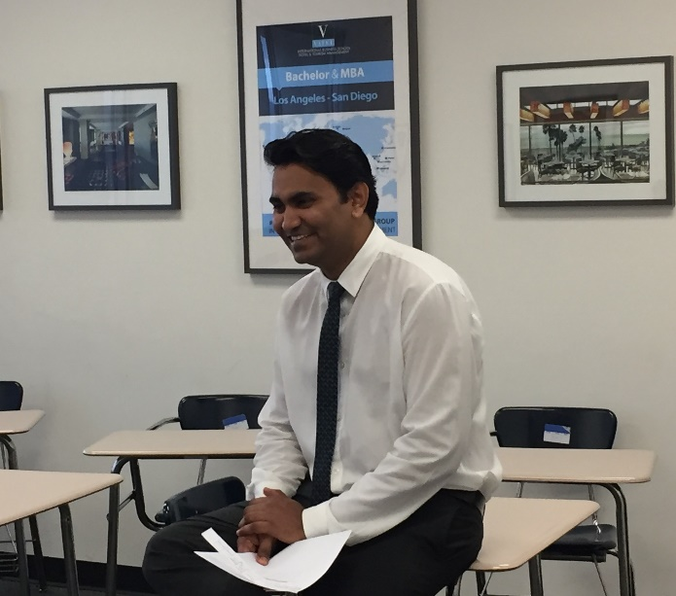
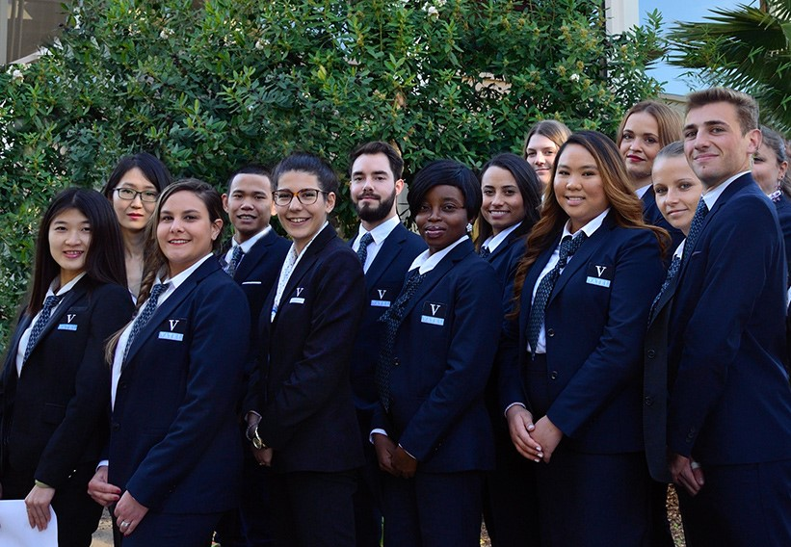
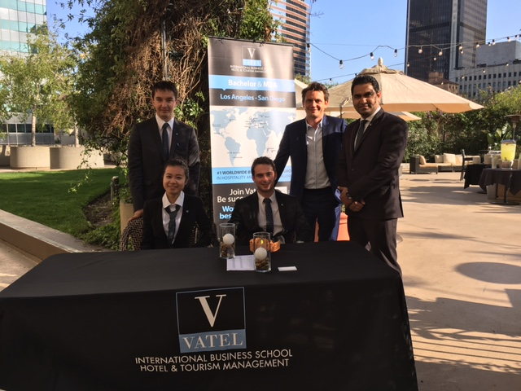
Top Reasons Students Choose Vatel USA
Graduates complete their programs with degrees and paid practical experience in the industry. Vatel USA partners with 4 and 5 star hotels across the USA which gives students professional training opportunities that fit their career goals
Small class sizes support students academically and prepare students professionally. The Vatel USA international student body represents over 20 countries

Slide 4

Hospitality Careers
Graduates Work in Hospitality Positions Including:
Guest Relations Front Office Sales & Marketing Communication and Social Media Training and Recruitment | Food & Beverages Meetings and Events Public Relations Human Resources Rooms Division

Slide 5
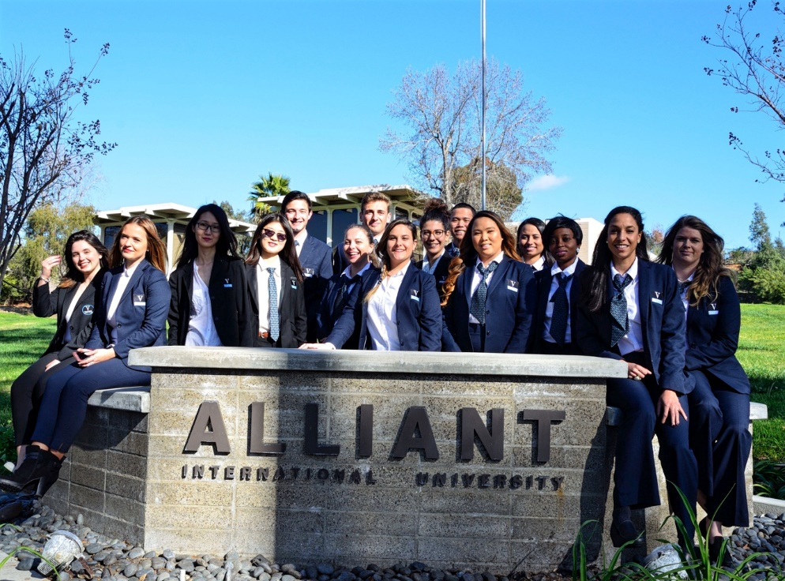
Vatel Partnership with Alliant
2017
Shared Values
Professional Practice
Industry Connection
Brand
Campus
Professors

Slide 6

Vatel Institute of Hospitality Management at Alliant International University
Embedded within California School of Management and Leadership
  MBA with a Concentration in Hospitality Management
  BS in Hospitality Management
August and January Start Dates
5

Slide 7
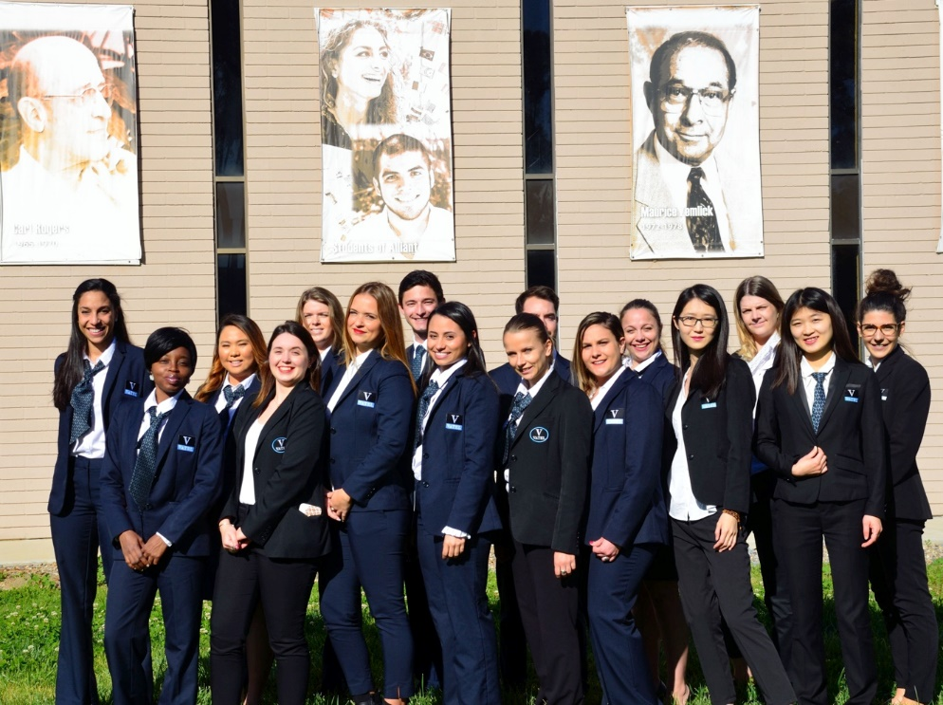
MBA with a Concentration in Hospitality Management
5
Cohort Structure
Intensive Schedule
Uniforms
Practical Experience
Degrees from Alliant and Vatel Group

Slide 8
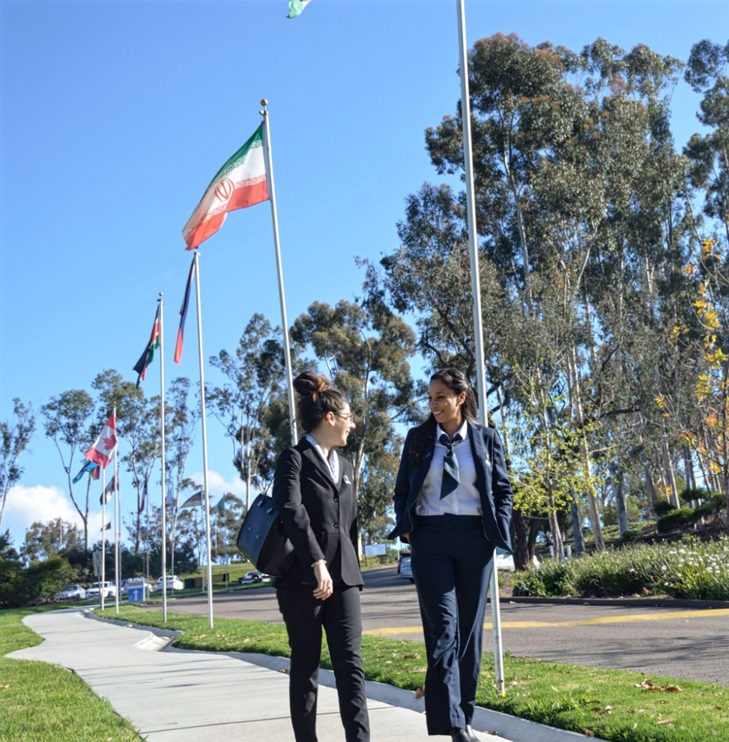
Bachelor of Science in Hospitality Management
5
Internship Courses
Hospitality Courses
Fast Track Courses
Placement Assistance

Slide 9










Vatel Partner Hotels
Part Time Paid Internships
Full Time Paid Internships
Career Development Course
Placement Assistance

Slide 10
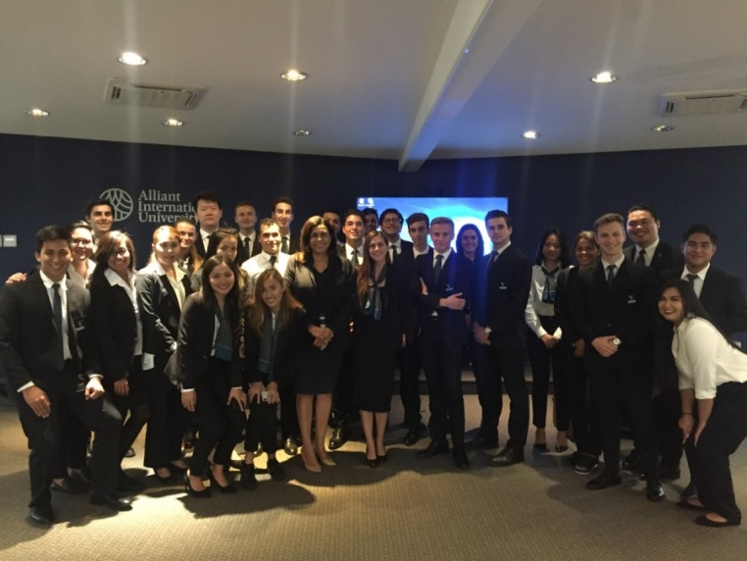
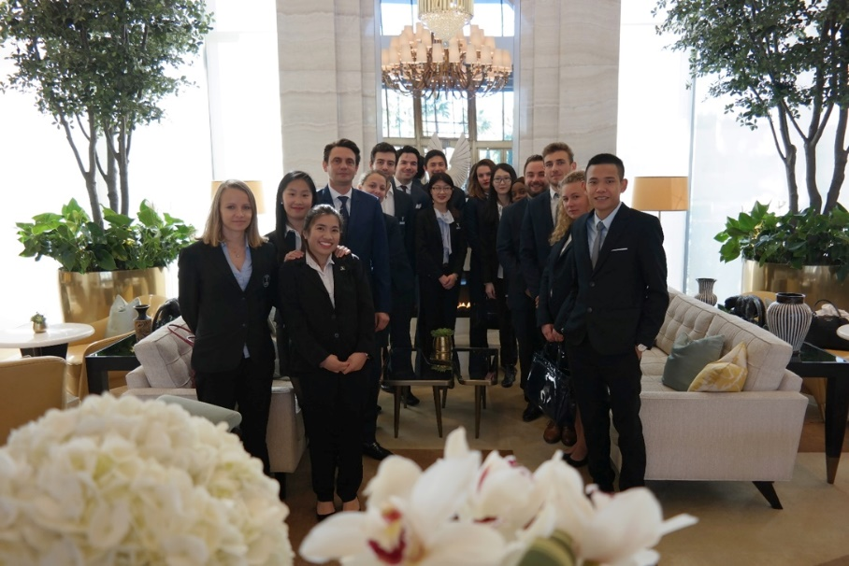
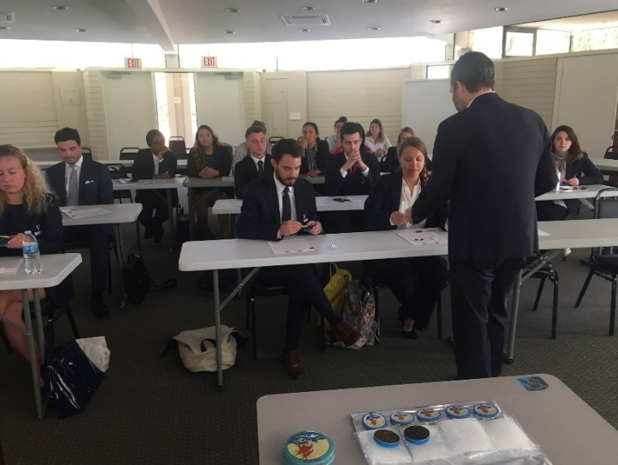
Industry Exposure

Slide 11
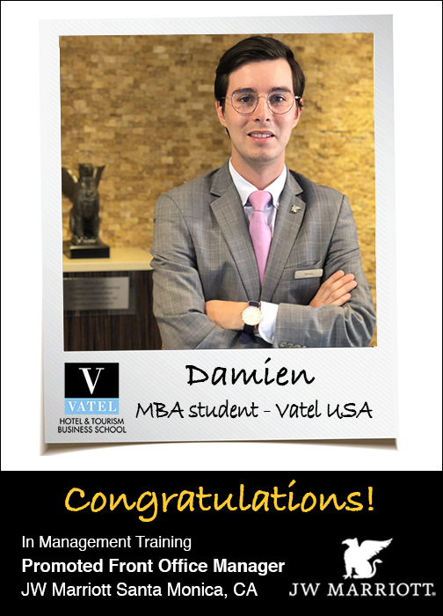
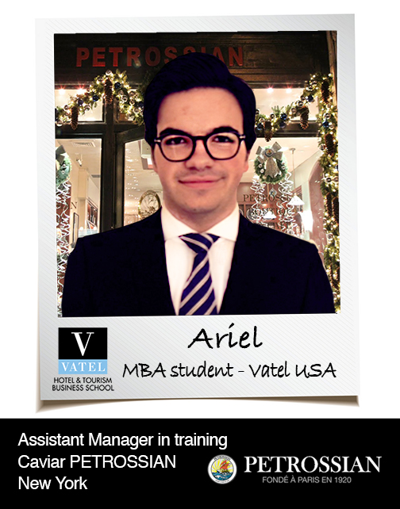
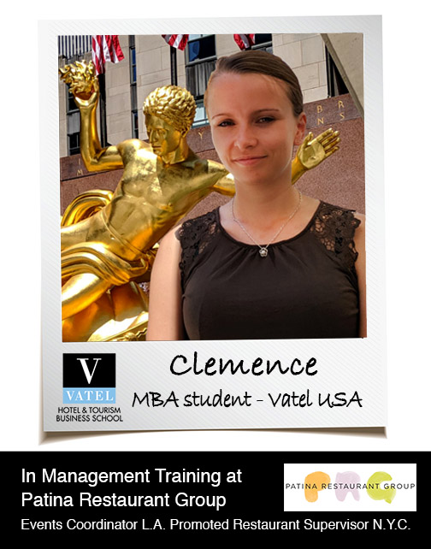

Slide 12
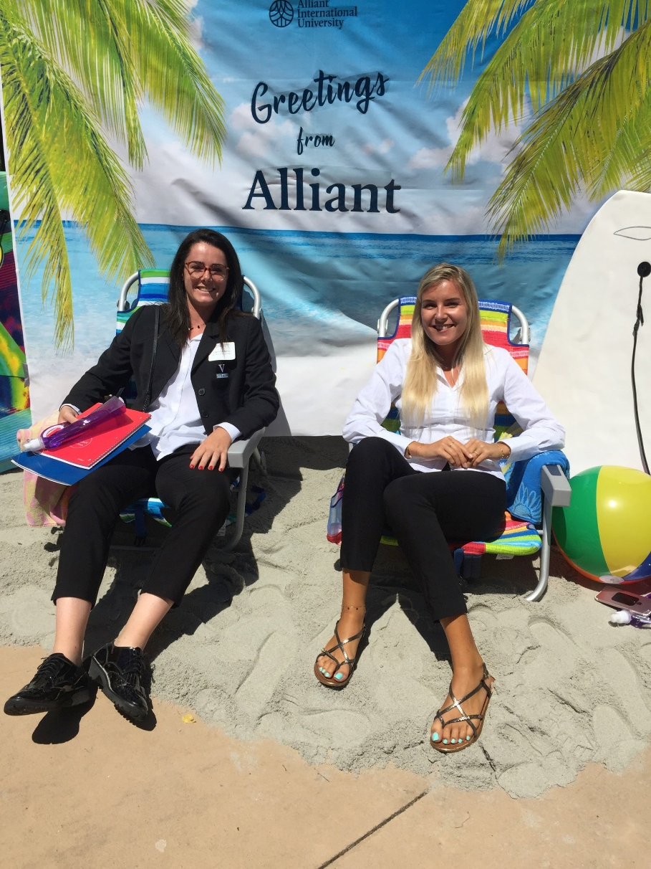

Contact Information
Palak Neema
(Sr. Counselor USA and Trainer)
Study Metro Edu Consultant Pvt Ltd
517-Shekhar Central, Manoramaganj,
Indore, Madhya Pradesh, India- 452018
Mobile +91-8989625013
Skype: palak_107

