Slide 1
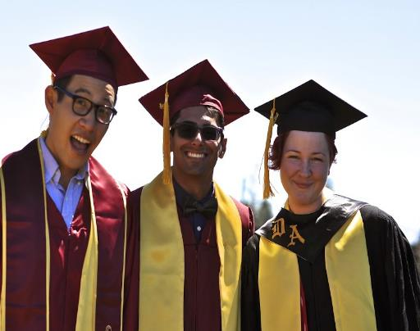
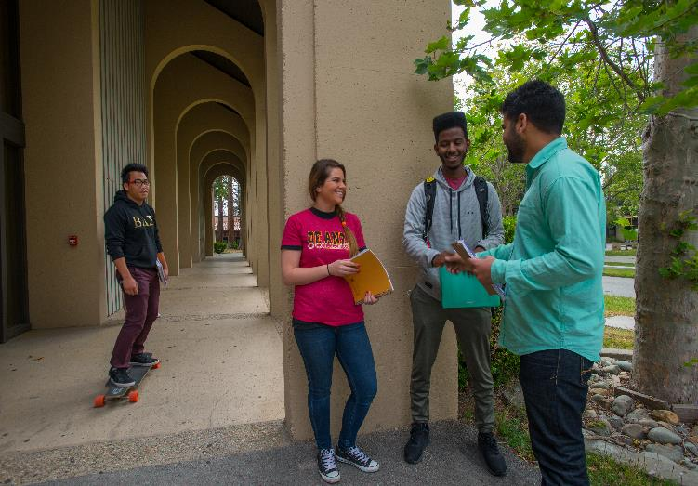
Community Colleges
DEEPALI SHAH Assistant Director, International Student Recruitment
Based out of India
Notes:
#1 Large (De Anza) and Medium (Foothill) sized community colleges in California – edsmart.org – based on graduation and transfer rates

Slide 2
What is a Community College?
2
+
2
=
A bachelor’s degree at half the cost
Years at Foothill College or De Anza College
Years at a prestigious university
First 2 years are general education and lower division major requirements
Affordable tuition fees - $7,488 per year
Ease into U.S. education with flexibility
All classes taught by professors
Articulation agreements and guarantees, transfer counselors, and Transfer Center support students in transfer process
2-year Associate’s degrees also offered
OPT (work authorization) is possible after an Associate’s degree

Slide 3
Why Community College?
Many academic programs
Outstanding transfer partnerships
+2
2+2
Affordable tuition
Nationally recognized faculty
Small class sizes with individual attention
State-of-the-art facilities
Safe community and campus atmosphere
Flexible admission; No SAT required
Support services, honors, and campus abroad programs
Notes:
- Several faculty members have won awards and recognition for research, including California Professor of the Year -

Slide 4
2 Colleges | 2 Years | Unlimited Possibilities
Located in Silicon Valley
Affordable Tuition: USD 7,488 per year
Over 100 transfer agreements
Transfer Admission Guarantees and Preferences with 40 universities including 7 University of California Campuses (UC)
Graduate from top universities: UC Berkeley, UCLA, NYU, UBC, Yale and many more!
Notes:
#1 Large (De Anza) and Medium (Foothill) sized community colleges in California – edsmart.org – based on graduation and transfer rates

Slide 5
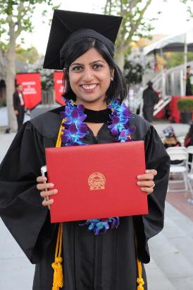
Transfer Success
International Student Acceptances Fall 2018:
UC Berkeley – 76 UCLA – 110 UC San Diego – 233 UC Davis – 354
#1 for acceptances & transfer to the UC system!
Our Students were also accepted to: Stanford, Brown, Columbia, Yale, Cornell, USC, NYU, Johns Hopkins, Carnegie Mellon, Drexel, Ohio State University, Purdue University, University of Washington, University of Arizona, Boston College, Indiana University – Bloomington, University of Michigan – Ann Arbor, Virginia Tech, University of British Columbia, University of Toronto….and many more!
.

Slide 6
Flexible admissions
Admission 3 Times a year: Fall, winter, and spring quarters
Online application: Deadline for Fall 2020 is July 31, 2020
Transcripts from grade 9 to 12 (If student does not have grade 12 transcripts, mid term mark sheets or predicted scores will be accepted)
(If student does not have grade 9 transcripts, they can upload from grade 10 onward).
English Proficiency Accepted: TOEFL 61 IBT, IELTS 6.0, iTEP Level 4, Duolingo 95 DTE, PTE 45.
Can be waived off for IB and A level students depending on their English scores.
Can be waived off for students with English score on SAT above 500, if taken
No SAT required
Passport Copy needed
Application fee: USD 75
Application - international.fhda.edu

Slide 7
Student Testimonials
Looking back at my journey so far I can truly say it was everything I could hope for; a home away from home. At Foothill, I got to meet people from all over the world and have found myself a family here with people from different backgrounds. My favorite memory from my time here is a day where I was feeling particularly blue and home sick. My roommates from Sweden went out and bought Indian food to eat it family style. I think that was the day I realized you don’t always have to be home to feel at home. I chose Foothill to start my undergraduate degree to gain valuable life experiences and to get better opportunities. I can truly say I have gained both.
SHRUTI VENKATESH – INDIA TRANSFER: UNIVERSITY OF CALIFORNIA, LOS ANGELES MAJOR: COMMUNICATIONS

Slide 8
Student Testimonials
My dream was to attend a top ranked university, but I didn’t want to burden my family financially. I learned about Foothill’s strong transfer reputation and agreements and decided to apply. My parents were skeptical at first, but now they are very happy with my choice. I have learned that this is the best way to get a degree in the United States. I was able to save money and transfer to Purdue University to pursue Agricultural Engineering. The beauty of Foothill’s campus, affordability, campus life, and competiveness provided me with an amazing experience.
SUREJ SATHYA - INDIA TRANSFER: PURDUE UNIVERSITY MAJOR: ENGINEERING

