Slide 1
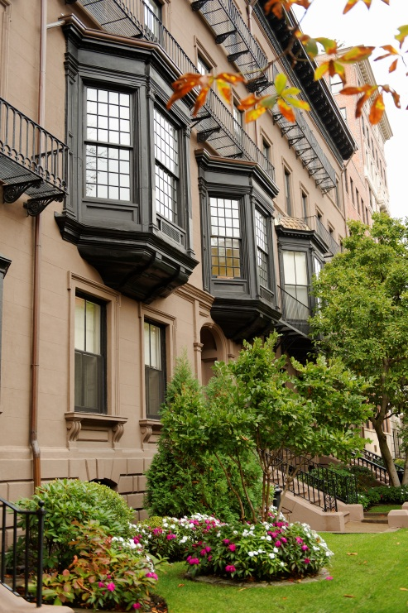
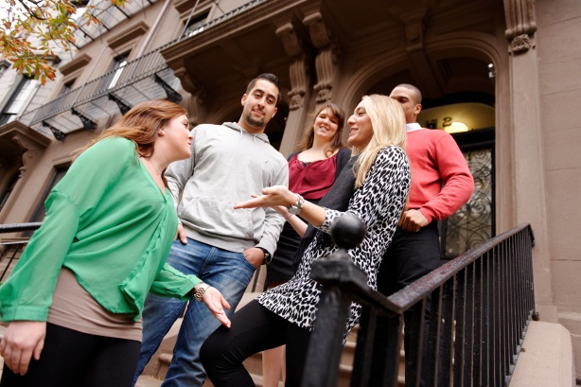
Mission Statement
Fisher College changes lives by positioning students in their quest for the knowledge and skills that will guide them through a lifetime of intellectual and professional pursuits.

Slide 2
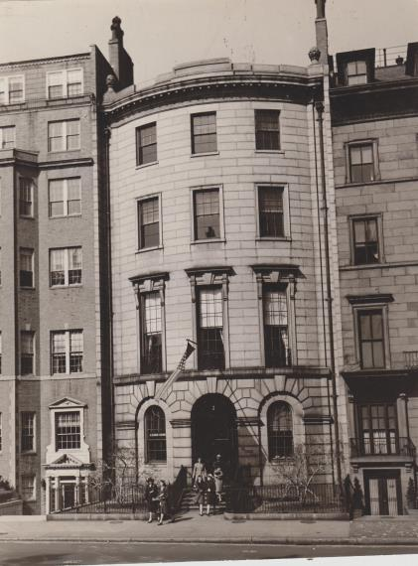
History
1903 Founded in Somerville, MA
1910 Established in Boston
1939 Purchase of 118 Beacon Street
1957 Degree Granting College
1975 DAPS Established
1997 Purchased 115, 139, 141 Beacon Street
1998 Online Division Established, Instituted Baccalaureate Degrees, and Co-Ed
2006 Purchase of One Arlington Street
(Boston School of Modern Languages)
2010 Purchase of 111 Beacon Street (Butera School of Art)
2013 Purchase of 10-11 Arlington Street
(Tellus Institute)

Slide 3
Fisher College Profile
Founded in 1903
Private, not-for-profit
Safe and Historical Boston Location
Small and Diverse Private College
Currently 825 Undergraduate Students
Approximately 18% International Student Population
56% Multi-Racial
Average Class Size of 18
Personal Attention and Individualized Experience
MBA, Bachelor’s, Associate’s, and ESL Program Offerings

Slide 4
Program Offerings
Bachelor of Arts Degrees
Biology
Liberal Arts
Psychology
Bachelor of Science Degrees Human Services
Communication and Media Studies
Criminal Justice
Information Technology (Computer Science
Cyber security
Gaming
Software Enginerring
Management
Accounting
Fashion Merchandising
Finance
Health Care Management
Human Resource Management
Leadership
Sport Management
Marketing
Master of Business Administration (MBA)-Year Full-time (Intensive)

Slide 5
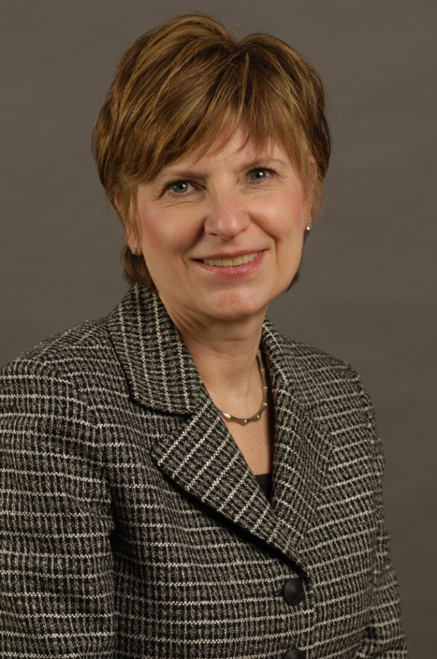
Nancy Pithis
Dean of International Academic Operations and Curriculum Development
Office Location:
3rd Floor of 116 Beacon Street
Phone- 617-236-8814
Fax- 617-236-5473
npithis@fisher.edu

Slide 6
Center for International Programs & Services (CIPS)
The Center for International Programs and Services (CIPS) is committed to providing quality services to international students at Fisher College. We accomplish our mission in several ways:
Assist with matters that concern the international student population
Educate students by providing information prior to their arrival
Strengthen the academic infrastructure for international students and coordinate academic
advising, course scheduling, and registration activities
Advise students on visa and employment matters
Provide information on legal rights and responsibilities
Support students in issues that affect their adjustment, and address their personal concerns
Coordinate programs and activities that will assist students
OPT guidance and support

Slide 7
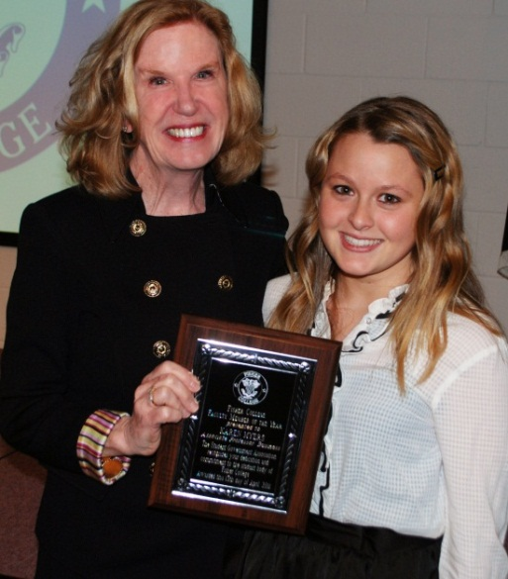
Fisher’s primary focus? Student Success!
Academic Advising by faculty – same advisor throughout your studies
Academic Outreach and Success Counseling
Academic Center for Enrichment
Small class sizes

Slide 8
Additional Opportunities
Learning Communities
Study Abroad
Worldwide Programs
Semester at Sea
Partnership with CIS (Madrid)
Short Term May – One-week Explorations (Paris/London)
The Washington Center
12-credit – full semester internships
Honors Program
Phi-Theta Kappa/Golden Key
ROTC
Research Opportunities

Slide 9
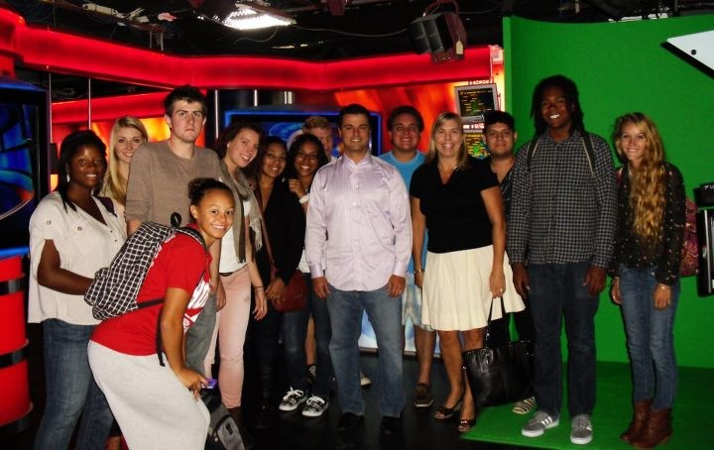
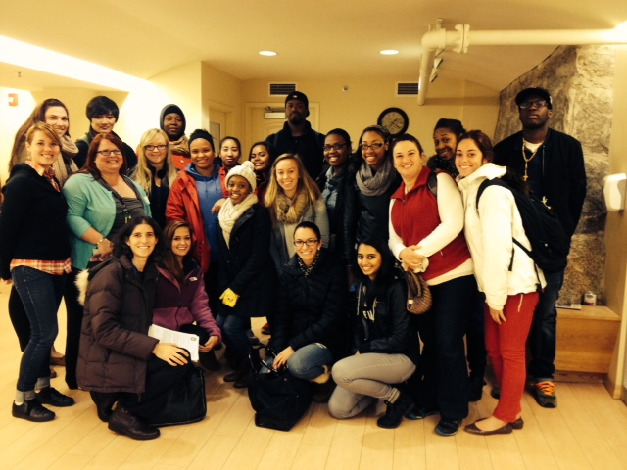
BOSTON is our campus
Human Services: The Women’s Place
Communications: WBZ studios
French classes: The French Library
Acting classes: Shear Madness
Art classes: Museum of Fine Arts
Fashion Students: Boston Fashion Week

Slide 10
Application Requirements:
Application for Admission (online or paper)
Official High School Transcript (with Graduation Year)
Official College Transcript (if applicable)
IELTS; TOEFL or SAT Scores
A Notarized Bank Statement Showing Funds of $53,000
A Letter of Support (if applicable)
International Student Scholarships

Slide 11
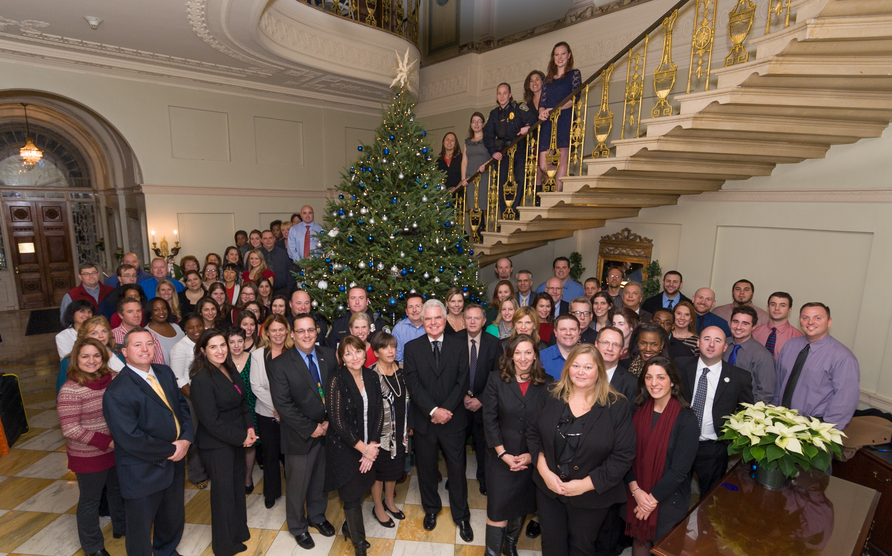
This is what WE do!
The WE

