Slide 1
PiggyBank
Esher College - The Internship
Maddy Power and Pasha Taylor

Slide 2
Problem Statement
PiggyBank helps people in poverty or struggling with money in local areas to receive help from others without facing hard labour, prejudice money spending/poverty.
Poverty impacts people globally and is a state of living by which people have inadequate monetary funds to sustain and afford the basic necessities. Our app however, is focussed mainly on UK poverty.
Problem is often intergenerational and is an impact of poor governance and funding for the poor (council housing and public spending)

Slide 3
Team Idea
’PiggyBank’ is our company, which is an app, that can be accessed by those living in poverty in and around the UK. To reduce this significant issue, the app would help provide equal benefits for all who qualify and provide discounts for basic necessities such as food, water bills and electricity. This can improve their quality of life and allow them to prioritise their spending. We wanted to make donation quick and simple for someone of any age or class. Sometimes donating to charity can become daunting and difficult, which will deter someone from donating. Our goal is to make it quick, easy and personal. The pre-set donations are from 25p - £1. This makes the app available for someone of little income or large income. Our app allows you to set your location. This allows us to direct the money donated from that area to someone in need from the same area. This brings a concept of community and personal identity to our app.
Patent some of the code involved in the formation of the app. Further, trademark the logo.

Slide 4
PiggyBank App
Designed by Maddy Power

Slide 6
Our logo
The logo is designed to be simple and universal. Not only does the iconography of the piggy bank match the name of our app but also the function of putting money aside. The piggy bank also signifies ‘saving’ which in this case is polysemic: ‘saving’ in terms of money and in terms of helping people in tough situations.

Slide 7
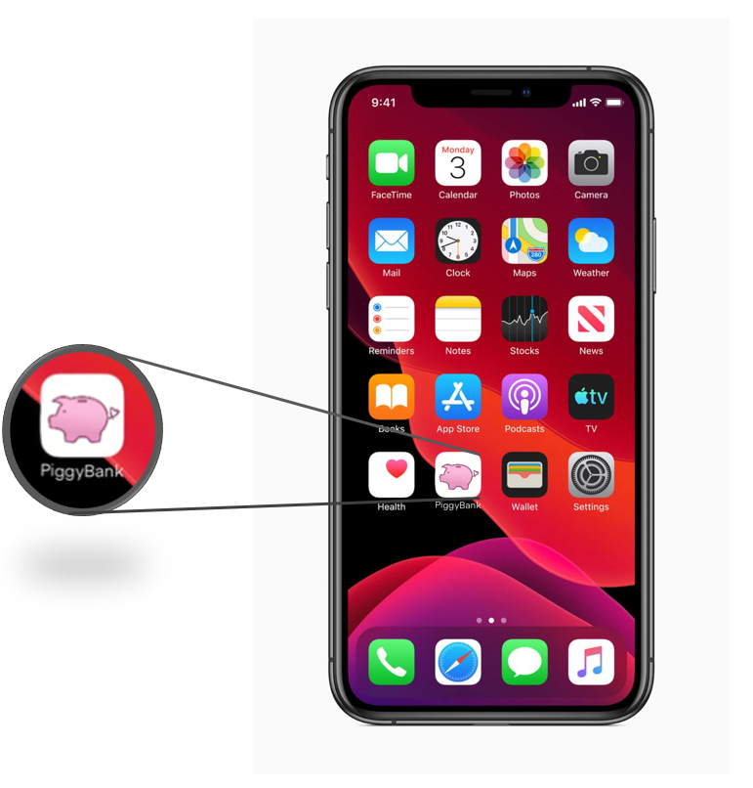
Application Design
This is an idea of what our app would look like downloaded on someone's iPhone
We plan to make the app available for all devices and for all mobile operating systems to ensure the customer has access no matter what

Slide 8
Loading page design

Slide 9
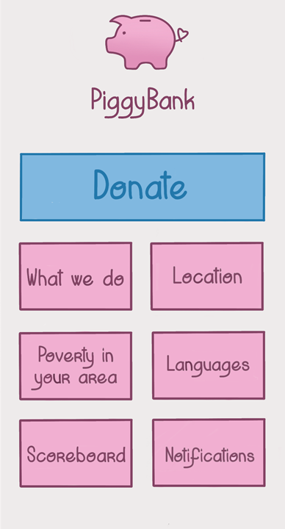
Home page design

Slide 10
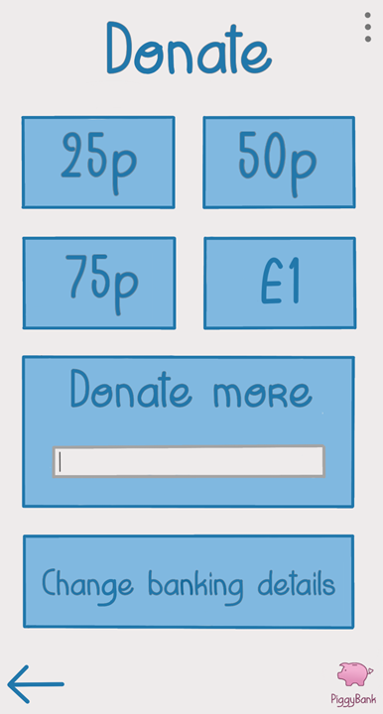
Donation tab design

Slide 11
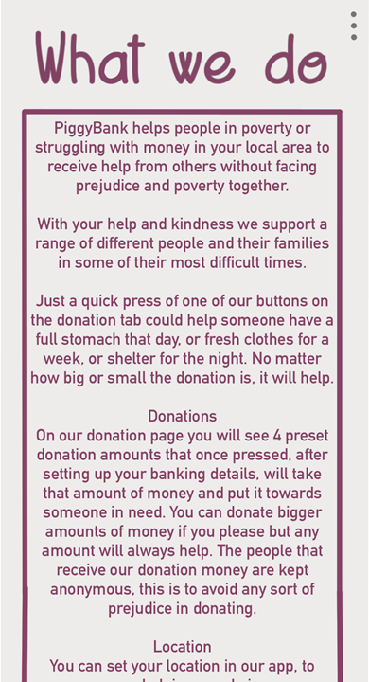
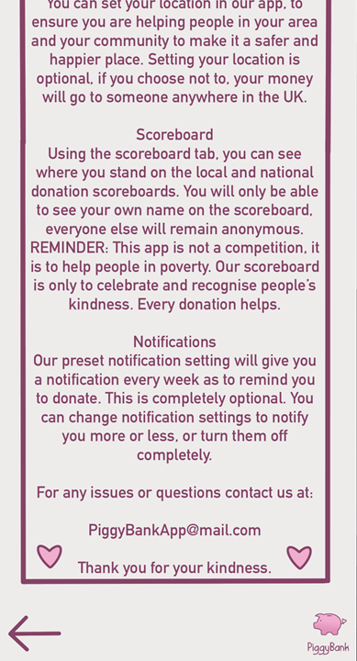
What We Do tab design

Slide 12
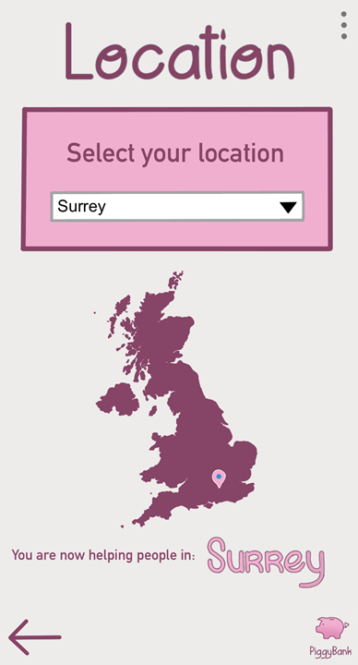
Location tab design

Slide 13
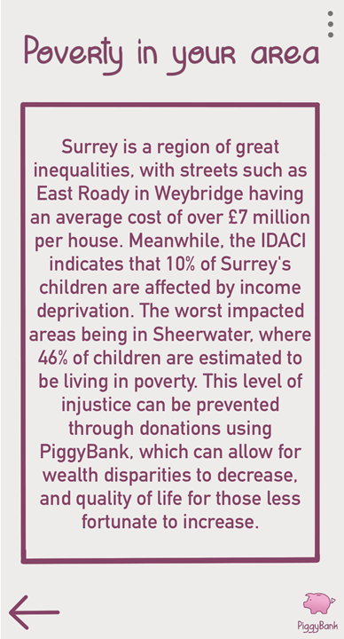
Poverty in your area tab design
Information written and gathered by Pasha Taylor

Slide 14
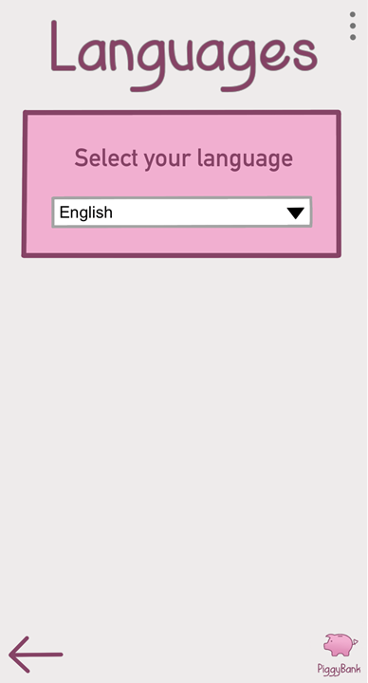
Languages tab design

Slide 15
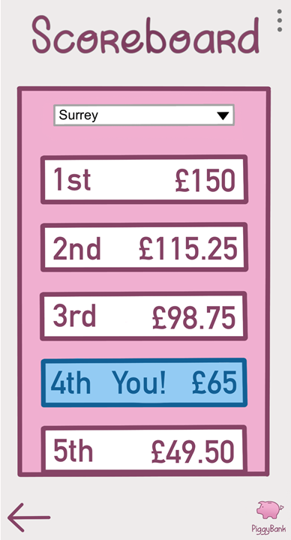
scoreboard tab design

Slide 16
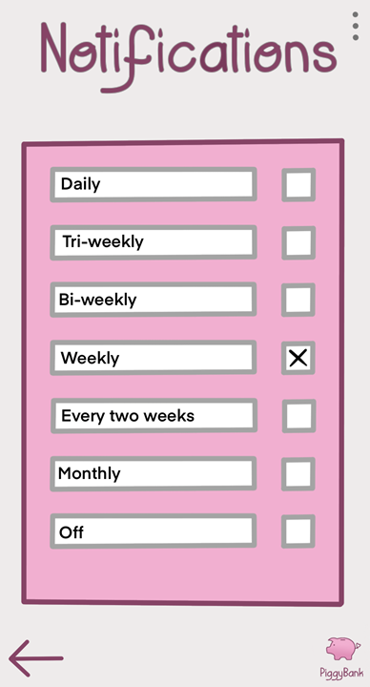
Notifications tab design

Slide 17
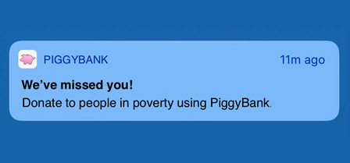
Notification design IOS
Notification design Android

Slide 18
Advertisement

Slide 19
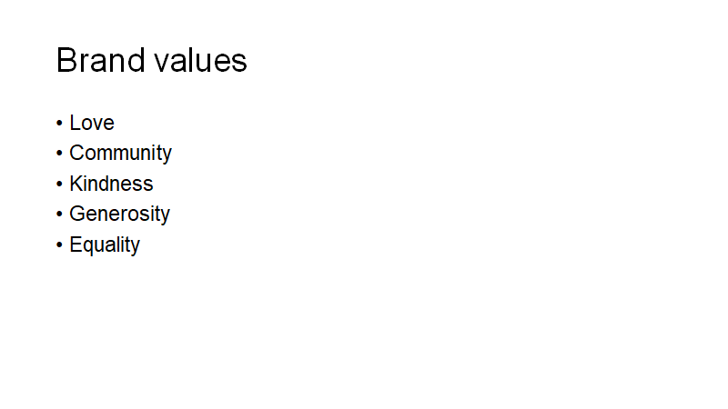

Slide 20
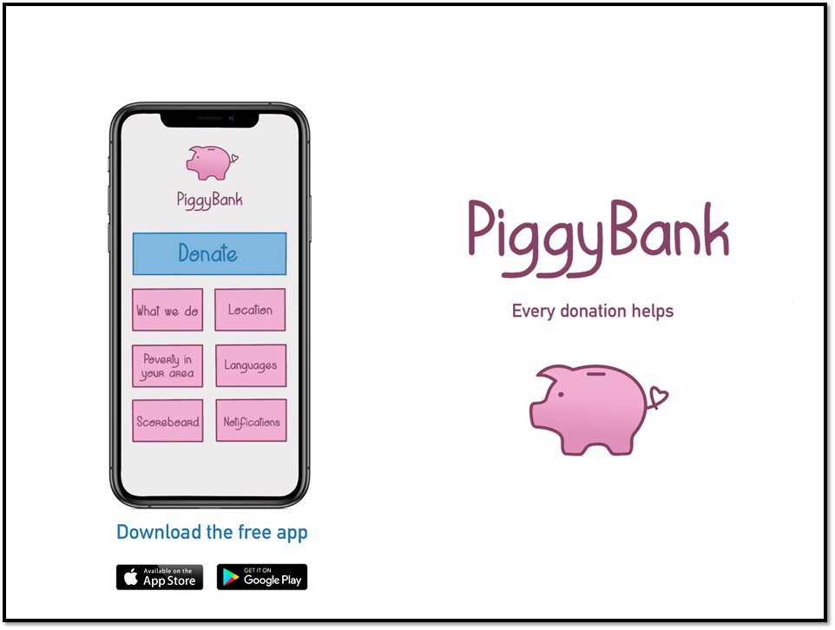

Slide 21
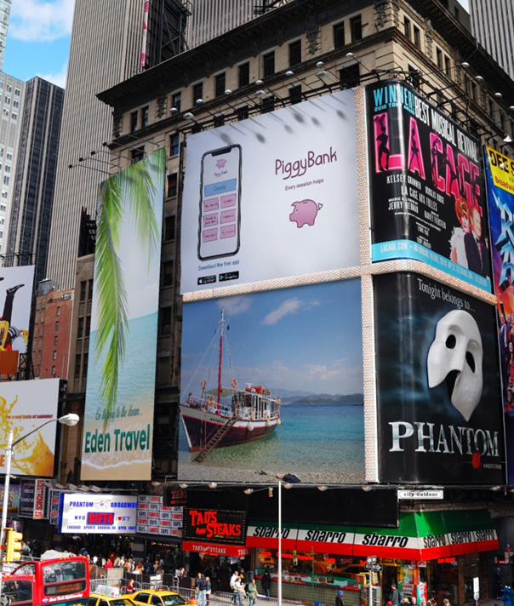
Example of advert on Billboard

Slide 22
Elevator Pitch/Twitter Pitch
Twitter pitch: It’s about time we end this poverty crisis, we shouldn’t have to feel that twang of guilt when walking past the homeless. Help today, by donating at PiggyBank #endinequality
Elevator Pitch: Our app, PiggyBank, allows people of all ages and income to easily donate to people struggling with poverty in their local areas. Our app is designed to overcome prejudice and support and encourage kindness, love and community. The features include, an anonymous scoreboard, to show how much the user and others in their community have donated, notifications that remind the user to donate a small amount weekly (or more often/less depending on what setting they choose) and lots of information about poverty in their specific area to spread awareness and information.

Slide 23
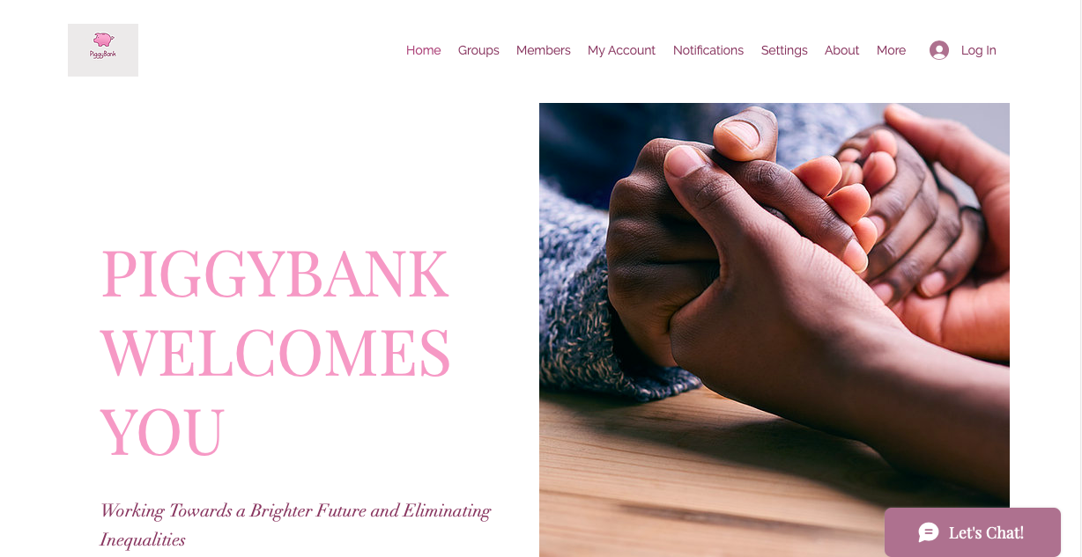
Our website: https://taylorpasha2.wixsite.com/website

Slide 24
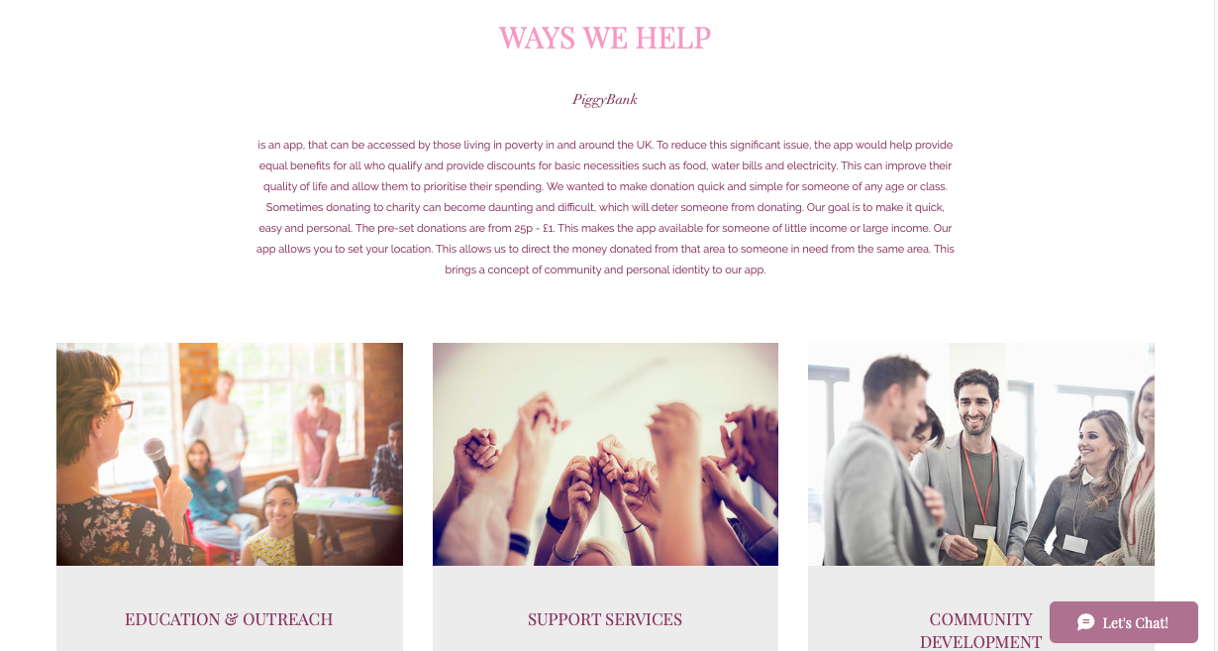

Slide 25
