Slide 1
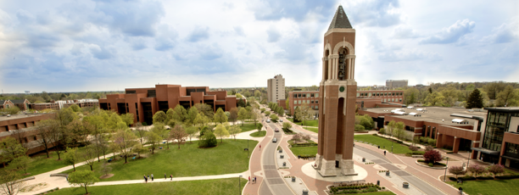
RECRUITMENT GUIDE
Pursue your dreams and study in the United States!

Slide 2

WHY BALL STATE?
Named “One of the best universities in the Midwest” by the Princeton Review
More than 22,500 students enrolled for 2019-2020
Students come from all 50 states and 68 different countries
190 academic majors, ranging from Art and Architecture to Communication Studies, Health Sciences, Theatre, Dance, Music, Natural Sciences, and Sociology (no Engineering though)
Propelled by an innovative, immersive approach to education, students experience hands-on, real-world experiences and are encouraged to solve problems for local and global communities
bsu.edu/international

Slide 3
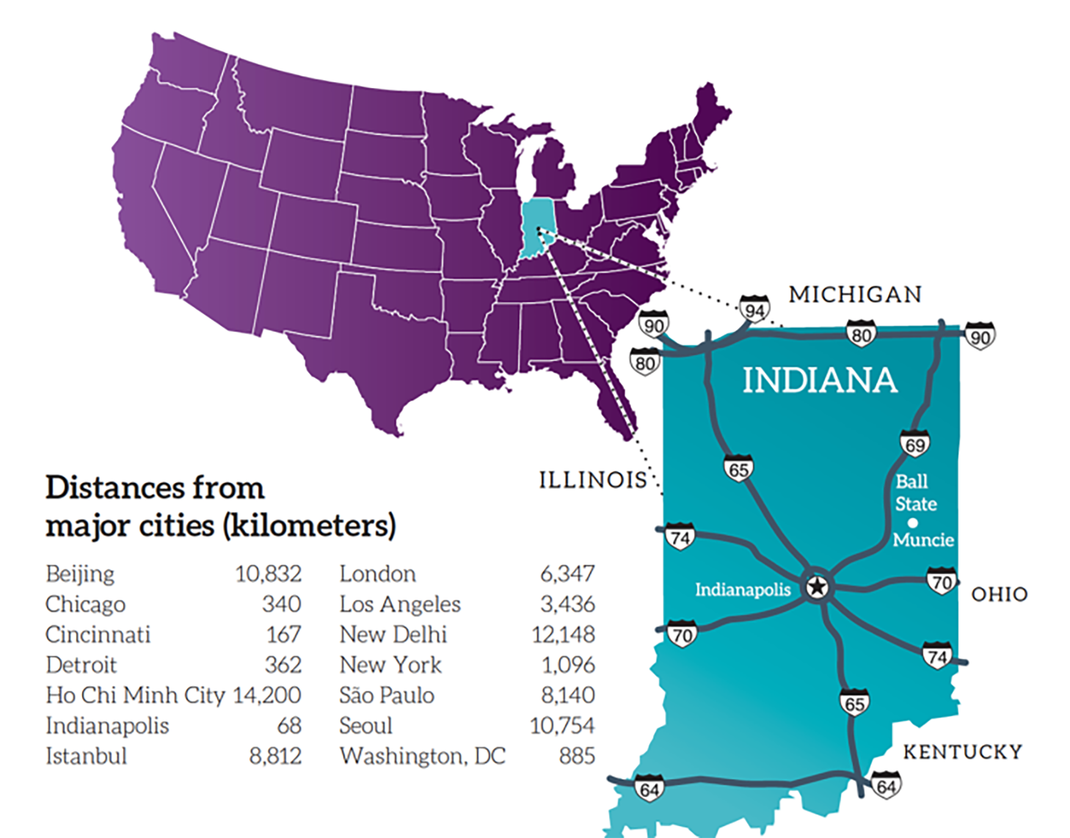
OUR CAMPUS
Beautiful campus in Muncie, Indiana
Small college town located a short distance from larger metropolitan cities
Experience all four seasons (spring, summer, fall, winter)
Cutting edge technology powers innovative experiences
State-of-the-art facilities
bsu.edu/about

Slide 4
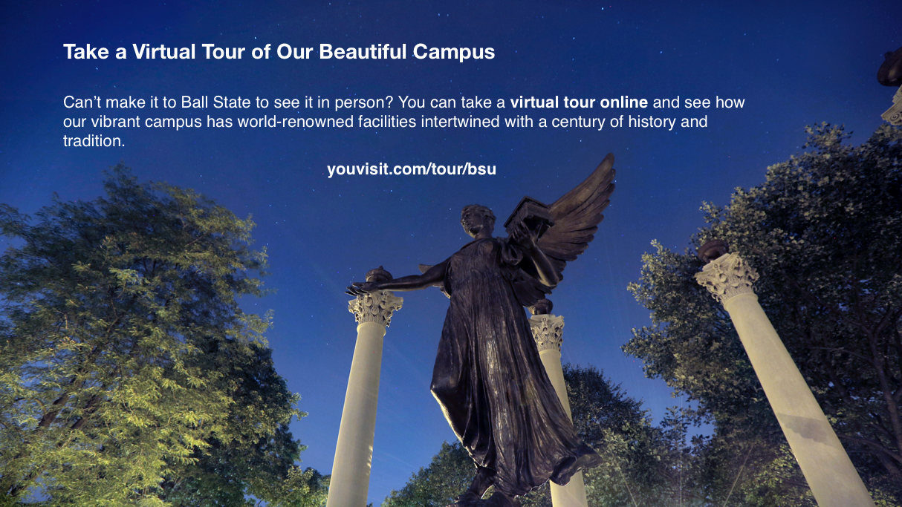

Slide 5
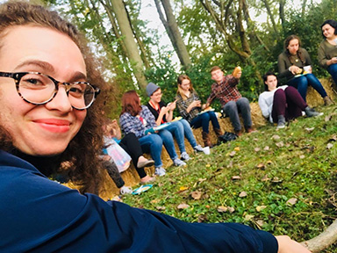
OUR ACTIVITIES
Hundreds of student organizations and clubs
Free arts and cultural events
Recreation and fitness programs
NCAA Division 1 athletic programs
bsu.edu/BennyLink

Slide 6
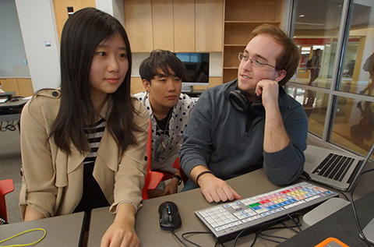
OUR HOUSING
Beautiful renovated residence halls
University apartments available for qualifying students
Award-winning dining facilities
Fitness rooms and free internet
bsu.edu/housing

Slide 7
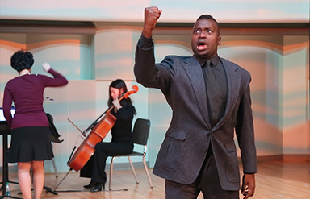
OUR SCHOLARSHIPS
Scholarships available ranging from $2,000 to $8,000 per year
Scholarships are based off GPA
Graduate Assistantships (GA) available for students working toward an advanced degree
GA’s receive a majority waiver of tuition fees
bsu.edu/international

Slide 8
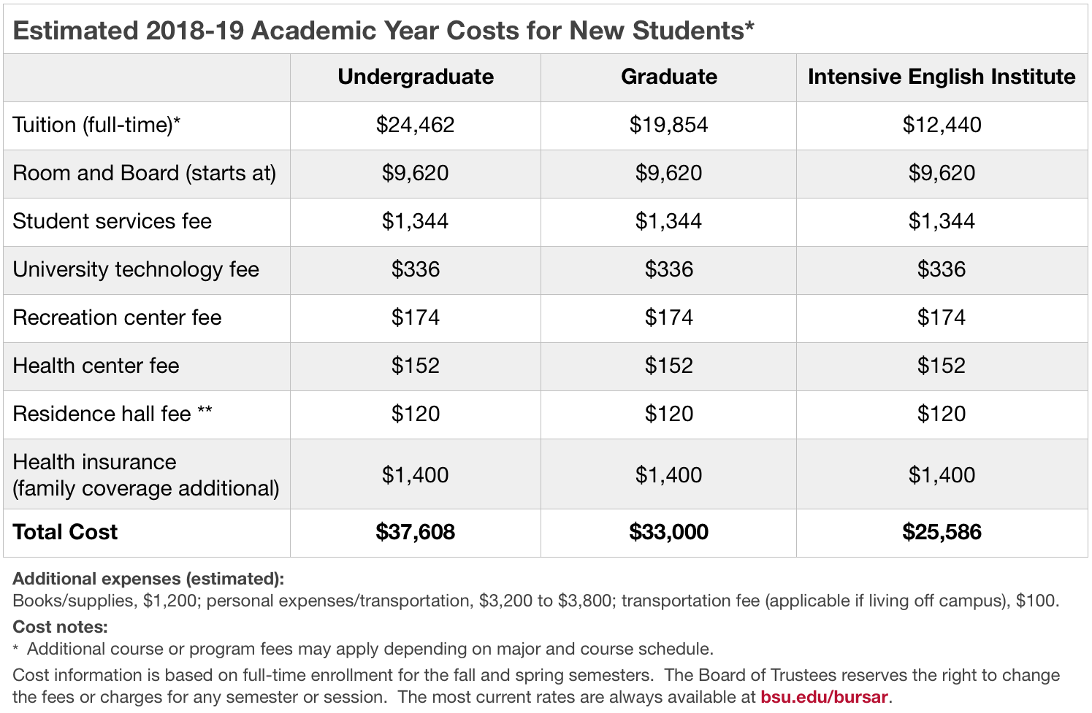
OUR COST

