Slide 1
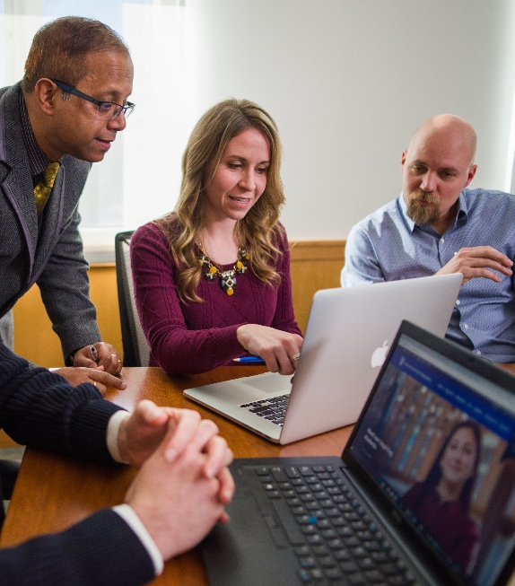
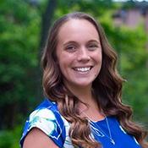
MBA Webinar
Annie Connors, MA
Assistant Director of Graduate Admissions

Slide 2
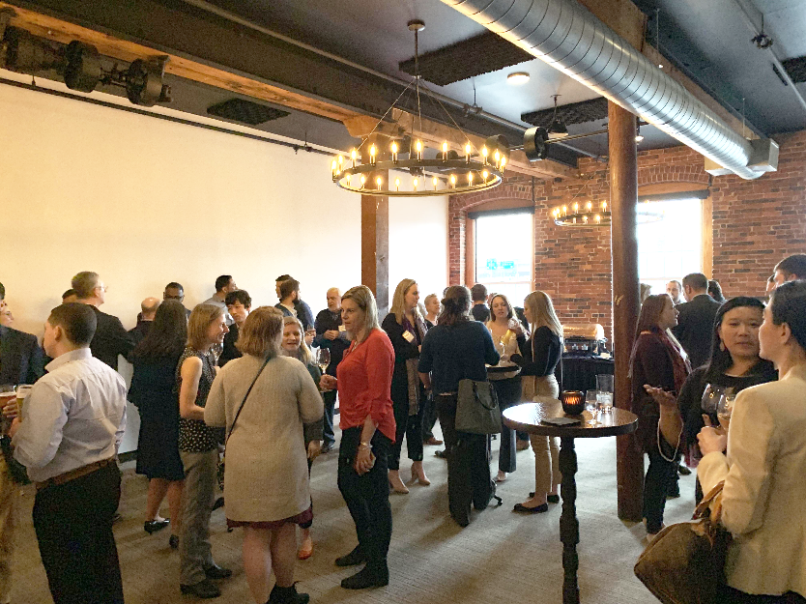
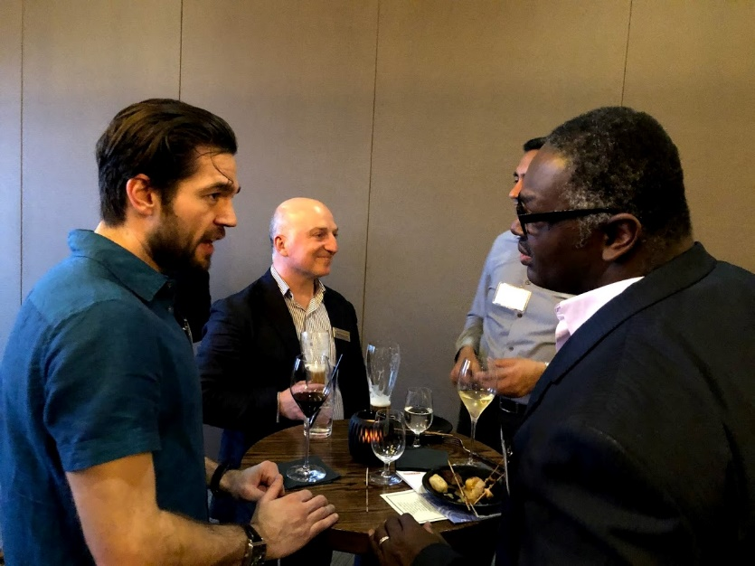
Why an MBA?
Gain a competitive set of soft and hard management skills
Learning about yourself that can transform your career
Fresh perspectives on leadership & teams
Broaden your network & learn from your peers

Slide 3
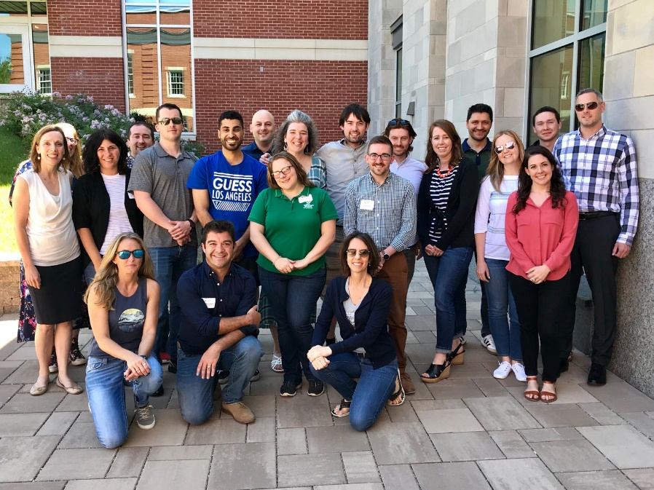
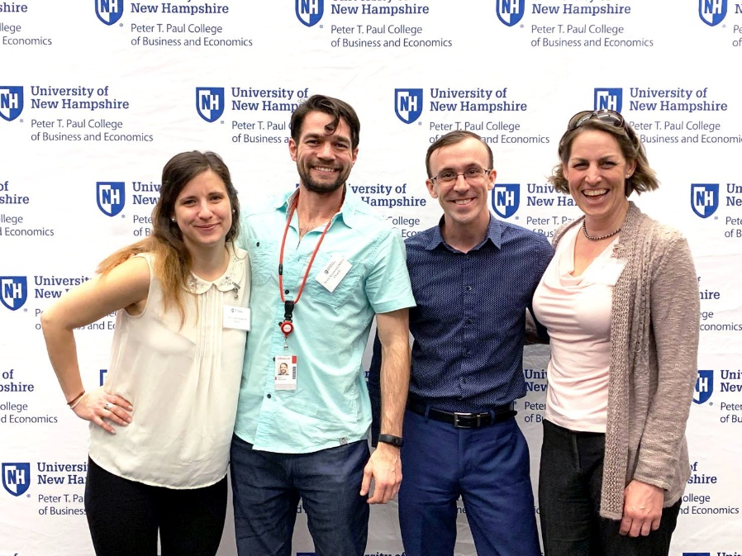
Why the Paul College MBA?
The Paul College core curriculum develops leadership and managerial skills through informed decision-making grounded in rigorous analysis.
Small class sizes with experienced peers
Research-active and practice-active faculty bring cutting-edge knowledge to the classroom
Intellectual rigor
UNH alumni network

Slide 4
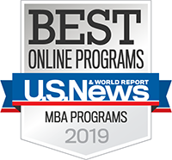
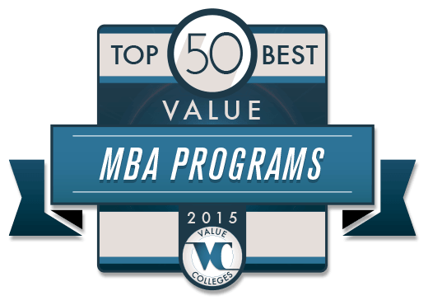
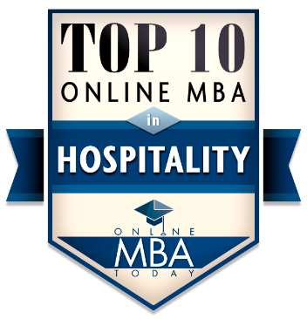
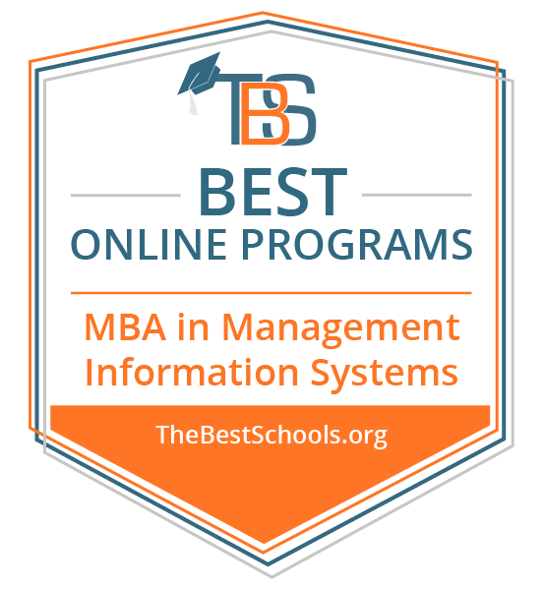
National Rankings & Accreditations
Online Program ranked #51 – U.S. News & World Report
AACSB accredited – The only business school in NH with Part-Time & Online program to hold this elite accreditation.
Top 50 Best Value MBA Programs
Notes:
US NEWS and World Report ranked our part time and online MBA programs among the 100 in the nation. We are the only Part-Time & Online MBA in Northern New England to make the top 100 list.
All of our MBA program delivery models hold the elite AACSB accreditation. We are one of only 560 business schools world wide to hold this elite accreditation. The only part-time and online program in NH.
We are proud to be recognized as a military friendly school. UNH has an office on campus dedicated to the specific needs of United states veterans and their families.

Slide 5
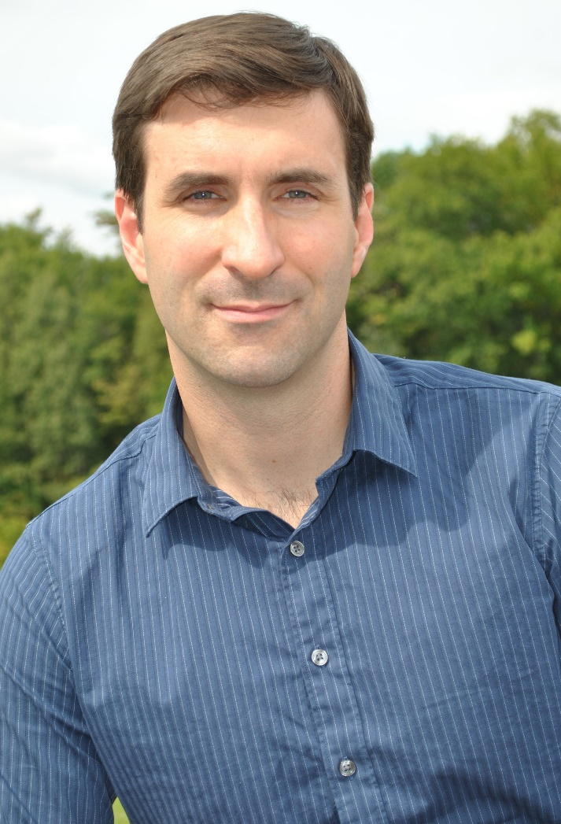
Job Outcomes – Top Employers
Full-Time MBA
Dartmouth Hitchcock Medical Center
Division for Children, Youth and Families
Online MBA
Fidelity Investments
Portsmouth Naval Shipyard
Part-Time Durham MBA
Liberty Mutual
Dell EMC
Pratt & Whitney
Part-Time Manchester MBA
FLIR Systems
Raytheon
Saxa Solutions
I entered the UNH Online MBA program 3 years ago to acquire knowledge and skills to perform better in my current position.
One thing that struck me about the MBA program is that it offers some very broad foundational theory as well as specific actionable advice on how to apply the theory.
Jesse McGowen, MBA ‘18G
Vice President
Mikros Technology

Slide 6
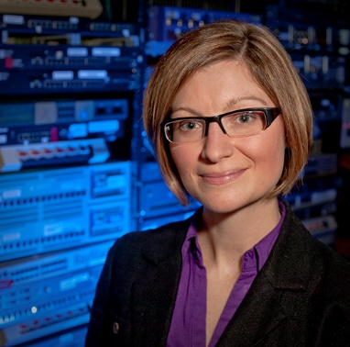
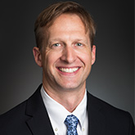
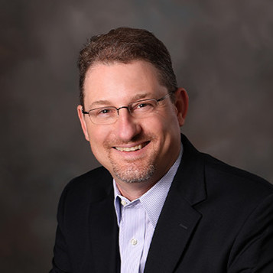
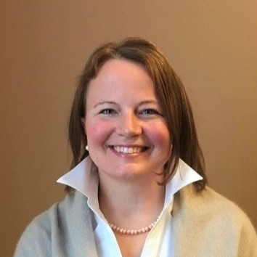
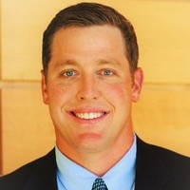
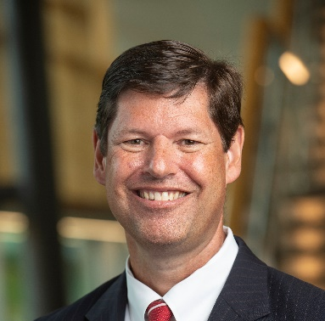
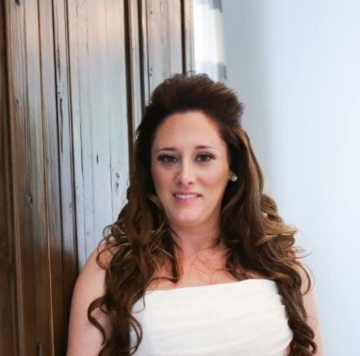
Job Outcomes – Where are our alumni?
Erica Johnson ‘11
Chief Executive Officer
QA Café and CloudShark
Brian Fruh ‘17
Chief Information Officer
Pax World
Nathan Saller ’11
President, Chief Executive Officer
Bellwether Community Credit Union
Meghan Norwood ‘08
Vice President, Professional Services
Amadeus Hospitality
Seth Gabarro ‘15
Director
Health System Solutions at American Well
Theresa Conn ‘15
Supply Chain Sustainability Manager
NEMO Equipment
Robb Atkinson ‘19
Managing Director
Millennium Agency
Christina Lentz ‘19
Quality Control Supervisor
Lonza

Slide 7
Program Overview
 | Full-Time MBA Program | Part-time and Online MBA Programs
Time-to-Complete | 12 months | 2-3.5 years
Curriculum | Core curriculum and elective courses are offered. | Core curriculum and elective courses are offered.
Delivery Method | Durham / Face-to-face | Durham / Face-to-face Manchester / Face-to-face 100% online Combined

Slide 8
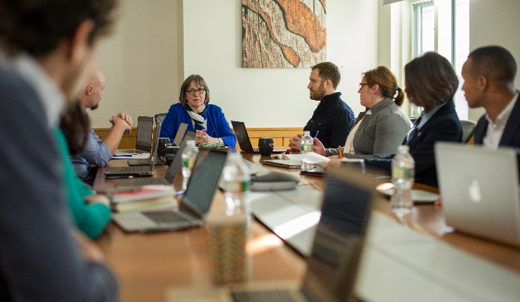
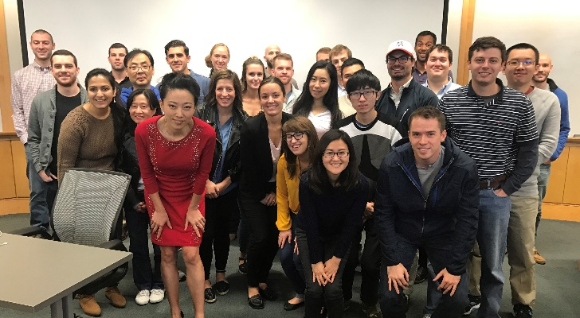
Core Curriculum
Managing Yourself and Leading Others
Accounting: Financial Reporting, Budgeting & Analysis
Economics of Competition
Leveraging Technology for Competitive Advantage
Marketing: Building Customer Value
Data Driven Decisions
Financial Management: Raising & Investing Money
Managing Operations
Creating Winning Strategies
Full-time Program ONLY
Corporate Consulting Project
International Business
Internship
Notes:
These are the core courses represented in both the full time and part time MBA programs. The required courses do vary slightly between the full-time and part-time program however the core focus is the same. The curriculum for our MBA programs are created to provide students with a broad business overview allowing them to be successful leaders in any industry.
Our faculty teaches primarily MBA students. They come to the classroom with relevant, real world experience they have acquired from owning their own business, consulting services and working in a team at large corporations.

Slide 9
Options
Finance
Global Business
Growth & Innovation
Hotel & Hospitality Management
Information Systems & Business Analytics
Marketing
Notes:
We offer 6 specialization areas. It’s not mandatory for students to choose a specialization, however, they may choose electives in these focus areas to complete their MBA.

Slide 10
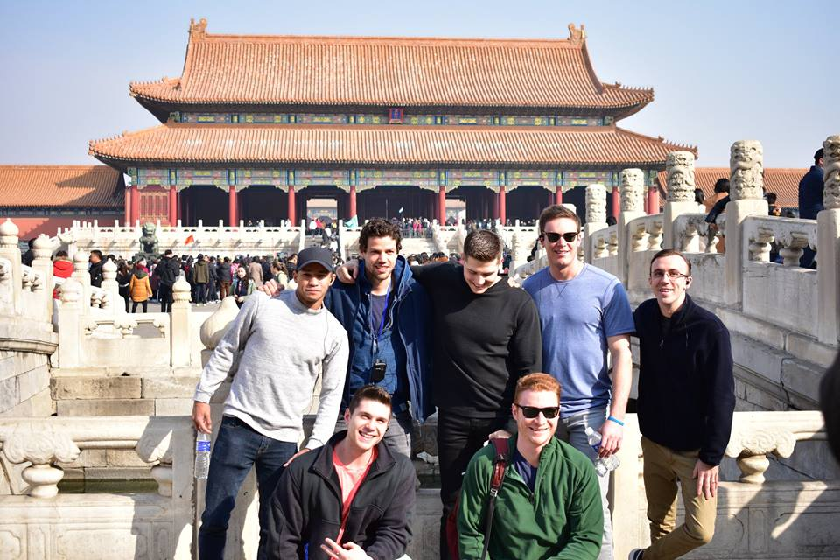
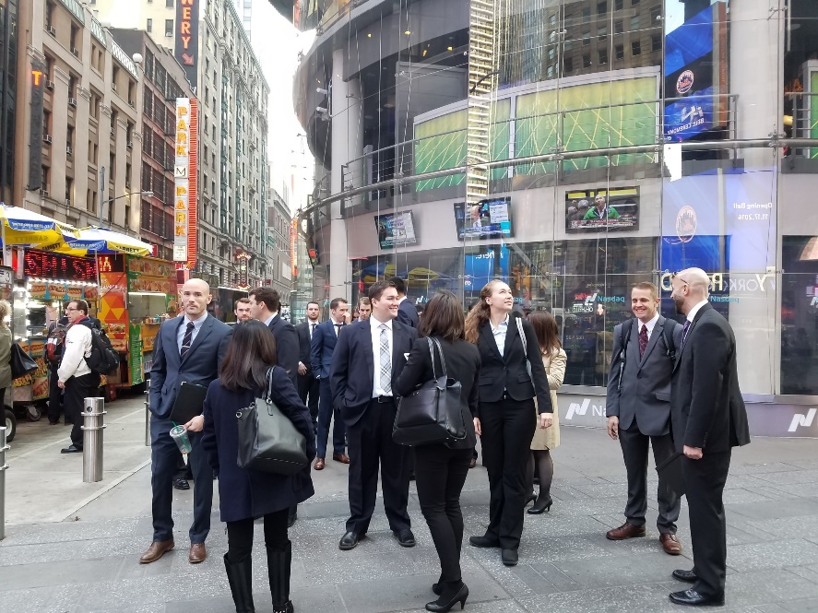
Full-Time MBA Program
Earn your MBA in 12 months
Intensive on-campus cohort model
Durham campus
Monday-Thursday classes
8:00 am -12:30 pm class schedule
China & New York City residency trips
Internship
8-week terms; 16 classes (48 credits)
Scholarships Available
Notes:
The Part time professional MBA program is designed for working professionals. This flexible program allows students to take classes in the evenings in Durham, or Manchester or 100% online from anywhere in the world. You can also change where you’d like to take your classes through out the program. You have between 2-6 years to complete your degree. Life changes can happen in that time frame. You may choose to take some classes online and some in person. Our goal is to make this as flexible as possible to meet the demands of a working professional.

Slide 11
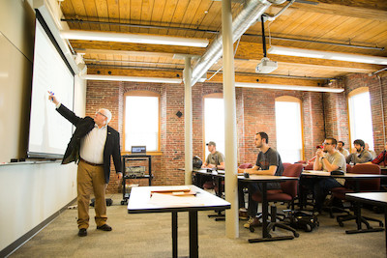
Part-Time & Online MBA
Flexible delivery model designed for working professionals
Durham, Manchester and/or 100% online
Same program-Same Faculty
Evening classes in Durham or Manchester, 5:40-9:15pm
8 week terms; 16 courses (48 credits)
Typically completed in 2-3.5 years
Small class sizes
Experienced cohort

Slide 12
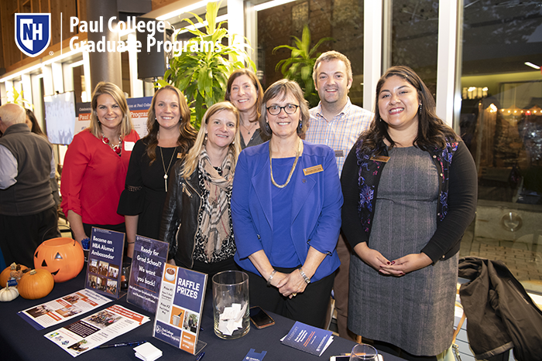
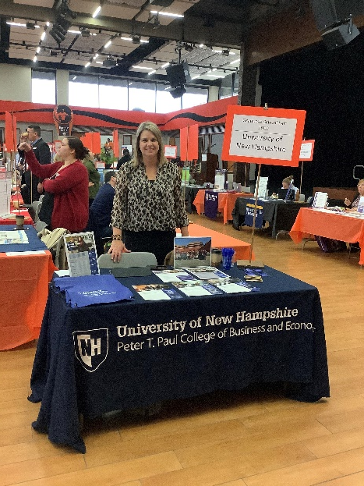
Paul College Graduate Office
Rebecca Barbour: Director of Graduate Programs
Annie Connors: Assistant Director of Graduate Admissions
Andrew Mitchell: MBA Program Coordinator
Hollie Dutton: Graduate Programs Assistant – MSA & Economics
Cynthia Plascencia: Admissions Officer– All Graduate Programs inquiries
Tara Hunter: Administrative Assistant
Notes:
Students have a strong support system not only through their instructors and fellow peers, but also through the Graduate Programs office staff. Highlighted is our MBA coordinator, Andrew Mitchell who works closely with all MBA students to answer questions throughout the program, map out their courses, and see them through graduation.

Slide 13
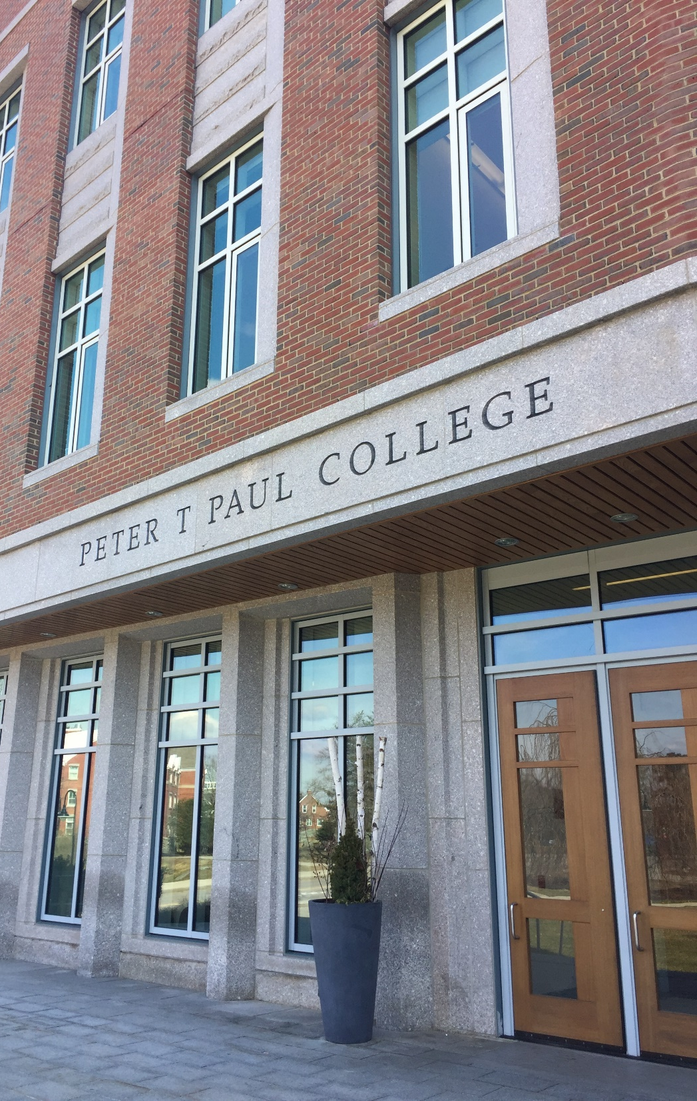
Getting Started
Portfolio review method
Two years of professional experience
3.0 minimum undergraduate GPA
GMAT optional

Slide 14
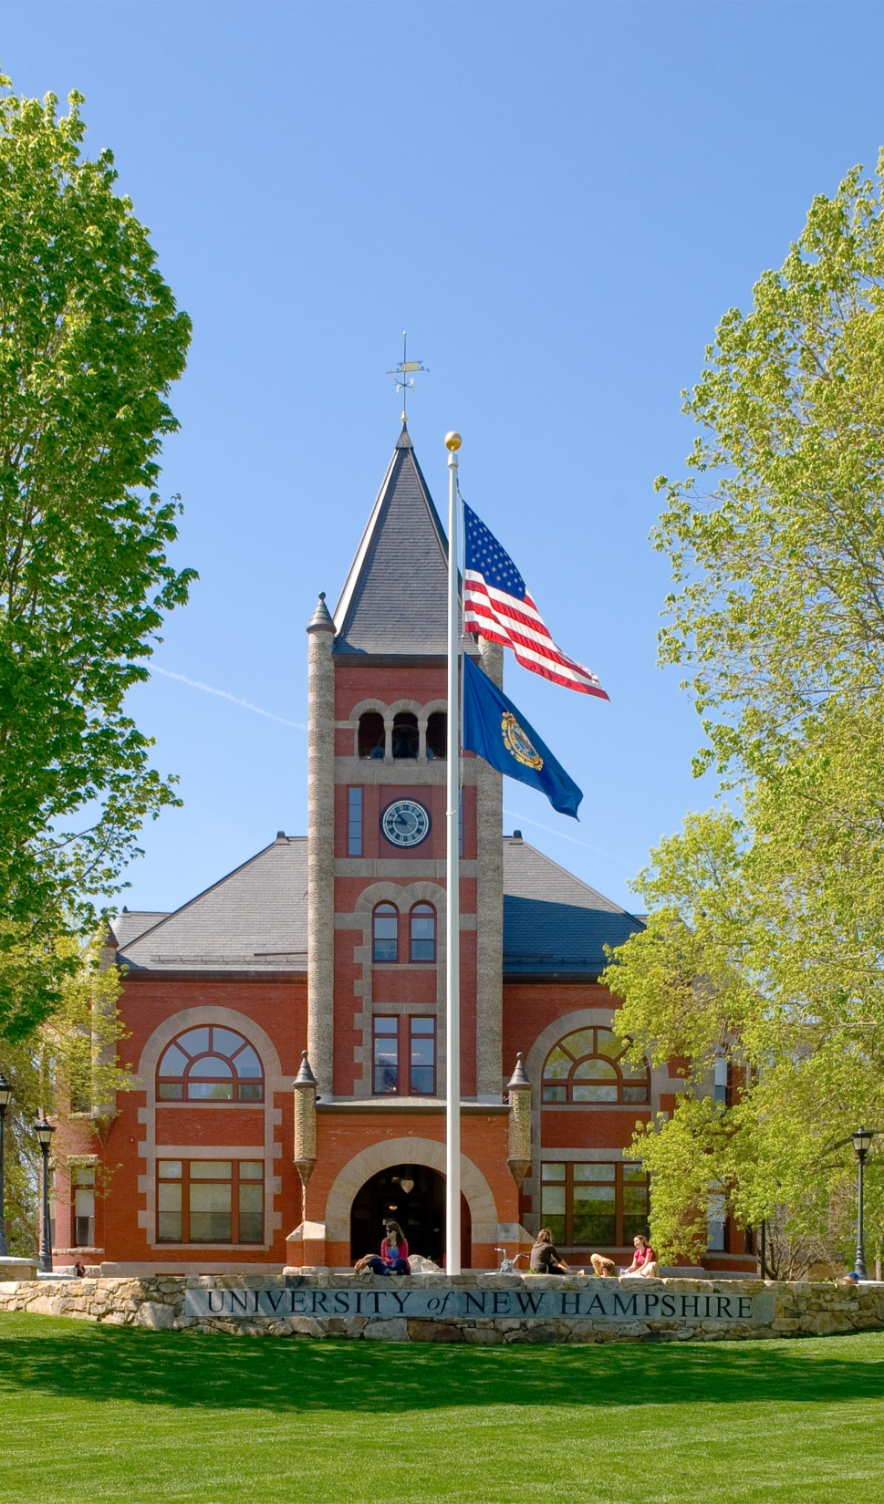
Application Process
Online Application
Resume
Recommender’s Name and Email Address (2)
Essay Questions
Official Transcripts
Proof of NH residency (NH residents)
Use Code: INFO65 to waive your $65 application fee
Notes:
You’ll need 2 Professional references. Colleagues, professors, member of boards your have served on all make great references. You will need to submit their email and contact information on your on-line application. The graduate school will contact you directly on your behalf. They should not expect to take more than 15 minutes on the referral process.
Transcripts: all to be sent directly to the grad school from your undergraduate institution. Schools make this process pretty easy these days.
Essay: 1) What are your short and long term goals? Why is an MBA a critical step toward achieving these goals? Why are you interested in UNH? 2) List 10 facts about yourself that will help your future classmates get to know you. *Optional: Please provide any additional information you believe is important and/or address any areas of concern that will be beneficial to the Admissions Committee in considering your application (e.g. unexplained gaps in employment, choice of recommenders, academic performance, or extenuating personal circumstances).

Slide 15
Questions?

