Slide 1
THE
ADVENTURE
STARTS HERE
UNITED KINGDOM

Slide 2
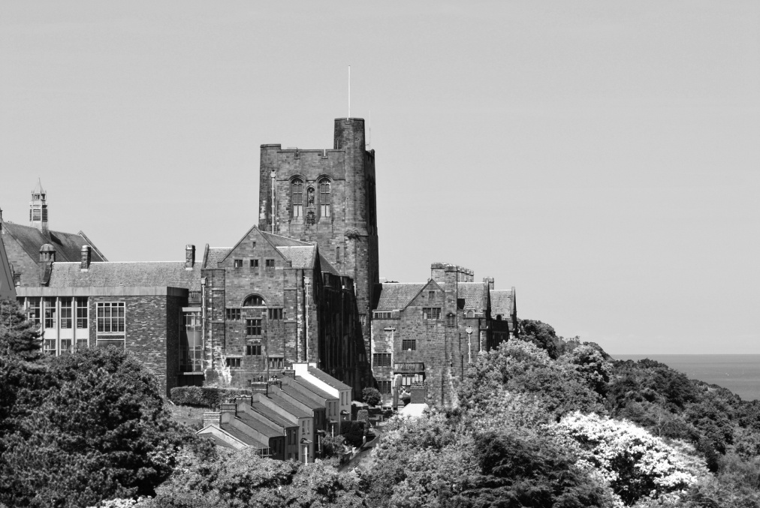
Bangor

Slide 3
Why Bangor?
“Our teaching is rated “outstanding” and amongst the best in the UK”
(TEF Gold Rated)
Best university in the UK for clubs & societies
(WhatUni? Student Choice Awards 2019)
Best Student Accommodation
(WhatUni? 2018)
Top 10 in the UK for student satisfaction
(National Student Survey 2017, 2018, 2019)
Bangor excels in some of the most important areas that matter to students.

Slide 4
Why Bangor?

Slide 6
Why Bangor? – 3 Reasons
Reason | Explanation
1. Cost Effective | Cheap cost of living (1 of lowest in UK) Competitive fees Competitive scholarships (up to 50% off)
2. Competitive both domestically & internationally in subjects that matter | Schools of Psychology, Environmental Sciences, Banking, Modern Languages and Electronic Engineering are all highly regarded. These areas are shaping the world and our future.
3. Location, location, location | Student’s mindset, Enjoy the great outdoors Rest, relax and refresh

Slide 7
Student diversity
Top 150 in the World for International Outlook
THE World Ranking 2019
Austria
Bangladesh
China
Ghana
India
Japan
Malaysia
Nigeria
Spain
United States
12,000 students
7,000 Home/EU
5,000 Overseas
120+ countries
Capacity for more!

Slide 8
Subject Areas
*Accounting, Banking & Finance
Biological Sciences
Biomedical Sciences & Biotechnology
*Business & MBA
Celtic Studies
*Computer Science
Education & Childhood Studies
*Electronic Engineering
English Language & Literature
*Environmental Sciences
*Forestry & Land Management
*Healthcare & Nursing
History & Archaeology
Islamic Banking & Finance
Law
Linguistics & TEFL
Media & Creative Studies
Music
*Ocean Sciences
Philosophy & Religion
Product Design
*Psychology
Social Sciences
*Sports Sciences
Which courses are most popular with your students?
Are there any growing areas of interest?

Slide 9
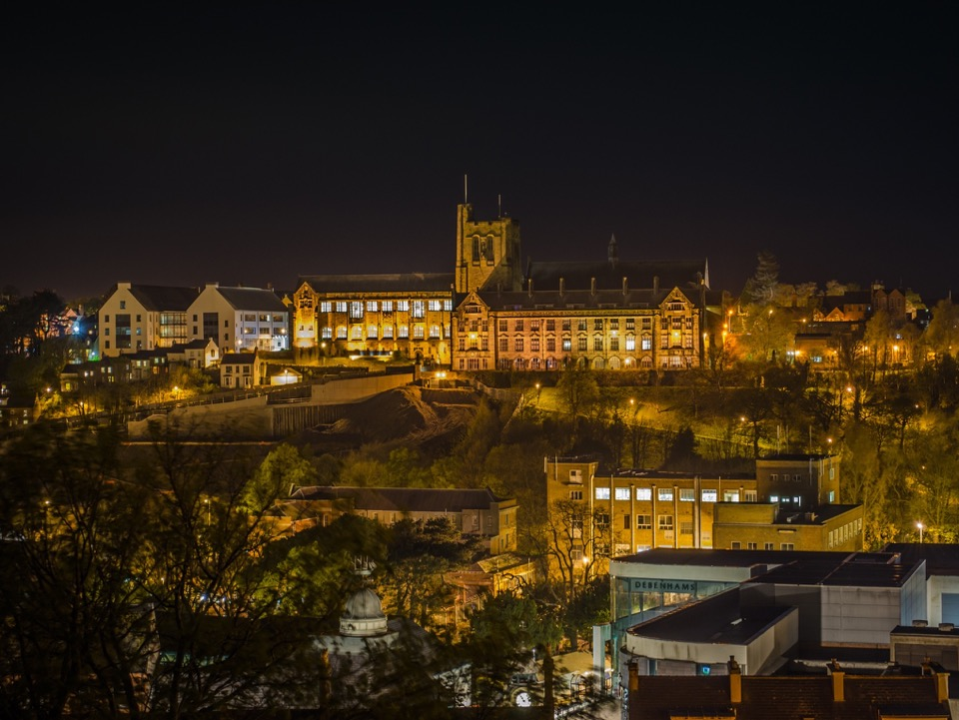
Academic
EXCELLENCE
FOR 136 YEARS
(Est. 1884)

Slide 10
Standing
Teaching
Excellence Framework
GOLD
Scores based on mock assessment of Benchmarked TEF score by Times Higher Education magazine
High Teaching
Low Research
High Teaching
High Research
Low Teaching
Low Research
Low Teaching
High Research
Research Excellence Framework
Scores reflect research intensity-weighted GPA published in 2014 REF

Slide 11
Standing
Teaching
Excellence Framework
GOLD
Scores based on mock assessment of Benchmarked TEF score by Times Higher Education magazine
30
Universities
Bangor
(others 36 include; Cambridge, Durham, Oxford, Manchester, Sheffield, Imperial, York)
40
Universities
14
Universities
Research Excellence Framework
Scores reflect research intensity-weighted GPA published in 2014 REF
* Next REF Survey is due to be released in 2020/21

Slide 12
University Rankings
TEF Gold rated university for teaching excellence (TEF 2017)
Top 10 UK university for student satisfaction (NSS 2019)
Top 15 UK university for teaching quality (Times University League Table 2020)
Top 10 UK university for job prospects (WhatUni? Student Awards 2019)
Top 50 UK university (QS World University Ranking 2019)
Students go to university to receive quality education and to improve their future prospects
– Bangor is one of the best in the UK for both of these important metrics.

Slide 13
Subject Ranking
Business Studies | Top 10 Employability Top 20 Student Experience
Psychology, Art & Design | Top 10 Teaching Quality
Media Studies | Top 20 Teaching Quality
Computer Science, Electronic Engineering, Accounting & Finance, English, Law, Sociology | Top 15 Teaching Quality
Agriculture & Forestry, Creative Writing, Philosophy, Radiography, Social Policy | Top 10 in the UK
Education, Linguistics, Law, Music, Nursing & Midwifery, Sports Science | Top 20 in the UK
Environmental Sciences, Media & Film, Marketing | Top 20 in the UK
Biological Sciences; Modern Languages; Education; Linguistics; Social Sciences; Ocean Sciences; Geography; Music, Psychology; Healthcare Sciences and Medical Sciences | Top 20 in the UK

Slide 14
LOCATION
AMONG THE BEST

Slide 15
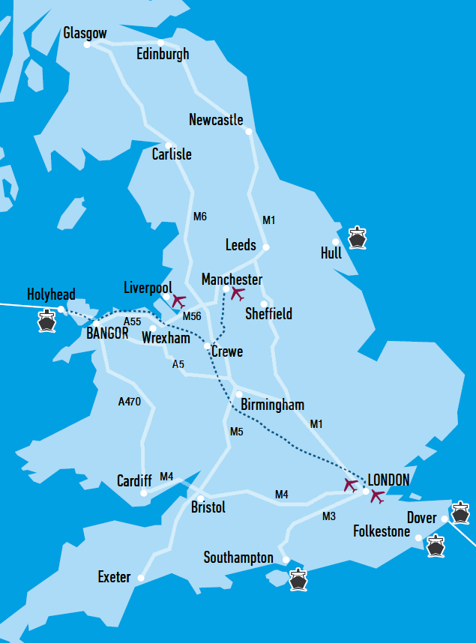
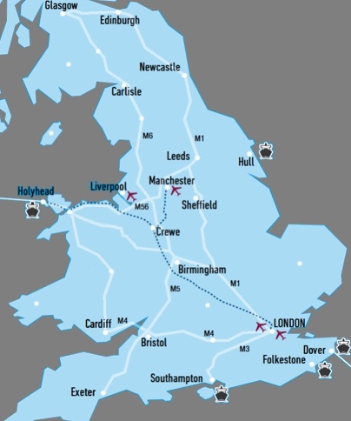
BEST UK
UNIVERSITY
SETTING
(The Independent)
One of the lowest for cost of living
Mountains & Coast
London (3 hours)
Liverpool/Manchester (1 hour 30)
*Note - Students must live within 1 hour of Bangor

Slide 16
Location
Quarry Karts Velocity 2
Notes:
International students are guaranteed accommodation

Slide 17
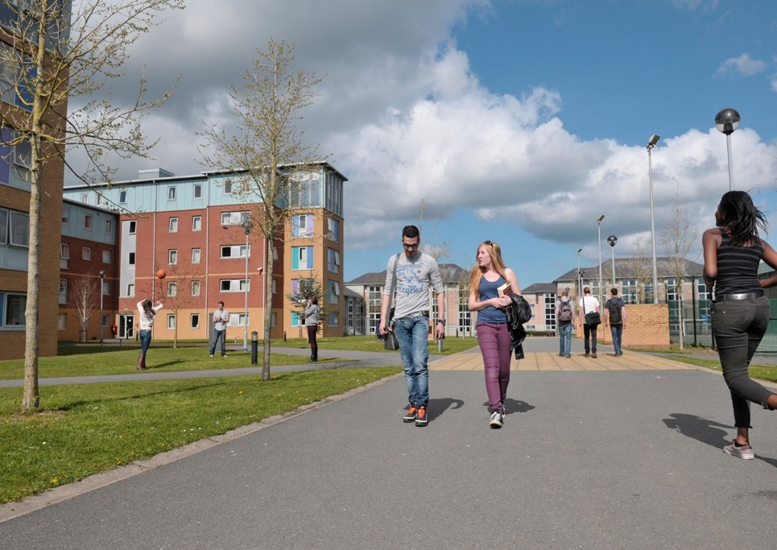
BEST
ACCOMODATION

Slide 18
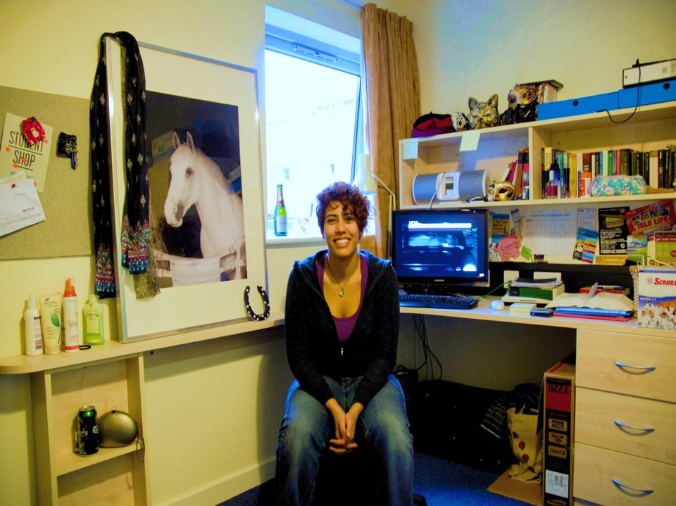
Accommodation
Ranked Top 5
in the UK for
STUDENT ACCOMODATION
(WhatUni 2019)
Guaranteed for international students
5-10 minute walk to university
Range of rooms between £95 - £190/week
Single bedrooms, private bathroom, Wi-Fi, shared kitchen, free gym membership, cafés, bars, on-site laundry services and more….

Slide 19
Fitness

Slide 20
ONE OF THE BEST VALUE PLACES TO STUDY IN THE UK
(THE INDEPENDENT)
GENEROUS
SCHOLARSHIPS
WORTH OVER £1MILLION

Slide 21
Scholarships
What’s on offer | Value
Vice-Chancellor Scholarship | 50% of the Tuition Fee
Professional Experience Scholarship | Up to £4,000
Dean Scholarship 2020/21 | Up to £5,000
International Scholarship 2020/21 | Up to £3,000
Commonwealth Master’s Scholarship 2020 | Full tuition fee waiver, monthly stipend, return airfare and more
Alumni/Existing Students/Family Discount | £1,000 in addition to the Bangor International Scholarship
Chevening Partnership Scholarship | Full fee waiver

Slide 22
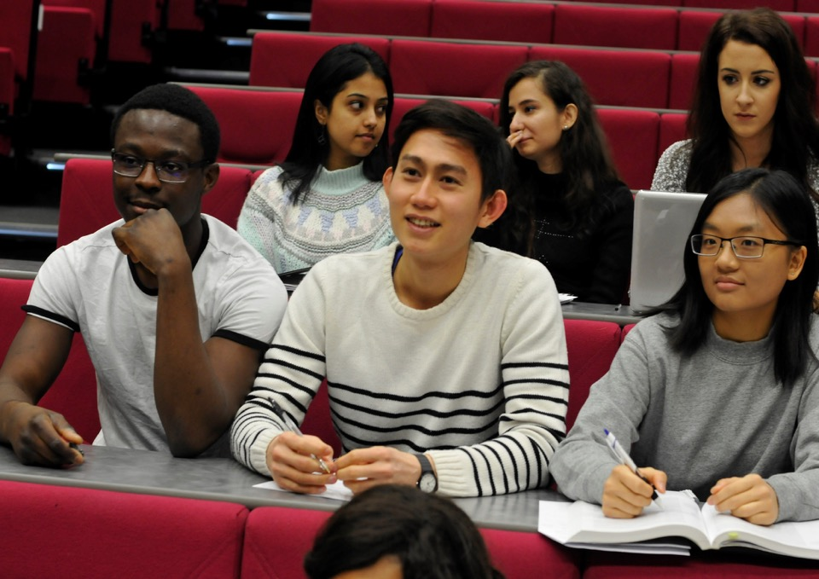
Award Winning
SUPPORT

Slide 23
Student Support
Top 10 in the UK for STUDENT
SUPPORT
(WhatUni 2018)
Employment Regulations
Immigration
Visa Applications
Health Care
Financial Matters
Living & Staying in Bangor
General Welfare Issues
Travelling Abroad

Slide 24
Thank You
Contact Details
Morgan Edwards
Regional Manager (South Asia)
Email - m.edwards@bangor.ac.uk
Mobile - 07584 556 726
Phone - 01248 38 84 16
Social Media – Bangor University/Bangor International

Slide 25
Business Studies/MBA
Top 10 in the UK for Graduate Prospects in Business Studies
(The Complete University Guide 2019)

Slide 26
Business Studies/MBA
Work experience vs Professional Qualifications? (ME Case study)
Bangor University MBA Streams | Career Direction | Professional Qualification
Banking and Finance MBA | CFO, Financial Manager, Financial Analyst | CFA Level 1
Banking and Law MBA | CFO, M&A, Partnerships | -
Chartered Banker MBA (Distance)* | Banking, Investment Banking | Chartered Banker
Environmental Management MBA | CEO, CSR, Sustainability | CMI Level 7
Finance MBA | CFO, Finance Manager, Analyst | CFA Level 1
Information Management MBA | CTO, Head of Systems, Project Managers | CMI Level 7
International Marketing MBA | CMO, Head of Marketing, PR? | CMI Level 7
Islamic Banking and Finance MBA | For banks w/ Muslim customers | CFA Level 1
International Business MBA | VP International, Cross-Border M&A | CMI Level 7
Law and Management MBA | Head of Governance, Compliance etc. | CMI Level 7
Management MBA | Broadest and least specialist MBA | CMI Level 7
* Bangor University is the only university in the UK who can offer this dual qualification
* Demand for more distance learning programs in India?

Slide 27
Business Studies/MBA
Top 50 in World for Banking (*43 in RePEc Ranking)
Top 10 in the UK for graduate prospects (The Complete University Guide 2019)
Top 10 in the UK for student satisfaction (National Students Survey 2019)
Project and consultancy work of high level
e.g. World Bank, European Commission, and UK Treasury
Research within the School has helped form European Policy

Slide 28
Business Studies Alumni
Fortune 500, FTSE 100 & SENSEX-20 companies:

Slide 29
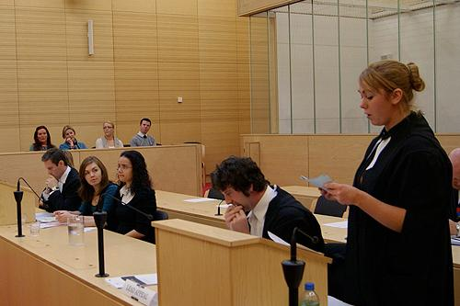
Law
Top 20 UK University for Law
(Guardian Ranking 2020)

Slide 30
Law
Ranked Top 15 in the UK for Teaching Quality (Times 2020)
All LLB programs have QLD (Qualifying Law Degree) status
Small class sizes compared to other larger UK Law Schools
90% of Bangor Law Graduates go onto further study or work
Work Placements with a number of Law firms during study
Bangor Student Law Society organises Legal Advice Clinics, Mooting Competitions, Street Law exercises to gain real life experience.

Slide 31
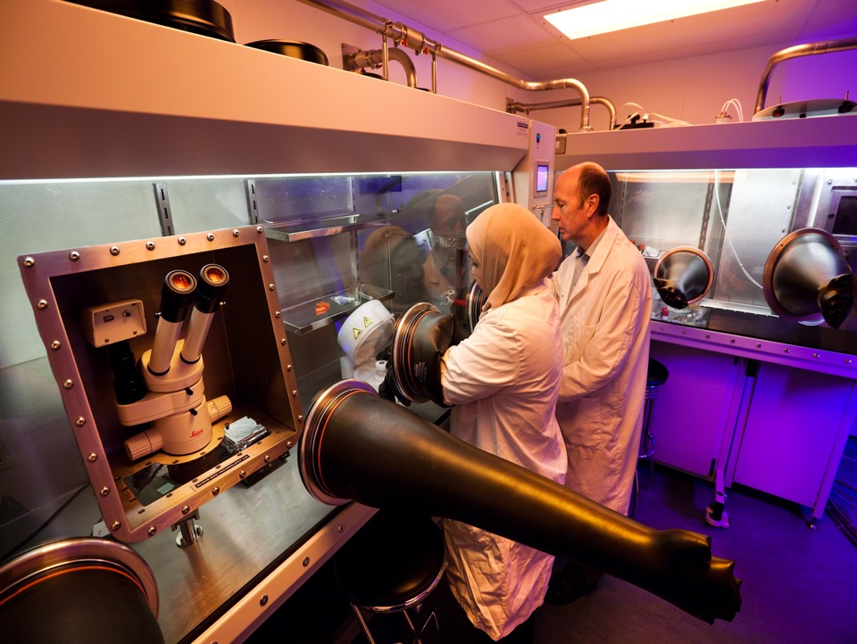
Electronic Engineering
Top 25 in the UK for Electronic Engineering
(Guardian League Table 2020)

Slide 32
Electronic Engineering
Top 25 in UK for Electronic Engineering (Guardian 2020)
Top 15 in the UK for teaching quality in Electronic Engineering (The Times 2020)
Oldest Electronics Engineering department in UK
IET accreditation for continuous 30 years
Specialisms:
VLSI Design, Optoelectronics, Broadband & Optical Communications (5G Research), Nanotechnology & Microfabrication, Organic Electronics, Bioelectronics, Microwave Devices, Polymer Electronics

Slide 33
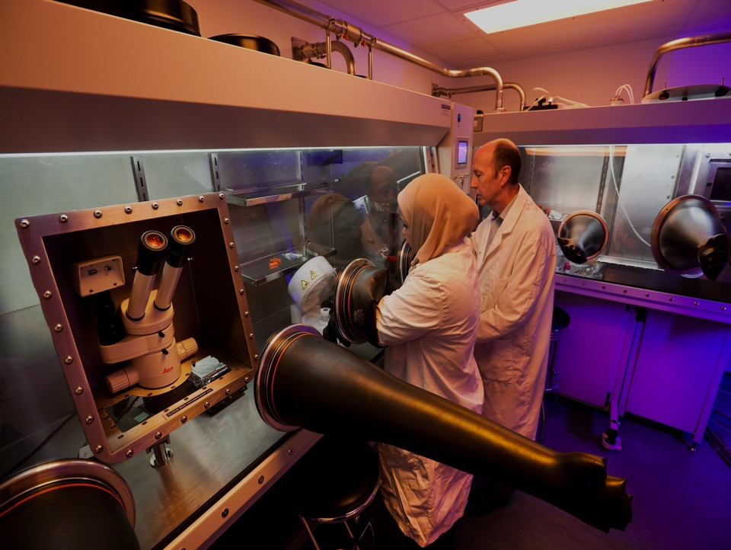
Electronic Engineering Alumni
*90% Employment Rate

Slide 34
Computer Science
Top 15 in the UK for Teaching Quality in Computer Science
(The Times League Table 2020)

Slide 35
Computer Science
Top 15 in UK for Teaching Quality (Times 2020)
High Staff to student ratio allowing staff to spend time with individual students.
All courses are accredited by the BCS (British Computer Society)
CAST (Centre of Advance Software Technology) provides projects and employment for our students during and after their studies.

Slide 36
Computer Science

Slide 37
Biotech & Genetics
Top 20 in the UK for Research in Biological Science
(Research Excellence Framework)

Slide 38
Biotech & Genetics
Top 20 in the UK according to the latest Research Excellence Framework (REF)
Centre of Excellence for Molecular Cancer Studies (North West Cancer Research Fund Institute is located within the School of Biological Sciences)
Forefront in research for molecular biology, genomics, proteomics and transgenic technologies; unravelling the cascade of controls which leads from genotype to phenotype.
Close links with NHS
Top of the range Laboratories; Advanced Mass Spectrometry Facility, Transcripomics Analysis Suite (incorporating a scanner and robotic arrayer), Imaging Facility, Bioinformatics Beowulf cluster, and Housing for Research Animals.

Slide 39
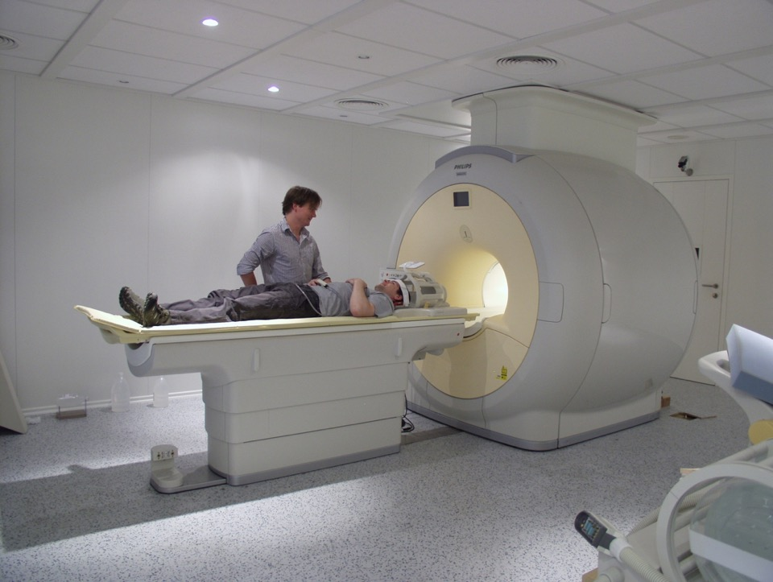
Psychology
Top 20 in the UK for Psychology Research
(Research Excellence Framework)

Slide 40
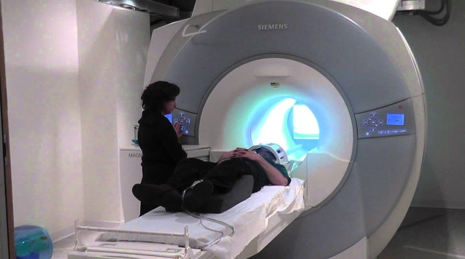
Psychology
Top 10 in the UK for Teaching Quality (Times League Table 2020)
Top 20 in the UK for Psychology research (REF, Complete Guide 2020)
Top 10 in the UK for course satisfaction (Guardian 2020)
3T MRI Scanner costing £1,500,000
One of the oldest and largest Psychology departments in the UK

Slide 41
THE
ADVENTURE
STARTS HERE
WALES, UNITED KINGDOM
Notes:
International students are guaranteed accommodation

