Slide 1
Welcome to John Jay College of Criminal Justice!
Notes:
TITLE SHOULD BE: FONT: ARIAL BLACK COLOR: DARK BLUE or CYAN

Slide 2
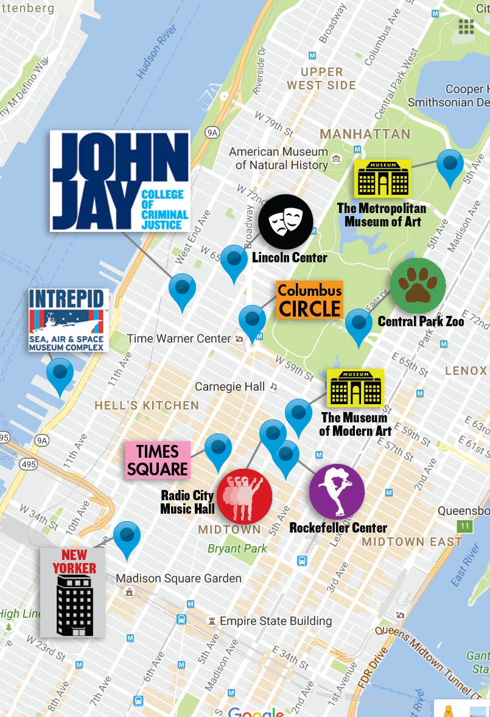
New York City
as your Classroom
Notes:
TITLE SHOULD BE: FONT: ARIAL BLACK COLOR: DARK BLUE or CYAN

Slide 3
Community of Bloodhounds
Student Body
13,000 +
60+
130+
15
Undergraduate Students
Student Clubs & Organizations
Nationalities Represented
47%
First-generation College Students
NCAA Division III Athletic Teams
60K
Square-foot Rooftop Park and Commons
Diversity

Slide 4
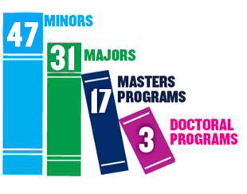
Educating for Justice
Most Popular Majors & Programs
BA/MA Tracks
Pre-Law Institute
PRISM
Articulation Agreements
Notes:
TITLE SHOULD BE: FONT: ARIAL BLACK COLOR: DARK BLUE or CYAN

Slide 5
Majors
Anthropology (BA) Applied Math (BS) (Data Science and Cryptography)
Cell and Molecular Biology (BS)
Computer Science and Information Security (BS)
Criminal Justice (BA) (Crime Control and Prevention)
Criminal Justice (BS) (Institutional Theory and Practice)
Criminal Justice Management (BS)
Criminology (BA) Culture and Deviance Studies (BA)
Economics (BS)
Emergency Services Administration (BS)
English (BA)
Fire Science (BS)
Forensic Psychology (BA)
Forensic Science (BS)
Fraud Examination and Financial Forensics (BS)
Gender Studies (BA)
Global History (BA)
Humanities and Justice (BA)
Human Services and Community Justice (BA)
International Criminal Justice (BA)
Latin American and Latina/o Studies (BA)
Law and Society (BA)
Philosophy (BA)
Police Studies (BS)
Political Science (BA)
Public Administration (BS)
Security Management (BS)
Sociology (BA)
Spanish (BA)
Toxicology (BS)
Notes:
TITLE SHOULD BE: FONT: ARIAL BLACK COLOR: DARK BLUE or CYAN

Slide 6
Special Programs
Special Programs
Average HS GPA 94
Average SAT score 1340
Essay Questions
Recommendation Letters
Interview
Average HS GPA 89
Average SAT score 1150
Essay Questions
Recommendation Letters
Interview

Slide 7
The John Jay Value
Full-time 2019-2020 Tuition
Out of State Resident - $18,600 (30 credits)

Slide 8
How to Apply
Apply online: www.jjay.cuny.edu/apply-international-student
Freshmen Admission:
$65 Application fee
Official HS transcript(s) with translation
Official TOEFL/IELTS/DuoLingo English scorers
International Admissions are on a rolling basis for Fall and Spring Intakes.
Transfer Admission:
$70 Application fee
Proof of Completion of Secondary School
Official College transcripts from all colleges previously attended w/ translations.
Proof of English proficiency if educated outside the U.S.
International Admissions are on a rolling basis for Fall and Spring Intakes.
Notes:
TITLE SHOULD BE: FONT: ARIAL BLACK COLOR: DARK BLUE or CYAN

Slide 9
Is John Jay Your Top Choice?
Would you like a priority review of your application and possible earlier decision?
If so, join our Priority Action Program!
To join you must complete the following steps:
High School students need to submit their freshman application before December 1st.
Opt in to the Priority Action Program by clicking the invitation link, that will be sent via email after submitting the application, before December 1
Submit all Transcripts and SAT/ACT scores to John Jay College and CUNY’s University Application Processing Center (UAPC) prior to Dec. 10th

Slide 10
Immigration Information
Special Programs
If you plan on studying on a student visa:
International students who are admitted into a degree program at CUNY will need to obtain a Certificate of Eligibility (Form I-20) in order to enter and/or remain in the U.S. as an F-1 student.
This will be emailed to you after you are admitted to the college.
You will need to prove you have the financial support to study at John Jay for one year.
This financial support can come from sponsors who will fill out affidavits of support in the application.
2020-2021 Cost of Attending:
Bachelor’s Degree - $14,880.00
Master’s Degree/Advanced Certificate - $15,390.00
Master’s in Public Administration (MPA) - $18,180.00
You are also responsible for the estimated living expenses:
Books and Supplies: $1,819.00
Transportation: $1,518.00
Personal Expenses: $3,207.00
Housing: $18, 540.00
Meals (at home) $2,883.00
Lunch $1,813.00
Total Student Living Expenses: $29,780.00

Slide 11
Then:
Once approved you will receive the completed I-20 form by mail.
Make an appointment with the nearest embassy or consulate. Most appointments for a visa interview can be made via their webpages.
GIVE YOURSELF PLENTY OF TIME. Visa processing can take weeks-even a month or so. Bring all the required documents to your interview.
Once you have your Visa you can enter the US 30 days before the semester begins.
Registration and advisement takes place a week or so before classes begin. Don’t worry we’ll have space for you!
Immigration Information
Special Programs
Please Note:
Tuition and Fees stated are based on Bachelor’s degree students registered for 12 credits per semester. This is the minimum number of credits required to be a full-time undergraduate student (necessary to maintain lawful immigration status)
Master’s and MPA students are required to be registered for 9 credits a semester.
You can have financial sponsors and housing sponsors. These sponsors will complete affidavit of support and their support will be included in the overall cost of attendance/living expenses.

Slide 12
Hope to see you soon!!
International Admissions Office
524 West 59th Street
L.64.20
New York, NY 10019
internationaladmissions@jjay.cuny.edu
www.jjay.cuny.edu/international

