Slide 2
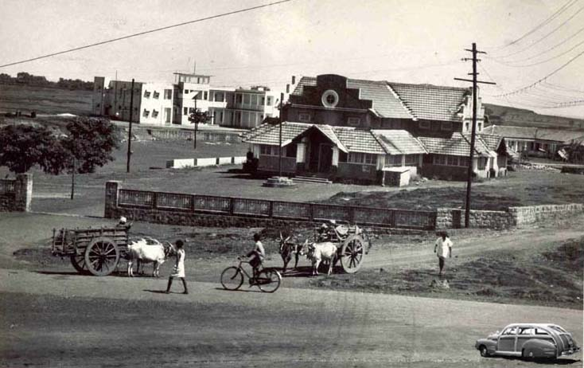
About Manipal and its Global Presence
NEPAL
First private educational institute of India, set up in a small town – Manipal, Karnataka, India.
DUBAI
ANTIGUA
MALAYSIA
1953
TODAY
Founded by Dr T M A Pai

Slide 3
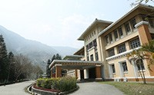
Manipal’s Global Presence
MAHE INDIA
Manipal, Karnataka
Best Private University of India - QS World Rankings 2020
MANIPAL UNIVERSITY JAIPUR
Jaipur, Rajasthan
A Public Private Partnership with the State of Rajasthan
SIKKIM MANIPAL UNIVERSITY
Gangtok, Sikkim
A Public Private Partnership with the State of Sikkim
MANIPAL COLLEGE OF MEDICAL SCIENCES
Pokhara, Nepal
A leading medical institution together with a 700-bed Manipal Teaching Hospital.

Slide 4
Manipal’s Global Presence
MANIPAL INTERNATIONAL UNIVERSITY
Nilai, Malaysia
A full-fledged Malaysian University offering multi-disciplinary programs.
GLOBALNXT UNIVERSITY
Malaysia
A pioneering institution offering graduate programs through a unique global classroom pedagogy.
MELAKA MANIPAL MEDICAL COLLEGE
Malaysia
The single largest contributor of Doctors to the Malaysian healthcare system.
AMERICAN UNIVERSITY OF ANTIGUA
Antigua
Successfully addresses the growing shortage of Doctors in the USA.

Slide 5
About MAHE Dubai
Manipal Academy of Higher Education, Dubai is the branch campus of Manipal Academy of Higher Education (MAHE), Manipal, India – the Best Private University in India (QS World Rankings 2020).
MAHE Dubai campus established its presence in Dubai in the year 2000. Today, we are home to over 2000 students from more than 40 nationalities and boast of a strong network of over 4000 alumni.

Slide 6
Why trust MAHE Dubai with your Education?
Degree from MAHE Dubai is recognized by
Ministry of Human Resource Development, Government of India
University Grants Commission (UGC)
Knowledge and Human Development Authority (KHDA), Dubai, UAE
World Education Services (WES)

Slide 7
Why trust MAHE Dubai with your Education?
KHDA Ratings
Knowledge and Human Development Authority (KHDA) has rated MAHE Dubai as 4 stars
(out of 5) in its latest Higher Education Classification and Rating Framework.

Slide 8
Why trust MAHE Dubai with your Education?
In 2019, Forbes Middle East awarded MAHE Dubai as the Best University offering
‘Outstanding Support for Students’.

Slide 9
Why trust MAHE Dubai with your Education?
Manipal Academy of Higher Education has been granted the status of Institute of Eminence by the
Ministry of Human Resource Development (MHRD), Government of India.
We are among the only three private Universities to have received this status.

Slide 10
Why trust MAHE Dubai with your Education?
QS World University Rankings has consistently ranked Manipal Academy of Higher Education as
the #1 Private Indian University.
We have achieved the recognition for four years in a row –
QS Rankings 2017, 2018, 2019 and 2020.
NIRF Rankings 2018 and 2019, released by the Ministry of Human Resource Development (MHRD), Government of India has placed Manipal Academy of Higher Education as
the #2 Private Indian University.
Overall it is the 9th Best University in India.

Slide 11
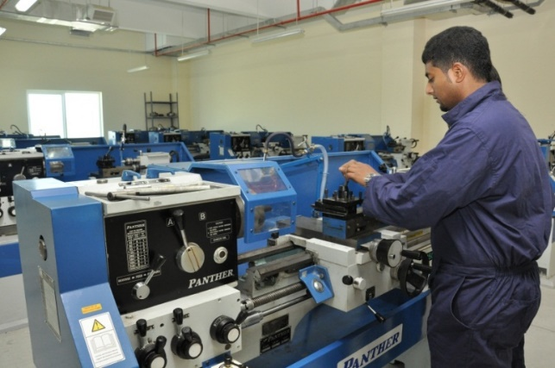
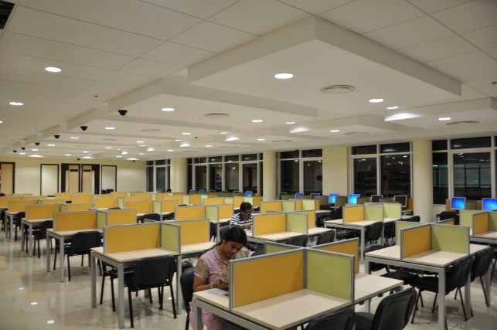
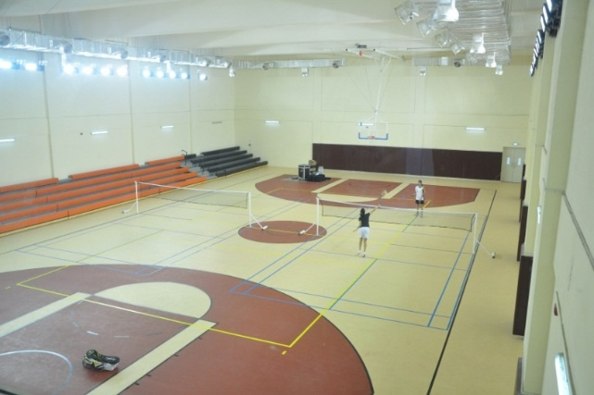
Facilities and infrastructure at MAHE Dubai
Labs
Green Campus
Library
Labs
Sports
Campus in the Evening

Slide 12
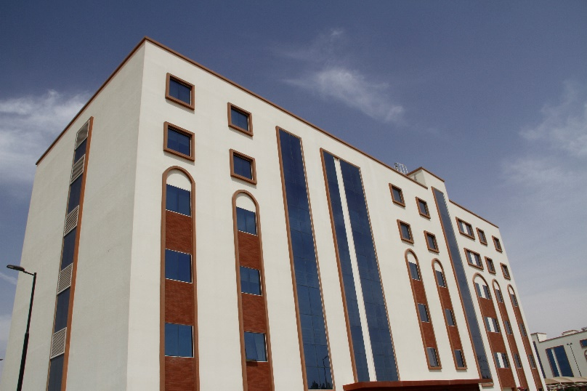
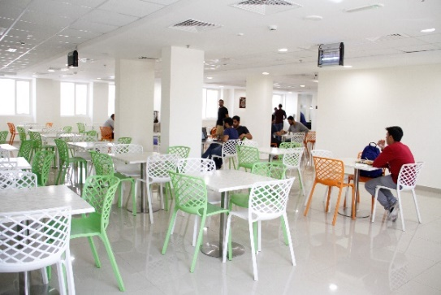
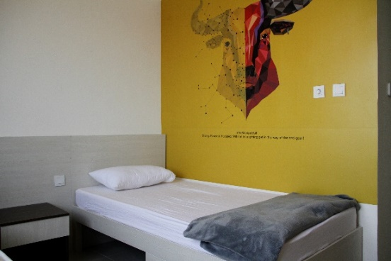
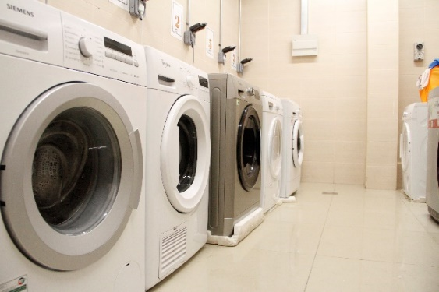
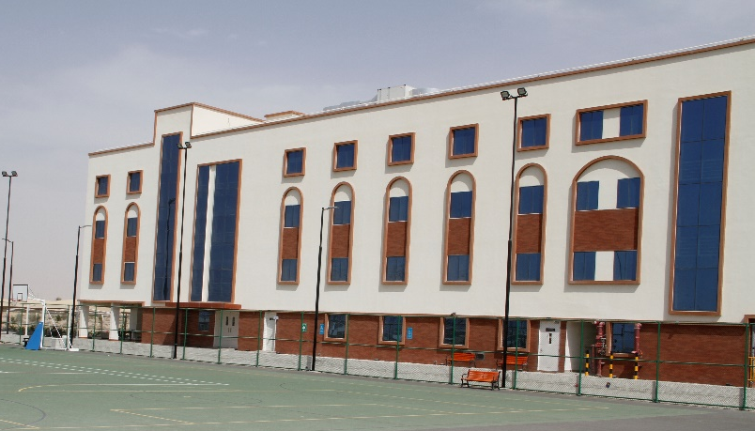
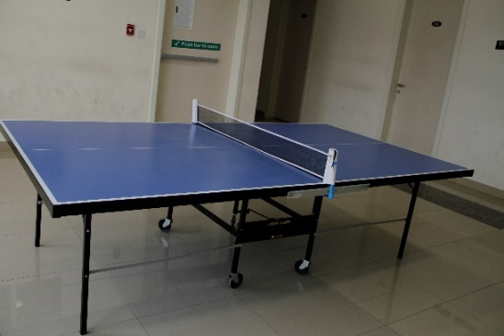
On-campus hostels at MAHE Dubai
Dedicated hostels for girls and boys
Single, double and triple occupancy
Safe and secure campus – 24/7 security and CCTV surveillance
Free WiFi, Gym and Laundry Access
Free Airport drop and pickup
Weekly shopping and Dubai site-seeing visits
Cafeteria with India and International cuisines

Slide 13
Why study in Dubai?
A cultural melting pot with people from over 200 different nationalities
Global employment and entrepreneurship opportunities
Experience world-renowned hospitality
One of the fastest growing cities in the world
Adventure. Travel. Shop. Your choice!

Slide 14
Programs offered at MAHE Dubai
40+ programs offered across 5 schools and 7 disciplines.
Undergraduate, Postgraduate, Certificate Courses, Foundation Courses, as well as PhD.

Slide 15
Programs offered at MAHE Dubai
Undergraduate programs
Postgraduate programs
B Tech Engineering – Day
B Tech Engineering – Evening
BSc Information Systems & Management
Chemical
Civil
Computer Science
Electrical & Electronics
Mechatronics
Civil
Mechanical
Mechanical
Electrical & Electronics
MTech Computer Science & Information Security
MTech Construction Engineering & Management
MTech Engineering Management
MTech Manufacturing Engineering
MSc Information Sciences
PG Diploma in Data Science

Slide 16
Programs offered at MAHE Dubai
BCom Professional
BCom Professional (with ACCA)
BBA
BBA – Evening
Undergraduate programs
Postgraduate programs
MBA Global Business (Day)
Work Mode MBA ( Evening / Weekend )
PG Diploma in Logistics & Supply Chain

Slide 17
Programs offered at MAHE Dubai
Undergraduate programs
Postgraduate programs
BA Media & Communication
Certificate Program in Graphic & Multimedia
MA Media & Communication
BArch
Certificate Program in Interior Design
Bachelor of Design (Interior Design)
MA Interior Design

Slide 18
Programs offered at MAHE Dubai
Undergraduate programs
Postgraduate programs
MSc Medical Biotechnology
MSc Molecular Biology & Human Genetics
BSc Biotechnology
BSc Food and Nutrition Science
BA Humanities

Slide 19
Other programs at MAHE Dubai
Foundation Program
English Enhancement Program
PhD
Engineering
Management
Biotechnology

Slide 20
Scholarships offered at MAHE Dubai
Academic Scholarship
Up to 30% scholarship offered in form of tuition fee waiver in the first year of study
Sports Scholarship
Up to 50% scholarship offered in form of tuition fee waiver in the first year of study
Extended Scholarship
Provision to extend the scholarship of first year to the following year tuition fees
Girl Child Scholarship
Al Daem Scholarship
100% scholarship
Offered in partnership with the Embassy of India, UAE
Up to 100% special scholarship to students under financial distress
Alumni Scholarship
Up to 25% scholarship for graduates of MAHE Dubai for their further study at MAHE Dubai

Slide 21
Tech-enabled Learning
Student learn in a highly competitive tech-enabled environment, including
Student Communication App
Learning Management System App
Global online courses embedded in the curriculum
Online Assignment Assessment Tool
Online Research Repository

Slide 22
Our Academic and Industry Partners

Slide 23
MAHE Dubai Career Services to facilitate Placements and Internships

Slide 24
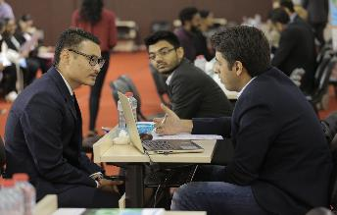
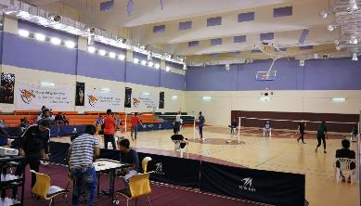
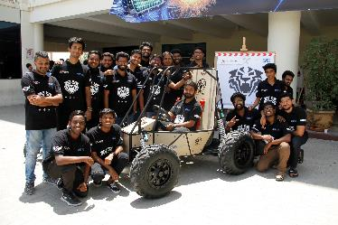
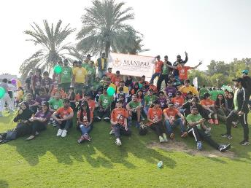
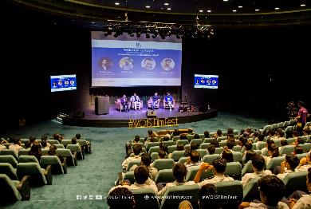
Student-centric activities across the year for their holistic development
Career Fair
Sports Fest
WOIS- Short Film Festival
Technovanza
Walkathon

Slide 25
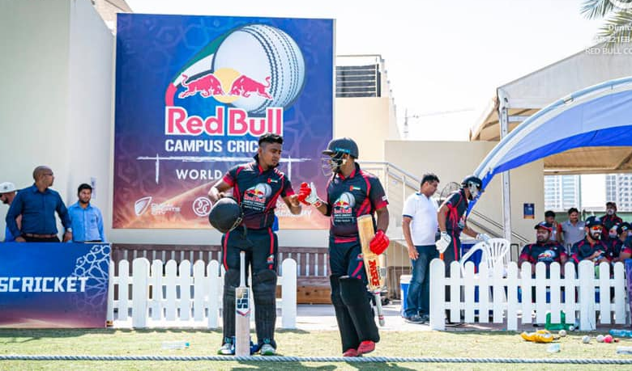
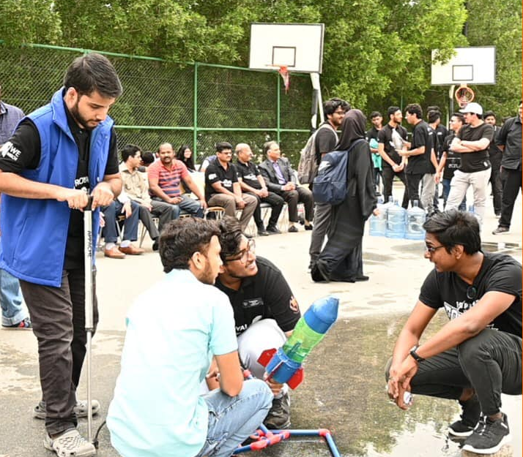
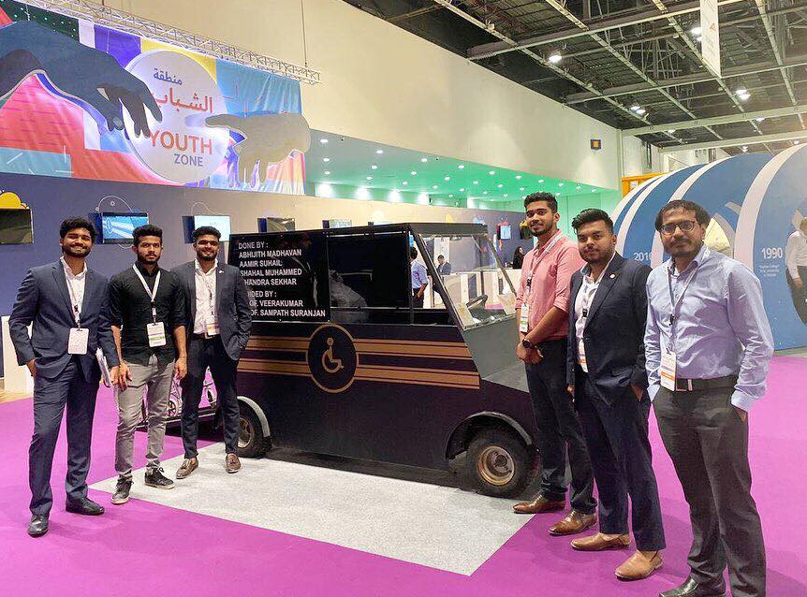
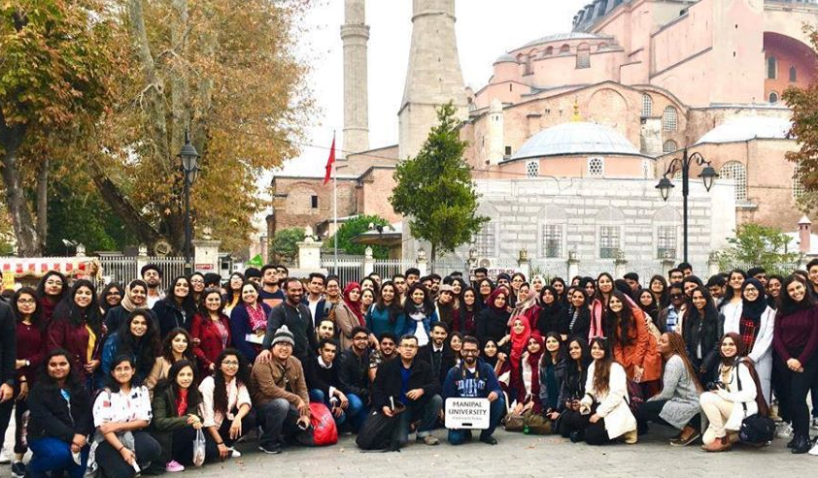
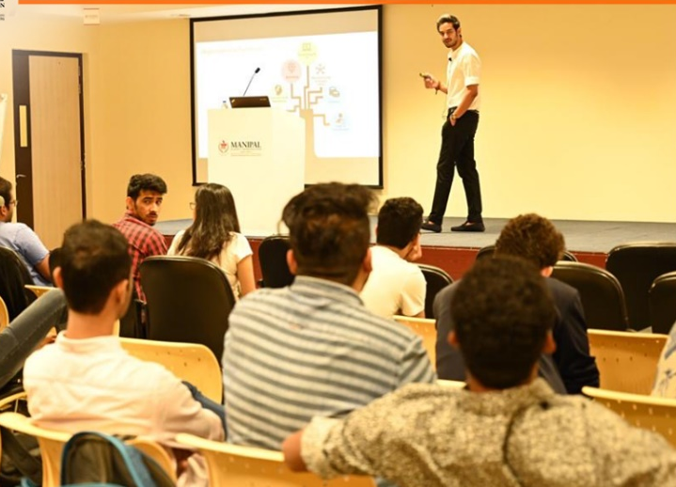
Student-centric activities across the year for their holistic development
International
Tournaments
Project Fest
Student Project Showcase
Cultural
Events
International
Visits
Industry
Connect

Slide 26
The MAHE Dubai Advantage
Merit based Scholarship
Globally recognized
Faculty
Industry oriented curriculum
Research & Project based learning
State-of-the-art
infrastructure
Career Services
(Placements & Internships)
Tech-based Pedagogy
Global Collaborations
Academic Partnerships
On-campus Hostels

Slide 27
Thank You!

