Slide 1
TRINITY WESTERN UNIVERSITY
Info Session

Slide 2
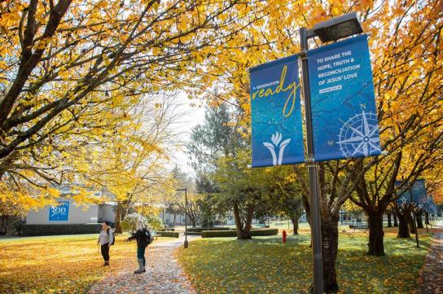
Table of Contents
Welcome to TWU
Campus Locations
Programs
Student Life
Application Process
Q&A

Slide 3
Welcome to TWU

Slide 4
Why Canada
Canada opens its arms for students around the world to study internationally.
High quality of life for those who choose to visit or make home within its borders.
It is particularly attractive to international students, offering access to a 3-year post-graduate work permit(PGWP) and Permanent Residence (PR).
Enjoy discovering Canada’s beauty, diversity and many opportunities during and after your studies.

Slide 5
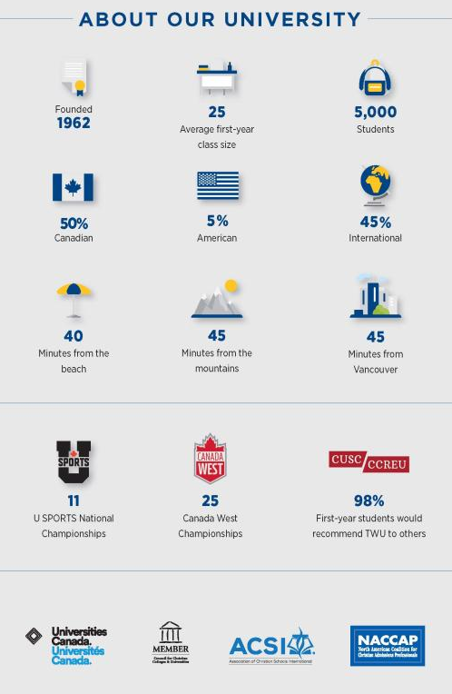
Why TWU
Recognized for Academic Quality
Received seven consecutive A+ rankings for Quality of Teaching and Learning
Holds three Canada Research Chairs
Wins national championships in U Sports.
Wide array of undergraduate, graduate, and adult degree-completion programs
competence to make a positive impact in the lives of others.

Slide 6
National Survey of Student Engagement:
Assessing schools on student satisfaction, teaching practices and more
If you could start over, would you go to the institution you are now attending?

Slide 7
National Survey of Student Engagement:
Assessing schools on student satisfaction, teaching practices and more
Supportive Environment​ This engagement indicator assesses how well universities provide support for academic and non-academic endeavours, ranging from tutoring services and writing centers to recreation, health care and counselling. Also measured are opportunities for students to be involved socially at campus events and activities and to interact with students from different backgrounds.

Slide 9
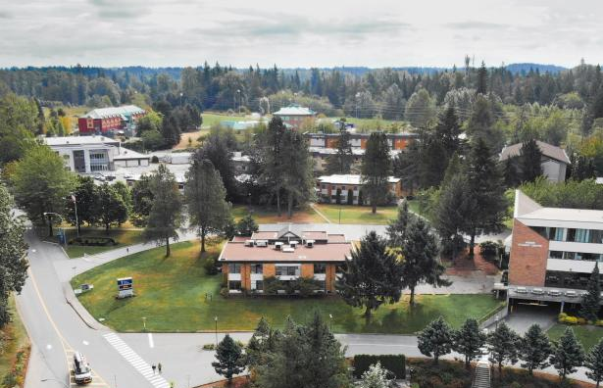
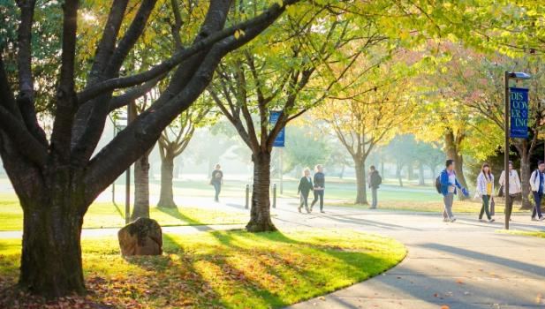
LANGLEY CAMPUS (1962)
Our main campus spans 157 acres and is located only 45 minutes from downtown Vancouver.
Facilities:
Gym
Library
Learning Commons
Science Labs
Music Rooms
Bookstore
Cafeteria
Commuter Collegiums
Undergraduate On Campus Housing
Back 40: walking trails
Sports Fields
Theatre

Slide 10
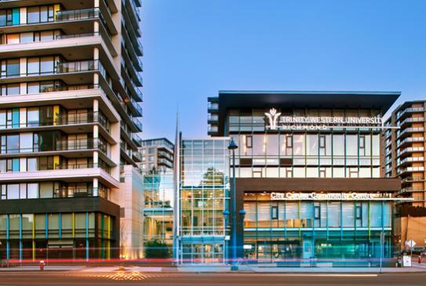
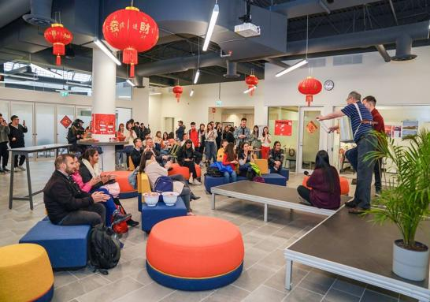
TWU Richmond
Located in the heart of the city, TWU Richmond provides programs tailored to the urban and international audience in Richmond and Metro Vancouver.
Convenient Location
Close to the SkyTrain
Part-time Work Opportunities
TLC(Trinity Language Centre)
Learning Commons
Collegium
High-tech Classrooms
Close Community
Two Locations:
Minoru (2015')
Lansdowne(2020')

Slide 11
Undergraduate Programs
FACULTY OF NATURAL
& APPLIED SCIENCES
Biology (BSc)
Biotechnology (BSc)
Biotechnology and Business Administration (BSc)
Biotechnology and Chemistry (BSc)
Chemistry (BSc)
Computer Science (BSc)
Engineering (Transfer Program)
Environmental Studies (BSc)
General Studies (BSc)
Geography (BSc)
Information Systems (minor)
Mathematics (BSc)
Mathematics with Computing Science (BSc)
Natural and Applied Sciences (BSc)
Physics (concentration, minor)
Pre-Professional Sciences
Dentistry, Medicine, Pharmacy, Veterinary Medicine
SCHOOL OF BUSINESS
Accounting (minor)
Biotechnology and Business Administration (BSc) Business Administration (BA)
Business Administration (BBA)
• Accounting (CPA-accredited)
• Corporate Finance
• Human Resource Management
• International Business
• Leadership and Management
• Marketing
Corporate Communication (BA)
Economics (minor)
Information Systems (minor)
International Development Studies (minor)
Sport and Leisure Management (BHK)
SCHOOL OF EDUCATION
Education (BA/BEd or BSc/BEd)
• Elementary
• Secondary
Two-Year Post-Degree Program (BEd)
• Elementary
• Secondary
Special Education (minor)
SCHOOL OF HUMAN KINETICS
Elementary School Physical Education (minor)
Human Kinetics (BA)
Human Kinetics (BHK)
• Generalist
• Kinesiology
• Physical Education
• Sport and Leisure Management Sport and Leisure Management (BA)
FACULTY OF HUMANITIES
& SOCIAL SCIENCES
Biblical Studies (BA)
Catholic Studies (minor) *offered in partnership with Catholic Pacific College Christianity and Culture (BA)
English (BA)
Environmental Studies (BA)
European Studies (BA)
French (concentration, minor)
Gender Studies (minor)
General Studies (BA)
Geography (BA)
History (BA)
Human Services (certificate)
Humanities (BA)
Inter-Cultural Studies (BA)
International Studies (BA)
Linguistics (BA)
Philosophy (BA)
Political Studies (BA)
Psychology (BA)
Religious Studies (BA)
Social Studies (concentration, minor) Sociology (BA)
Spanish (concentration, minor)
Teaching English as a Second Language (certificate)
World Languages and Cultures (BA)
SCHOOL OF THE ARTS,
MEDIA + CULTURE
Acting (BFA)
Art + Design (BA)
Arts, Media + Culture (BA)
Corporate Communication (BA)
Film Studies (minor)
Game Development (BA)
Media + Communication (BA)
• Leadership stream
• Media stream
• Professional writing stream Music (BA)
Theatre (BA)
Worship Arts (BA)

Slide 12
UG Program Requirements
Program | Academic Admission requirement | Language Admission requirement | Tuition per Semester Hour | Tuition per Year | Scholarship
UG | GPA 2.7 | IELTS 6.5 overall with 6.0 Writing | $777/s.h. | $23,310 30 credits/year | GPA3.0-3.75 $2,000/year GPA3.76-4.00 $4,000/year GPA4.01+ $6,000/year
U1 | GPA 2.0-2.69 | IELTS 6.0 overall with 5.5 Writing | $777/s.h. | $23,310 30 credits /year | N/A
Open Gate | 70% + Students have completed grade 11 | IELTS 6.0 with no score less than 5.0 |  |  | N/A

Slide 13
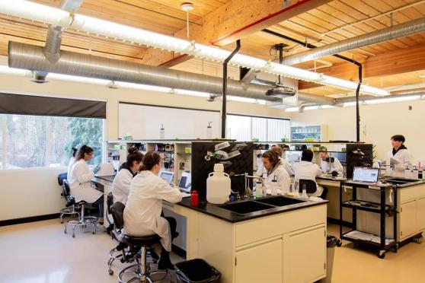
U1/UG Document Checklist
1. Signed and completed TWU Application Form
2. Application Fee of $150 CAD (Non-Refundable)
3. Signed Refund Policy
4. Copies of high school and post- secondary transcripts
5. A copy of High School Diploma
6. School Enrollment Certificate (If you have not graduated from a high school/post-secondary school)
7. A copy of student’s passport (Info Page)
8. A copy of valid study permit (If Applicable)
9. Proof of English Language Proficiency (IELTS, TOEFL OR CAEL report if applicable)

Slide 14
MASTER OF BUSINESS ADMINISTRATION
• Management of the Growing Enterprise
• International Business
• Non-Profit & Charitable Organization Management
MASTER OF ARTS IN LEADERSHIP
• Business
• Education
• Health
MASTER OF ARTS IN INTERDISCIPLINARY HUMANITIES
• English
• History
• Philosophy
MASTER OF ARTS IN LINGUISTICS
MASTER OF ARTS IN IN TESOL
MASTER OF ARTS IN COUNSELING PSYCHOLOGY
Graduate Programs

Slide 15
MBA Program
The International Business specialization equips students in the art of business leadership from a global perspective. An MBA with an international focus gives students the expertise and confidence to take their business career goals to a global level.
No more than 35 students in the class
Students can connect with the Professors
Professors have real world experience (CEOs, business owners and entrepreneurs)

Slide 16
MA Leadership Program
Our degree program is designed to develop emerging leaders to become confident and effective servant leaders for the 21st Century.
Specializations:
Business
Intended for those in the business world who want to take their leadership to the next level.
Education
Equips graduates to shape their organizations in visible and meaningful ways, positively influencing future generations of learners.
Health
Designed for entry-level health-care providers to grow their leadership capacity and for middle managers to enhance their leadership skills.

Slide 17
Graduate Program Requirements
Program | Academic Admission requirement | Language Admission requirement | Tuition per Semester Hour | Program Tuition
MBA | GPA 3.0 Conditional Offer: >2.3 | IELTS: 7.0 each band | $805/s.h. | $36,225 CAD *additional cost for Travel Study and MBA Bridge Courses
MA Leadership (all streams) | GPA 3.0 Conditional Offer: >2.75 | IELTS: 7.0 each band | $725/s.h in Langley $795/s.h. in Richmond Campus | $26,092.00 CAD Langley Campus $28,622.00 CAD Richmond Campus

Slide 18
MBA/MA Leadership Document Checklist
1. Signed and completed TWU Application Form
2. Application Fee of $150 CAD Dollars (Non-Refundable)
3. Signed Refund Policy
4. Copies of All post-secondary transcripts
5. Copy of post-secondary degree
6. School Enrollment Certificate (If you have not graduated from a post-secondary school)
7. Personal Statement
8. 2 Reference Letters (One Professional, One Academic/Two Academic)
9. Resume
10. FCSA Report (If post-secondary degrees and transcripts were earned outside of Canada or US)
11. A copy of the student's passport (Info Page)
12. A copy of a valid study permit (If Applica13. Proof of English Language Proficiency (IELTS, TOEFL OR CAEL report if applicable)

Slide 19
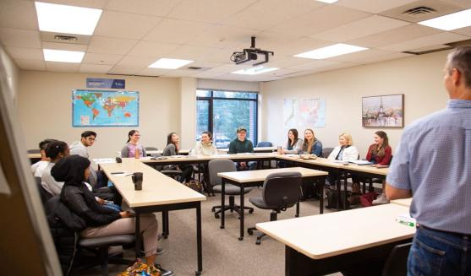
BA in Leadership
TWU’s BA in Leadership program will give you the tools you need to lead well in whatever setting you find yourself. This is a block transfer program.
Program | Academic Admission requirement | Language Admission requirement | Tuition per Semester Hour | Program Tuition
BA in Leadership | GPA 2.0* | IELTS 6.0 overall with 5.5 other bands | $777/s.h. | $48,951CAD (63 Credits)
Students can transfer up to 60 Credits
Completion of a Bachelor’s degree, or three-year diploma, post-secondary courses in process (at least 2 years study with 45 credits)

Slide 20
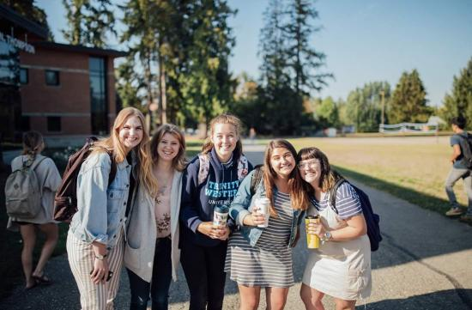
BA LEADERSHIP Document Checklist
1.Completed and Signed BA Leadership Application Form
2. Application fee of $150 CAD (non-refundable)
3. Completed and Signed FCSA Application Form (evaluation fee of $215 USD)
4. Signed Refund Policy
5. All official post-secondary transcripts (original and notarized versions)
6. Copies of all post-secondary diplomas or degrees (original and notarized versions) or School Enrollment Certificate (original and notarized version) if you have not graduated from a post-secondary school
7. Official Proof of English Language Proficiency Completed and Signed ESL Application Form (conditional admission)
8. A copy of the student’s passport
9. A copy of a valid Study Permit (if applicable)

Slide 21
Trinity Language Center
Program | Level | IELTS | TOEFL | CAEL |  | Tuition
AES Language Program for Academic Studies | AES Level 1 | <=4.0 | <=34 | 0-29 | Language Course | $6,960CAD
 | AES Level 2 | 4.5 W: >= 4.0 | 35-45 W: >= 6 | 30-39 W: >= 15 | Language Course | $6,960CAD
 | AES Level 3 | 5.0 W: >= 4.5 | 46-59 W: >= 12 | 40-49 W: >= 30 | Language Course | $6,960CAD
 | AES Level 4 | 5.5 W: >= 5.0 | 60-77 W: >= 14 | 50-59 W: >= 40 | Language Course | $6,960CAD
PGS Language program for Graduate Students in TWU | PGS Level 1 | 6.0 W: >= 5.5 | 78-87 W: >= 18 | 60-69 W: >= 50 | Language Course+ University courses | $7,932CAD
 | PGS Level 2 | 6.5 W: >= 6.0 | 88-99 W: >= 21 | 70-79 W: >= 60 | Language Course+ University courses | $8,998CAD

Slide 22
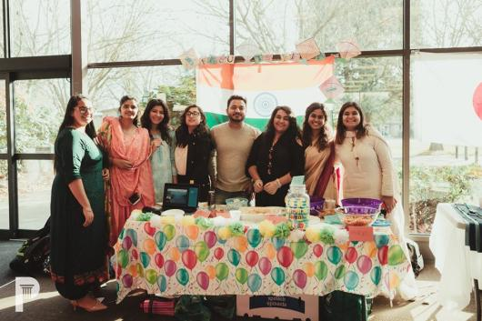
STUDENT LIFE
Community Life
Student Leadership
Student Ministries
Learning Commons
Wellness Centre
Gym
Library
GLOBAL ENGAGEMENT OFFICE
The Global Engagement Office is dedicated to making disciples through its on and off campus programming.
COMMUNITY DINNERS
Are you "culturally hungry"? Learn how to cook a delicious meal from a different culture and learn more about their culture.
BRIDGE
Make friends with local North American students and international students through fun activities, amazing discussion and group hangouts. This is your opportunity to build cross-cultural friendships!

Slide 23
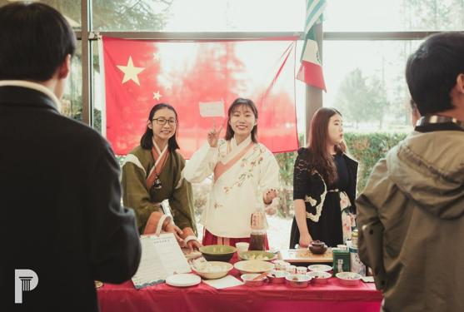
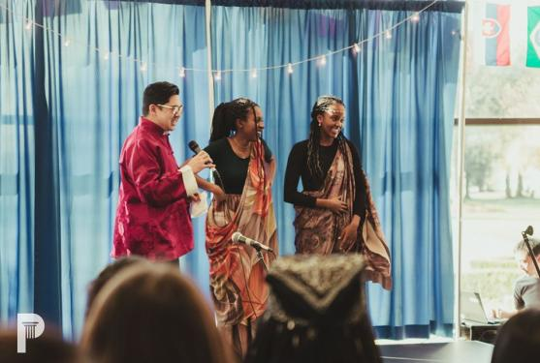
INTERNATIONAL STUDENTS
More than 60 countries are represented in the student body.
INTERCULTURAL PROGRAMS
The Intercultural Programs (ICP) team serves the international student population by providing them with an introduction and orientation to the TWU community, and by offering ongoing support as they transition to life and school in Canada.
CULTURE CLUBS
Get involved with the various TWUSA culture clubs on campus. These clubs get together to hangout, run activities in the community and promote their culture. Clubs include Indian, Chinese, Afro-Caribbean, Korean and Latin.

Slide 24
UNDERGRADUATE ON CAMPUS HOUSING: LANGLEY
2020-2021 Academic Year | Dorm Room Rates
Premium:
Douglas | $4,950
Skidmore | $5,100
Robson (2 person) | $5,200
Standard:
Robson (3 person) | $4,400
Fraser | $4,400
Economy | $3,900
Single | Additional $2,000
2020-2021 Academic Year | Apartment Room Rates
McMillan:
1 Bedroom (2 person) | $5,000
2 Bedroom (3 person) | $6,000
2 Bedroom (4 person) | $4,500
Fraser:
1 Bedroom (2 person) | $5,100
2 Bedroom (3 person) | $6,100
2 Bedroom (4 person) | $4,600
Jacobson:
3 Bedroom (6 person) | $4,300
3 Bedroom (5 person) | $4,700
3 Bedroom (4 person) | $5,350
2 Bedroom (4 person) | $4,300
2 Bedroom (3 person) | $4,700
*Meal Plan per Semester: $1,862-$3,063 CAD

Slide 26
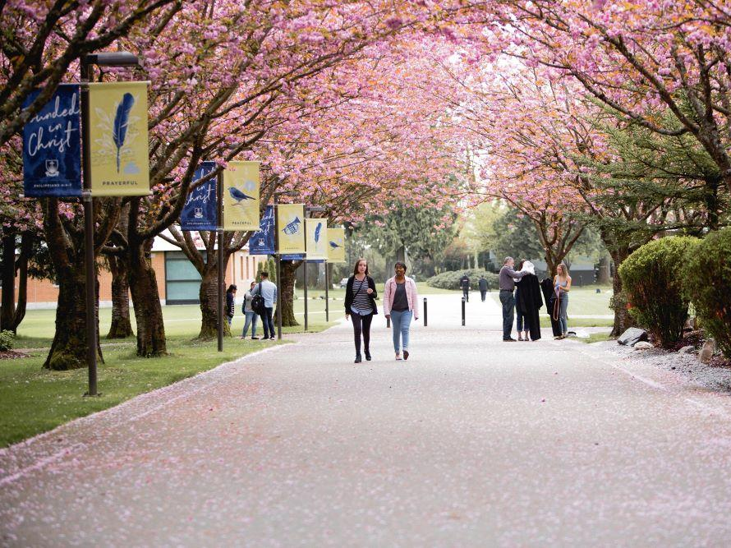
Q&A

