Slide 1
Top 4 Reasons to choose Canada
High quality education
Security
Job opportunities
Quality of life

Slide 2
Learn FRENCH and get a monthly pay of $800 (full time)
BEST CITY FOR STUDENTS IN 2017 by QS Best Student Cities 2017
Biggest center of commerce, tourism and other economic sectors in Canada
Highest employment/ job opportunities is Canada
Montreal has the second highest number of restaurants
Unlimited access to public transports, like bus and metro
Montreal has a diverse climate

Slide 3
Quebec Experience Program (PEQ)
The most popular fast-track immigration program that allows eligible international graduates of Quebec schools and temporary foreign workers living and working in the province to apply for permanent residence selection.
Processing time
All complete applications received under the Programme de l’expérience québécoise (PEQ – Québec Experience Program) will be processed on a priority basis, within 20 working days.
Full-time French courses
Anyone holding an immigration status, regardless of how long they have lived in Quèbec, can take a free full-time French course and obtain financial assistance offered for participating in this course.
New! Since July 1, 2019:
The allowance for participation has been increased from $141 to $185 per week. There is also the possibility of receiving a transportation allowance and a child-care allowance.

Slide 4
CCSQ college Collège de comptabilité et de secrétariat du Québec
The College

Slide 5
Designated Learning Institution
DLI# Longueuil - O246881964391
Sherbrooke - O246881964451

Slide 6
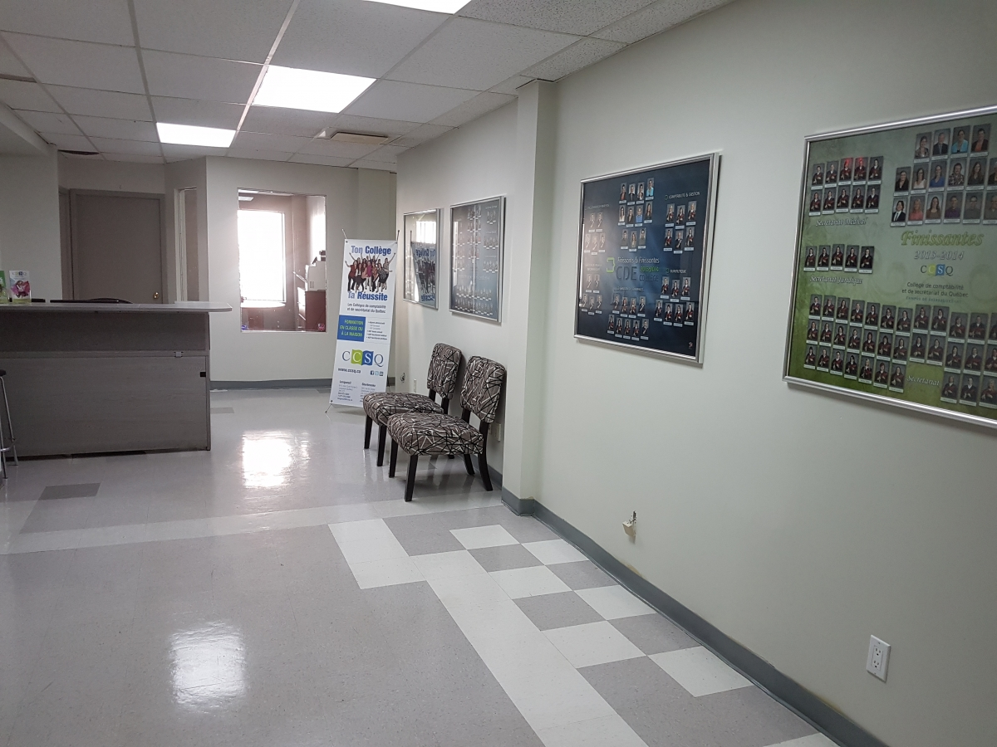
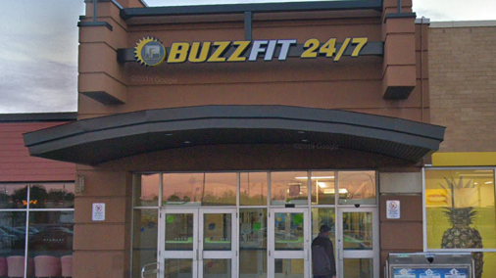
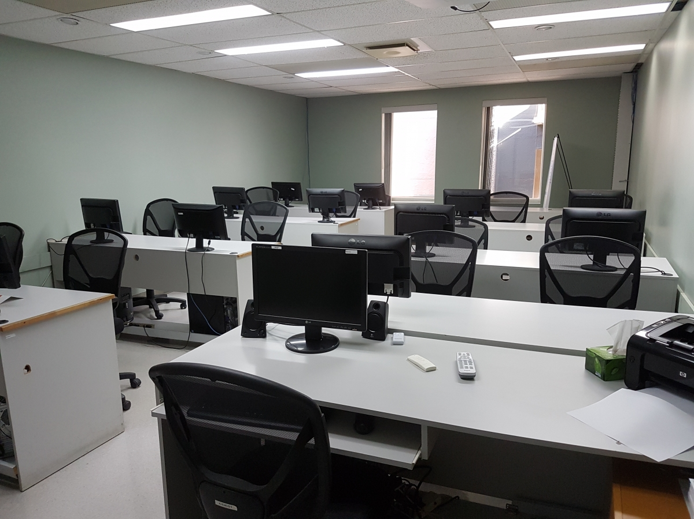
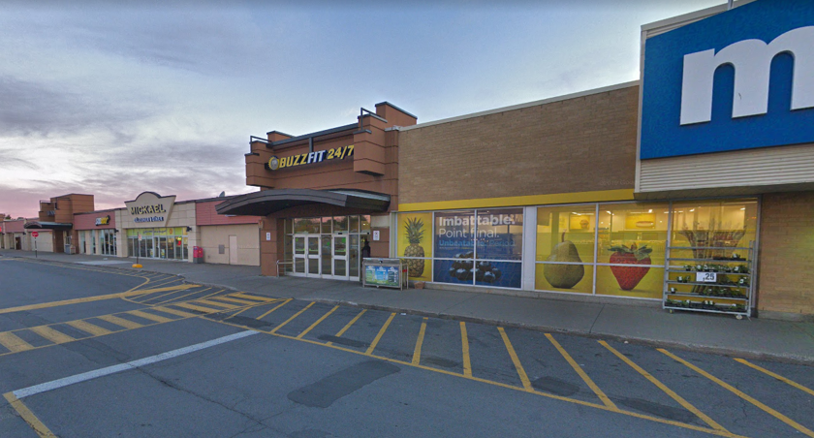
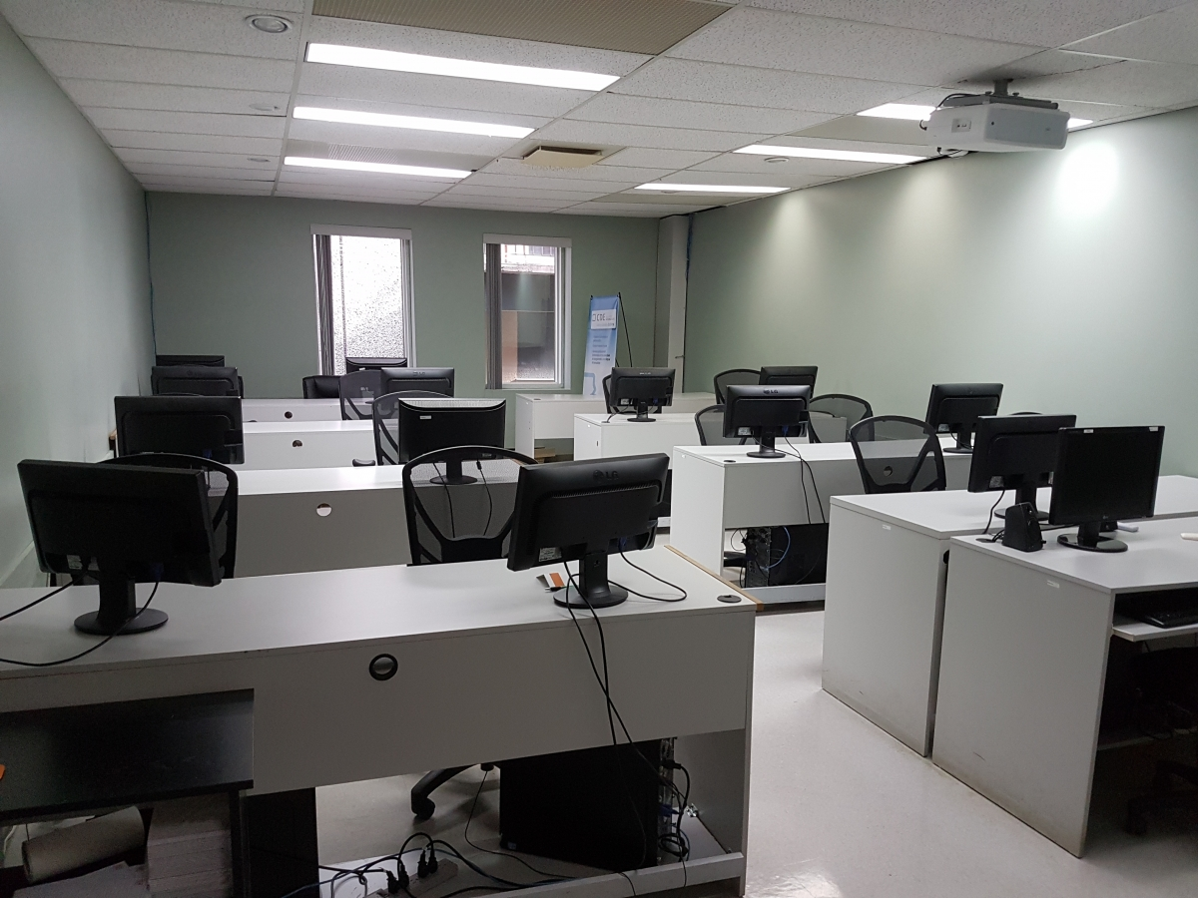
Location 1 (Sherbrooke)
Sherbrooke campus is located in the heart of downtown Sherbrooke near the intersection of Wellington and King street. .
Has 8 classrooms, computer assembly workshop, dining room and vending machine for students.
Accessible by public transport and car
Nearby campus accommodation available for 4 months free of cost
Near to the campus are public services, municipal services, restaurants and cafes. buses, trains, public library, arena, sports center and parks.

Slide 7
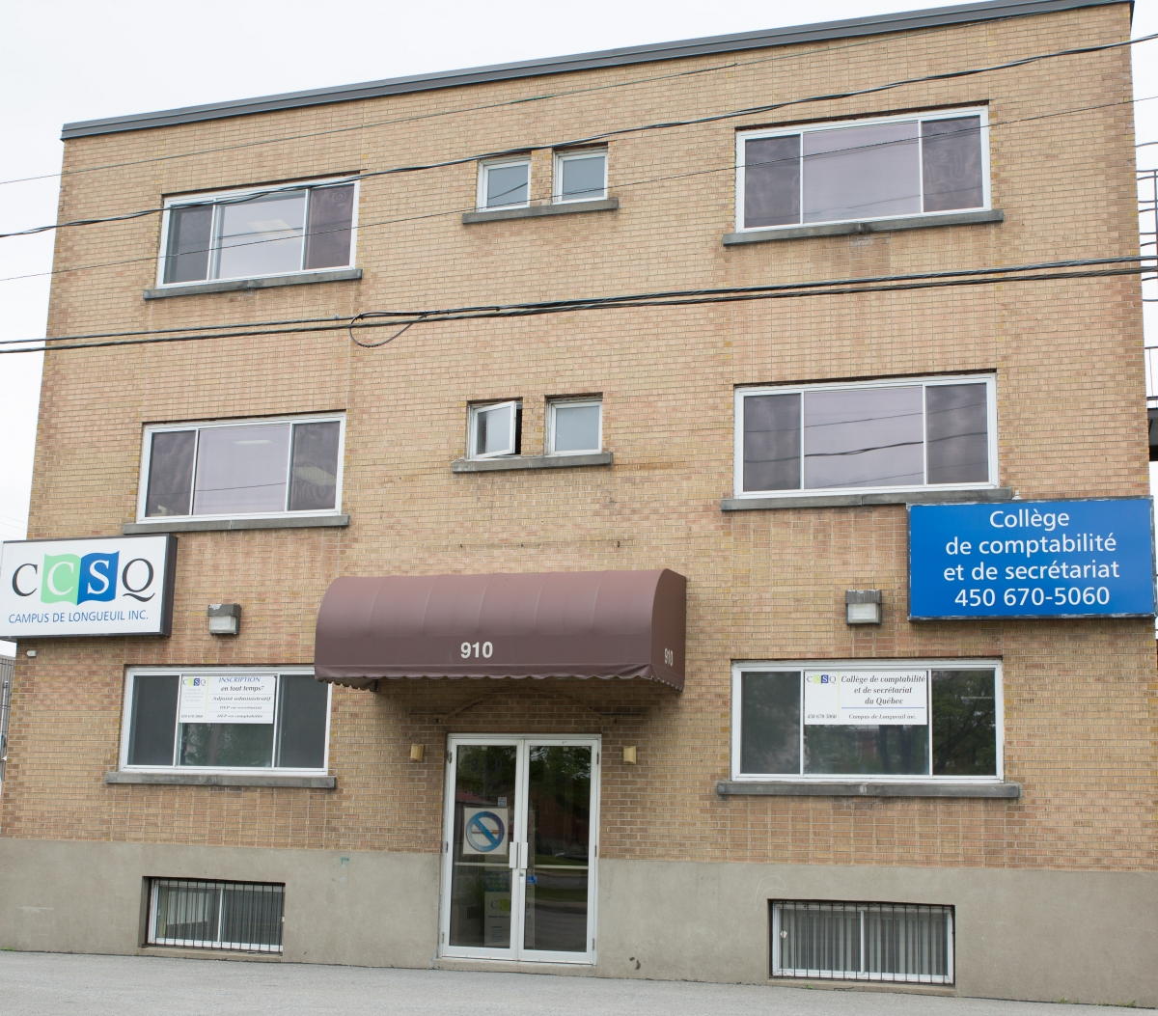
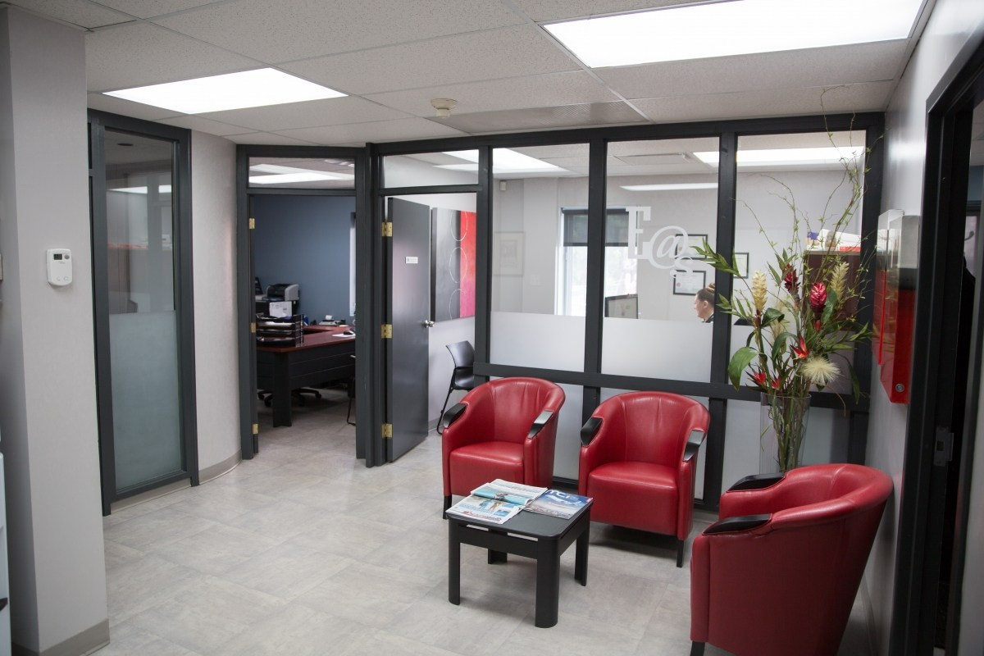
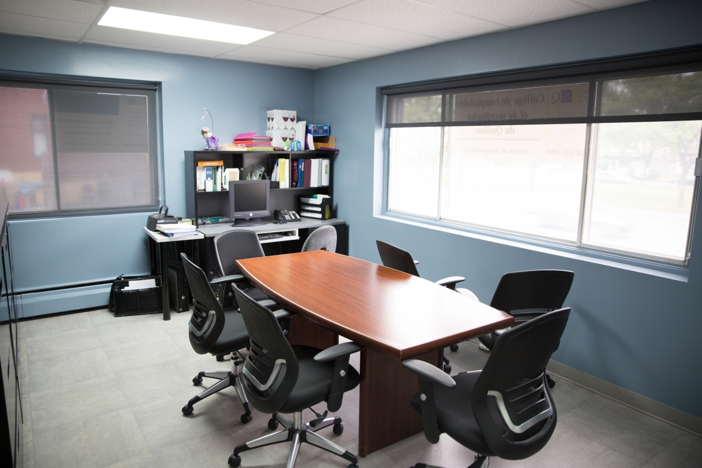
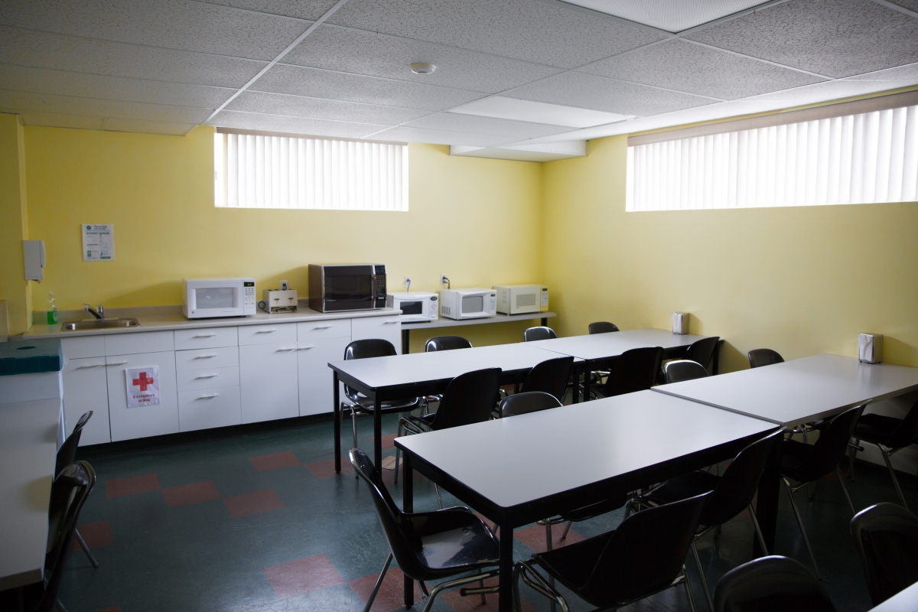
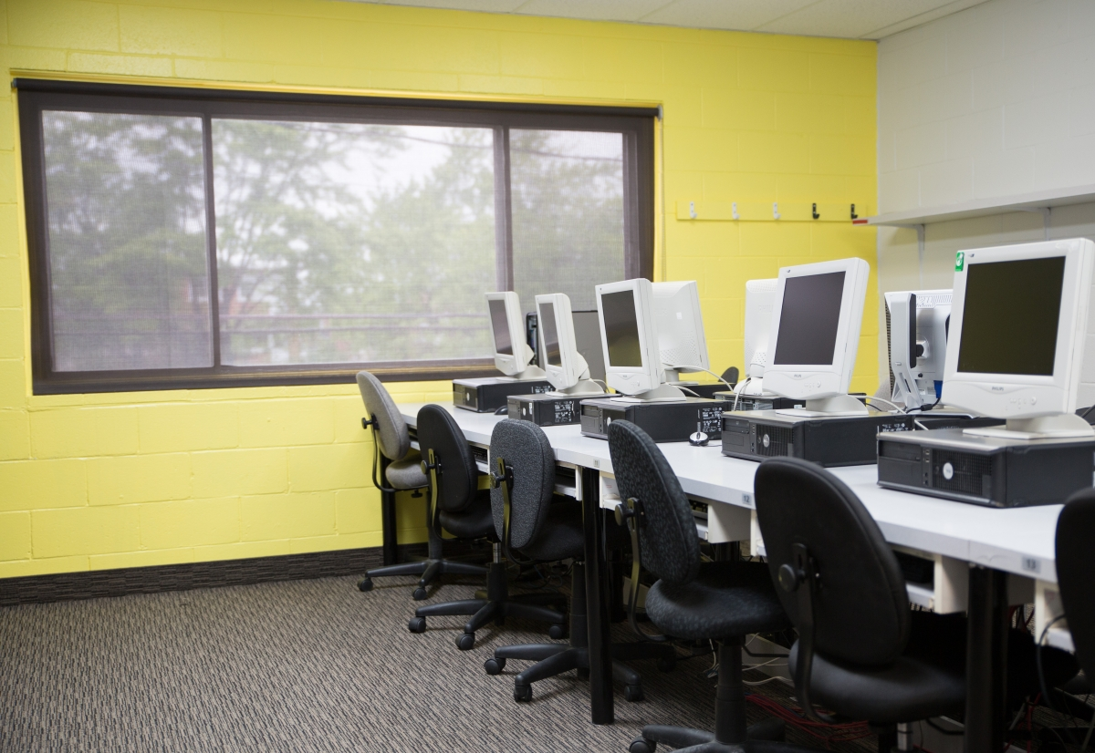
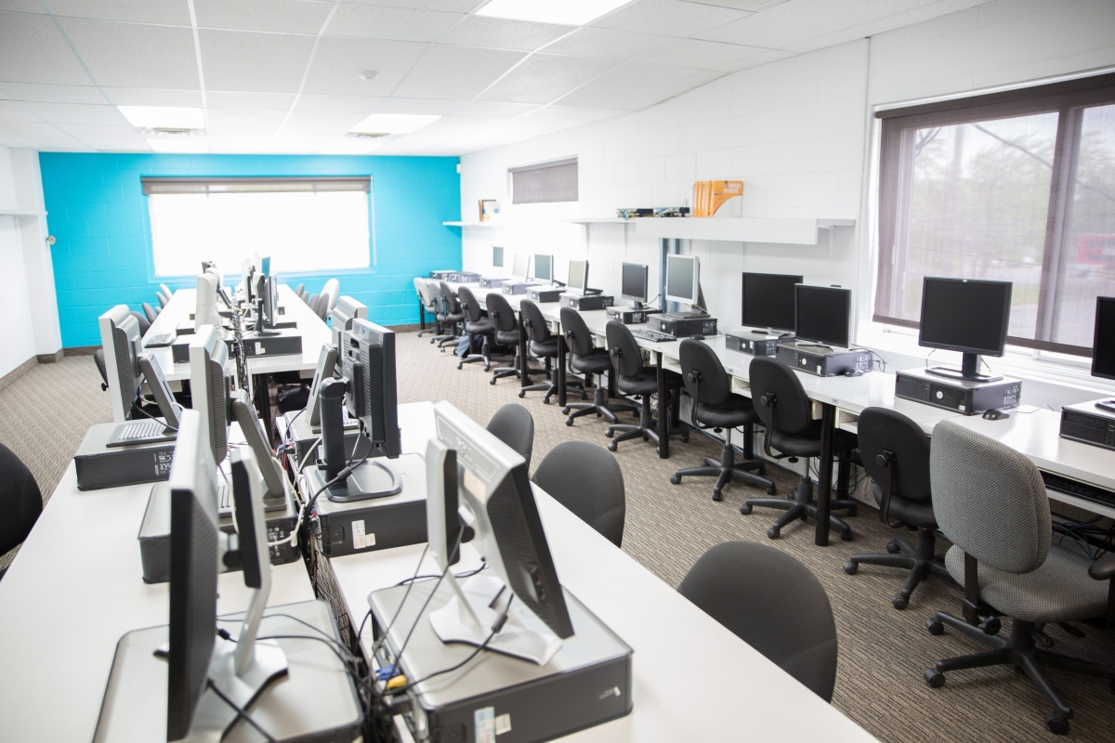
Location 2 (Longueuil)
located on Boulevard Curé-Poirier West in Vieux-Longueuil.
Proximity to shopping marts restaurants and parks.
5 Classrooms, 2 dining areas and vending machines for students.
New campus is almost ready with a very large capacity
Nearby campus accommodation available for 4 months free of cost
In downtown Montreal

Slide 8
Highlights of CCSQ of Canada
Students are eligible for Post-Graduate Work permit
Highly trained and effective career service department
In-Demand Programs with High Employment Ratio
Assistance for internships providing access to high quality jobs
Job services free of charge to graduate students
Flexible class schedule (2-3 days per week)
Perks
FREE Accommodation for 4 Months
FREE Airport pick Up and Accommodation Drop-Off

Slide 9
Programs Intakes –May and sept
Post Secondary Programs
Sherbrooke Campus -
Computing Support
Legal office specialist
Medical office specialist
Longueuil Campus -
Medical office specialist

Slide 10
PROGRAM – Computing support
** Offered only at Sherbrooke Campus
Skills Acquired
Positions Available
Develop skills needed to perform tasks needed on standalone and networked computers
Analyze the architecture and operations of a computer system
Install the physical and logical elements of a work tation and manage access to the resources of a network
Install the shareable resources of a network
Restore a computer workstation
Computer Network Technician
Data Center Operator
Internet Website Technician
Network Support Analyst
Network Support Technician
System Administrator
Web Technician
and more…
Potential Employers
private and public companies,
municipalities,
or self-employment

Slide 11
PROGRAM – Legal office specialist
** Offered only at Sherbrooke Campus
Skills Acquired
Jobs Available
Specialized skills
Produce acts in ordinary civil proceedings
Produce a dispute file in family law
Prepare notebook and authorities
Produce notarial deeds
Produce documents related to non-contentious I matters
Produce documents related to updating a business
Secretarial skills
Inspect the quality of documentation
Correct texts, layout collate and distribute documents,
Edit documents / presentations / spreadsheets, visual designs of documents
Enter data and text into a computer
Keep agendas up to date
Document management
Customer Services
Provide technical support
Handle cash
Produce reports
Coordinate different tasks
Legal secretary
Administrative Assistant – Legal
Commercial Law Secretary
Corporate Law Secretary
Family Law Legay Assistant
Legal Assistant
and more…
Potential Employers
Law firms
Public notaries
Municipal governments
Federal and provincial governments
Offices of trustees and bailiffs

Slide 12
PROGRAM – Medical office specialist
** Offered at both Sherbrooke and Longueuil Campuses
Skills Acquired
Positions Available
Specialized skills
Carry out operations related to user consultation
Produce medical documents
Perform the activities related to the management of medical supplies
Perform accounting operations related to medical procedure
Perform general secretarial tasks
Secretarial skills
Inspect the quality of documentation
Correct texts, layout collate and distribute documents,
Edit documents / presentations / spreadsheets, visual designs of documents
Enter data and text into a computer
Keep agendas up to date
Document management
Customer Services
Provide technical support
Handle cash
Produce reports
Coordinate different tasks
Medical Secretary
Receptionist
Medical Transcriptionist
Administrative medical Assistant
Medical Stenographer
Ward Secretary – Hospital
Potential Employers
Private and public clinics
Hospitals
CLSC
CHSLD
CIUSSS

Slide 13
Eligibility Requirements
Program Name | Eligibility
Computing Support - DEP | Grade 12 Non-Medical (Physics, Chemistry and Mathematics) Grade 12 – Diploma in related field Grade 10 – Diploma in related field Related work experience
Legal Office Specialist - DEP | Grade humanities with Political science, economics / Psychology / Sociology/ History/ Public Administration/ Maths / Accounting / Stats / Business Studies as one of the core subjects Grade 12 – Diploma in related field Grade 10 – Diploma in related field Related work experience

Slide 14
Eligibility Requirements
Program Name | Eligibility
Medical Office Specialist - DEP | Grade 12 Medical (Physics, Chemistry and Biology) Grade 12 – Diploma in related field Grade 10 – Diploma in related field Related work experience

Slide 15
PROGRAM Eligibility requirements
Academics
English Language Proficiency
Post Secondary Programs
First or second class with minimum 55% overall in Grade 12 or Equivalent
Work Experience
Applicants must demonstrate relevant employment experience with employee reference letter, and last 3 pay slips or last 3 months bank statements or previous year ITR - if the gap in studies is more than a year.
For all programs for both campuses
Overall 6.0 bands and above with nothing less than 5.5 band in one individual module. (IELTS)
General
Age: - 17 – 22 years preferred
Gap in Studies: - Applicants may be accepted with maximum of one year.
Applicants with a study gap exceeding 5 years will not be considered.

Slide 16
Documents
International student application form
Cancellation and Refund Contract signed by student
Passport bio data and last page.
10th and 12th mark sheets
English proficiency score report such as IELTS
Employment reference letter (if applicable)
last 3 pay slips or last 3 months bank statements or previous year ITR - if the gap in studies is more than a year – if applicable

Slide 17
Application Process
Step 1. Email duly filled application form along with documents to our Admissions Team at admissions1@ccsqinternational.com
Step 2. Pre-Admission letter will be issued to eligible candidates within 72 hours
Step 3. Student must deposit 1st year tuition fee to receive final Letter of Admission
Step 4. Student can then apply for CAQ and Study Permit/ Student Visa
(we have a tie – up with a firm who can support students to obtain visa at an additional cost)
Expected Processing time:
Pre-Admissions / Final LOAs & Fees Receipts are processed in 2-3 Business Days.
If student visa is refused , refund will be processed in 2 weeks by deducting Registration Fee of $250 + Applicable wire transfer fee

