Slide 1

School of
Computer Science & Mathematics
Graduate Programs
Dr. Eitel J.M. Lauría,
Graduate Director

Slide 2


Graduate Programs Overview
MS in Information Systems
Information Systems Management
Business Analytics
Computer Networks & Security
Advanced Certificate in Information Systems
Advanced Certificate in Business Analytics
MS in Computer Science Software Development
Cloud Computing Track
Mobile Computing Track

Slide 3
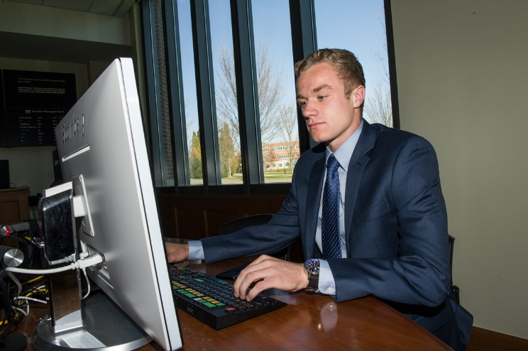

Graduate Programs Overview
Professional degrees
Flexible format (face to face, online, hybrid formats)
Pragmatic Emphasis: experiential learning & projects
Collaborative Learning & Team work
Effective Communication
Independent research
Integration of theory and practice
Latest Techniques & Supportive Technology (e.g. VCL)
Open to explore many project areas

Slide 4
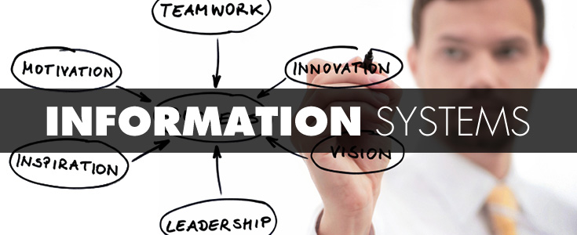
Provides balanced combination of technical and managerial skills
Potential students have backgrounds in:
Business
Technology
Other specialties who are looking to make themselves more marketable in increasingly technology-dependent organizations.
Curriculum designed to standards set forth by the Association of Computing Machinery and Association of Information Systems “MSIS Model Curriculum”
Prepares individuals for a career in industry and government
Three concentrations:
Information Systems Management
Business Analytics
Computer Networks & Security

Slide 5
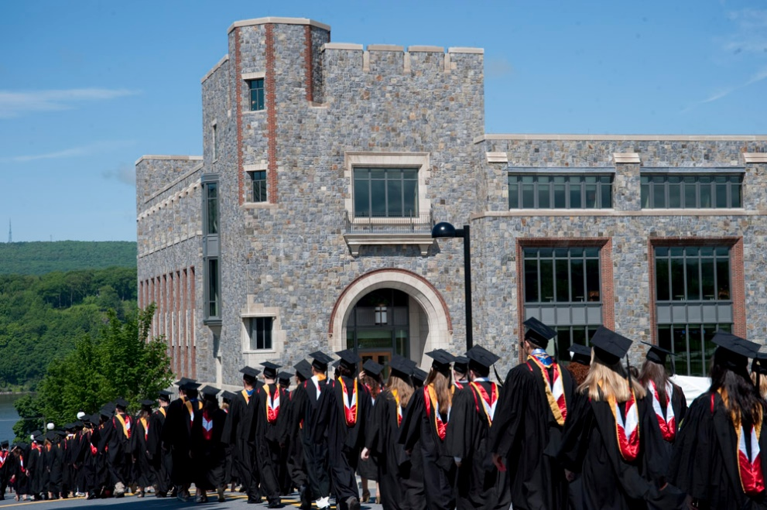
MSIS Careers
Information Systems Management
Systems Analyst / Designer
Business Analyst
Project Manager
IS Auditor
IS Manager
Chief Information Officer (CIO)
Business Analytics
Data Analyst / Architect
Database Administrator
Business Analyst
Data Science Specialist
Business Analytics Manager
Chief Data Officer (CDO)
Computer Networks & Security
Security Administrator
Network Specialist
Internet Engineer
System Administrator
Network Operations Mgr.
Chief Technology Officer (CTO)

Slide 6
MSIS Program Structure
MSIS527 Syst. & Inf. Concepts
MSIS537 Data Management
MSIS567 Data Communications
MSIS570 Systems Analysis & Design
MBA667 Accounting
MSIS730 IS Policy
MSIS720 IS Project (Capstone)
Computer Networks & Security
Business Analytics
IS Management
MATH130 Intro to Statistics
MATH130 Intro to Statistics
MATH130 Intro to Statistics
MSIS545 Intro to Data
Analysis/Comp. Stats
MSIS601 Network Design &
Implementation
MSIS620 Emerging
Technologies
MSIS637 Decision Support
Systems
MSIS603 Network Security
MSIS621 Enterprise
Architecture
MSIS602 Net. Virtualization
3 electives
(MSIS , MBA or MSCS)
MSIS645 Data Mining &
Predictive Analytics
2 electives
(MSIS , MBA or MSCS)
2 electives
(MSIS , MBA or MSCS)
Core Elective Foundation/Prerequisite

Slide 7

MSIS Elective Courses
Data & Information Management
Computational Statistics
Legal Environment of Business
Wireless Communications
Web Services
Among others …

Slide 8
Information Systems Certificate
18 credits
6 Courses
50% of MSIS
Designed to satisfy the professional needs of students who wish to acquire graduate-level knowledge in Information Systems (IS), but who (initially) do not wish to pursue a full graduate degree
Systems & Information Concepts in Organizations
Data Management
Data Communications
Systems Analysis & Design
Information Systems Policy
Information Systems Project
All courses taken in the certificate program are MSIS courses and may be later applied to the MSIS degree provided the grades earned are B or better

Slide 9
Business Analytics Certificate
2 Semesters
4 Courses
12 Credits
Unique technology learning environment:
Close Collaboration with IBM
Open source and commercial software
Intensive use of technology, hands-on approach
Over 10 years of experience delivering in Business Intelligence & Analytics, Information Decision Systems, Data & Information Management
Potential audience
Managers and Professionals
(IT, marketing, advertising, finance, health care)
Researchers (Physics, Engineering, Social Sciences, Medicine)
Business Analysts and Consultants
Finance Professionals.
Data Management
Intro to Data Analysis & Computational Statistics
Decision Support Systems
Data Mining and Predictive Analytics

Slide 10

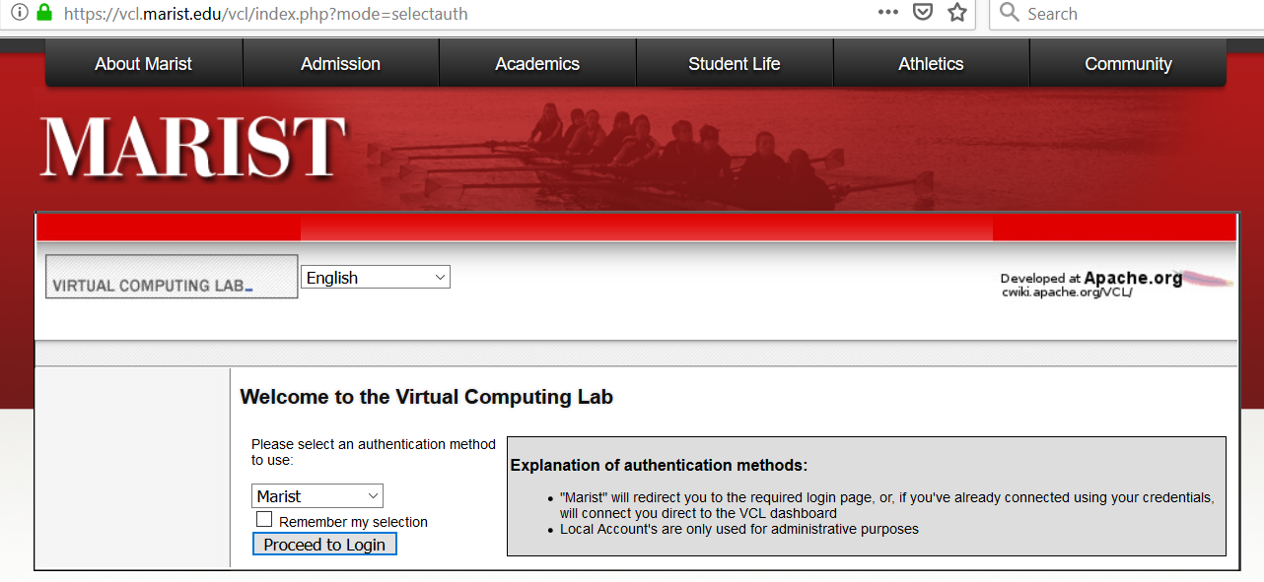
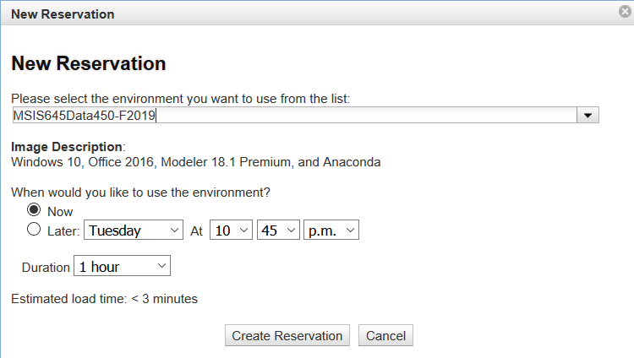
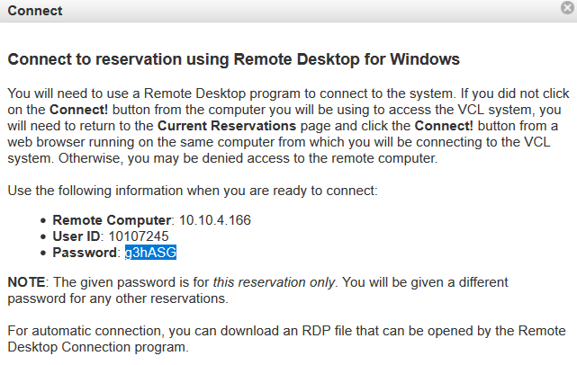
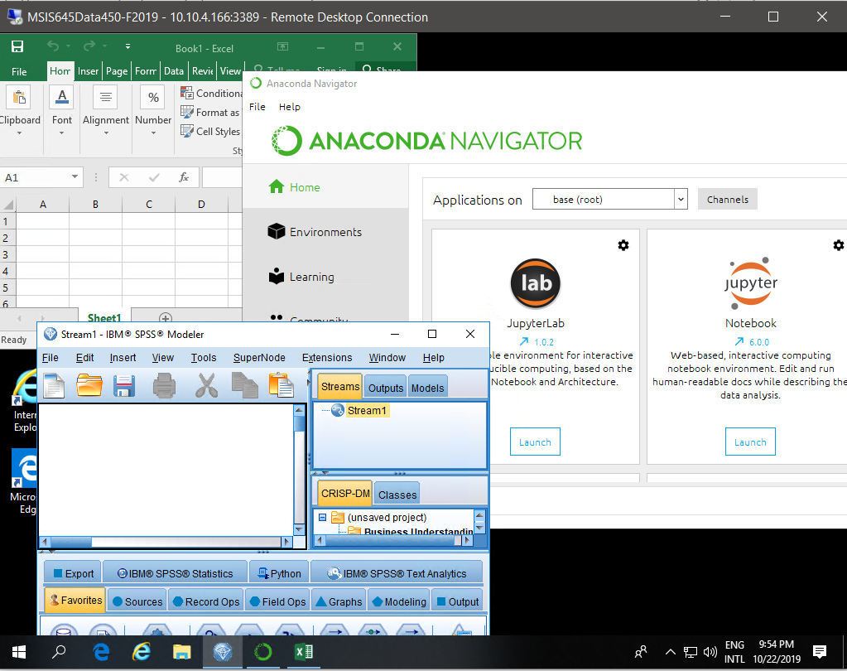
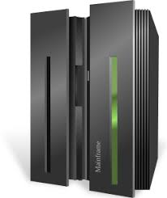
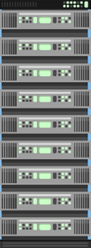

Our Virtual Computing Lab
School of Computer Science & Mathematics
Graduate Programs
Student’s
Physical
Machine
Access Reserve Launch
VPN
IT
infrastructure
VPN
My
(Linux)
Server
Virtual Machine
VPN
SCM’s ECRL

Slide 11
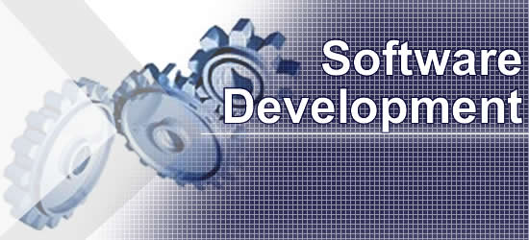
MS in Computer Science Software Development
Master of Computer Science in
Software Development
2 Tracks
  Cloud Computing
  Mobile Computing
32 Credits (4 credit courses)
  16 credits of core courses
  8 credits of track
  4 credits of electives
  4 credits of capping course (Project)
Comprehensive theoretical foundation
First installation of the World’s First IBM LinuxONE III providing an innovative response to security issues
First graduate institution to acquire zEnterprise machines
NY State Center of Excellence in Cloud Computing and Business Analytics
Excellent name recognition providing employment and internship opportunities through Marist's Career Services Office

Slide 12

Software Development Careers
Master of Computer Science in
Software Development
  Application Programmers
  Systems Developers
  Database Designers
  Network Specialists
  Project Managers
  Software Engineers/Developers

Slide 13
MSCS/SD Program Structure
Master of Computer Science in
Software Development
MSCS510 Software Design & Development
MSCS542 DB Management Systems
MSCS560 Networking
MSCS630 Security Algorithms & Protocols
MSCS710 Project (capstone)
4-credit courses
8 courses, 32 credits
Cloud Computing
Mobile Computing
MSCS680 Parallel Computing
MSCS565 Game Development I
MSCS620 Cloud Computing
MSCS700 Enterprise Mobile Dev.
1 MSCS elective
1 MSCS elective
Core Elective

Slide 14
Prerequisite courses for career changers:
Master of Computer Science in
Software Development
All international students will take placement exams in these two subjects during the first week of courses.
Object Oriented Programming concentrates on Advanced Java.
Students who score well will be moved to more advanced classes.
4-credit courses
8 courses, 32 credits
Up to four 4-credit
prereqs
MSCS501 Object Oriented Prog.
MSCS502 Adv. Data Structures
All international Engineering students are waived from the
following two prerequisite courses.
MATH250 Discrete Mathematics
MSCS503 Computer Org. &
Architecture

Slide 15

MSCS/SD Electives
Master of Computer Science in
Software Development
Game Development II
Computer Graphics
Artificial Intelligence
Software Verification & Maintenance
Independent Study

Slide 16
Admission Requirements
Master of Computer Science in
Software Development
Online application with documents uploaded
  http://gradcas.liaisoncas.org/apply
Bachelor Degree in any subject
Scanned transcripts from all prior degrees
Two letters of recommendation from professors or work supervisors
Resume
Personal Statement – This must be your own work.
TOEFL, IELTS, or PTE
  Students with CGPA of 68% or higher:
    IELTS 6.0 or higher, TOEFL 70 or higher, PTE 50 or higher
  Students with CGPA of 67% or lower:
    IELTS 6.5 or higher, TOEFL 79 or higher, PTE 58 or higher

Slide 17

Cost and Financial Assistance
School of Computer Science & Mathematics
Graduate Programs
Merit Scholarships based on CGPA. Total scholarships are $2,000 - $4,000 USD
Tuition - $880 per credit
MSIS affidavit amount $32,449
MSCS affidavit amount $37,729
No Deposit Required
Financial documents may be sent after you receive your admission decision.
Email your complete transcript and English proficiency exam to graduate@marist.edu for a fee waiver.

