Slide 1
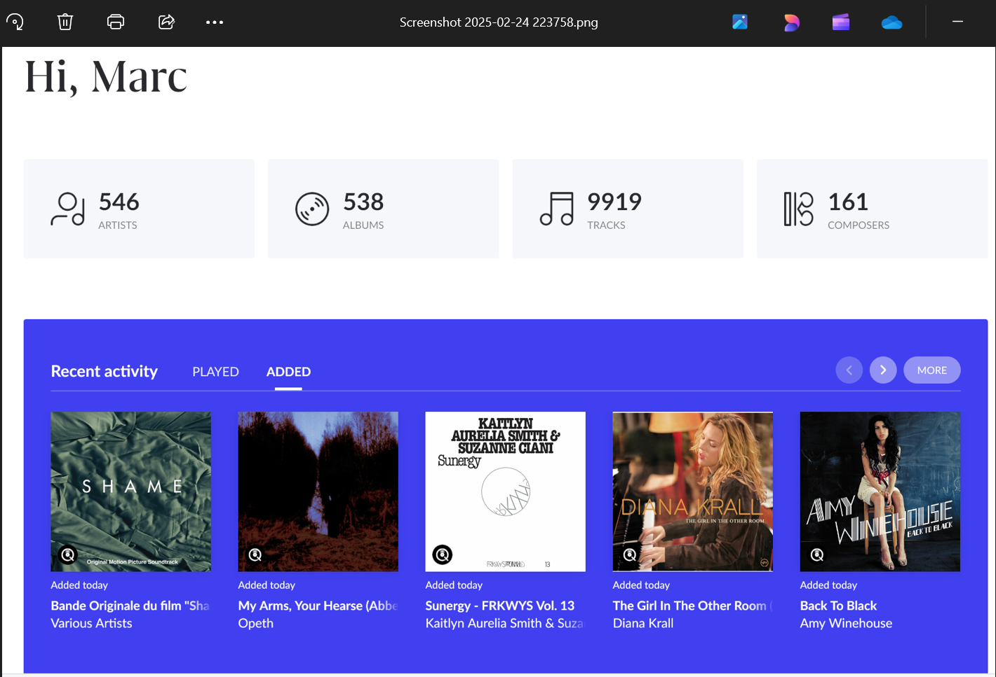
I have not added any of these albums today

Slide 2
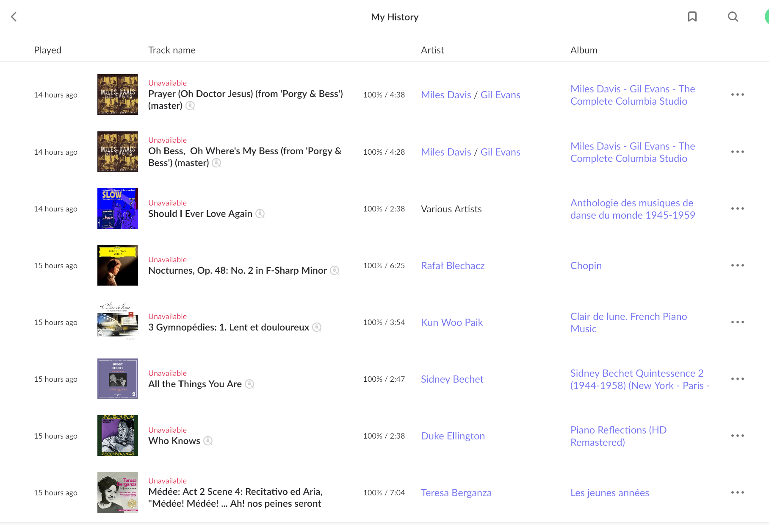
All these albums were in my library yesterday and are no longer available today

