Slide 1
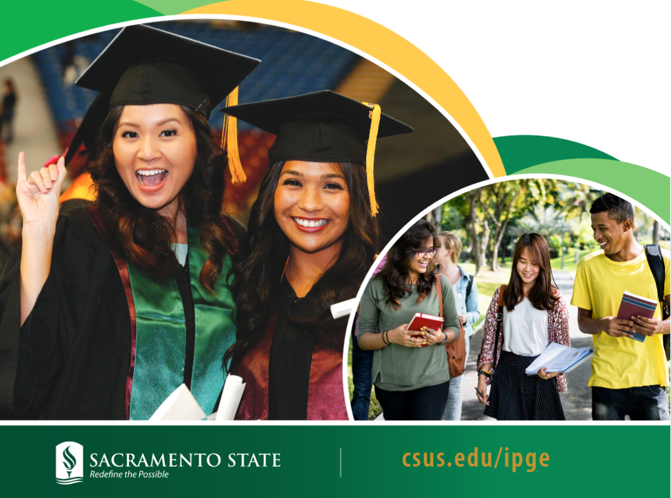
Welcome to Sacramento State!

Slide 2
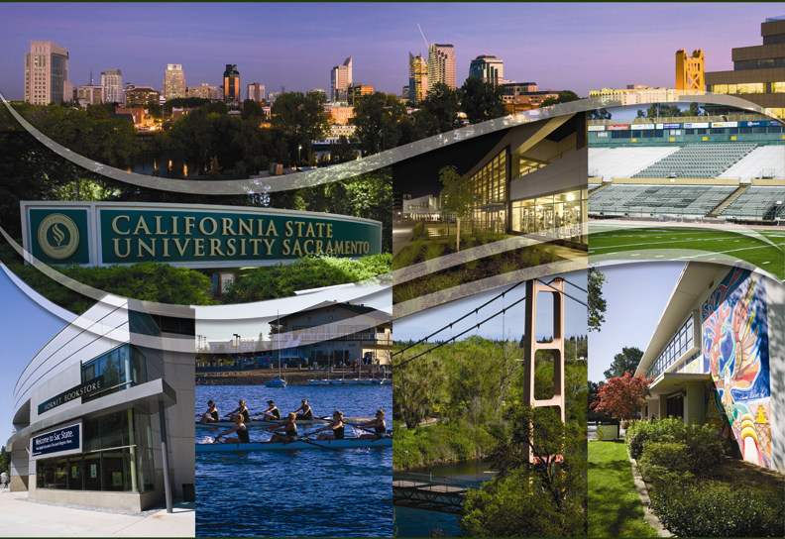


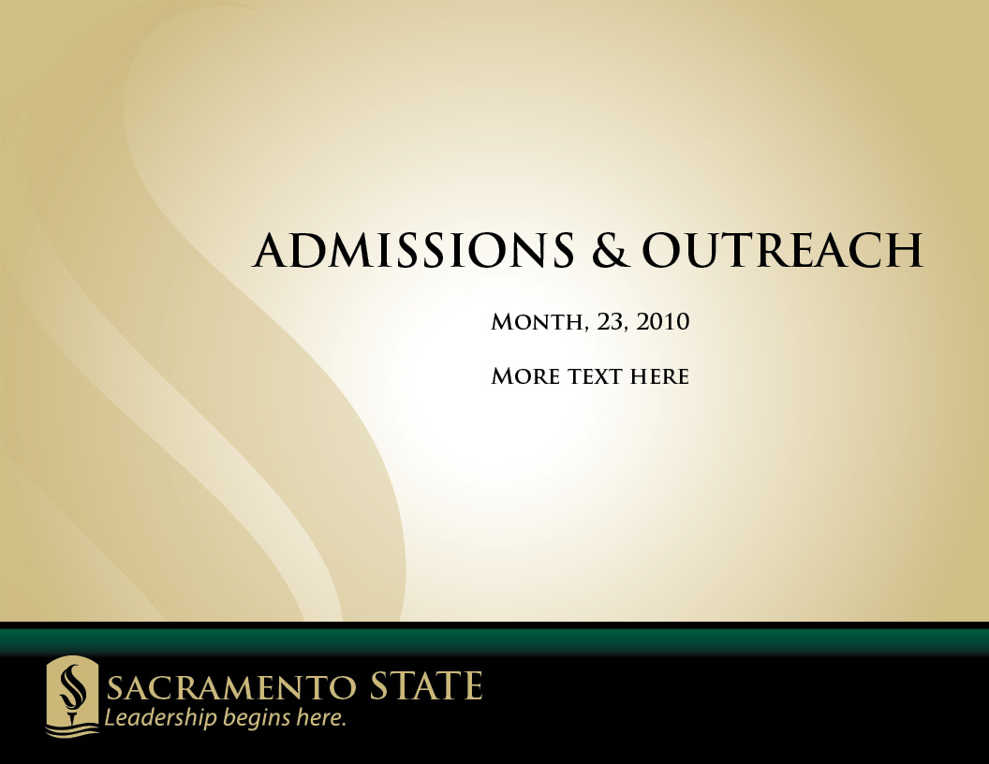
Sacramento State provides a world-class education in the heart of California’s Capital Region. The University is home to top academic programs, comprising a learning community where students, faculty, and staff come together to Redefine the Possible.

Slide 3
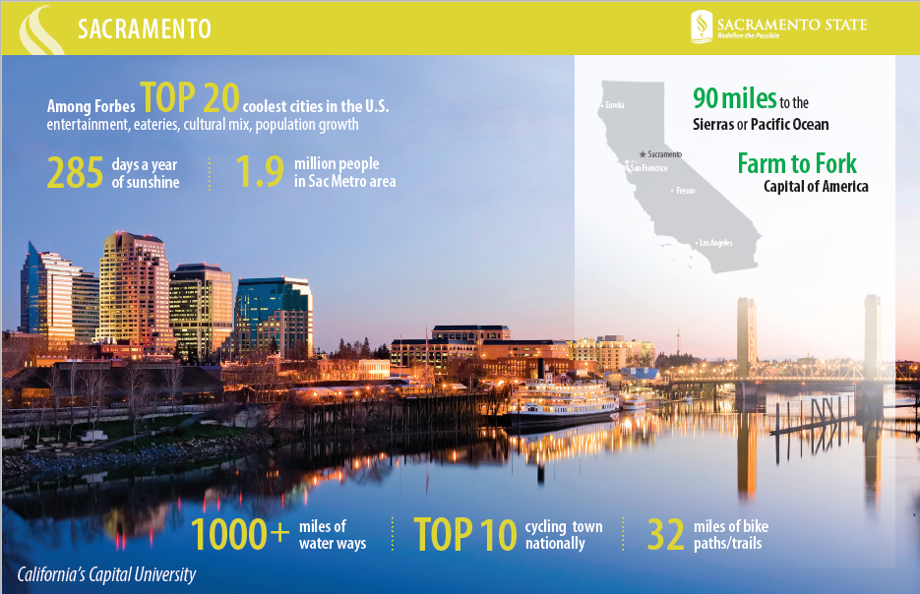

Slide 4
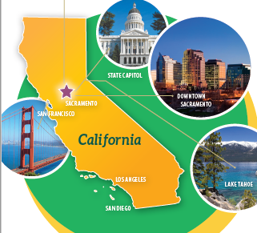

The City of Sacramento
Centrally located 145 km from the Pacific Ocean and the Sierra Mountains, Sacramento boasts 285 days a year of California sunshine, and Sacramento State students enjoy miles of bicycle trails stretching along the nearby American River.

Slide 5
About Sacramento State
Established in 1947
6th Largest CSU Campus
    Nearly 33,000 students
700 International Students
  Representing over 120 countries
Centrally located in a growing, diverse region of Northern California
Small Class Sizes – 1 Faculty for 27 students
58 undergraduate Degree Programs
45 Graduate Degree Programs
Career and Internship Opportunities

Slide 6
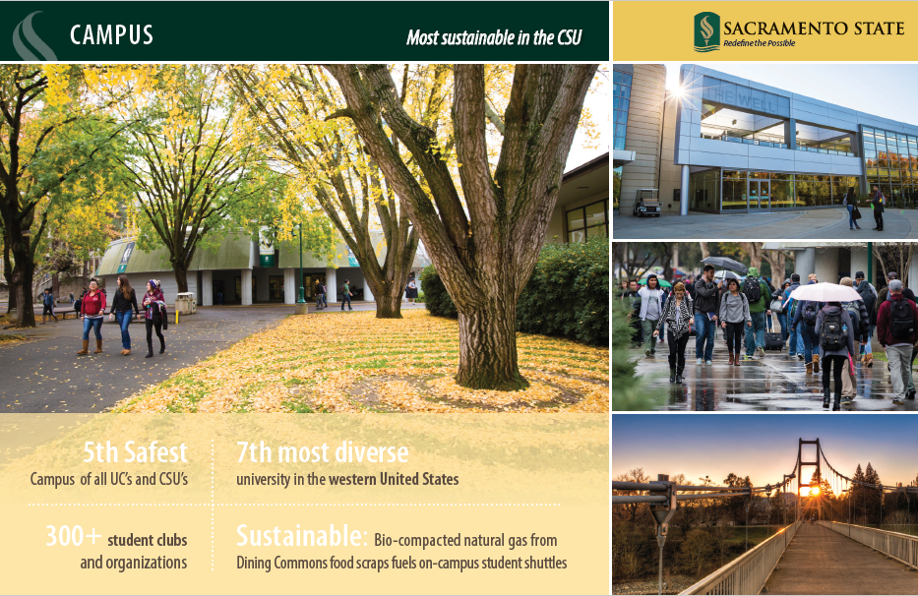

Slide 7
Cost of Study
Estimated Costs | UG | Grad
Mandatory Campus Fees | $7,623 | $8,638
Tuition ($396/unit) | $11,880 (30 units) | $7,128 (18 units)
Health insurance | $1,360 | $1,360
Living expenses | $9,500 (AY) | $9,500 (AY)
Total Estimated on I-20 | ~ $30,300 | ~$29,300
Variations in Academic
Cost in USA
Undergraduate tuition for AY 2020-21, based on one year non-resident undergraduate tuition:
UC Berkeley $43,168
Michigan State $38,486
U Mass $32,343
U Conn $32,066
Penn State $31,346
Ohio State $28,229
Arizona State $26,470
Idaho State $21,024
Sacramento State $16,800
*fees are for fall and spring semester; represent student/university support services

Slide 8
Academics at Sacramento State
58 undergraduate majors to choose from amongst the 8 different colleges
College of Arts & Letters
School of Music recognized nationally and is accredited member of the Nat’l Assoc. of Schools of Music
Strong French degree program; rare in area and amongst CSUs
College of Business Administration
Fully AACSB accredited
12 different concentrations to choose amongst
College of Education
Child Development major very popular amongst students
Offers Doctorate in Education (Ed.D)
College of Engineering and Computer Science
ABET accredited programs in: Civil, Computer, Electrical & Electronic, Mechanical Engineering
Computer Science, B.S.
Construction Management Program accredited by American Council for Construction Education
College of Health & Human Services
Popular majors offered: Criminal Justice, Kinesiology, Public Health, Recreation & Tourism Administration, Social Work
College of Natural Sciences & Math
Popular Majors Among International Students: Biological Sciences, Chemistry, Geography, Geology, Mathematics, Physics
Sacramento State ATLAS program is operated by the University’s Department of Physics and is the sole undergraduate-only US participant of the Large Hadron Collider (LHC) research efforts being carried out at CERN
College of Social Sciences & Interdisciplinary Studies
Popular Majors Among International Students: Economics, Environmental Studies, Psychology, Family and Consumer Sciences
College of Continuing Education
Runs the International MBA (IMBA) program in conjunction with the College of Business Administration, which is a graduate program

Slide 9
Undergraduate Admission Requirements
Document | Min. Requirement
Class X and XII marks or high school transcript (int’l system) * | 60% higher cumulative on exams; 80% average (B: 3.0) for int’l system
TRANSFER: submit post-secondary transcripts ** | Min 2.4 GPA; 2.7+ GPA for Engr/CS majors
English Proficiency Exam | 64 ibt / 6.0 IELTS/ 50 PTE
SAT/ACT*** | optional but recommended
Passport copy | required
Financial statement & affidavit | $30,300
Agent representation | Packet must include letterhead
* Min 5 subjects that must be academic in nature (practical subjects such as home economics not counted)
** Transfer students with int’l transfer coursework may not receive all credit; will be reviewed in house; note: typically, students with transfer coursework from Indian institutions do not receive direct equivalent credit and will still be responsible for the majority of the Sac State degree requirements
*** min SAT reading 550, mathematics 570 to be waived from required entrance exams (new SAT score)

Slide 10
Graduate Admission Requirements
Document | Min. Requirement
Departmental requirements * | Application/SOP/LOR/ foundation courses
Post-secondary transcripts ** | 3.0 (~ 7.3/10.0) GPA; focus on last 2 years of UG program
English Proficiency Exam | 80 ibt / 6.5 IELTS/ 65 PTE
GRE/GMAT *** | Dependent upon program
Passport copy | required
Financial statement & affidavit | $29,300
Agent representation | Packet must include letterhead
Check program website for add’l requirements: https://www.csus.edu/graduate-studies/future-students/graduate-programs-and-deadlines.html
** Students must complete a minimum four year bachelor's degree to be eligible for admission. Applicants must have one of the following to qualify for admission if they do not have a four year degree:
3 year degree plus master's; or 2 bachelor's degrees (to total 4 yrs.); or, 3 year degree + Assoc. In Chartered Accounts, India; or, 3 year
degree + postgraduate diploma (in a related field), that required the three year degree from an AICTE (All India Council for Technical
Education).
*** GRE recommended scores for CS (+55% quantitative percentile and +45% verbal percentile) and Engr ((+50% quantitative percentile and +40% verbal percentile)

Slide 11
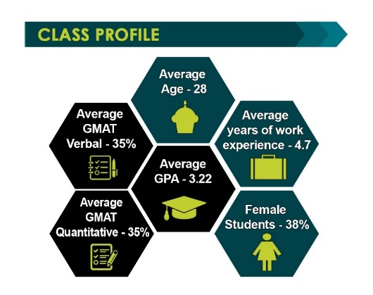
Which MBA Program Is Right for Me?
http://www.csus.edu/cba/graduate/matrix.html
MBA:
https://www.csus.edu/college/business-administration/graduate/mba.html
* GMAT/GRE waiver explained in detail for different types of situations/work experience
GMAT/GRE may be used interchangeably if program indicates GRE accepted
Use the GRE/GMAT conversion tool used by the business program here:
https://www.ets.org/s/gre/flash/bschool/comparison/17302/170/
International MBA On-Campus:
https://www.csus.edu/college/business-administration/graduate/mba-international.html
How to Apply:
https://www.csus.edu/college/business-administration/internal/forms/imba_onesheet_final_program-cost_001.pdf
EMBA (MBA for Executives – not recommended for int’l students due to part-time program)
http://www.csus.edu/cba/emba/whyemba.html

Slide 12
Undergraduate Deadlines
Term | Cal State Apply | Document Deadline
Fall 2020 | 10/01 – 07/01* | 07/01/2020
Spring 2021 | 08/01 – 12/01* | 12/01/2021
GRADUATE DEADLINES
*CS dept may have limited spots available for spring 2021. *Will have better idea after August 1, but applicant pool expected to be far more competitive for spring 2021 if spots are available due to limited space .
Term | Cal State Apply | Document Deadline
Fall 2020 | 10/01 – 04/01** | 04/01/2020
Spring 2021 | 08/01 – 09/15 | 09/15/2021
The new application, CAL STATE APPLY, will go live on August 1, 2020.
https://www2.calstate.edu/apply/international
.
* Local area transfer students may apply past the deadline
** Early application filing to CS/ENGR programs recommended

Slide 13
Spring 2021 – Graduate Programs Accepting Applications***
Anthropology
Art Studio
MBA
Civil Engineering
Computer Engineering
Computer Science
Computer Science (Software Engineering)
Economics
Electrical & Electronic Engineering
English (Composition)
English (Creative Writing)
English (Literature)
History
Humanities
Mechanical Engineering
Music (Composition)
Music (Conducting)
Music (Performance)
Recreation, Parks, and Tourism
Spanish
TESOL (Teaching English to Speakers of Other Languages)
*** Please note that these programs are anticipated to be open, but may change their status without notice or at the last minute so make sure to visit the Office of Graduate Studies (OGS) website before applying: http://www.csus.edu/gradstudies/futurestudents/applicationdeadlines/index.html

Slide 14

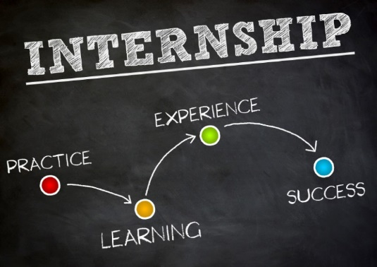
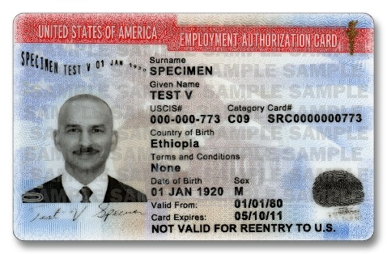
Student Employment Opportunities
F-1 students may participate in CPT (Curricular Practical Training) after the 1st year of study
CPT may be done in conjunction with on-campus employment, but not to surpass 20 hours total per week during academic year
OPT (Optional Practical Training) available to F-1 students who have completed at least 9 months consecutive study
Post-completion OPT provides 12 months’ employment; certain STEM disciplines are eligible for 24 month extension
F-1 students eligible for on-campus jobs up 20 hrs during school yr/40 hrs during term breaks
GA/TA/RA may be available dependent upon department or funding

Slide 15
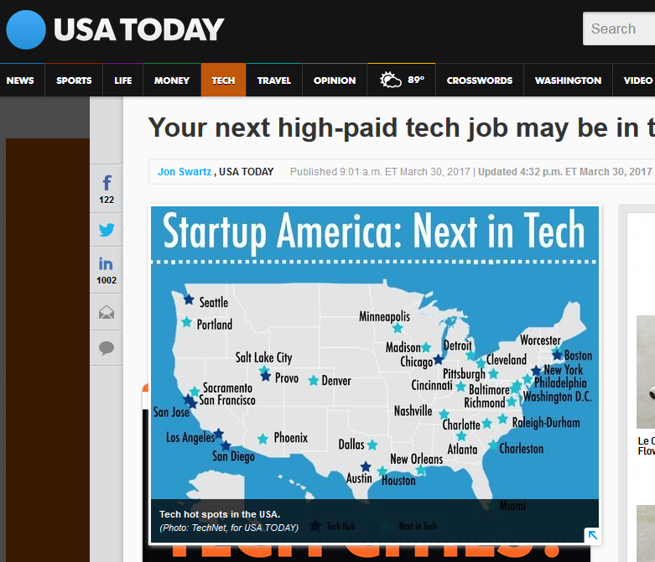
The Local Economy
Intel Corp.
Hewlett-Packard
Apple Inc.
Aerojet Rocketdyne
Oracle Corp.

Slide 16
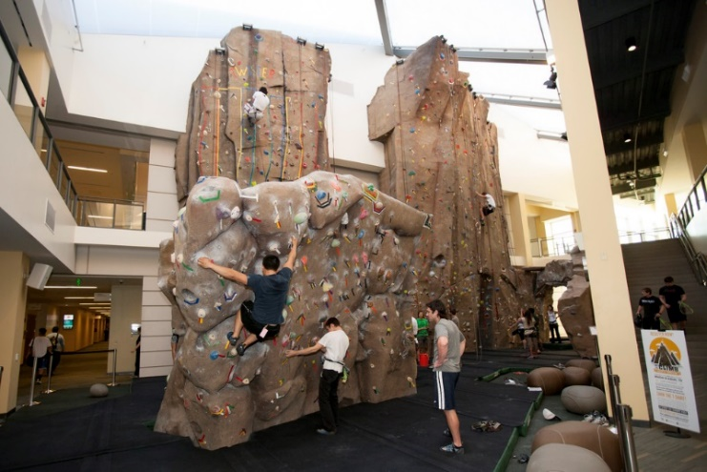
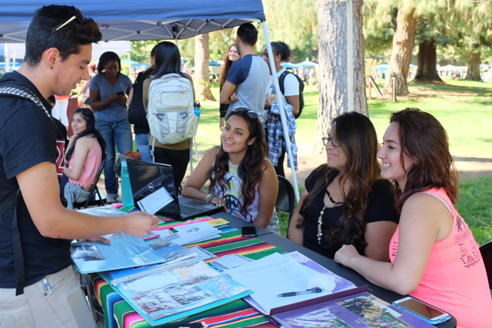
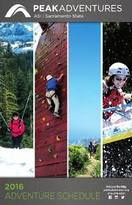
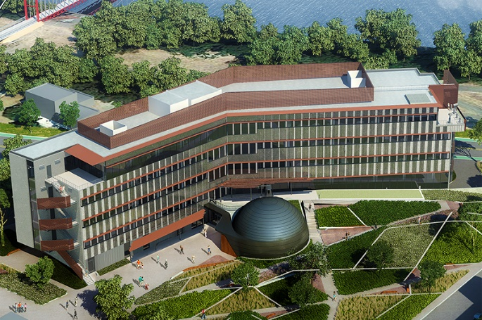
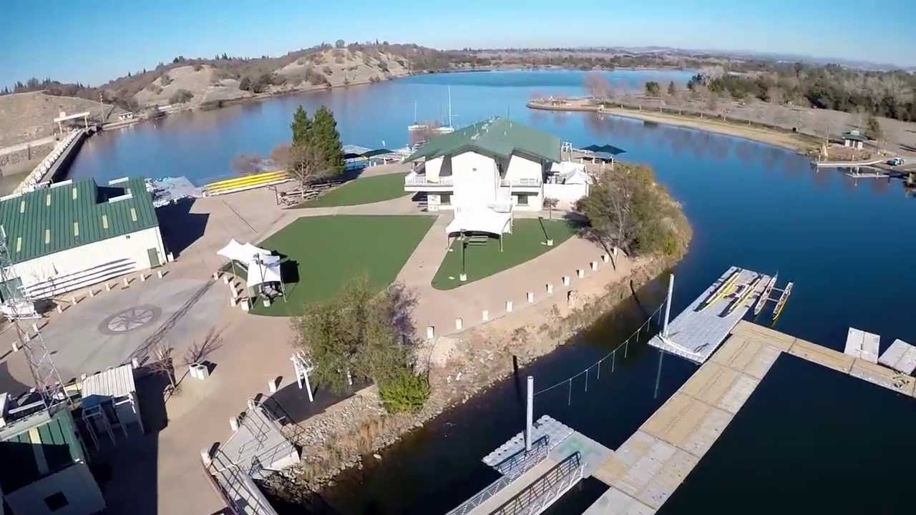

Student Life @ Sac State
Over 300 Student clubs and organizations!
Rock Wall at The Well
Ernest E. Tschannen Science Complex
Aquatic Center aerial view

Slide 17
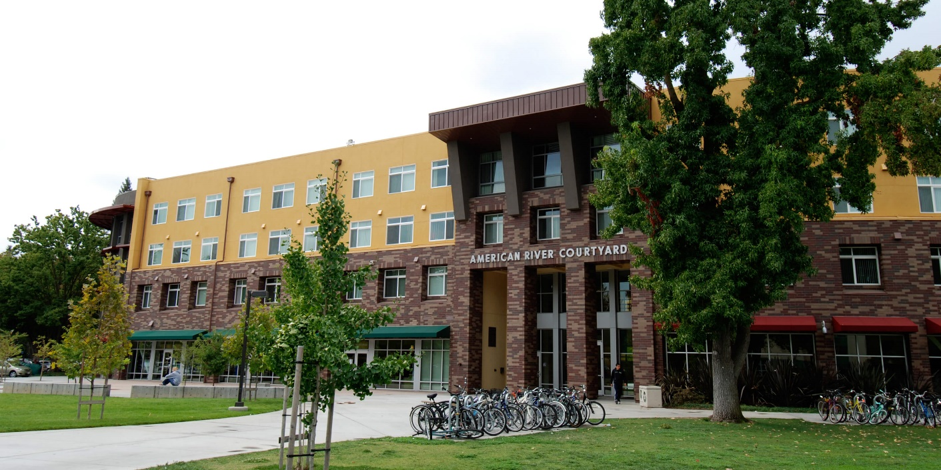
Sacramento State On-Campus Housing
Students* living in Sac State’s Residence Halls enjoy the convenience of easy access to the university and university events (concerts, theater, movies, clubs, etc.), a social environment of activities planned with American and other international residents, and they do not need to worry about furniture or transportation to campus for classes.
*Students are encouraged to apply to on-campus housing as early as possible.

Slide 18
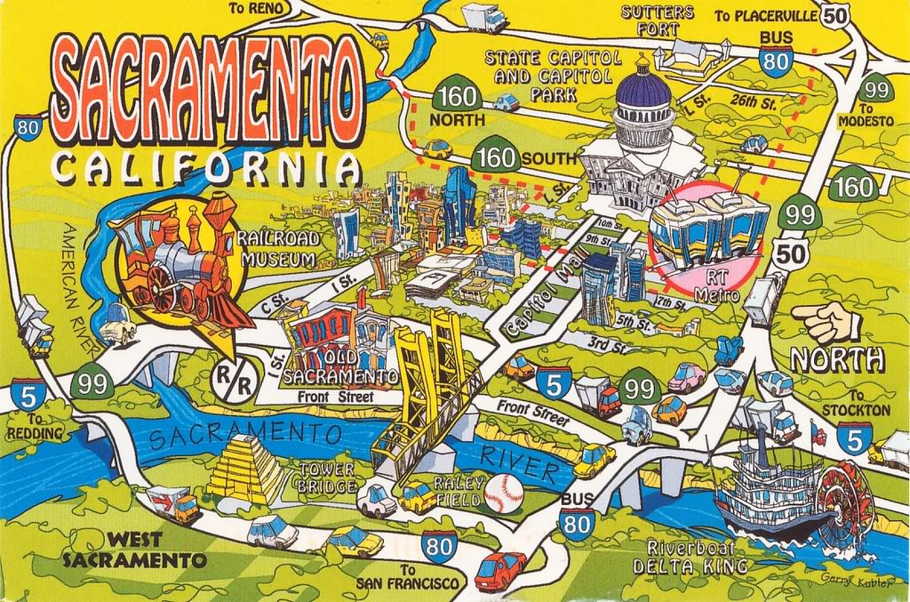

Slide 19
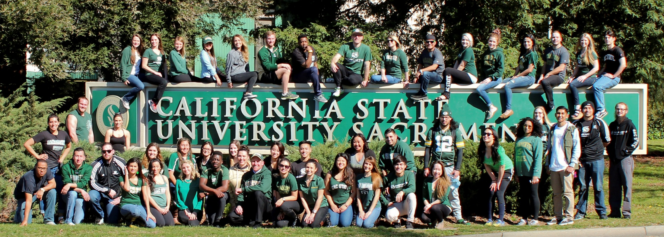
Questions?
Contact our International Admissions Team
Karla Piacentini, karla.piacentini@csus.edu (Alpha A – I)
Stephanie Ingvaldson, ingvaldson@csus.edu (Alpha J-N)
Stephanie Palmer, s.palmer@csus.edu (Alpha O – Z)
Documents can be mailed to the following address:
California State University, Sacramento
International Admissions
Library 1001, MS 6012
6000 J Street
Sacramento, CA 95819
Undergraduate Application Documents may be emailed to the International Admissions email account:
intlinfo@csus.edu

Slide 20

Thank You For Your Time!

