Slide 2
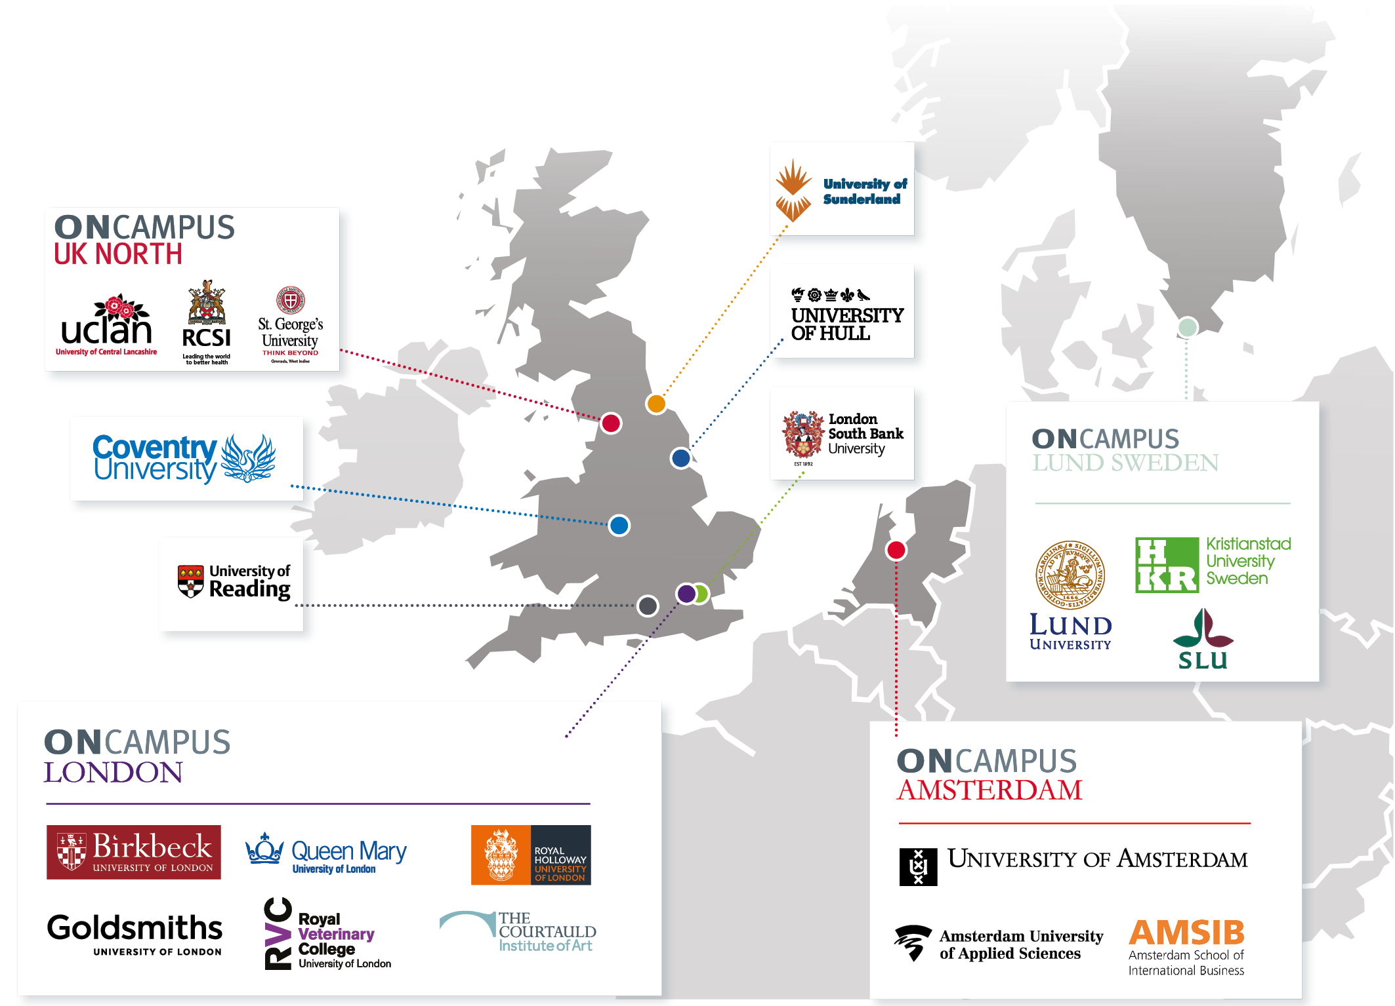

Slide 3
ONCAMPUS
UK

Slide 4
The UK ONCAMPUS centres – University partners
ONCAMPUS Coventry leading to Coventry University – ONE TO ONE TRANSFER
ONCAMPUS London South Bank University leading to London South Bank University – ONE TO ONE TRANSFER
ONCAMPUS UK North (UCLAN) Leading to UCLAN (University of Central Lancashire) and other Northern Universities – ONE TO MANY TRANSFER
ONCAMPUS Hull leading to University of Hull – ONE TO ONE TRANSFER
ONCAMPUS Reading leading to University of Reading – ONE TO ONE TRANSFER
ONCAMPUS Sunderland leading to University of Sunderland - ONE TO ONE TRANSFER
ONCAMPUS London (Birkbeck university of London) leading to Birkbeck University of London – ONE TO MANY TRANSFER - Preferred Partners Royal Holloway university of London, Queen Mary university of London, Goldsmiths university of London, Royal veterinary college, the Courtauld Institute of Art.

Slide 5
The UK ONCAMPUS centres – offerings
What do we offer at ONCAMPUS centres?
Foundation Programmes – IFP (International Foundation Programme)/IIFP (Intensive International Foundation Programme)/UFP (Undergraduate Foundation Programme) – 9 Months + 3 years of Bachelors
International year 1 – 9 Months + 2 years of Bachelors
PRE MASTERS – MQP (Master’s Qualifying Programme)/MFP (Masters Foundation Programme) - 1term, 2 term or 3 term leading to Masters

Slide 6
FOUNDATION PROGRAMMES
CENTRES | ACADEMIC AND ENGLISH REQUIREMENTS | Intakes/Faculties | Partner University Scholarships
ONCAMPUS COVENTRY | Class 12th – 40% IELTS UKVI – 4.5/4.0 | Intakes - 6 / Mostly All Faculties - September, November, January February, March and June) | Range of scholarships available – www.coventry.ac.uk
ONCAMPUS LSBU | Class 12th – 40% IELTS UKVI – 4.5/4.0 | Intakes – 3 / Mostly All Faculties | On obtaining merit – 25% discount on course fee each year of study OR 1000 Pounds Scholarships.
ONCAMPUS UK North - ONE TO MANY TRANSFER | Class 12th – 40% IELTS UKVI – 4.5/4.0 | Intakes – 3 / Mostly All Faculties | Up to 3000 Pounds each year of study (Except MBBS Program)
ONCAMPUS Sunderland | Class 12th – 40% IELTS UKVI – 4.5/4.0 | Intakes – 3 / Mostly All Faculties | Up to 1500 Pounds each year of study
ONCAMPUS Hull | Class 12th – 40% IELTS UKVI – 4.5/4.0 | Intakes – 3 - Business & Eng. | Up to 3500 Pounds each year of study
ONCAMPUS Reading | Class12th – 40% IELTS UKVI – 5.0/4.5 | Intakes – 2 / Mostly All Faculties | Range of scholarships available – www.reading.ac.uk

Slide 7
INTERNATIONAL YEAR 1
CENTRES | ACADEMIC AND ENGLISH REQUIREMENTS | Intakes/Faculties | Scholarships
ONCAMPUS COVENTRY | Class 12th – 50% IELTS UKVI – 5.5/5.0 Eng. 50 at Maths and 50 at Physics | Intakes - 3 (September & November, January)/ Faculties – Art & Design, Business, Engineering & Humanities | Range of scholarships available – www.coventry.ac.uk
ONCAMPUS LSBU | Class 12th – 50% IELTS UKVI – 5.5/50 | Intakes – 3 (September & November, January)/ Business | On obtaining merit – 25% discount on course fee each year of study OR 1000 Pounds Scholarships if no merit
ONCAMPUS Hull | Class 12th – 50% IELTS UKVI – 5.5/5.0 | Intakes – 3 (September & November, January) - Business & Eng. | Up to 3500 Pounds
ONCAMPUS Sunderland | Class 12th – 50% IELTS UKVI – 5.5/5.0 | Intakes – 3 (September & November, January)/ Only Business | Up to 1500 Pounds

Slide 8
PRE MASTERS – MQP/MFP
CENTRES | ACADEMIC AND ENGLISH REQUIREMENTS | Intakes/Faculties | Scholarships
ONCAMPUS COVENTRY | Bachelors – 45% IELTS UKVI 1 Term – 6.0/5.5 - 2 Terms – 5.5/5.0 3 Terms -5.0/4.5 | Intakes (Multiple) - Faculties – Business, Life Sciences, Engineering & Humanities & Social Sciences | Range of scholarships available – www.coventry.ac.uk
ONCAMPUS UK North – ONE TO MANY TRANSFER | Bachelors – 45% IELTS UKVI 2 Terms – 5.5/5.0 - 3 Terms -5.0/4.5 – 4 Terms – 4.5/4.0 | Intakes (Multiple) – Business | Up to 3000 Pounds
ONCAMPUS Hull | Bachelors – 45% IELTS UKVI 3 Terms -4.5/4.0 | Intakes – 2 (September & January) - Business | Up to 3500 Pounds
ONCAMPUS Sunderland | Bachelors – 45% IELTS UKVI 1 Term – 5.5/5.0 - 2 Terms – 5.0/4.5 3 Terms -4.5/4.0 | Intakes (Multiple) - Business, Life Sciences, Engineering & Humanities | Up to 1000 Pounds
ONCAMPUS Reading | Bachelors – 50% IELTS UKVI 3 Terms – 5.0/5.0 | Intakes – 2 (September & January) Art & Design, Economics & Business | Range of scholarships available – www.reading.ac.uk

Slide 9
ONCAMPUS London – Foundation Programmes
ONCAMPUS London (Birkbeck UOL) – Preferred Progression Partners – ONE TO MANY TRANSFER | Foundation Programmes - 2 Types/ Entry Requirements
Birkbeck University of London Queen Mary University of London Goldsmiths University of London Royal Holloway University of London Royal Veterinary College Courtauld Institute of Art Plus leading to Top Universities | Undergraduate Foundation Programme Class 12th – 50% Call 11th – 60% IELTS UKVI – 5.0/4.5 - 3 Terms IELTS UKVI – 4.5/4.0 – 4 Terms Faculties Business Engineering & Physical Sciences Humanities & Social Sciences Life Sciences Intakes - 3 September, January and June
LSE, QUEEN MARY OF UNIVERSITY (LLB), Kings College London (LLB) | University of London, International Foundation Programme – Class 12th – 60% , IELTS UKVI – 5.5 /5.0 - Additional Entrance Exam Intakes – 1 September

Slide 10
ONCAMPUS London – IY 1/University of London Graduate Diploma
ONCAMPUS London - ONE TO ONE TRANSFER | International Year 1 – Business/ Entry Requirements
Birkbeck to Birkbeck | Class 12th - 65% IELTS UKV1 – 5.5/5.0 Intakes – 3 (September, November & January)
ONCAMPUS London - ONE TO MANY TRANSFER | University of London Graduate Diploma/ Entry Requirements
Stand Alone Qualification Finance Management International Development Academic Direction from London school of Economics and Political Science Awarding Body University of London | Bachelors - Pass Class IELTS UKV1 – 6.0/5.5 - 3 Terms IELTS UKVI – 5.5/5.0 – 4 Terms Intakes 2 – (June & September)

Slide 11
ONCAMPUS London – Master’s Foundation Programme
ONCAMPUS London - ONE TO MANY TRANSFER | PRE MASTERS/Entry Requirements
Birkbeck University of London Queen Mary University of London Goldsmiths University of London Royal Holloway University of London Plus leading to Top Universities | Master’s Foundation Programme Bachelors - 50% IELTS UKV1 2 Terms – 6.0/6.0 3 Terms – 5.5/5.5 4 Terms – 5.0/5.0 Multiple Intakes Faculties Business Life Sciences Engineering Social Sciences Intakes - Multiple

Slide 12
ONCAMPUS UK North – Medicine Undergraduate Foundation Programme
MUFP – 9 months/September till June
Course Modules – English, Chemistry, Biology and Mathematics
No UKCAT Needed – At the time of entry into Foundation nor at Progression
Progression available to the following Universities (Each university` has its own progression requirements)
UCLAN – University of Central Lancashire – 50-60 seats for International Students
RCSI – Royal College of Surgeons in Ireland – 70% seats for International Students (150 Plus seats) – Around 150+
St. George’s university, Grenada
University of Nicosia
Course Fee: 20985 Pounds – MUFP
Progression Course Fee – UCLAN (5 Years, MBBS-) 38000 Pounds (P.A), RCSI (5/6 years, MB, Bch, BAO) - 48000 Pounds (P.A) and St. Georges University, Grenada (5.5 Years, Doctor of Medicine and Doctor of Veterinary Science)

Slide 13
Course Fee
CENTRS | IFP/UFP | International Year | MQP/MFP – Per Term | UOL, IFP | University of London
ONCAMPUS Coventry | £ 14685 - Standard £15990 - Lab Based | £ 14685 - Standard £15990 - Lab Based | £4895 – Standard £5330 – Lab Based | NA | NA
ONACAMPUS LSBU | £ 13245 - Standard £ 14745 – Lab Based | £ 13245 - Standard | NA | NA | NA
ONCAMPUS UK North | £14490 - Standard £15990 – Lab Based | NA | £9660 | NA | NA
ONCAMPUS Hull | £ 14295 - Standard £ 15390 – Lab Based | £ 14485 - Standard £15990 - Lab Based | £14295 - 3 Terms | NA | NA
ONCAMPUS Sunderland | £13485 - Standard £14595 – Lab Based | £13485 - Standard | £4495 - Standard | NA | NA
ONCAMPUS Reading | £16785 (For all Pathways) | NA | £16785 – Standard £18990 – Business | NA | NA
ONCAMPUS London | £17490 – Standard £18645 – Lab Based £18990 - UOL - Foundation £18990 - UOL – Grad Dip | £17490 - Standard | £17490 – 3 Terms £11330 – 2 Terms | £18990 | £18990

Slide 14
ONCAMPUS
Europe

Slide 15
Europe ONCAMPUS centres – University partners
ONCAMPUS Amsterdam leading to University of Amsterdam
ONCAMPUS Amsterdam leading to Amsterdam University of Applied Sciences
ONCAMPUS Lund leading to Lund
ONCAMPUS Lund leading to Kristianstad University
ONCAMPUS Lund leading to Swedish University of Agricultural Sciences

Slide 16
ONCAMPUS University of Amsterdam (UvA)/Amsterdam University of Applied Science - Netherlands
ONCAMPUS Amsterdam | ONCAMPUS Amsterdam University of Applied Sciences
Located at University of Amsterdam – (Foundation leading to Bachelors and Pre Masters leading to Masters happens at the University if Amsterdam) | Students study Foundation at ONCAMPUS Amsterdam and then Progress to Bachelors at UvA just 15 minutes from UvA
Features ^{64th} Ranked University in the world – QS University Rankings 2019 Triple Crown Status – AACSB, EQUIS and AMBA Member of Universitas 21 | Features One of the oldest institute of Professional Business Education in the Netherlands 250 Partner Institutes across 50 different Countries Internship Opportunities – Nike, Dell, Microsoft, GE
Duration of Program Foundation Leading to Bachelors – 9 Months + 3 Years Pre Masters Leading to Masters – 9 Months + 1 Year | Duration of Program Foundation Leading to Bachelors – 9months + 4 years On obtaining 70% at Foundation student, can fast track to 3 years of Bachelors

Slide 17
ONCAMPUS University of Amsterdam (UvA)/Amsterdam University of Applied Science - Netherlands
ONCAMPUS Amsterdam | ONCAMPUS Amsterdam University of Applied Sciences
Foundation leads to BSc Business Administration, BSc Economics and Business Economics, BSc Actuarial Science, BSc Econometrics and Operations Research, BSc PPLE MQP leads to MSc Business Administration, MSc Economics, MSc Business Economics, MSc Econometrics: Data Science & Business Analytics, MSc Econometrics: Econometrics Track | Foundation leads to BBA International Business
Intakes Foundation – September & January MQP – September | Intakes Foundation – September & January

Slide 18
ONCAMPUS University of Amsterdam (UvA)/Amsterdam University of Applied Science - Netherlands
ONCAMPUS Amsterdam | ONCAMPUS Amsterdam University of Applied Sciences
Entry Requirements Foundation Class 12th - 50% MET (Maths Entry Test) - Foundations (40% & 60%) IELTS - September - 5.0/4.5 – January 5.5/5.0 – 4 Programs (BSc Business Administration, BSc Economics and Business Economics, BSc Econometrics and Operations Research, BSc (Actuarial Science) BSc PPLE IELTS – September – 5.5/5.0 – January – 6.0/5.5 Course Fee: Euros 18,285 | Entry Requirements Foundation Class 12th – 40% No MET Needed IELTS – September & January – 5.0/4.5 Course Fee: Euros 13,200

Slide 19
ONCAMPUS University of Amsterdam (UvA)/Amsterdam University of Applied Science - Netherlands
ONCAMPUS Amsterdam | ONCAMPUS Amsterdam University of Applied Sciences
Entry Requirements MQP – Master’s Qualifying Programme Bachelors - 55% NO MET IELTS - September - 6.0/5.5 Students with Relevant Background – NO GMAT (450) needed for MSc Business Administration For All Economics courses - Economics - GRE Needed – 155 Quant. Course Fee: Euros 18,285 | -----------------------NA------------------------------------

Slide 20
ONCAMPUS University of Amsterdam (UvA)/Amsterdam University of Applied Science - Netherlands
ONCAMPUS Amsterdam | ONCAM PUS Amsterdam University of Applied Sciences
Progression Requirements Foundation 4 Programs (BSc Business Administration, BSc Economics and Business Economics, BSc Econometrics and Operations Research, BSc (Actuarial Science) 60% overall Academic modules with no Modules less than 40% – IELTS 6.5/6.0 BSc PPLE – 70% overall with no modules less than 60% - IELTS 7.0/70 MQP – Master’s Qualifying Programme Research Project – IELTS 6.5/6.0 | Progression Requirements Foundation BBA International Business – 50% - IELTS 6.0/5.5 Fast Track – 70% - IELTS – 6.0/60

Slide 21
ONCAMPUS University of Amsterdam (UvA)/Amsterdam University of Applied Science - Netherlands
VISA PROCESS /ARRIVALS AND POST STUDY WORK PERMIT
COE – Certificate of Enrolment - Crucial no acceptance after the Last date of COE (May/July/November) - AUAS – (April/September) Visa Process – University files the Visa Passport Health Insurance Financials – Euros 10,800 Tuition Fee payment in Full Payment of Visa Charges Academic Documents/IELTS | University applies for entry visa with IND – MVV Approval University will contact the student after Visa Approval Student visit the Local/Consulate to collect the visa You use the visa to enter Netherlands – On Arrival collect Residence Permit POST STUDY WORK OPTIONS 1 Year Post Study Work Permit – Orientation year Part Time work opportunities - 10 hours in a week

