Slide 1
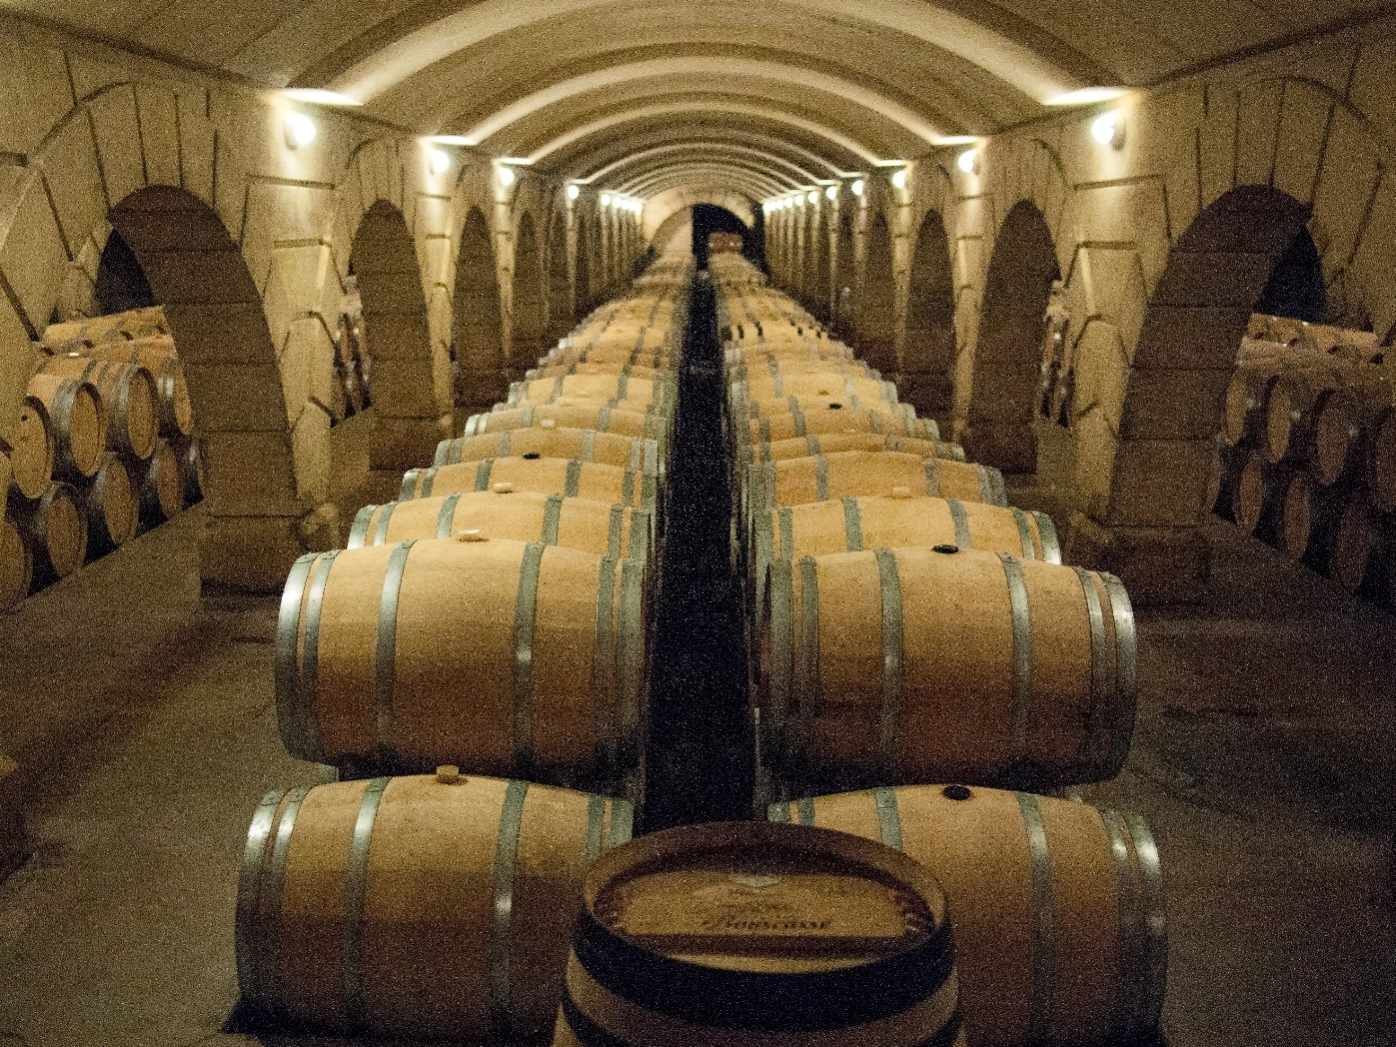
Hospitality and Wine & Spirits : Opportunities

Slide 2

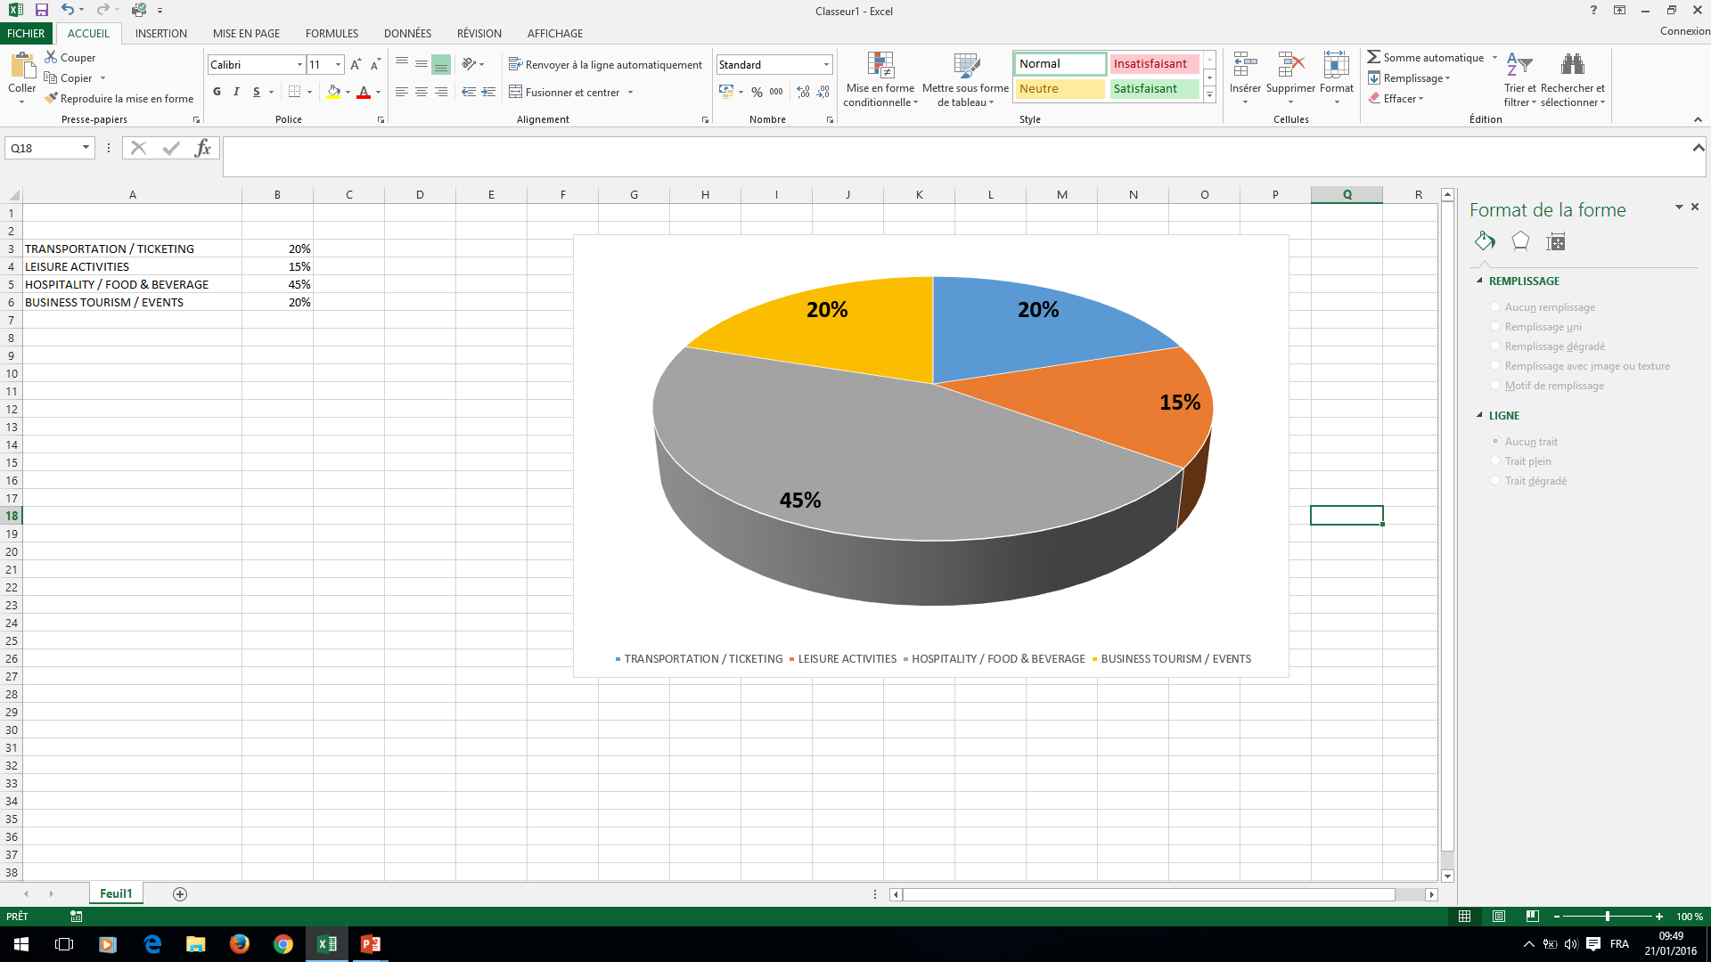
WORLDWIDE TOURISM REVENUE
45% for Hospitality/
Food & Beverage
20% Tourism/events going down
15% Leisure activities going up

Slide 3
Key numbers for India alone
Hospitality : 8,1% total employment. 9,2% of the GDP.
India is the 7th largest tourism economy in the world.
10 million foreigner tourists in 2017. Annual Growth Rate of 14%* !
Wine & Spirits : throughout Asia!
*Source : tourism.gov.in

Slide 4
Career corner
Restaurant Manager
F&B Manager
Banquet Manager
Breakfast Manager
Room service Manager
Sommelier
Restaurant Director
Accommodation Manager
Front Office
Booking Manager
Technical Manager
Night Manager
Housekeeping Manager
Concierge
Travel Manager
Finance Manager
Accounting Manager
Cost Controller
Marketing Manager
Sales Manager
Events Manager
Wedding Planner
Promotion/social Media
Manager
Human Ressources Manager
Recrutment Manager
Training Manager
Career counsellor
Entrepreneur
General Manager
Innovation and Quality Manager
Quality Auditor
PR
Luxury Journalist
Import/Export

Slide 5
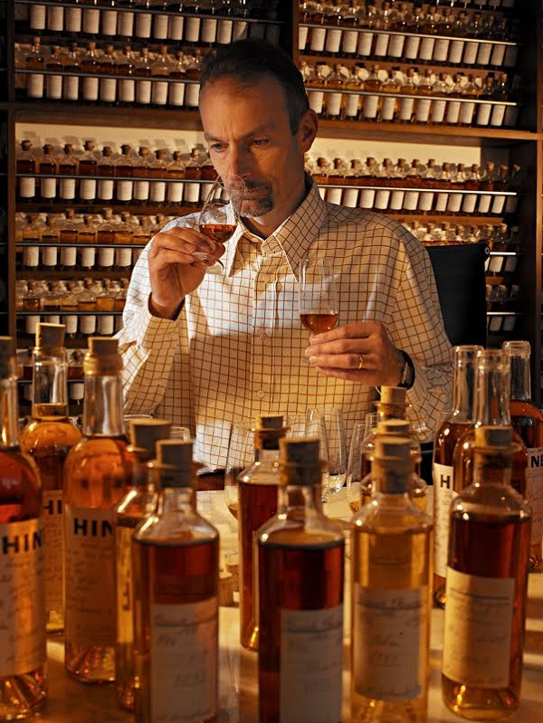

How to get ready for these opportunities ?

Slide 6
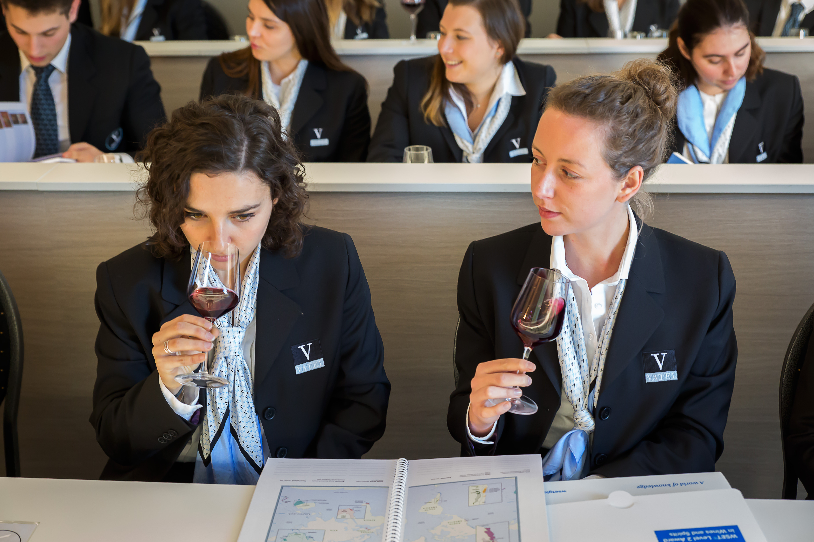
MBA
State-accredited
18 months including one internship
Subjects:
Finance Analysis
Taxation
Economic and law
Marketing
Thesis
Specialization in Wine and Spirits Management
Corporate strategy
Hospitality strategy
Digital & Innovation
Entrepreneurship…
Human Ressources Management

Slide 7
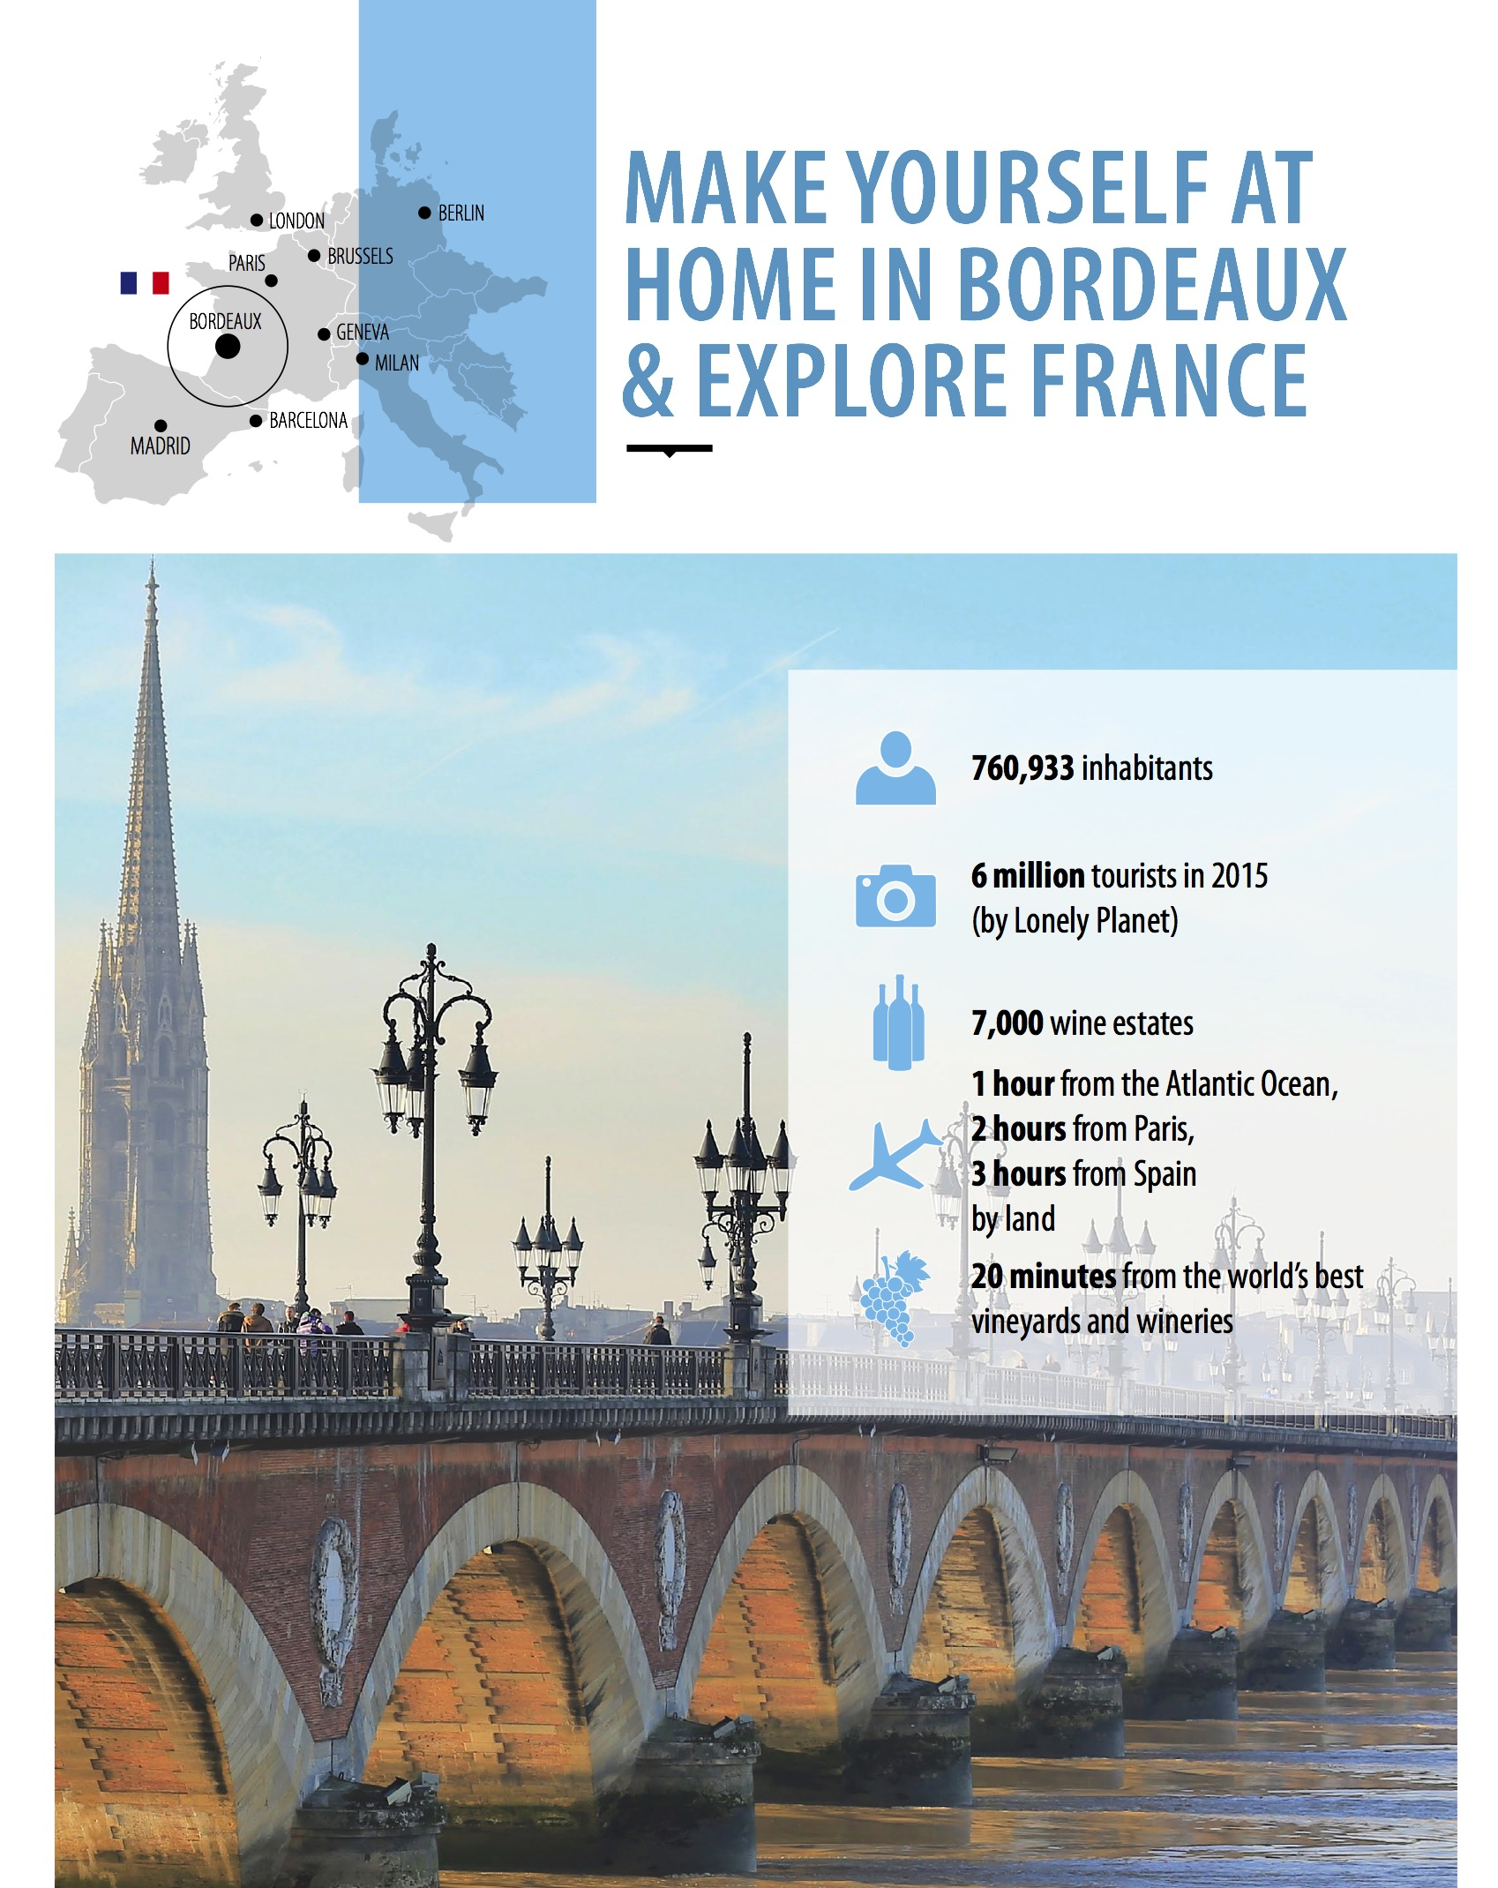
VATEL Bordeaux
UNESCO World Heritage
760 933 inhabitants
7000 wineries
1h from Paris, London, Barcelona by plane
2 h from Milan, Dublin,
3 hours from Spain

Slide 8
Admission Requirements
Admission interview + Entrance Tests
ID + Transcripts + cover letter + CV + language certificate
To take courses in French
  Equivalent to CEFR B2: DELF / TCF B2 (minimum)
  DALF C1 (recommended)
To take courses in English
  Equivalent to CEFR B2/C1: IELTS 6.0 (academic) or TOEFL iBT 90
  Cambridge CPE B2, CAE B2 or FCE Grade B

