Slide 1
University of Utah Asia Campus Incheon, South Korea
Notes:
And that brings us to our campus here in Incheon, South Korea. We were founded in 2014 with an incoming class of 13 students. Since then, we have grown exponentially and continuously enroll our largest freshman class year after year. As of Spring 2020, nearly 450 students are enrolled at the UAC.
Everything on our Asia Campus is the exact same as the Salt Lake Campus: all of the classes are taught in English, all of the faculty are approved by the Salt Lake Campus, your diploma and transcripts will look the exact same – the only difference is that you get to earn your university degree while experiencing two countries and gaining a truly unique experience.
But to better understand the campus, first it’s best to introduce our neighborhood

Slide 2
Utah Asia Campus
Founded in 2014
Emulates Salt Lake City Campus
Smaller class sizes
3+1 program
93% Retention Rate
Global Campus
Notes:
Now, as far as our university is concerned, we were founded in Songdo in 2014 and as mentioned before, everything on this campus emulates the Salt Lake City Campus. The benefit of attending school here though is that you get all of the benefits of a major public research university, but in a much smaller and focused environment. Our current student to faculty ratio is 13:1, which is unheard of for universities of our size, so you have a much more individualized university experience.
Another point that really sets us apart from the rest is that we operate on a 3+1 program, which means in order to earn your bachelor’s degree, you will study in Korea for 3 years and then study at the Salt Lake City campus in the USA for one year. You are able to experience two countries during your college career, and at a much more affordable price than studying in the USA for all 4 years. Students who graduate from our university are not only more marketable in a global workforce and but more culturally adept than the average US college student as well.
Students on our asia campus are more satisfied and successful than the national average, which is part of the reason for our 93% retention rate, and continual increase in enrollment numbers.
The last thing I’ll mention that really sets us apart from other universities is the fact that we are part of the Incheon Global Campus.

Slide 3
BS Civil And Environmental Engineering
Applies modern technologies to solve problems related to water resources, transportation, environment, or structure.
80% Job Placement Rate for “U” Graduates
#53 Best Engineering Program
(US News and World Report)
Careers In:
Construction Management | Groundwater Contamination | Transportation Design | Earthquake Engineering
Notes:
Our newest major on campus is Civil and Environmental Engineering. Civil Engineers work to improve everything related to our infrastructure including roads, bridges, canals, dams, pipelines, various forms of transportation, among other things. As a student at the U, you’ll be joining a cohort of future engineers who have an 80% job placement rate upon graduation. In addition to that, we have a guaranteed internship for all of our engineering students, which takes place during your senior year at the Salt Lake City Campus. Currently, we are the only ABET accredited engineering program in Korea, which is the premier accrediting body for engineering programs worldwide.
The program itself is heavy on STEM coursework, some of the classes you’ll take include Engineering Calculus, Chemistry, Physics, Hydraulics, Strength of Materials, Structural Load & Analysis, Steel Design, Highway Design
Guaranteed Internships
Legacy Bridge
Where do graduates work?
https://www.civil.utah.edu/ug_program

Slide 4
BA/ BS Communication
Choose from three paths
Journalism
Strategic Communication
Digital
Print
Public Relations
Advertising
Broadcast
Integrated Marketing
Absolute Communication
Theories/ Methods
Comprehensive
Productive skills
Careers In:
Marketing | Business Development | Social Media | Journalism | Public Relations | Human Resources | Sales
Notes:
Our Communication program is unique in that it allows students to really customize it to their liking. As a Comm major, you’ll be able to choose whether or not you pursue a Bachelor of Arts or a Bachelor of Science in Communication. Under these degrees, you can choose from one of three paths: Journalism, which focuses on digital, broadcast, and print journalism, Strategic Communication, which is more of the analytical side of communication, like public relations, statistical analysis, and integrated marketing; or Absolute Communication, which focuses on the key theories and methods that motivate effective communication, and improve productive skills like writing and speaking. You’ll study things like Mass Communication Law, Photojournalism, and Persuasion and Political Communication
The only difference between the BA and BS programs is the coursework that students take during their senior year. If they choose to pursue a BA, their senior year will focus more on language and linguistics, whereas students seeking a BS will take coursework geared more towards statistics and public relations.
There are all kinds of ways for our communication students to gain real life work experience. In 2015, Five Utah Asia Campus Communication students worked on recording stories about the Korean War, and afterwards each of them were selected to receive funding for their research from the Undergraduate Research Opportunities program (UROP).
Students may complete a Bachelor of Arts or Bachelor of Science in Communication within one of four sequences: Strategic Communication (public relations, advertising, integrated marketing); Journalism (online, broadcast, print)
https://attheu.utah.edu/facultystaff/olympic-sneak-peak/
Picture of Comm lecture series
BBC, NY Times,

Slide 5
BA Film & Media Arts
Tailor your degree across multiple areas of interest: Study creative production, theory, history, animation, video game design, and more!
Film + Animation + Video Game Design
#21 Best Film/ Video College
(USA Today)
Careers In:
Animation| Film | Production | Freelance| Entertainment Industry| Computer Game Design
Notes:
The Film and Media Arts Program at the U is one of the top programs in the nation. Similar to the degree in Communication, students have the ability to tailor their degree to suit their specific interests, including documentary, narrative and experimental filmmaking, animation, screenwriting, sound production, critical studies and new media.. Not only will you study Film, but you’ll also study Animation and Video Game Design. There are numerous ways for students to enhance their academic learning as well on our campus – recently we designed and built a blackbox for students to use however they best see fit, and this semester we created a brand new, state of the art animation studio to enhance the animation portion of our Film and Media program. Not to mention, we are in the process of establishing our first E-sports team on campus. So, it’s definitely an exciting time to enroll.
Students in the Film and Media program study a wide variety of coursework such as Motion Capture, Digital Drawing, Screenplay/ Drama Structure, Diversity in Film and Media and so on.
Study: Motion Capture, Digital Drawing, Screenplay/ Drama Structure
Students have the freedom to tailor the degree across multiple areas of interest including documentary, narrative and experimental filmmaking, animation, screenwriting, sound production, critical studies and new media.

Slide 6
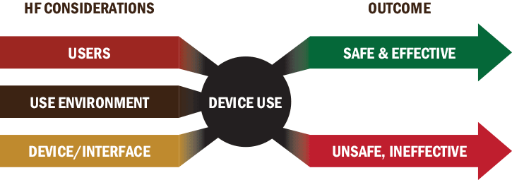
BS Psychology
Identifies the links between the mind, the body and the social world.
Pre-med
prepares students for advanced degrees in medicine
Coursework in
Clinical | Cognitive | Developmental | Social and Personality | Health | Behavior Neuroscience
Careers In:
Human Factors Certificate
Education| Advertising | Marketing | Criminal Justice| Research| Counseling | Social Work
Notes:
Psychology is oftentimes classified as a Hub Science, as it prepares students for employment in a variety of different fields. Psychology graduates go on to work in school counseling, therapy, advertising and marketing, criminal justice, along with numerous other fields. The Psych program at the U is world-renowned and highly esteemed: Our award-winning faculty are active researchers who investigate phenomena such as texting while driving, sexual attraction, group identity and discrimination, combat-related PTSD, and the interactions between physical and mental health.
As a Psych student, you will be given a solid foundation in various fields of psychology that will make you more marketable upon graduation, or assist you with pursuing higher education. Rather than focusing on one psychological topic, your coursework will hit several areas of the field, including clinical, cognitive, developmental, and Social and Personality.
For an extra 24-27 credits, students have the option of adding a Human Factors Certificate to their degree. This certificate option is concerned with how users interact with devices, and how to ensure those devices are safe, effective, and efficient. Some topics that a Human Factors Psychologist may deal with include ergonomics, workplace safety, product design, and human-computer interaction.
One last thing I’ll mention about our BS in Psychology, is that this program has the option of being Pre-med, so if you are hoping to go on to medical school, our psychology major will give you the knowledge and skills necessary to be successful on your MCATs.
“Hub Science”
"Human Factors is concerned with the application of what we know about people, their abilities, characteristics, and limitations to the design of equipment they use, environments in which they function, and jobs they perform.“ 24-27 credits
behind the design of everything from smartphones and children’s toys to online networks and public health ads.
Study: Adult Development and Aging, Personality Theories, Sensation and Perception

Slide 7
BS Urban Ecology
The study of the relation of living organisms with each other and their surroundings in the context of an urban environment
Designing Smart Cities
Songdo, South Korea
Seoul Sky Garden
Global Internship Opportunities
Careers In:
Environmental Planning | Urban Planning | Public Health | Public Policy | Community Development | Sustainability
Notes:
By 2050, the world’s population is expected to reach 9.8 billion, and 6.7 billion of these people are projected to live in urban areas. Urban Ecologists are the individuals who study how to accommodate this mass influx of people in our cities, and they aim to understand how human and ecological processes can coexist in human-dominated systems, like cities. Their efforts are focused on sustainability, efficiency, and simply how to make our cities livable. Urban Ecologists are the ones tackling the major issues in our cities such as water sources, energy, waste, food, mobility, and overall infrastructure design. It goes without saying that this will be a highly demanded major in the future.
A wonderful example of Urban Ecology at work is Seoul’s Sky Garden, located right next to Seoul Station. This garden used to be a highway overpass, but was repurposed in 2017 to serve as a garden and walkway in one of Seoul’s busiest areas. Through design, the Urban Ecologists were able to turn an unsightly highway overpass into something much more beautiful, which increases the quality of life in the area.
Not to mention, as Songdo is a planned city, it is an ideal lab setting for this major. Our students are able to see firsthand how a city is planned in an environmentally friendly and sustainable way.
Work with Career Development for Global Internships in and around Korea, USA, and more.
Songdo – an ideal lab setting for this major
Green Climate Fund
environmental management, fragile landscape protection, recreation and tourism, public lands planning, rapid population growth, rural towns, regional transportation, energy production and low density sprawl.

Slide 8
Tuition
Top 7% in the USA for best economic value of a college degree, and #1 in the Pac-12. (The Economist, 2015)
3 years in Korea:
$10,000 per semester
$20,000 per year
1 year in the USA:
$13,000 per semester
$26,000 per year
Notes:
One of the biggest benefits of attending university on our Asia Campus is that it is far more financially affordable than studying in the USA as an international student. Right now, the average cost of university for ONE YEAR in the USA is $45,000. But studying on our campus here in Korea, you are able to earn the exact same degree at more than half the price.

Slide 9
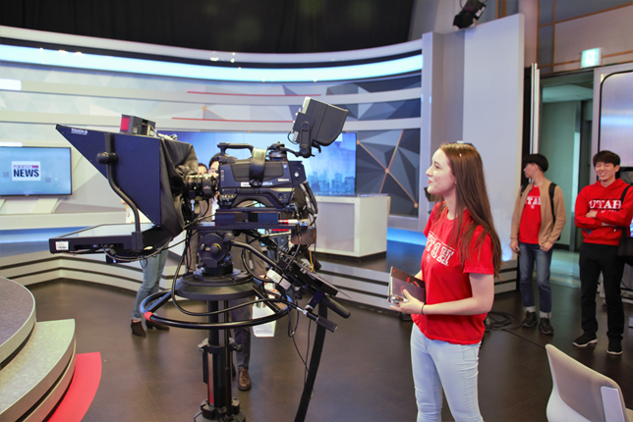
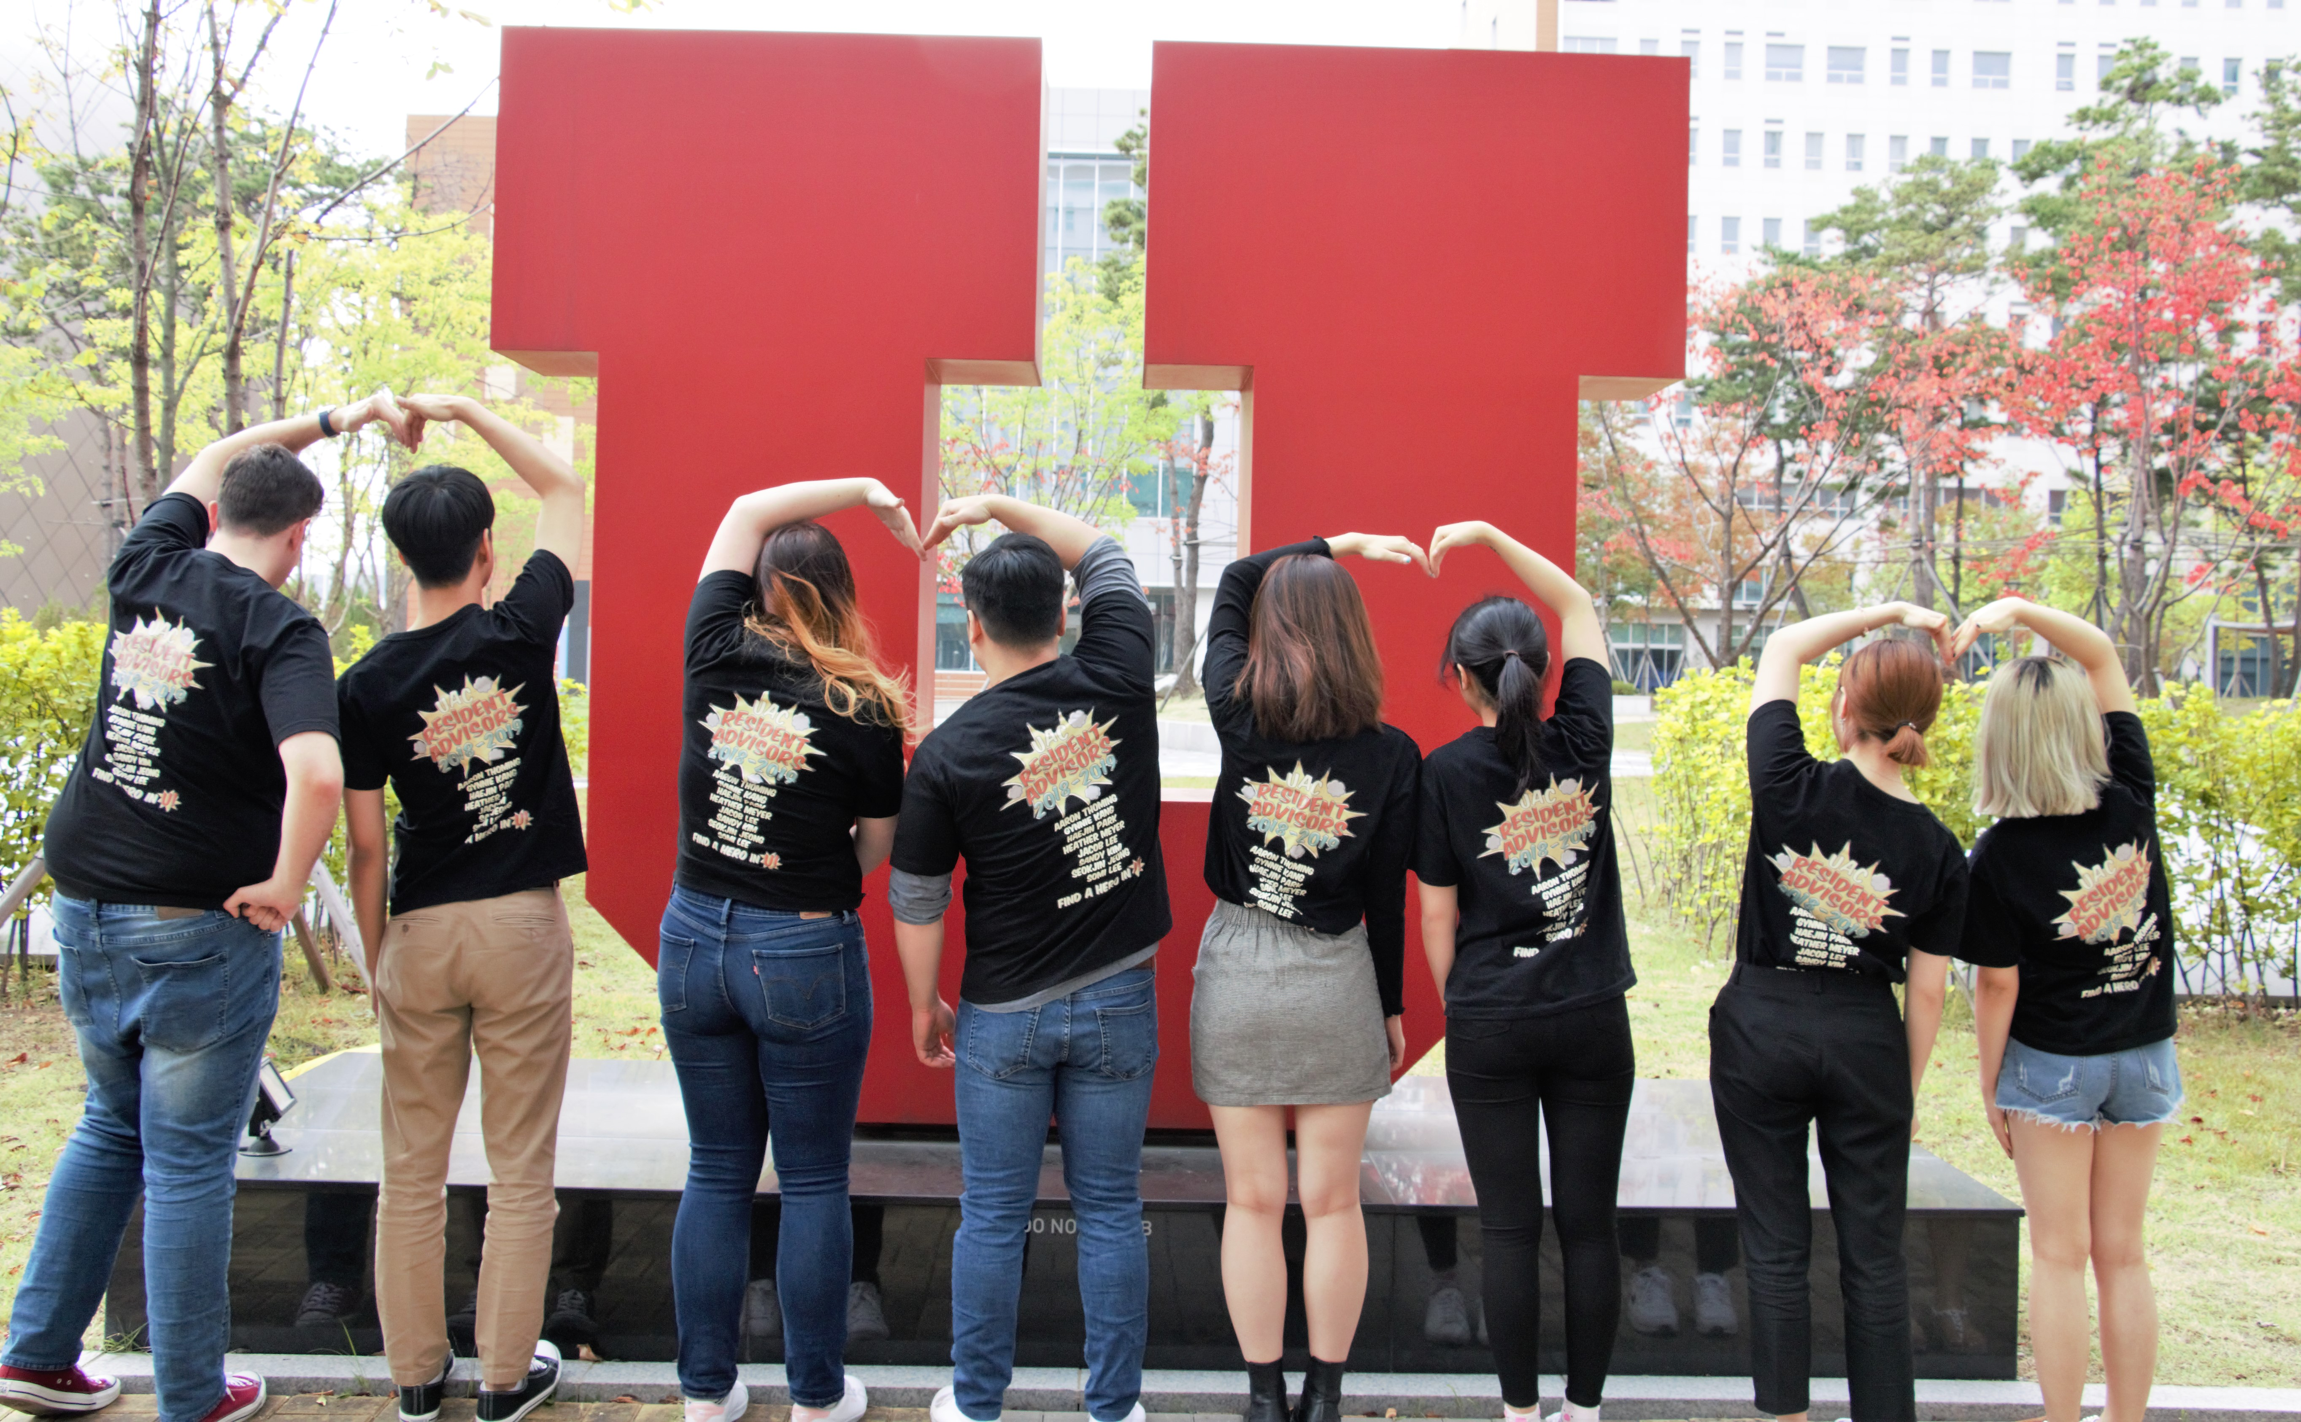
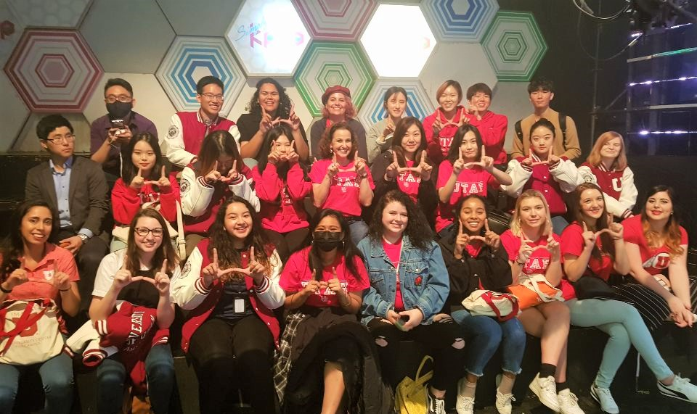
Scholarships
Awards available for current students as well!
Range from $1000 per year to 40% of tuition
Entrance Scholarship
Based on academic merit and school performance. Automatic consideration
New Horizon Scholarship
Based on extracurricular activity, community involvement, ability to contribute to diversity on campus.
UAC Opportunity Scholarship
Based on demonstrated financial need
Notes:
Another aspect of the admissions process that sets us apart from other US institutions is that there are numerous scholarship opportunities available to international students. These scholarships range from $1000 per year up to 40% of tuition, and if you couple the scholarship with an on-campus work opportunity, you are really able to minimize the cost of a university education. Currently there are three scholarships available for freshman applicants: our entrance scholarship is based on merit, so your academic performance; two is the New Horizon Scholarship, which is based on your extracurricular activities such as clubs, volunteer organizations, community involvement, and so on. This scholarship is awarded to individuals who we believe will enhance the diversity of our campus in a variety of ways. And the third, our Opportunity Scholarship, is awarded to students with demonstrated financial need.
Though these are the only scholarships awarded to incoming freshman, there are also several scholarship awards available for current UAC students, including a award specifically for students during their time at the Salt Lake City campus.
NHS, Opportunity: Must be admitted first, then submit two essays.
Scholarships do not carry over to the USA

Slide 10
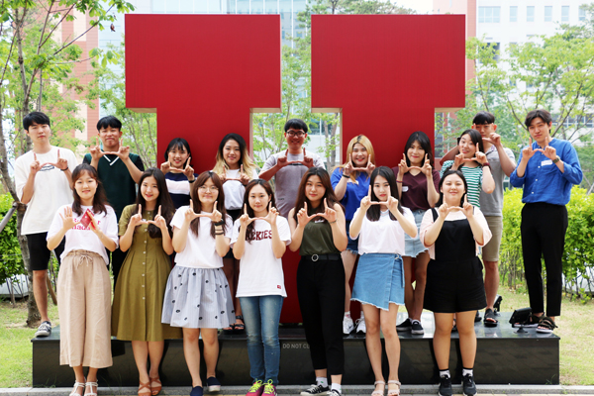
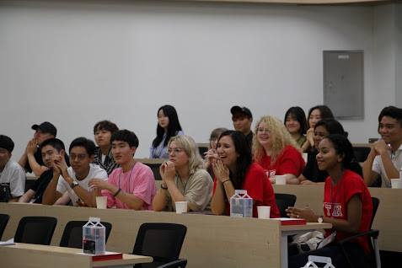
Required Documents
Apply Online! asiacampus.utah.edu
1. High school transcripts
(Grades 9 – 12)
2. Test Scores
TOEFL (80+), IELTS (6.5+), TOEIC (695+)
ACT or SAT*
*US Citizens or students attending a US accredited high school for 2.5 years or more
3. Optional Documents
Personal Essay
Letter of Recommendation
Portfolio
Notes:
As far as application documents go, we only need 3 things: your high school transcripts from the your last four years of school, your test scores (which I’ll talk more about in just a second), and any other optional documents you wish to include. These optional documents could be a personal essay, letters of recommendation, maybe you’re applying to film and media arts and would like to demonstrate your artistic ability through a portfolio, any additional material that you think would make you shine as an applicant.
In regard to test documents: If you are an applicant from a non-English speaking country, you will need to submit an English proficiency test, either TOEFL, IELTs, or TOEIC. Alternatively, if you are a US Citizen or have attended a US accredited high school for 2.5 years or more, you will need to submit either an SAT or ACT score. It is possible for us to use an SAT or ACT score to waive English proficiency as well, if you are an international student who would prefer not to take TOEFL or IELTs.

