Slide 1
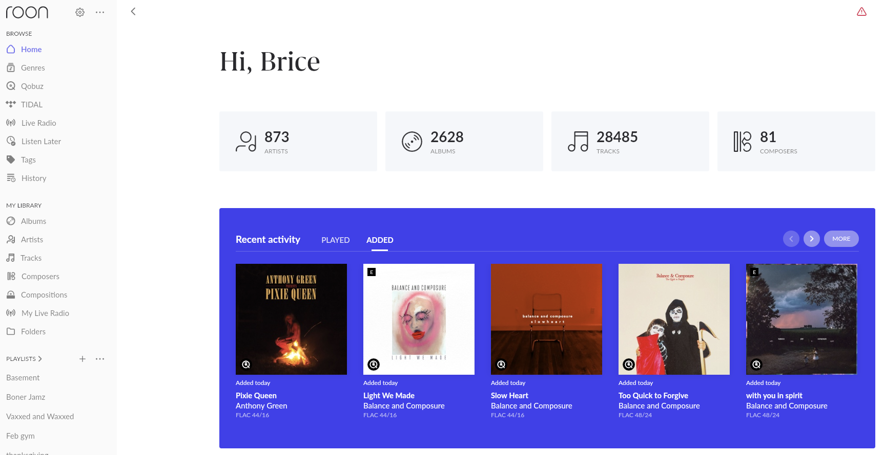
2628 albums here, but when I click on Albums from left-hand menu, it shows 1717 albums.
The albums shown here as recently added are not my most recently added. These were added many months ago.

Slide 2
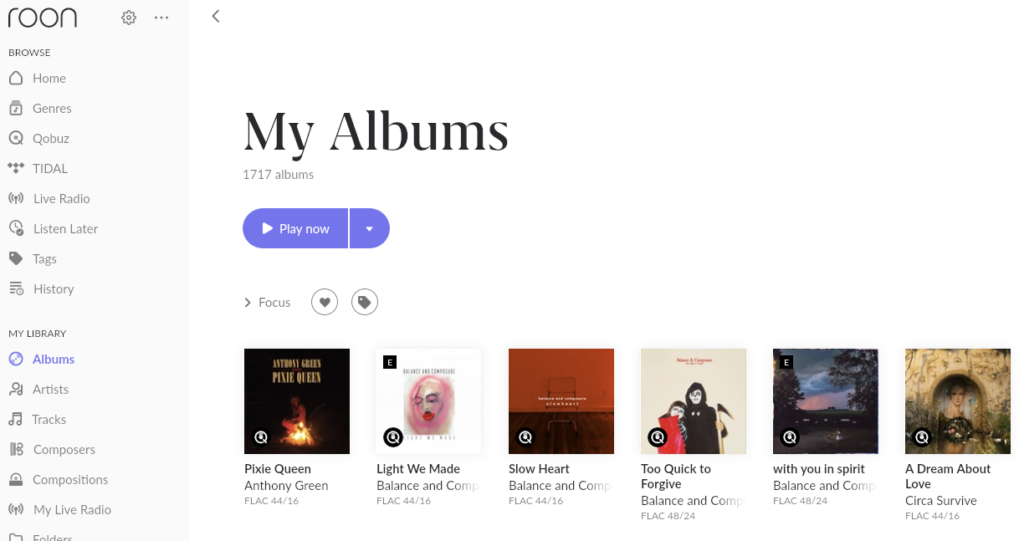

Slide 3
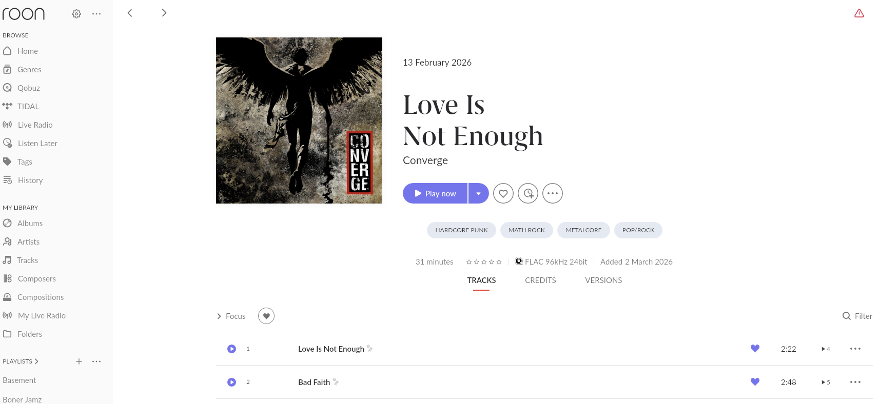
This is one of the albums I added most recently. What does it not show up in Recently Added or viewable in my Albums view?

