Slide 1


Slide 2


Stephen Sobierajski
Associate Director of Admissions
The Culinary Institute of America
Hyde Park, NY (Flagship Campus)

Slide 3



Three US Campuses

Slide 4


Slide 5



Notes:
At the CIA, you’ll definitely learn by doing. All of our bachelor’s and associate degree programs include the most experiential hands-on education anywhere.
Core academic courses prepare you to lead and excel in the business of food and hospitality. Many of our graduates go on to start their own businesses with the well-rounded education they receive here.
CIA students spend 12 weeks in one of our award-winning public restaurants and cafés—we have nine of them across our three U.S. campuses! In 2018 alone, our students cooked for and served nearly 300,000 customers.
Our culinary science labs are where curious students explore, experiment, and push the boundaries of food using the latest culinary technology and equipment.
And our unique Innovation Kitchen is where students operate their own pop-up concept.

Slide 6
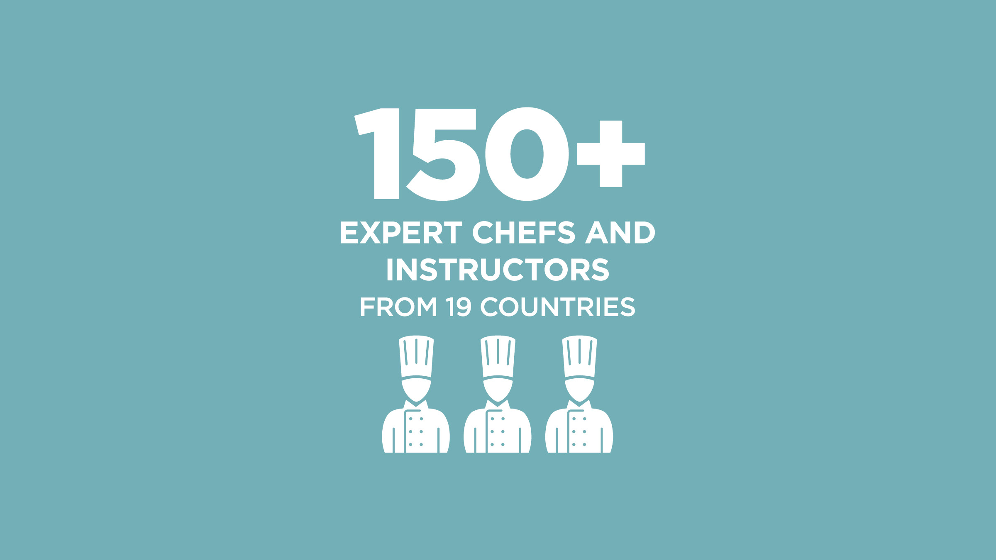
Notes:
Throughout your degree program, you’ll learn from an expert faculty.
Our chefs and professors come from all over the world and from all parts of the industry and higher education.

Slide 7
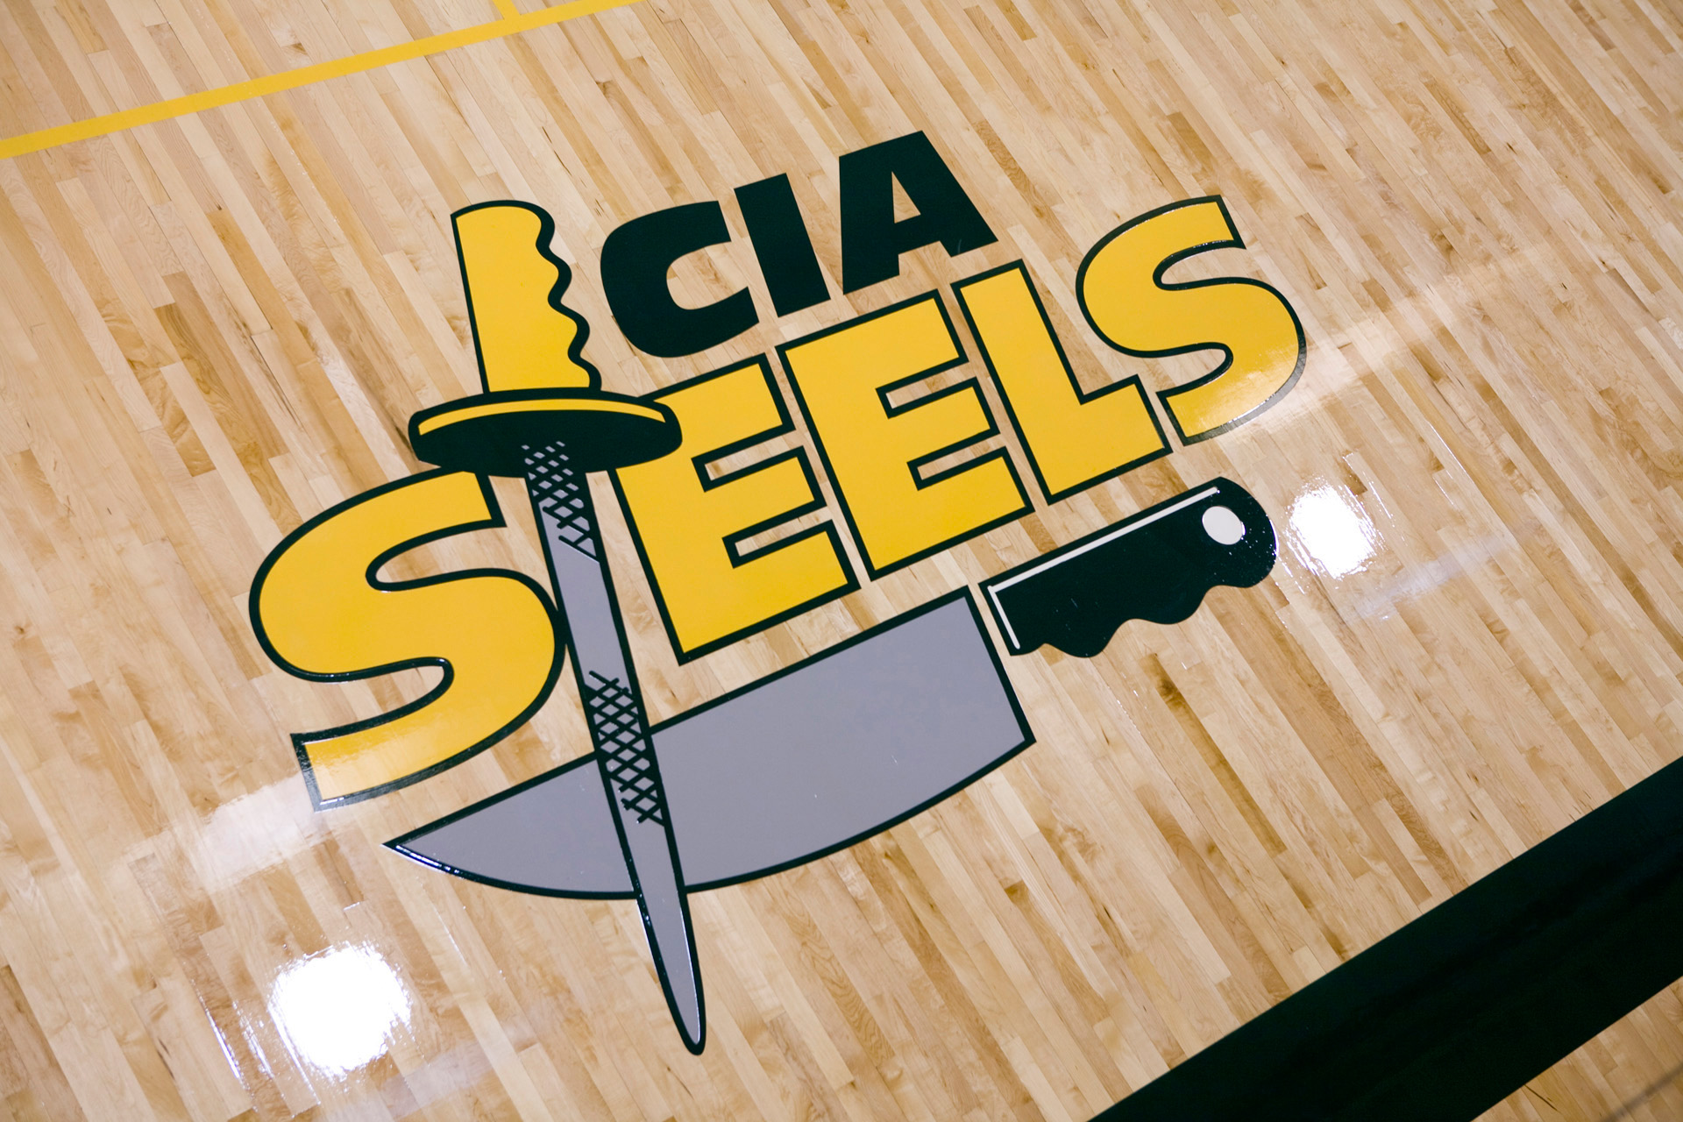

Notes:
We’re the CIA Steels! Our team is named for the tool chefs use to sharpen their knives.
The Steels compete in intercollegiate basketball, volleyball, cross country, soccer, and tennis.
You can also play intramural sports and take fitness classes or yoga.
And you can work out in the Student Recreation Center, which has a gym, fitness center, pool, weight room, and racquetball courts.

Slide 8














Notes:
100% of CIA students have the opportunity for a real-world internship working in the industry.
You can choose from 2,000+ CIA-approved locations like the ones shown here. Many of these companies come to our Career Fairs specifically looking to hire interns.
Most internships are paid, and the semester is included in your tuition.
You’ll make important professional contacts, and you may even get a job offer after graduation!

Slide 9

Career Services
3 career fairs every year, 150+ companies attending
Lifetime career services for grads
Access to 50,000+ CIA Alumni Network

Slide 10

1
Submit your application using our online application or The Common Application
2
Submit a Letter of Recommendation, Essay, Transcripts, and Proof of Funding to your admissions counselor
3
Submit your tuition deposit and I-20 Request Form
Notes:
Start by filling out your application for admission to the CIA.
Then provide the supplemental documentation that’s needed to officially complete your application file. We need all of these pieces before we can give you an admission decision.
Finally, make your deposit and receive your I-20. Once you have your I-20 you can make your visa appointment at the US Consulate.

