Slide 1
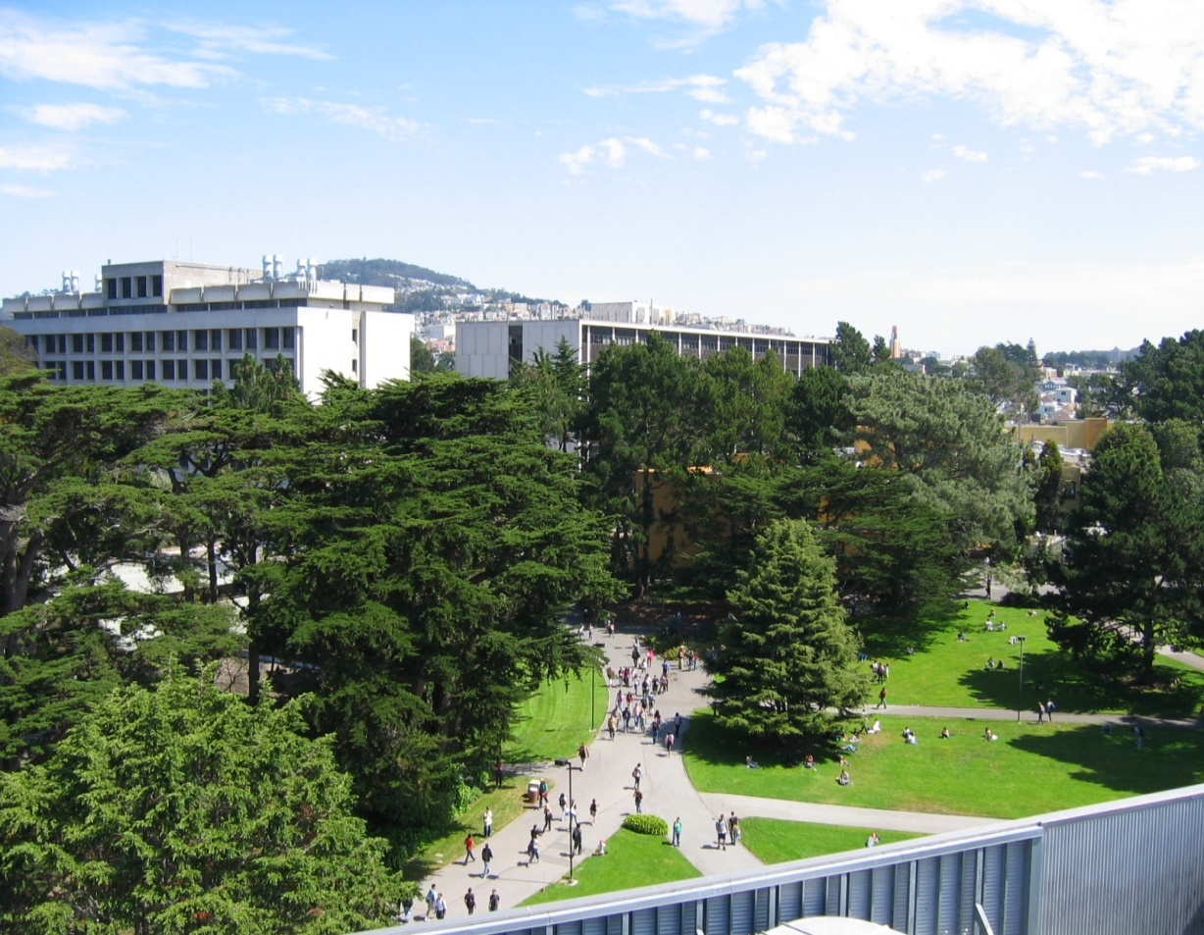


Slide 2


Slide 3
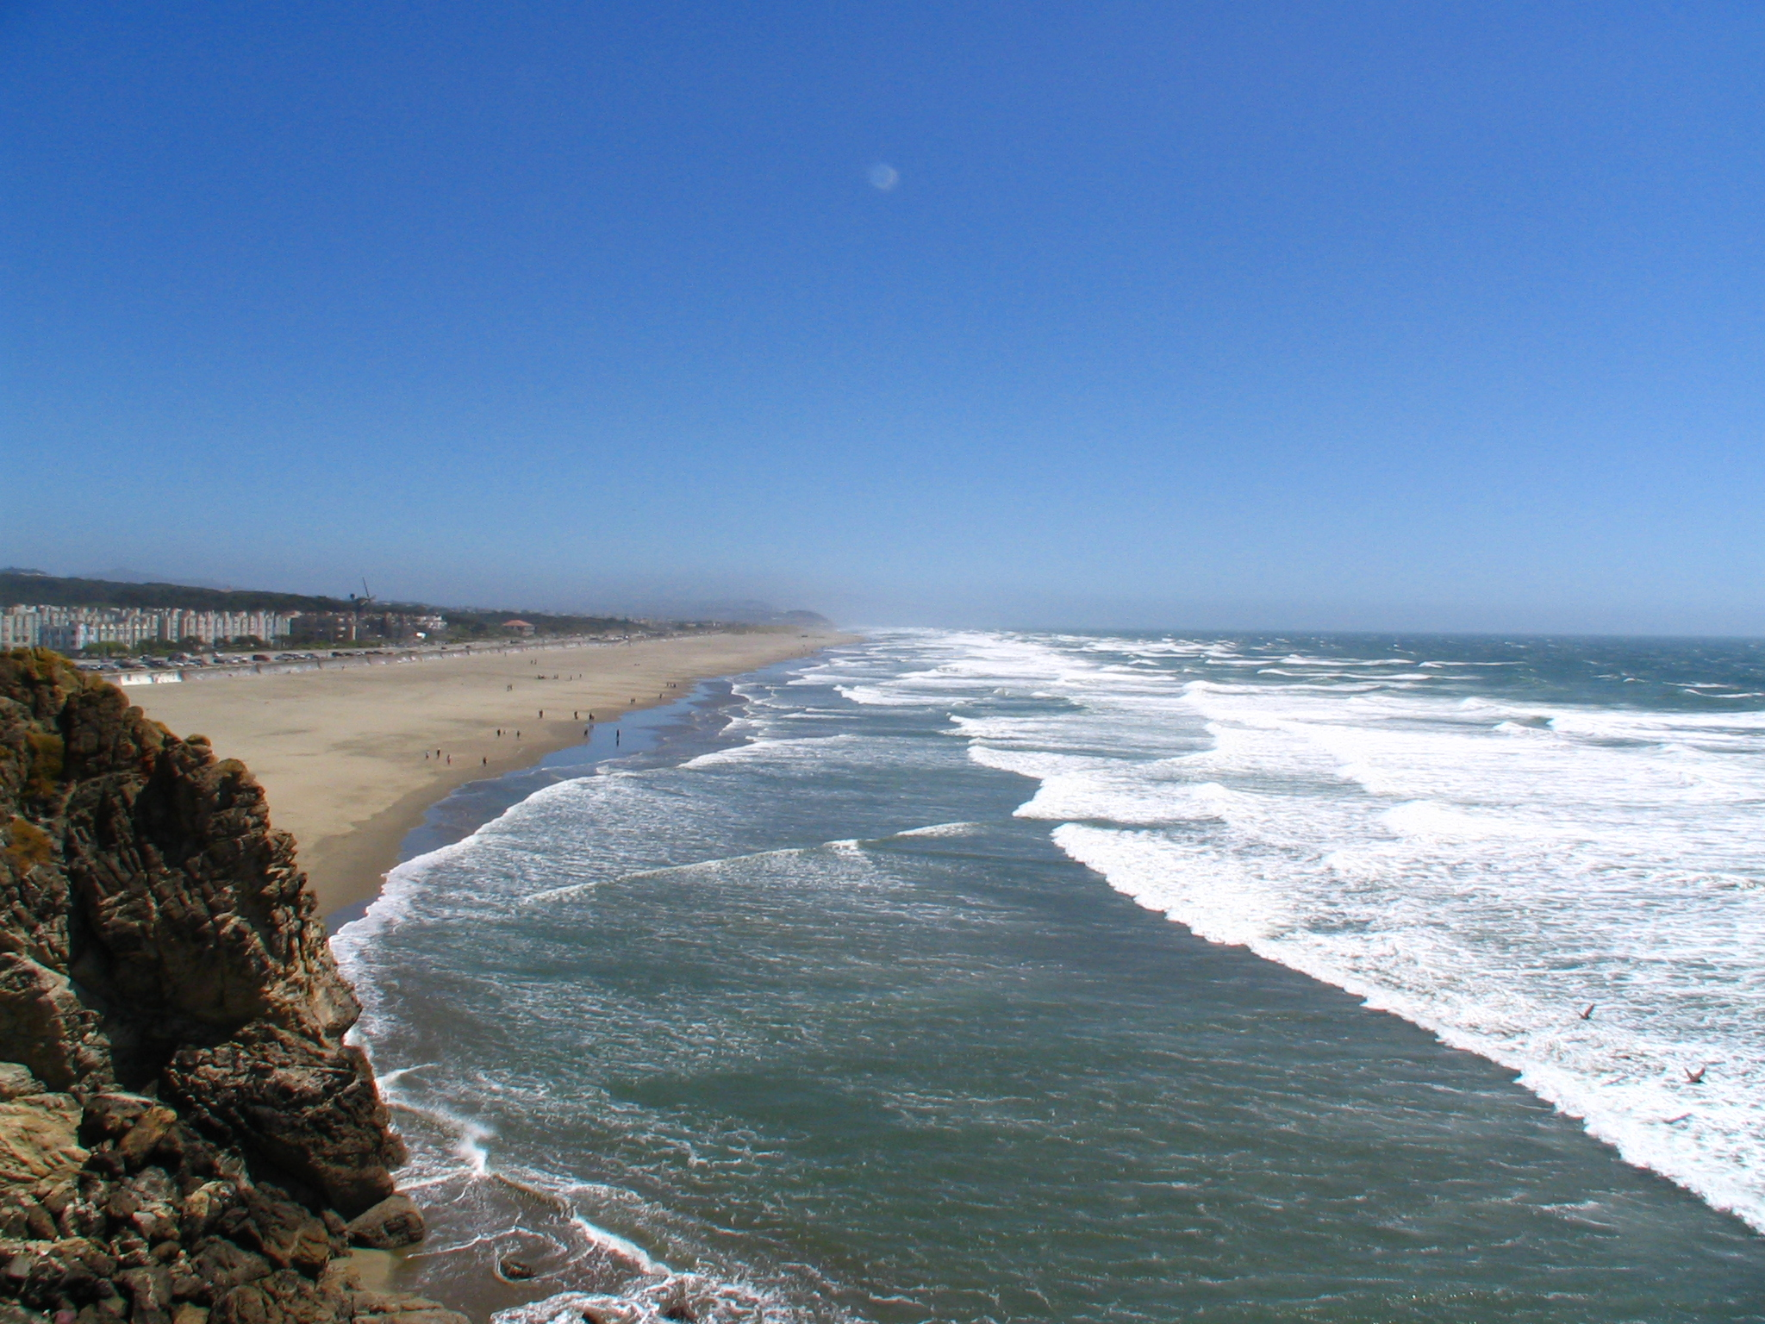
Ocean Beach (10 minutes from campus)

Slide 4

“San Francisco at night”

Slide 5
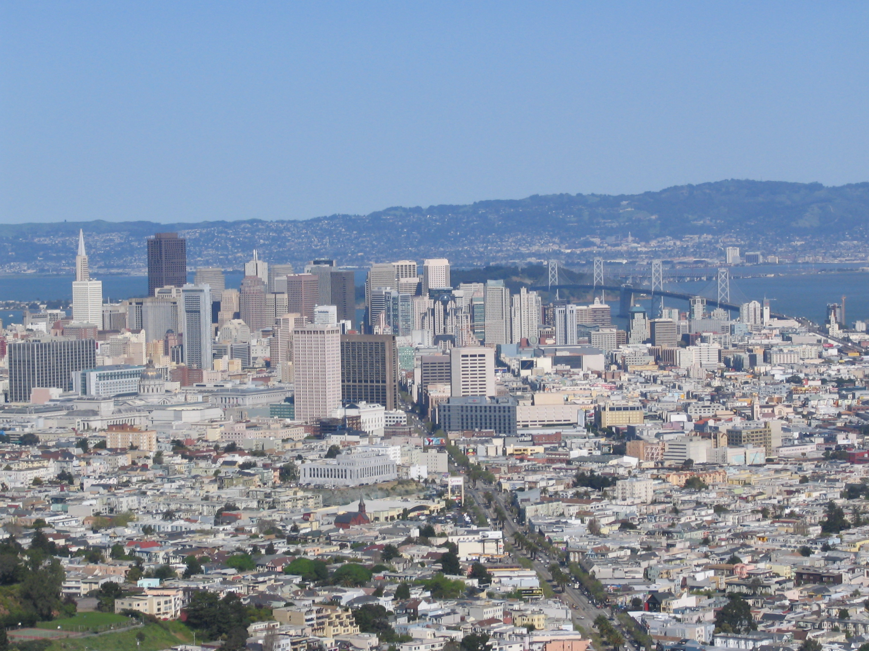

Slide 6
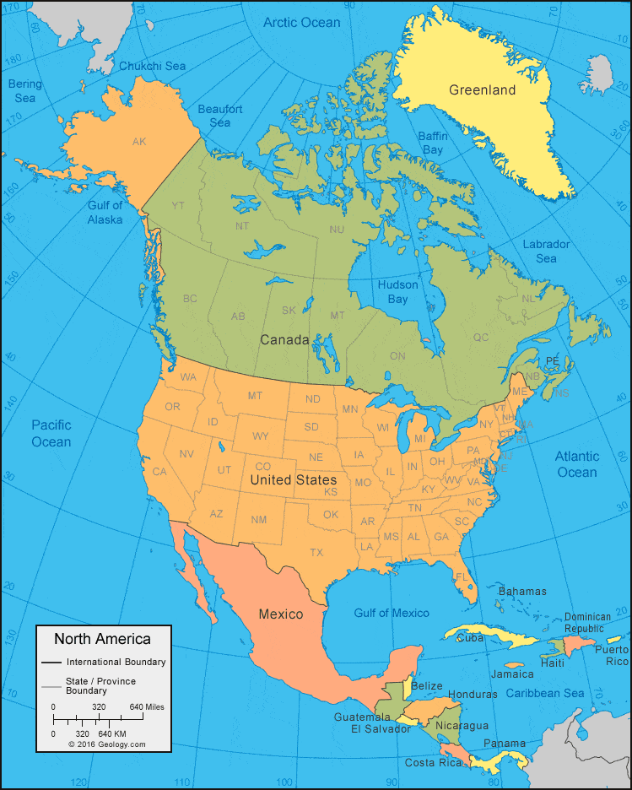
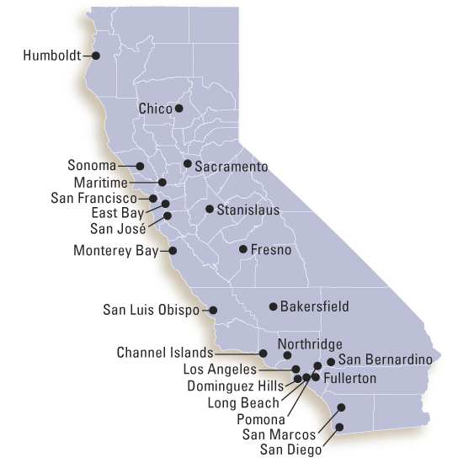
California State University

Slide 7

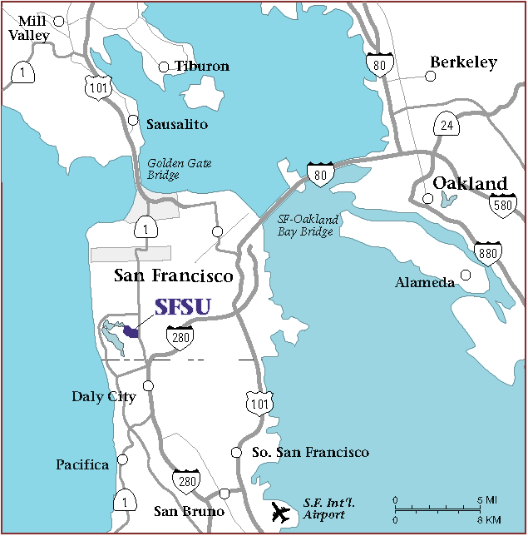
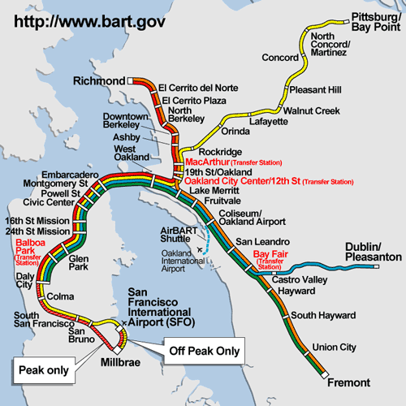
Visiting San Francisco State University is Easy!

Slide 8

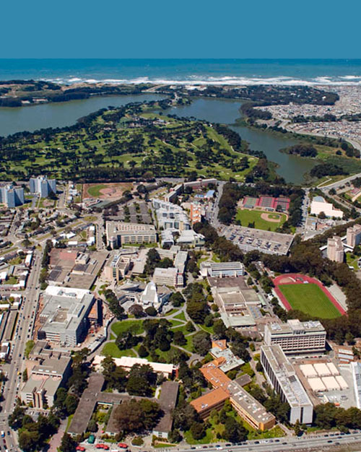
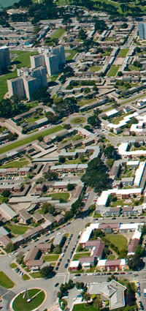
San Francisco State University

Slide 9
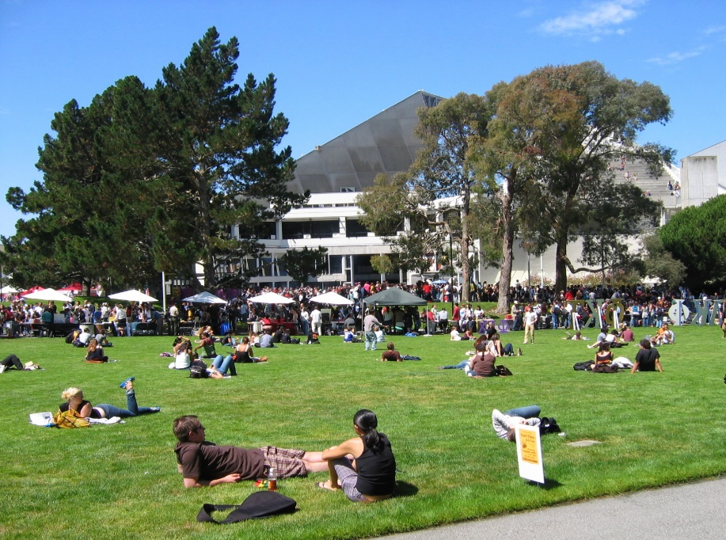
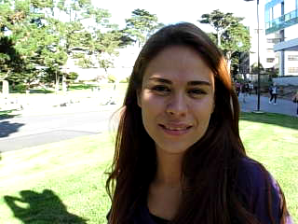
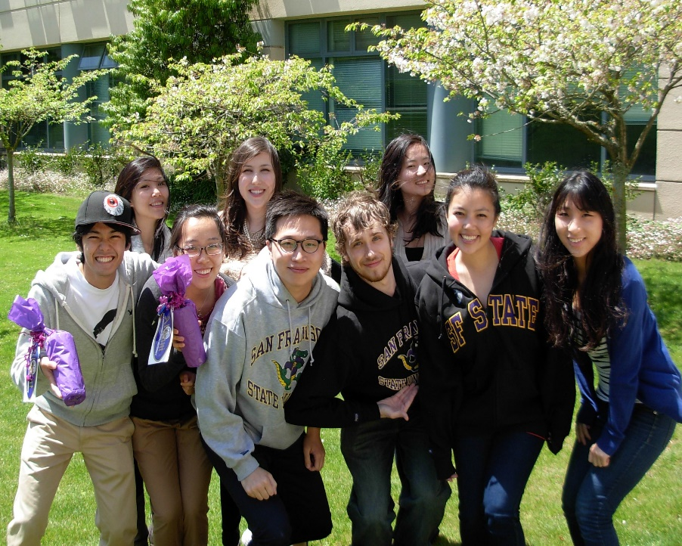
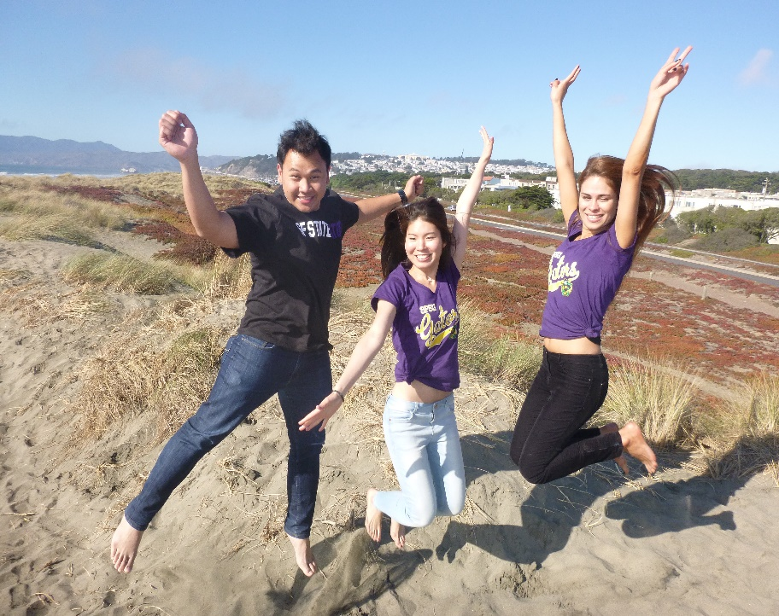

Slide 10
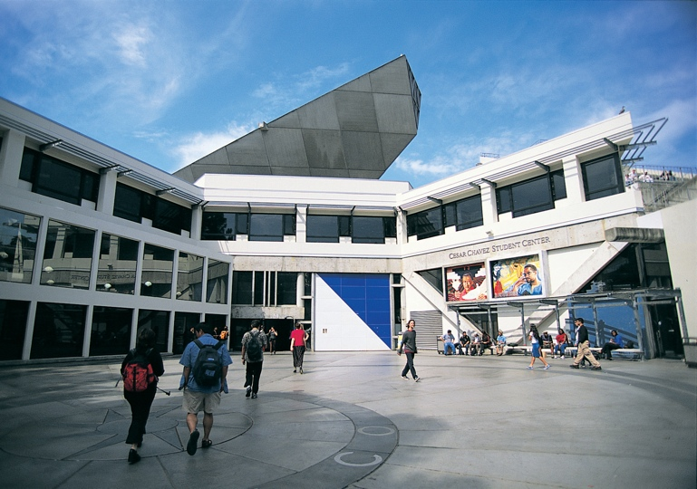
SF State Fact Sheet
Founded:1899.
Affiliation: CSU –WASC Accredited
Enrollment: about 29,000
  Undergraduate: 24,000+
  Graduate:5,000+
  International: 1,500
Degrees/Programs:
  Bachelor’s degrees in 115 areas of specialization
  Master’s degrees in 95 areas of specialization
Academic Calendar: Two 16-week semesters
  Fall: August to December
  Spring: January to May

Slide 11
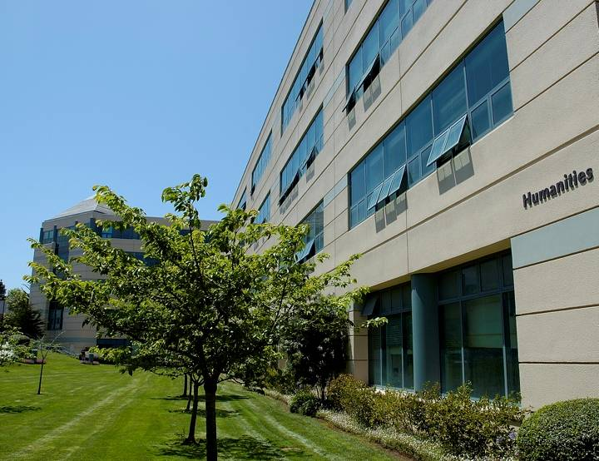
Most popular majors
among international students
Business (7 concentrations)
2. Engineering (4 concentrations)
Computer Science (BS/MS)
Biology (8 concentrations)
5. Economics (BA/MA)
6. International Relations (BA/MA)
7. English (MA -TESOL)
8. Cinema
9. Psychology
10. Design & Industry

Slide 12
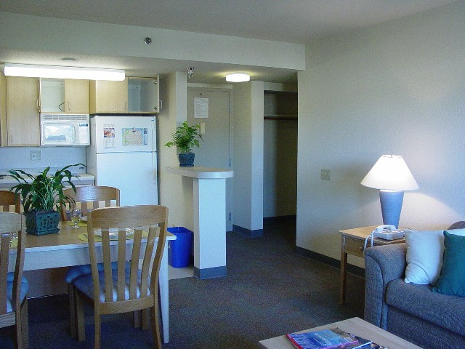
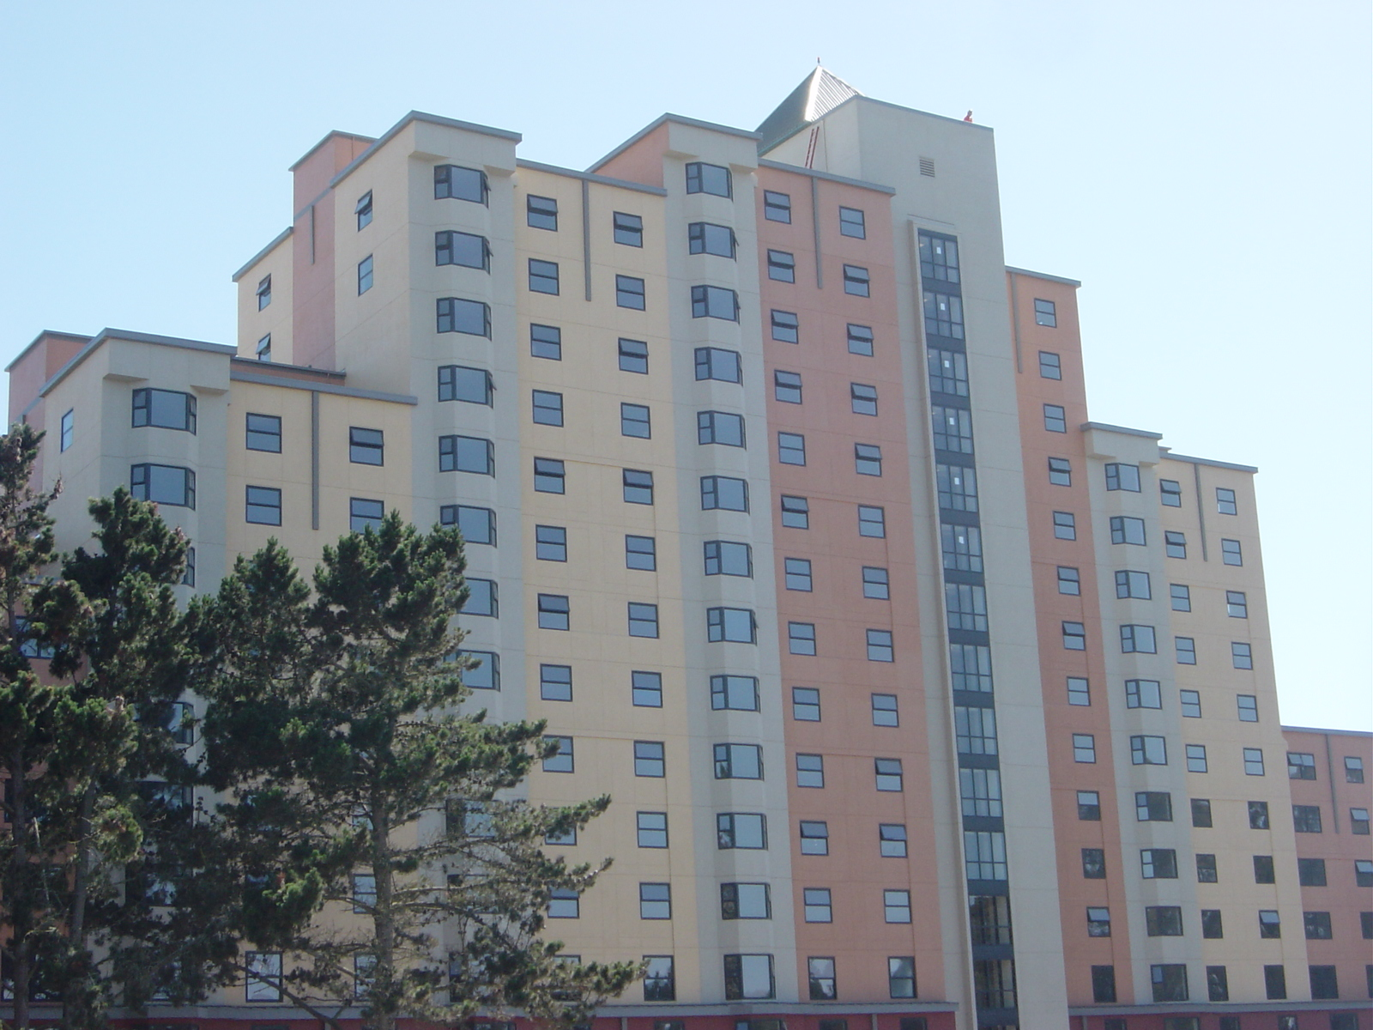
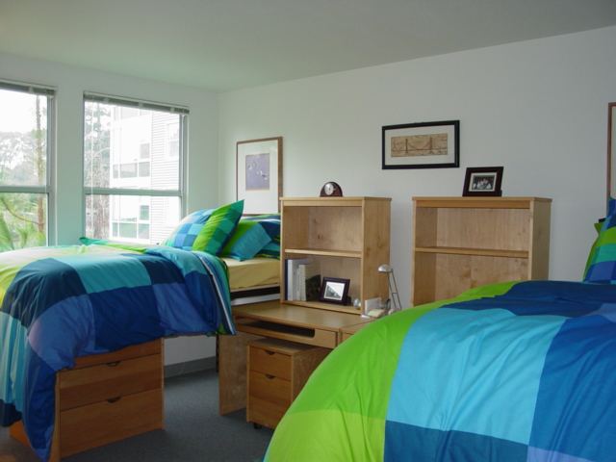
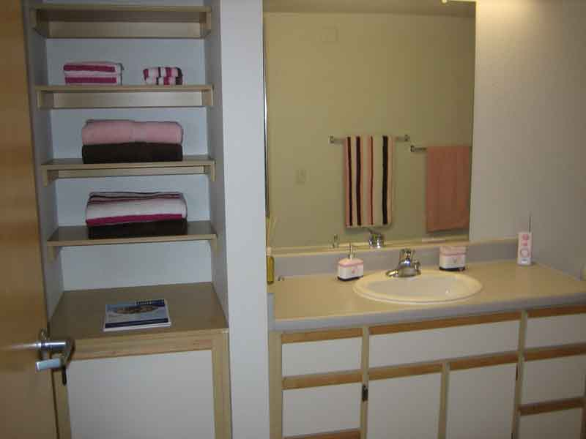
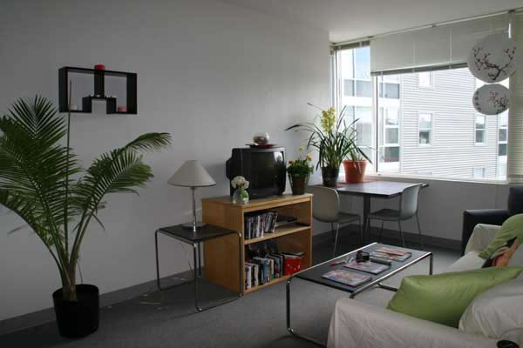
On-campus Housing
Dorm style
1 & 2 bedroom apartments
Family housing
Free cable & TV hookup
High speed internet connections
Conveniently located dining halls

Slide 13
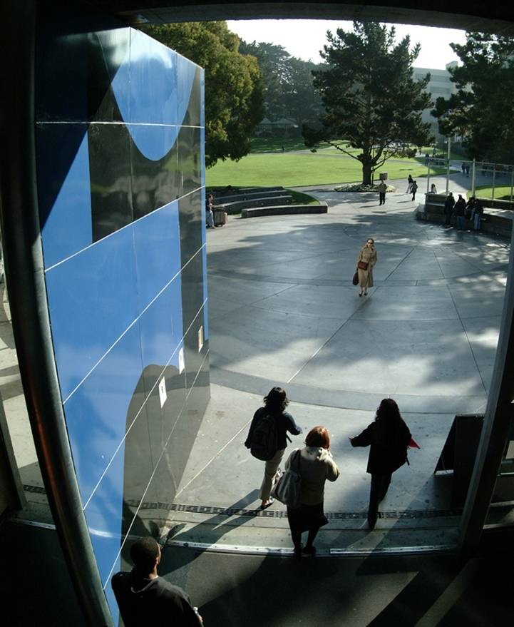
Admission Criteria
Undergraduate
  Secondary School/High School transcripts, proof of graduation
  ALL post-secondary academic transcripts
  2.5 GPA on 4.0 scale
  TOEFL minimum iBT 61 or
  IELTS minimum 6.0
Graduate
  4-year bachelor degree
  3.0 GPA on 4.0 scale
  College/University Transcripts
  TOEFL minimum iBT80 or
  IELTS minimum 6.5
  GRE/GMAT
  Personal Statement
  Letters of Recommendation

Slide 14
Undergraduate Programs
  EARLY DECISION
  Fall Admission Decision by February 15th
  Apply October 1 ~ November 30
  (extended to May 1)
  Spring Admission Decision by November 15th
  Apply August 1 ~ August 31
  (some majors closed for spring intake)

Slide 15
SF State Graduate Programs
Timeframe | 24 months: 3 courses per semester
Coursework | Foundation courses, Electives, Culminating Experience
Program | Average Master’s Program requires 30-33 total credits (10 – 11 courses in total) MFA, MSW & MBA Programs require 30 – 60 total credits
Schedule | Day and Evening courses offered
Average Cost* | $15,000 each year (full time enrollment) $22,000 for MBA
* Prices subject to change
15
Notes:
15
The Part- or Full-time MBA can take anywhere from 10 to 36 months depending how many courses you carry in with you:
Full-time load is considered four courses per Semester
Part-time is considered two courses per semester
All MBA student can take up to 5 electives.
If you carry in all the foundation level course work, and only have ten courses to complete, tuition can be as inexpensive as $ 18,265
If you don’t have a business background, don’t worry, this means you will take all the prerequisites that get you ready for the MBA level courses and will cost $32,520 (all course work required)
Flexibility of full-time/part-time MBA: Here’s the good news – the regular MBA program is entirely flexible you can always bump up your number of courses to a full time load or vice versa, or take a semester off if, say, your company is going IPO.
TRANSITION:
The regular program is easy to manage, flexible and a good value. For those of you with more work experience, let’s explore the Executive MBA program

Slide 16

Most Popular Majors
Computer Science - GRE AW 4.0 Quant 159 Verbal 145
Engineering – GRE AW 4.0 Quant 152 Verbal 151
MBA – GMAT AW 4.5 Overall Score 590
MS Business Analytics – GRE AW 4.0 Quant 155 Verbal 150
MBA Bridge – 3 year degree acceptable

Slide 17
Graduate Programs
  Application deadline varies:
  FALL SPRING
  Computer Science: March 1 October 1
  Engineering: June 1 November 1
  MBA / MS BA: May 1 October 15

Slide 18
COST OF EDUCATION - ANNUAL
UNDERGRADUATE (BACHELORS)
  $16,774 Tuition & Fees
  $23,132 Living Expenses
  $39,906 Total Estimated
GRADUATE (MASTERS)
  $15,040 Tuition & Fees
  $23,132 Living Expenses
  $38,172 Total Estimated
MBA / MBA Bridge
  $21,760 Tuition & Fees
  $23,132 Living Expenses
  $44,892 Total Estimated

Slide 19
Helpful Websites
Visit us at:
www.oip.sfsu.edu/future
Apply at:
www.calstate.edu/apply

